Slide 1
Software Design:
Modularity
Readings:

Slide 2
Earlier we asked:
Software Design Questions
<snip>
What design “goodness” criteria are there?
  What is a good design?
  What are the benefits of a good design?
  What is a bad design?
  What are the consequences of a bad design?

Slide 3
High-Level Design—Modularity
Myer, 1978:
  Modularity is the single attribute of software that allows a program to be intellectually manageable.
What is modularity?
What is a module?
Informally:
Modularity means decomposition into building blocks (components)
  Modules that can be developed, tested, (re)used independently.

Slide 4
Module Quality
A module: a basic unit (“chunk”) of software
  In C etc.: a function
  In OO languages, usually a class
Smaller than a “subsystem”
What makes a good module?

Slide 5
High-Level Design—Modularity
Key questions designers ask:
  What should be a separate module or
  subprogram and why?
  How do modules share information?
  What should modules “know” about
  other modules or the rest of the system?
  How is control organized in the system?
These are very hard questions to answer
And have been for a long time:
Parnas, 1972: “On the criteria to be used
in decomposing systems into modules”

Slide 6
Module Qualities
Encapsulates just one system task or function
Reusable
Testable
  Some say a module is the smallest chunk of code that can be tested independently
Hides a design decision from the rest of the system
Can be modified internally without affecting the rest of the system
  Interface vs. function in system

Slide 7
Design Quality Principles / Metrics
How can we evaluate a design description of modules and just quality?
Important principles:
  Information hiding
  Cohesion: is what's in this module all dedicated to one common goal or purpose
  Coupling: how complex is a given interaction between two modules?
    too complex is probably bad

Slide 8
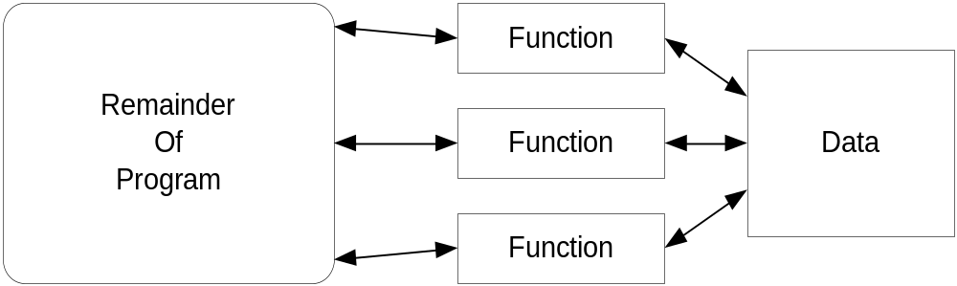
Information Hiding
The concept is actually to hide design decisions
Extremely important idea, impossible to overstate this
Very influential, led to modern notion of object
MUCH MUCH harder concept than it appears
Concept:
Justification:
  Details of data structure hidden
  Change restricted to one location

Slide 9
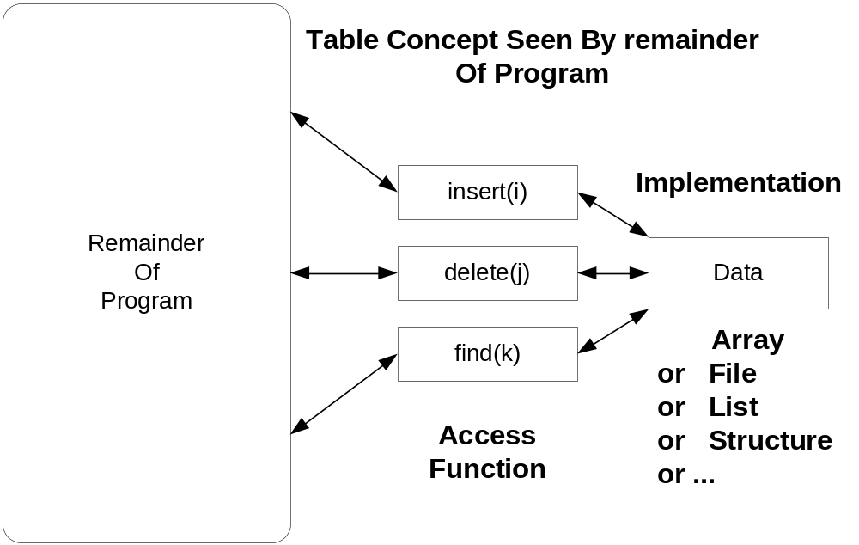
Benefit Of Information Hiding

Slide 10
Levels of Coupling
Uncoupled
Data coupling
  Data is passed between components
Stamp coupling
  Data structure is passed between components; only part of it used
Control coupling
  Data passed affects control flow. Passing a boolean or flag.
Common coupling
  Shared data
Content coupling
  One module changes internal data of another

Slide 11
Levels of Cohesion
Coincidental cohesion
  Grouped by chance
Logical cohesion
  Grouped by function but not related
Temporal cohesion
  Grouped by time of use
Procedural cohesion
  Grouped to ensure order of use
Communicational cohesion
  Grouped because of common I/O source/sink
Sequential cohesion
  Output of one module is input to next
Functional cohesion
  Information-hiding group

Slide 12


