Slide 1
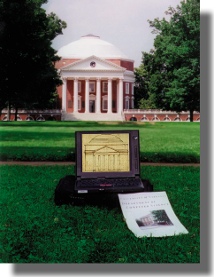
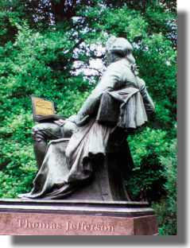
Theory of Computation
CS3102 – Spring 2014
A tale of computers, math, problem solving, life, love and tragic death
Nathan Brunelle
Department of
Computer Science
University of Virginia
www.cs.virginia.edu/~njb2b/theory

Slide 2
Midterm
Take home!
Date:
During the week before Spring break (out March 3, due March 6)?
  Don’t have to worry over the break
After Spring break (4 days within March 16-23)?
  1 more week of content but 2 more weeks to solve problems
  I will hold Skype/Google Hangout office hours over the break
Ready, set, vote!

Slide 3
Half
Let
Show that HALF preserves regularity.
e.g. if “RingoStarr” is in L, then “Ringo” is in HALF(L)
Let M be a DFA for language L
Intuition: follow the transitions of M for string v. “Check” that there is a path from v to an accept state that consumes |v| characters.
How do we do this “check”?
M

Slide 4
Half
Let
Show that HALF preserves regularity.
Intuition: follow the transitions of M for string v. “Check” that there is a path from v to an accept state that consumes |v| characters.
How do we do this “check”? Use the machine for
M’
Σ
M
ε
Σ
Σ
ε
Σ
F={(q,q)}
Σ

Slide 5
Double
Let
Show that DOUBLE preserves regularity.
e.g. if “BamBam” is in L, then “Bam” is in DOUBLE(L)
Let M be a DFA for language L
Intuition: Run L on w, in parallel non-deterministically “guess” the end state in machine M on w and check if starting from that guess puts the machine in an accept state
M
M
“Guess”

Slide 6
Double
Let
Intuition: Run L on w, in parallel non-deterministically “guess” the end state in machine M on w and check if starting from that guess puts the machine in an accept state
ε
ε
ε
M
M
M
Accept if:
M ends in state
M ends in an accept state
M
M
M
1
2
…

Slide 7
Yet Another Non-Regular Language
Let Σ={‘(‘,’)’}
E.g. ( ( ) ), ()()(), (()())(()) are all in the language
(()(((()() is not in the language
Show that B is not regular:
Use Pumping Lemma!
Consider
By the pumping lemma y may only contain ‘(‘, so the string cannot be pumped. Thus B is not regular.
What does this mean?
Regular expressions are useless for checking language syntax

Slide 8
Context-Free Grammars
Basic idea: set of production rules induces a language
Finite set of variables: V = {V₁, V₂, ..., V_{k}}
Finite set of terminals: Σ = {t₁, t₂, ..., t_{j}}
Finite set of productions: R
Start symbol: S
Productions: V_{i} → Δ where V_{i}∈V and Δ ∈(V∪ Σ)*
Applying V_{i}→ Δ to αV_{i}β
yields: α Δ β
Note: productions do not depend on “context”
- hence the name “context free”!

Slide 9
Example: design a context-free grammar for strings
representing all well-balanced parenthesis.
Idea: create rules for generating nesting & juxtaposition.
G₁: S → SS | (S) | ε
V = {S}
Σ = {(,), ε}
R = {G₁}
Ex: S → SS → (S)(S) → ()()
S → (S) → ((S)) → (())
S → (S) → (SS) → ... → (()((())()))

Slide 10
Context-Free Grammars
Def: A language is context-free if it is accepted by
some context-free grammar.
Theorem: All regular languages are context-free.
Given a DFA, we construct an equivalent CFG.
For DFA M=(Q, Σ, δ, q₀ , F) let:
V=Q
S= q₀
If δ(q_{i},a)=q_{j} then make Q_{i}→a Q_{j}
If q_{i} is an accept state then add rule Q_{i}→ε

Slide 11
Ambiguity
Def: A grammar is ambiguous if some string in its
language has two non-isomorphic derivations.
Theorem: Some context-free grammars are ambiguous.
Ex: G₁: S → SS | a | ε
Derivation 1: S → SS → aa
Derivation 2: S → SS → SSS → aa
Def: A context-free language is inherently ambiguous if
every context-free grammar for it is ambiguous.
Theorem: Some context-free languages are inherently
ambiguous (i.e., no non-ambiguous CFG exists).
Ex: {a^{i}b^{j} c^{k} | i=j or j=k} Prove this for EC!
Fault of the grammar
Fault of the language!

Slide 12
Example: design a context-free grammar for strings
representing all well-balanced parenthesis.
Idea: create rules for generating nesting & juxtaposition.
G₁: S → SS | (S) | ε
Ex: S → SS → (S)(S) → ()()
S → (S) → ((S)) → (())
S → (S) → (SS) → ... → (()((())()))
Q: Is G₁ ambiguous?
Another grammar:
G₂: S → (S)S | ε
Q: Is L(G₁) = L(G₂) ?
Q: Is G₂ ambiguous?

Slide 13
Example : design a context-free grammar that generates
all valid regular expressions.
Idea: embedd the RE rules in a grammar.
G: S → a for each a∈Σ_{L}
S → (S) | SS | S* | S+S
S → S* → (S)* → (S+S)* → (a+b)*
S → SS → SSSS → abS*b → aba*a
Q: Is G ambiguous?

Slide 14
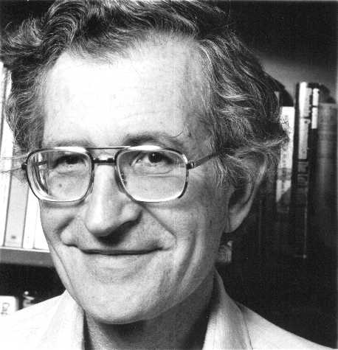
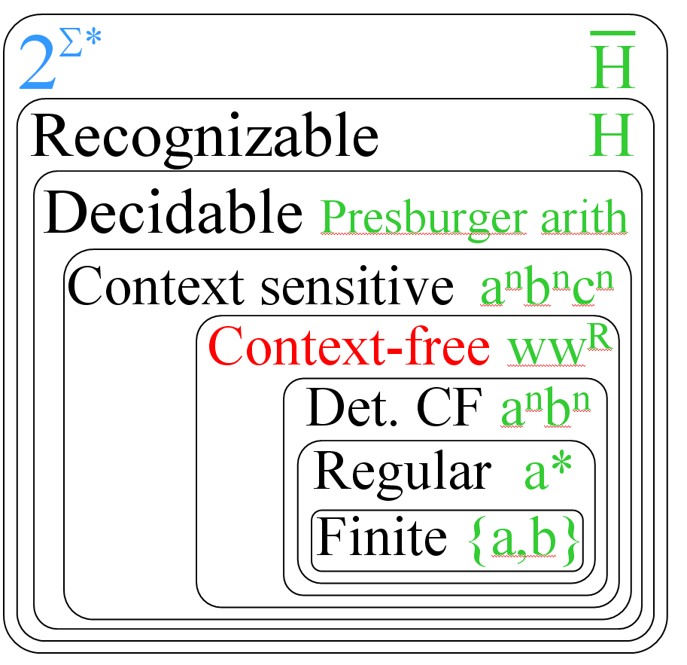
Historical Perspectives
Noam Chomsky (1928-)
Linguist, philosopher, cognitive scientist,
political activist, dissident, author
Father of modern linguistics
Pioneered formal languages
Developed generative grammars
Invented context-free grammars
Defined the Chomsky hierarchy
Influenced cognitive psychology,
philosophy of language and mind
Chomskyan linguistics, Chomskyan
syntax, Chomskyan models
Critic of U.S. foreign policy
Most widely cited living scholar
Eighth most-cited source overall!

Slide 15
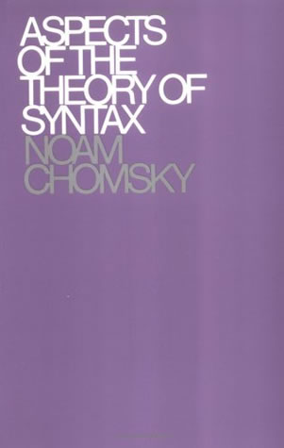
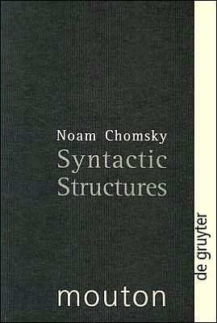
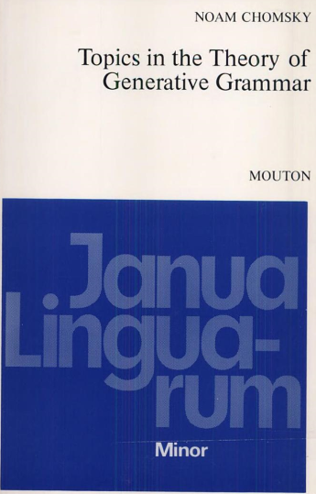
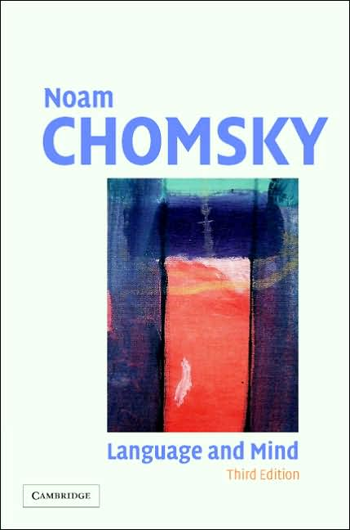
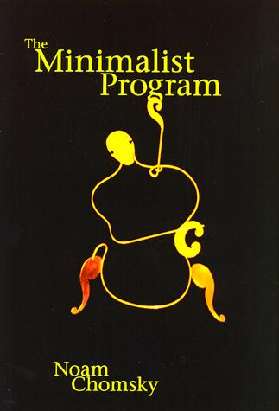
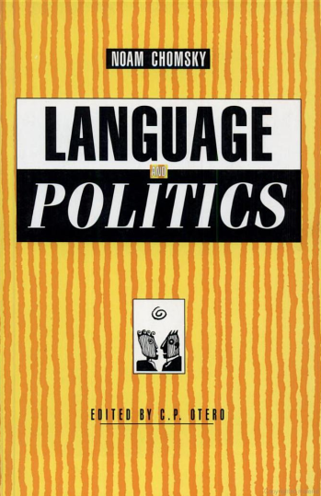
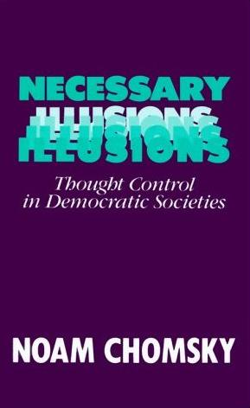
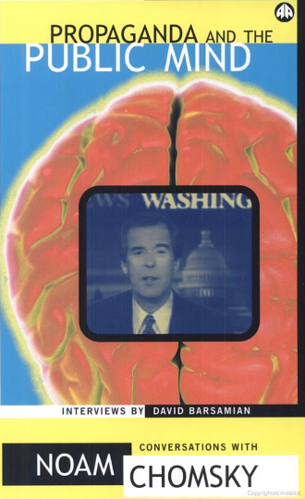



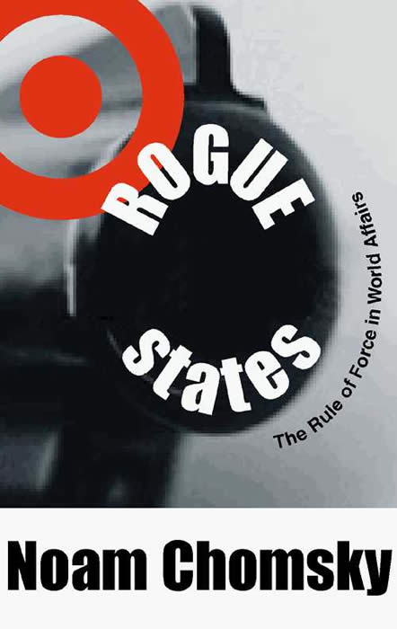


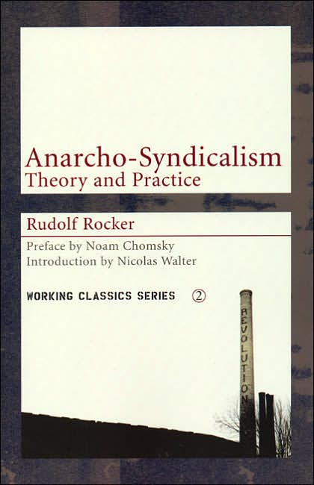
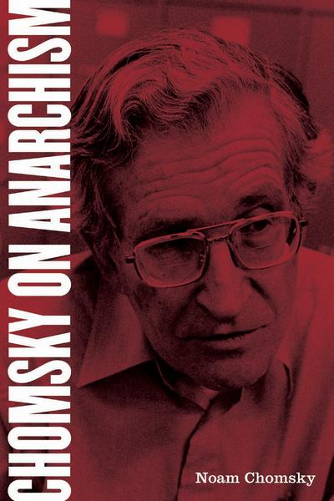
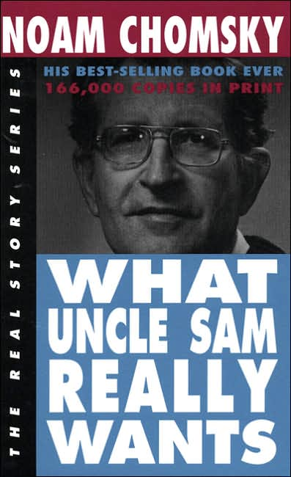
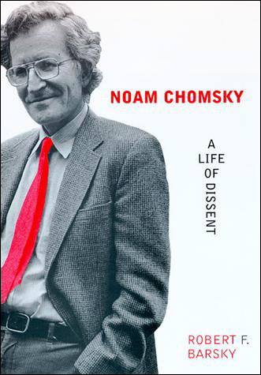

Slide 16
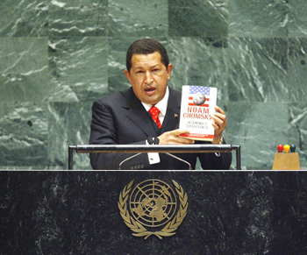
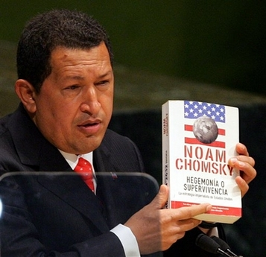
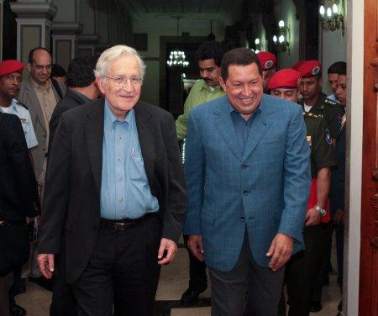
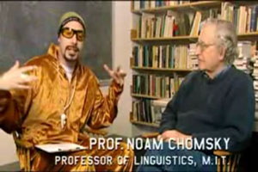
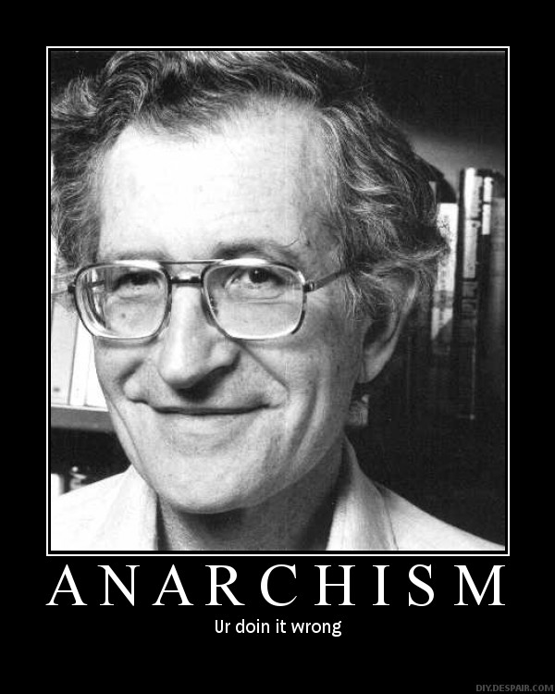

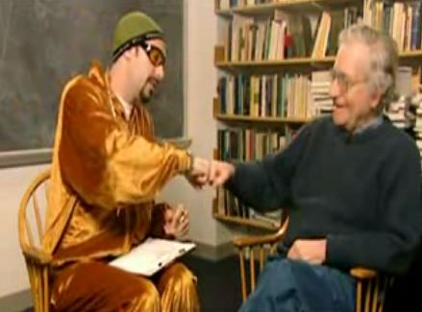

Slide 17
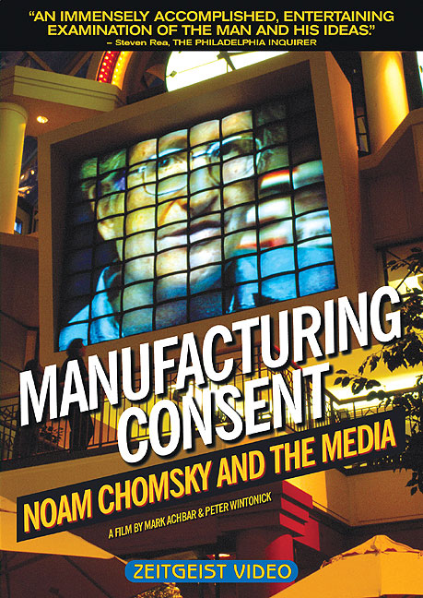
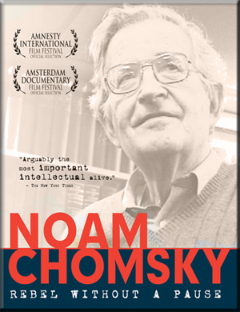
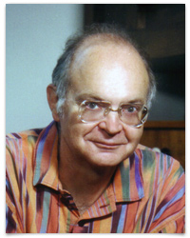


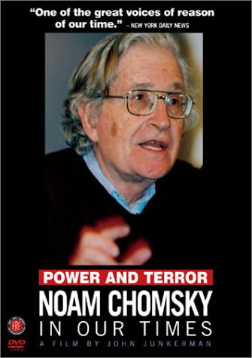
“…I must admit to taking a copy of Noam Chomsky's ‘Syntactic Structures’ along with me on my honeymoon in 1961 … Here was a marvelous thing: a mathematical theory of language in which I could use as a computer programmer's intuition!”
- Don Knuth on Chomsky’s influence

Slide 18
Pushdown Automata
Basic idea: a pushdown automaton is a finite automaton
that can optionally write to an unbounded stack.
Finite set of states: Q = {q₀, q₁, q₃, ..., q_{k}}
Input alphabet: Σ
Stack alphabet: Γ
Transition function: δ: Q×(Σ∪{ε})×Γ → 2^{Q×Γ∗}
Initial state: q₀ ∈ Q
Final states: F ⊆ Q
Pushdown automaton is M=(Q, Σ, Γ, δ, q₀, F)
Note: pushdown automata are non-deterministic! (proof of why next time)
q₁
q_{i}
q_{j}
q₀
q_{k}

Slide 19
Pushdown Automata
A pushdown automaton can use its stack as an unbounded
but access-controlled (last-in/first-out or LIFO) storage.
A PDA accesses its stack using “push” and “pop”
Stack & input alphabets may differ.
Input read head only goes 1-way.
Acceptance can be by final state
or by empty-stack.
Note: a PDA can be made deterministic by restricting
its transition function to unique next moves:
    δ: Q×(Σ∪{ε})×Γ → Q×Γ∗
M
a
b
Input
a
1
0
1
1
0
1
0
stack

Slide 20
Closure Properties of CFLs
Theorem: The context-free languages are closed under union.
Hint: Derive a new grammar for the union.
Theorem: The CFLs are closed under Kleene closure.
Hint: Derive a new grammar for the Kleene closure.
Theorem: The CFLs are closed under ∩ with regular langs.
Hint: Simulate PDA and FA in parallel.
Theorem: The CFLs are not closed under intersection.
Hint: Find a counter example.
Theorem: The CFLs are not closed under complementation.
Hint: Use De Morgan’s law.

Slide 21
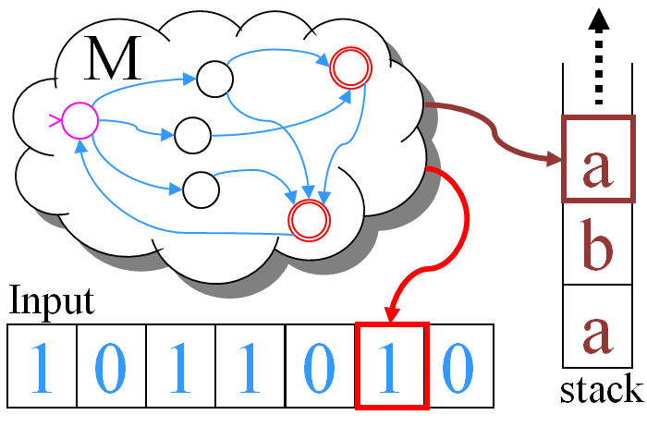
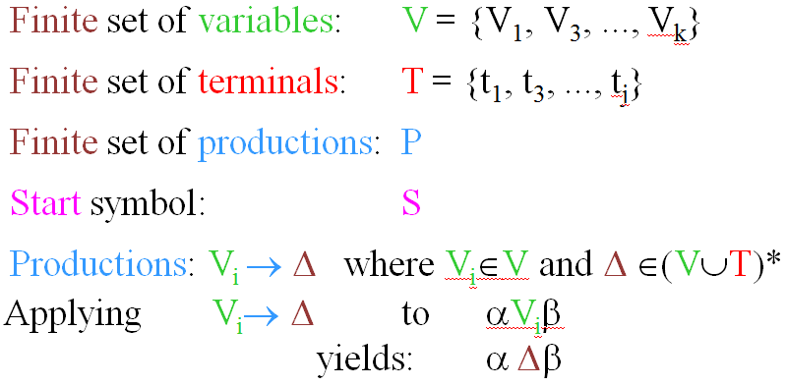
Decidable PDA / CFG Problems
(or CFG G)
Given an arbitrary pushdown automata M
the following problems are decidable (i.e., have algorithms):
Q₁: Is L(M) = Ø ?
Q₅: Is L(G) = Ø ?
Q₂: Is L(M) finite ?
Q₆: Is L(G) finite ?
Q₃: Is L(M) infinite ?
Q₇: Is L(G) infinite ?
Q₄: Is w ∈ L(M) ?
Q₈: Is w ∈ L(G) ?
≡
Extra-credit: prove each!

Slide 22
Undecidable PDA / CFG Problems
Theorem: the following are undecidable (i.e., there
exist no algorithms to answer these questions):
Q: Is PDA M minimal ?
Q: Are PDAs M₁ and M₂ equivalent ?
Q: Is CFG G minimal ?
Q: Is CFG G ambiguous ?
Q: Is L(G₁) = L(G₂) ?
Q: Is L(G₁) ∩ L(G₂) = Ø ?
Q: Is CFL L inherently ambiguous ?
≡
Extra-credit: prove each!

Slide 23
PDA Enhancements
Theorem: 2-way PDAs are more powerful than 1-way PDAs.
Hint: Find an example non-CFL accepted by a 2-way PDA.
Theorem: 2-stack PDAs are more powerful than 1-stack PDAs.
Hint: Find an example non-CFL accepted by a 2-stack PDA.
Theorem: 1-queue PDAs are more powerful than 1-stack PDAs.
Hint: Find an example non-CFL accepted by a 1-queue PDA.
Theorem: 2-head PDAs are more powerful than 1-head PDAs.
Hint: Find an example non-CFL accepted by a 2-head PDA.
Theorem: Non-determinism increases the power of PDAs.
Hint: Find a CFL not accepted by any deterministic PDA.
Extra-credit: prove each!

