Slide 1
CSE718
Hybrid Simulation Modeling Formalism via O2DES Framework for Mega Container Terminals
MD Sabbir Hossain ID: 23366022

Slide 2
Table of contents:
Problem Statement
Introduction
Related Work
Methodologies
Entity
State
Event
Activity
Discussion
Conclusion
Future work

Slide 3
Problem Statement
An "activity-based" formalism is applied to refine event graphs, enhancing the representation of synchronization and resource dynamics in equipment operation cycles.
Event modifications in specific activities improve synchronization, integrating resource availability and flowing entity considerations.
The complex event graph is simplified into an "entity flow diagram," clearly depicting material and message transfers, and activity synchronizations.
This visualization aids in understanding how different entities move through a container terminal, revealing module boundaries and interactions for potential further segmentation.

Slide 4
Introduction
This paper introduces the O²DES Framework for hybrid simulation modeling of mega container ports, highlighting the importance of an object-oriented approach, event-based modeling for discrete-event systems like quay cranes and AGVs, and a hierarchical, state-based modular structure for easier modeling and maintenance. It also emphasizes the use of an activity-based perspective for a macro-level view of system dynamics, showcasing the synergy of multiple methods in hybrid formalism.

Slide 5
Related Work:
Hybrid simulation (HS) merges DES, SD, and ABS, gaining traction in healthcare and emergency scenarios.
HS is used in studies for information spread in emergencies, health service delivery, and comprehensive healthcare system modeling.
Key applications of HS include COVID-19 containment, pandemic impact analysis, and healthcare resource management.
The paper advocates for a hybrid approach in pandemic modeling to enhance insights into public health and healthcare systems.
It stresses the importance of accessible, well-documented models, suggesting a centralized HS hub for efficient pandemic response.

Slide 6
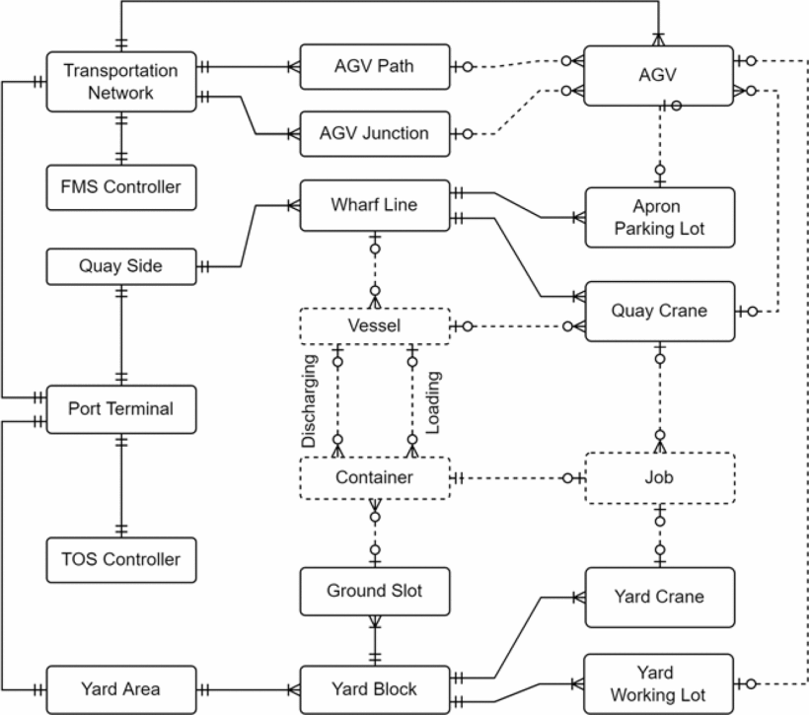
Methodology

Slide 7
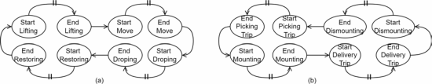
Entity Relationship Structure

Slide 8
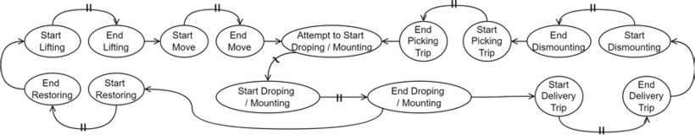
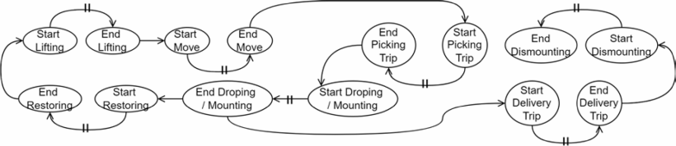
Event-Based Operational Rules

Slide 9
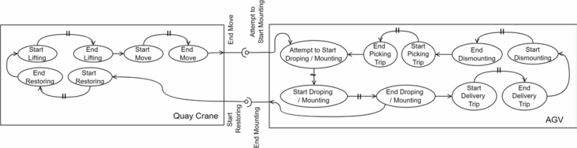
State-Based Hierarchical Modules

Slide 10
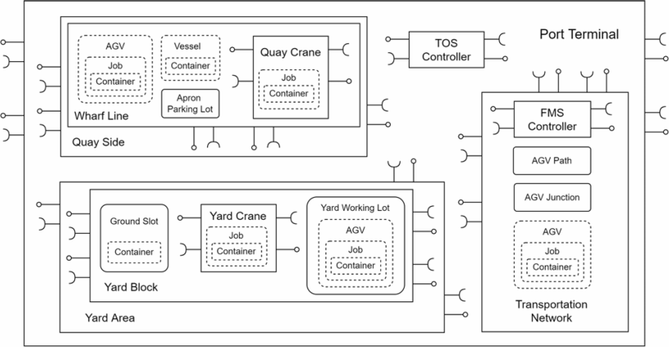
Activity-Based Entity Flows

Slide 11
Discussion

Slide 12
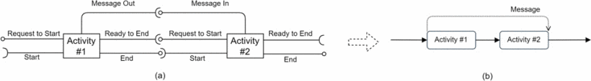
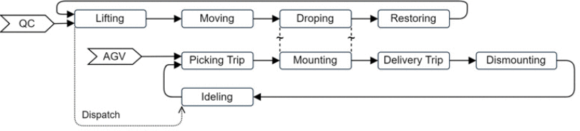

Slide 13
Conclusion
The paper introduces a hybrid ABS-DES model for COVID-19 management, combining the FACS model for disease transmission and the CHARM model for ICU patient flow, currently applied in case studies within the STAMINA project in Turkey, Romania, and Lithuania. It acknowledges the model's current focus on ICU bed resources and other priority parameters

Slide 14
Future Work
Future enhancements of the model will include the integration of healthcare staff resources to provide a more comprehensive view of hospital capacity management. Additionally, the implementation will be advanced by utilizing a message broker interface to streamline the interaction between the FACS and CHARM components in the hybrid model.

Slide 15
References
M. Saidani, H. Kim and J. Kim, "Designing Optimal COVID-19 Testing Stations Locally: A Discrete Event Simulation Model Applied on a University Campus", PloS one, vol. 16, no. 6, pp. e0253869, 2021.
CrossRef Google Scholar
H.K. Simpson, M. Clancy, C. Goldfrad and K. Rowan, "Admissions to Intensive Care Units from Emergency Departments: A Descriptive Study", Emergency Medicine Journal, vol. 22, no. 6, pp. 423-428, 2005.
CrossRef Google Scholar
.
S.J.E. Taylor, "Distributed Simulation: State-of-the-Art and Potential for Operational Research", European Journal of Operational Research, vol. 273, no. 1, pp. 1-19, 2019.
CrossRef Google Scholar
J. Viana, V.M. Ziener, M.S. Holhjem, I.G. Ponton, L.J. Thogersen, T.B. Simonsen, et al., "Optimizing Home Hospital Health Service Delivery in Norway using a Combined Geographical Information System Agent Based Discrete Event Simulation Model", Proceedings of the 2017 Winter Simulation Conference, pp. 1658-1669, 2017.
View Article
Google Scholar
Y. Wang, H. Xiong, S. Liu, A. Jung, T. Stone and L. Chukoskie, "Simulation Agent-Based Model to Demonstrate the Transmission of COVID-19 and Effectiveness of Different Public Health Strategies", Frontiers in Computer Science, vol. 3, no. 642321, pp. 1-8, 2021.

