Slide 1
CSE718
Md Sabbir Hossain
Student ID: 23366022

Slide 2
FACS-CHARM: A Hybrid Agent-Based and Discrete-Event Simulation Approach for Covid-19 Management at Regional Level

Slide 3
Table of contents:
Problem Statement
Introduction
Related Work
Methodologies
FACS
Charm
Facs-Charm Hybrid Model
ABS-DES
Discussion
Conclusion
Future work

Slide 4
Problem Statement
What would the impact of public health intervention be on the case numbers?
What would the impact of public health intervention be on the local hospitals?
When would COVID-19 bed surge be needed?
What would the impact of elective cancelation strategies be on bed capacities?

Slide 5
Introduction
The paper addresses the COVID-19 pandemic's challenges, utilizing a hybrid simulation approach that combines the Flu and Coronavirus Simulator (FACS) for predicting infection spread and the dynamiC Hospital wARd Management (CHARM) model for ICU patient flow, to evaluate regional public health interventions and their impact on healthcare systems.

Slide 6
Related Work:
Hybrid simulation models combining hospital and community dynamics offer detailed insights into pandemic management at a regional level.
Accessibility and reusability of models, as discussed by Aleman et al., are crucial for rapid response in early pandemic stages.
Standardized documentation of models, like the ODD protocol and STRESS guidelines, is emphasized for effective decision-making support.
The publicly available FACS and CHARM models demonstrate the practical application of hybrid simulation in pandemic analysis.

Slide 7
Methodology
The paper presents the Flu and Coronavirus Simulator (FACS), an agent-based model for simulating COVID-19 spread and intervention impacts, and the dynamiC Hospital wARd Management (CHARM), a discrete-event simulation for ICU flow and ward management. These models, forming a hybrid simulation, facilitate analysis of public health strategies and hospital resource allocation, offering outputs like bed availability and infection trends.

Slide 8
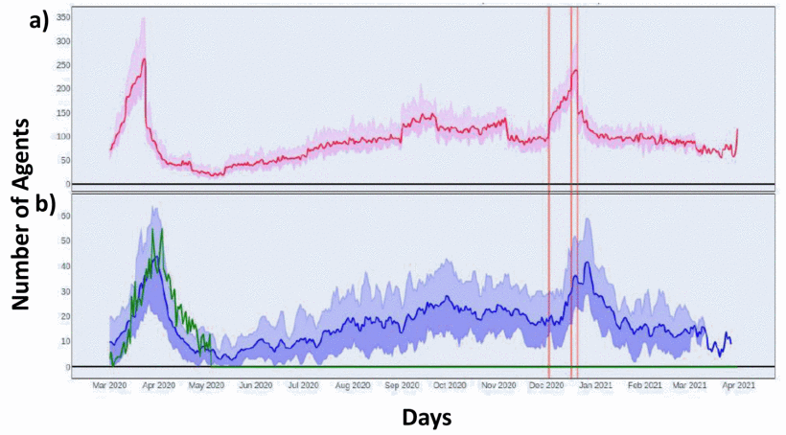
FLU and Coronavirus Simulator (FACS)

Slide 9
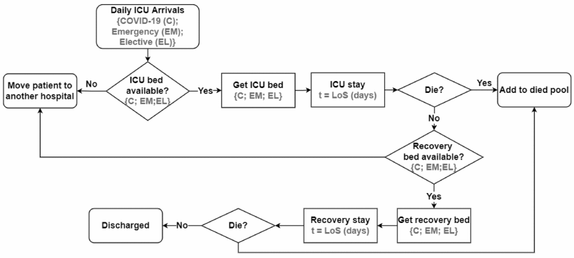
Dynamic Hospital Ward Management (Charm)

Slide 10
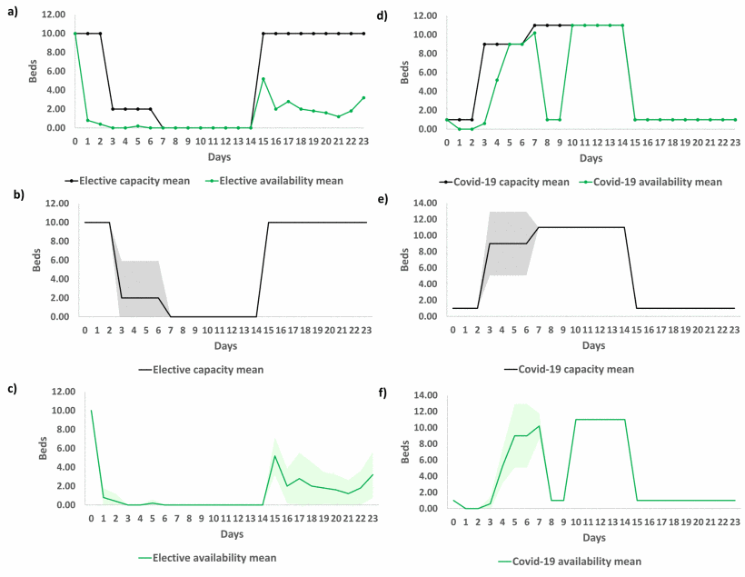
Facs-Charm Hybrid Model
The FACS-CHARM model, a sequential hybrid simulation, analyzes ICU capacity regionally and at individual hospitals.

Slide 11
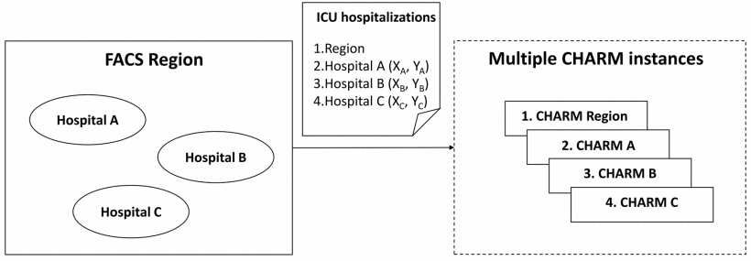
Discussion

Slide 12
Conclusion
The paper introduces a hybrid ABS-DES model for regional COVID-19 management, combining the FACS model for disease transmission analysis and the CHARM model for ICU patient flow and ward reconfiguration. This approach, integrating multiple simulation methods, is part of the STAMINA project with case studies in Turkey, Romania, and Lithuania, focusing on ICU bed resources while acknowledging staff shortages as a limitation in hospital capacity management.

Slide 13
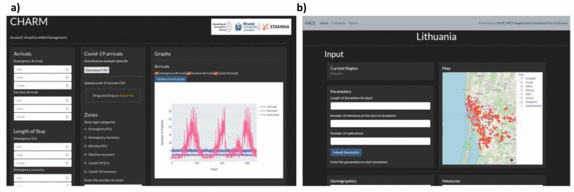
Future Work

Slide 14
References
D.M. Aleman, A. Anagnostou, C.S. Currie, J.W. Fowler, E.S. Gel, A.R. Rutherford, et al., "Panel on Simulation Modeling for COVID-19", Proceedings of the 2021 Winter Simulation Conference, pp. 1-12, 2021.
View Article
Google Scholar
2.
A. Anagnostou and S.J.E. Taylor, "A Distributed Simulation Methodological Framework for OR/MS Applications", Simulation Modelling Practice and Theory, vol. 70, pp. 101-119, 2017.
CrossRef Google Scholar
3.
A. Anagnostou, A. Nouman, S.J.E. Taylor, R. Pasupathy, S.-H. Kim, A. Tolk, et al., "Distributed Hybrid Agent-Based Discrete Event Emergency Medical Services Simulation", Proceedings of the 2013 Winter Simulations Conference, pp. 1625-1636, 2013.
View Article
Google Scholar
4.
D. Bell, C. Cordeaux, T. Stephenson, H. Dawe, P. Lacey, L. O'Leary, et al., "Designing effective hybridization for whole system modeling and simulation in healthcare", Proceedings of the 2016 Winter Simulation Conference, pp. 1511-1522, 2016.
View Article
Google Scholar
5.
A. Bouchnitaa and A. Jebranea, "A Hybrid Multi-Scale Model of COVID-19 Transmission Dynamics to Assess the Potential of Non-Pharmaceutical Interventions", Chaos Solitons & Fractals, vol. 138, pp. 109941, 2020.
CrossRef Google Scholar

