Slide 1
Book1
File created on: 5/18/2019 9:21:30 PM

Slide 2
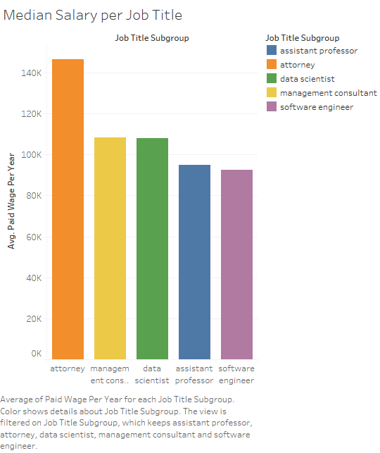

Slide 3
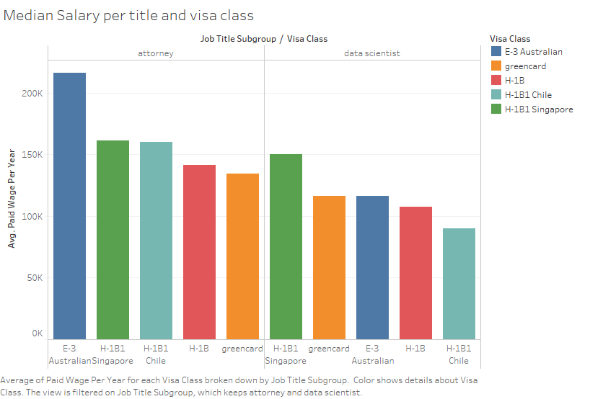

Slide 4
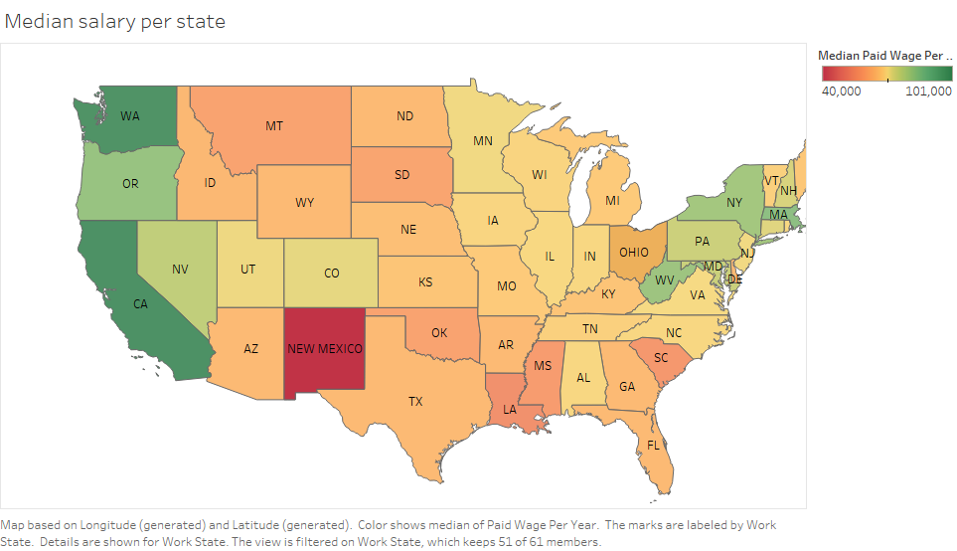

Slide 5
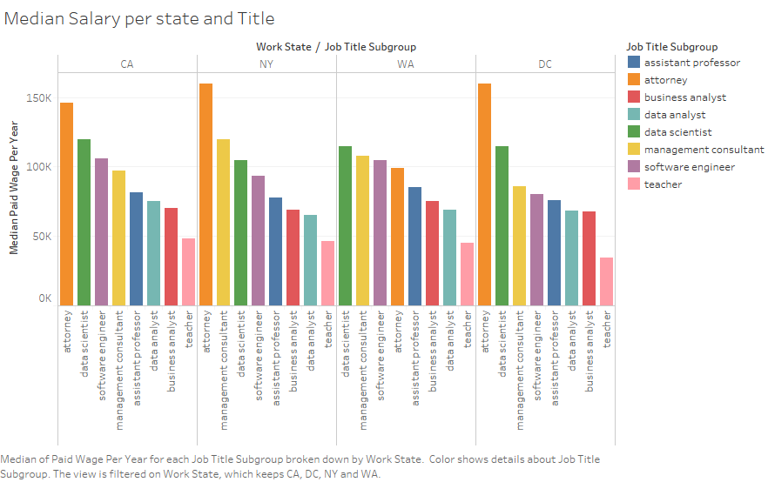

Slide 6
