Slide 1

Discrete Mathematics: The Unseen Architecture of Computing
Notes:
1

Slide 2
Group Member
Notes:
1

Slide 3
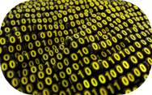
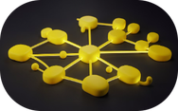
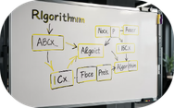
What is Discrete Mathematics?
Discrete mathematics studies structures made of distinct, separate elements rather than continuous ranges. It focuses on countable sets, finite graphs, logical statements and combinatorial systems. These discrete structures model digital phenomena — bits, finite state machines, graphs and algorithms — making the subject essential for designing reliable, efficient computing systems.
Digital Representation
Modelling Networks
Reasoning & Proofs
Graphs represent relationships: from social networks to communications systems.
Formal proofs guarantee algorithm correctness and system safety.
Bits and finite states underpin all computation; discrete maths formalises their behaviour.
Notes:
3

Slide 4
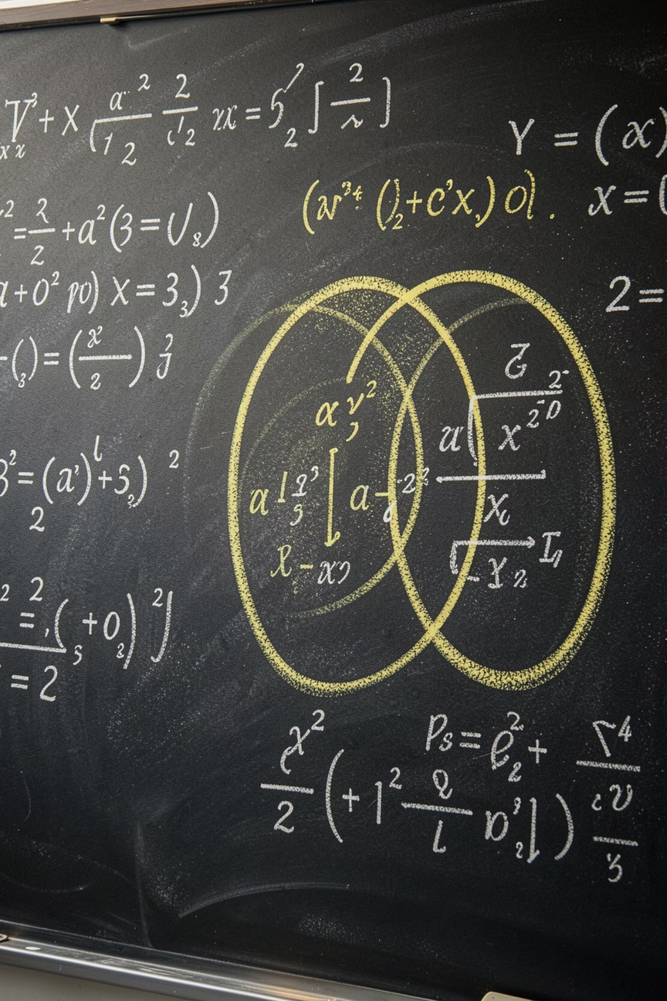




The Building Blocks: Logic and Sets
Logic and set theory form the bedrock of discrete mathematics. Propositional and predicate logic let us express precise rules and reason about truth. Sets organise distinct elements and underpin relations, functions and more complex structures. Historical challenges such as Russell’s paradox motivated rigorous axiomatic systems that keep modern foundations consistent.
Propositional Logic
Syntax and semantics for true/false statements — used in verification and programming languages.
Sets & Relations
Unordered collections, subsets, unions and intersections; fundamental for databases and type systems.
Russell's Paradox
A historical paradox that led to stricter axioms; an important lesson in careful definition.
Notes:
4

Slide 5
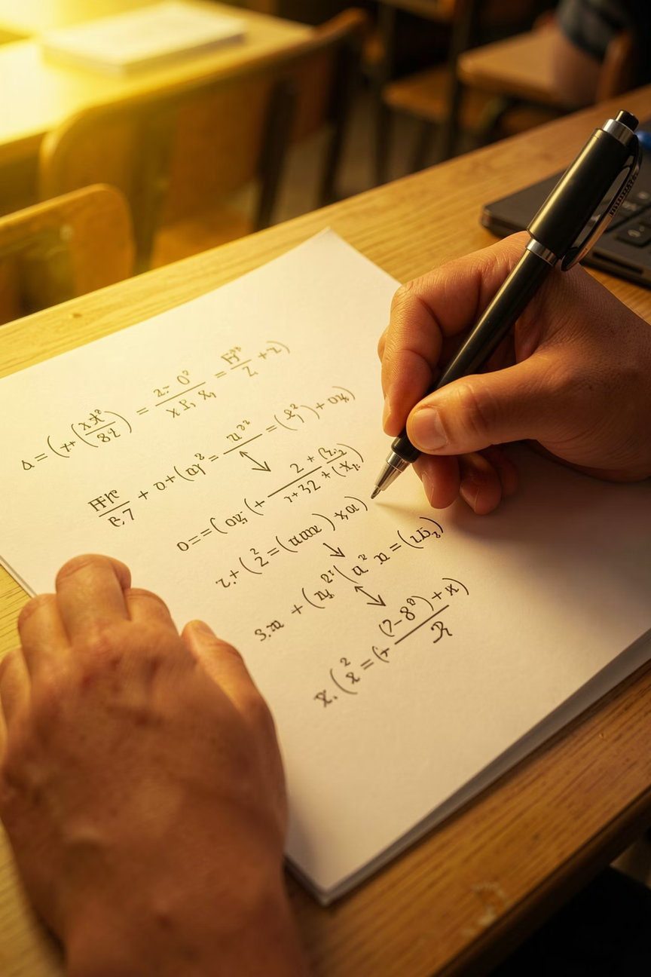
From Theory to Application: Proof Techniques
Proof techniques are practical tools for establishing truth in algorithms and systems. Mathematical induction proves properties across all natural numbers; direct proof and proof by contradiction validate identities and algorithm invariants. In software engineering and formal methods, these techniques underpin correctness proofs, model checking and rigorous specifications.
01
02
Mathematical Induction
Direct Proof
Base case, inductive step — used to prove recurrence solutions and loop invariants.
Logical deduction from assumptions to conclusion; common in algorithm analysis.
03
Proof by Contradiction
Assume the negation and derive an impossibility — useful for impossibility and lower-bound proofs.
Notes:
5

Slide 6
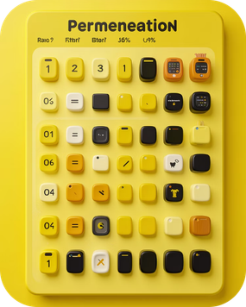

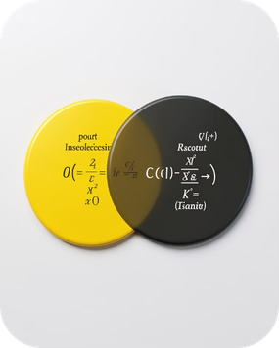
Counting the Digital World: Combinatorics
Combinatorics provides methods to count possibilities: permutations for ordered arrangements, combinations for selections, and the inclusion–exclusion principle for overlapping sets. These techniques are indispensable in probability, complexity analysis, hashing design, and resource allocation where precise counts shape algorithmic choices and guarantees.
Permutations
Combinations
Inclusion–Exclusion
Count arrangements where order matters — critical for scheduling and cryptographic keys.
Count selections where order doesn't matter — used in sampling and probability.
Correctly counts elements across overlapping categories — avoids double counting.
Notes:
6

Slide 7
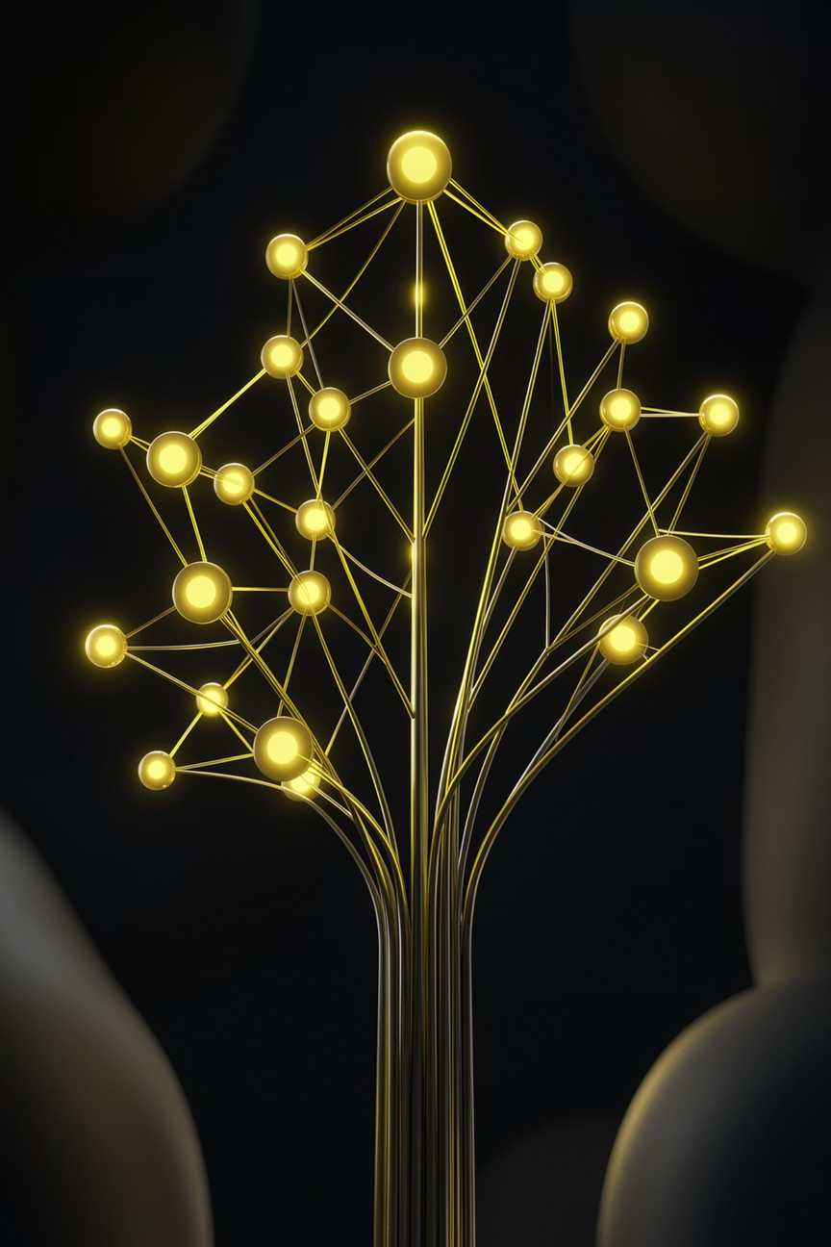


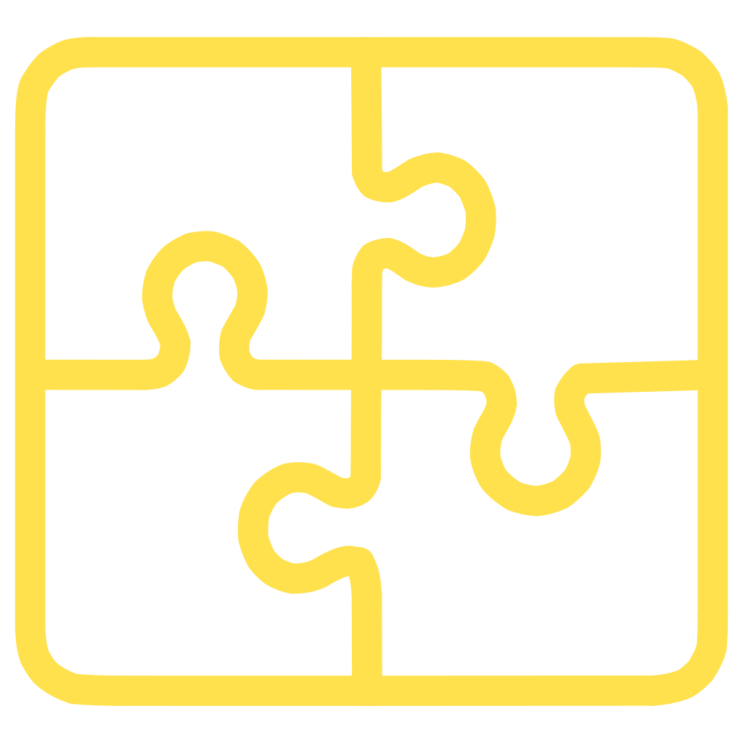
Structures for Data and Relationships: Graphs and Trees
Graphs model pairwise relationships; trees are acyclic graphs used for hierarchies. Graph theory provides algorithms for shortest paths, connectivity, matching and flow — directly applied to routing, network resilience and optimisation. Trees underpin file systems, search structures (BSTs, heaps), and parsers used throughout computing systems.
Routing & Networks
Dijkstra, Bellman–Ford and spanning tree algorithms make networks efficient and reliable.
Trees in Storage
B-tree, AVL and red–black trees keep data balanced for fast searches and updates.
Graph Algorithms
Matching, flow and connectivity algorithms solve optimisation, allocation and scheduling problems.
Notes:
7

Slide 8
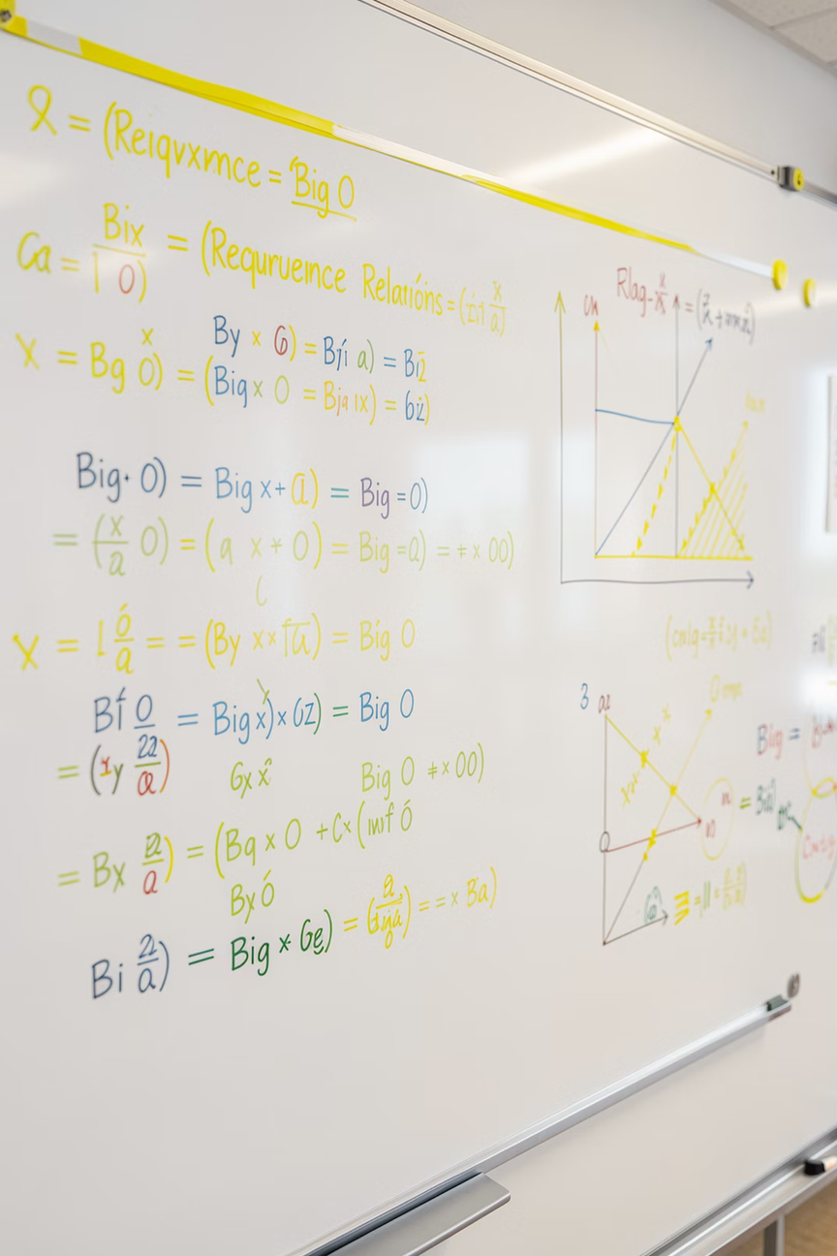
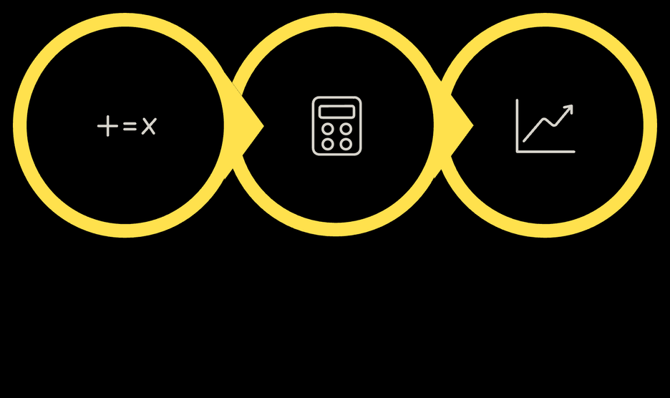
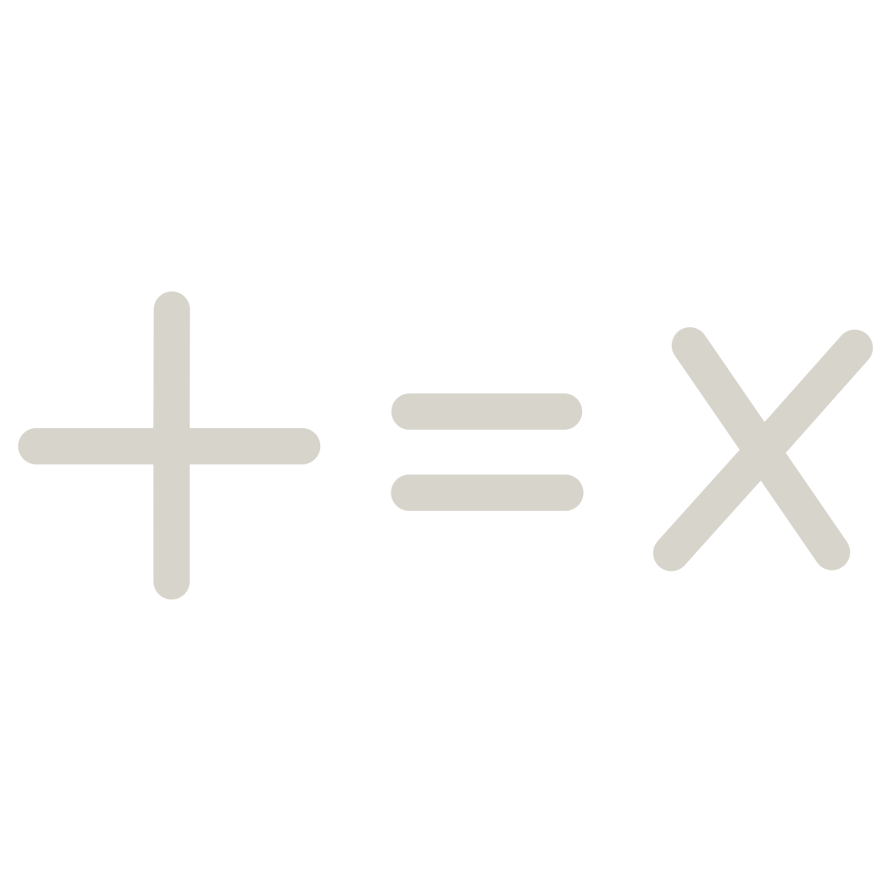


Algorithmic Thinking: Recurrence Relations & Complexity
Recurrence relations express the cost of recursive algorithms; solving them yields closed-form runtime estimates. Complexity analysis (Big O, Θ, Ω) categorises algorithms by growth rates, guiding selection and optimisation. Discrete mathematics gives rigorous tools — substitution, master theorem and asymptotic bounds — used to predict performance on large inputs.
Define Recurrence
Solve Recurrence
Interpret Complexity
Using recurrences and asymptotic analysis we transform recursive definitions into practical performance expectations, essential for system design and capacity planning.
Notes:
8

Slide 9
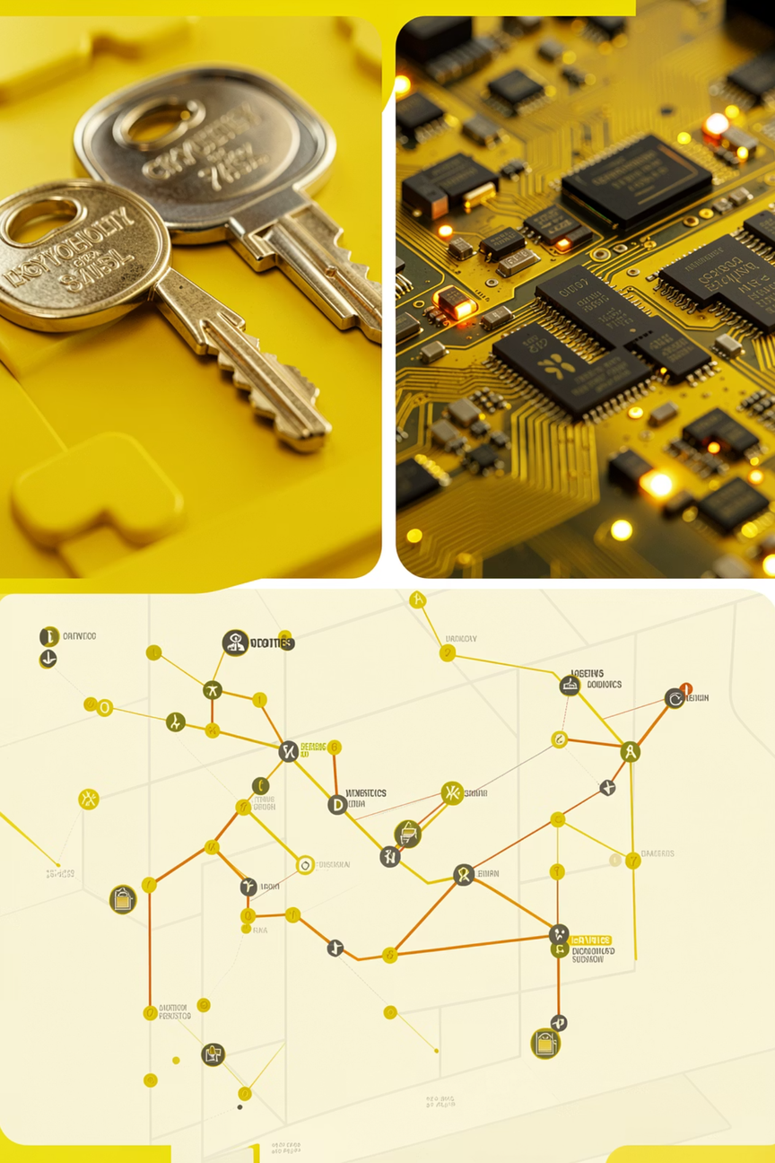
Discrete Mathematics in Action: Real-World Impact
Discrete mathematics powers many disciplines: cryptography secures communications; algorithms and data structures enable fast software; graph theory optimises networks; combinatorics supports probabilistic reasoning; and optimisation methods increase operational efficiency. Understanding discrete tools translates directly into better, provable engineering outcomes.
Computer Science
Engineering
Operations Research
Digital circuits and signal processing use logic, finite automata and discrete transforms.
Algorithms, databases, compilers and cryptography rely on discrete foundations.
Optimisation, scheduling and logistics use graphs, flows and integer programming.
Notes:
9

Slide 10
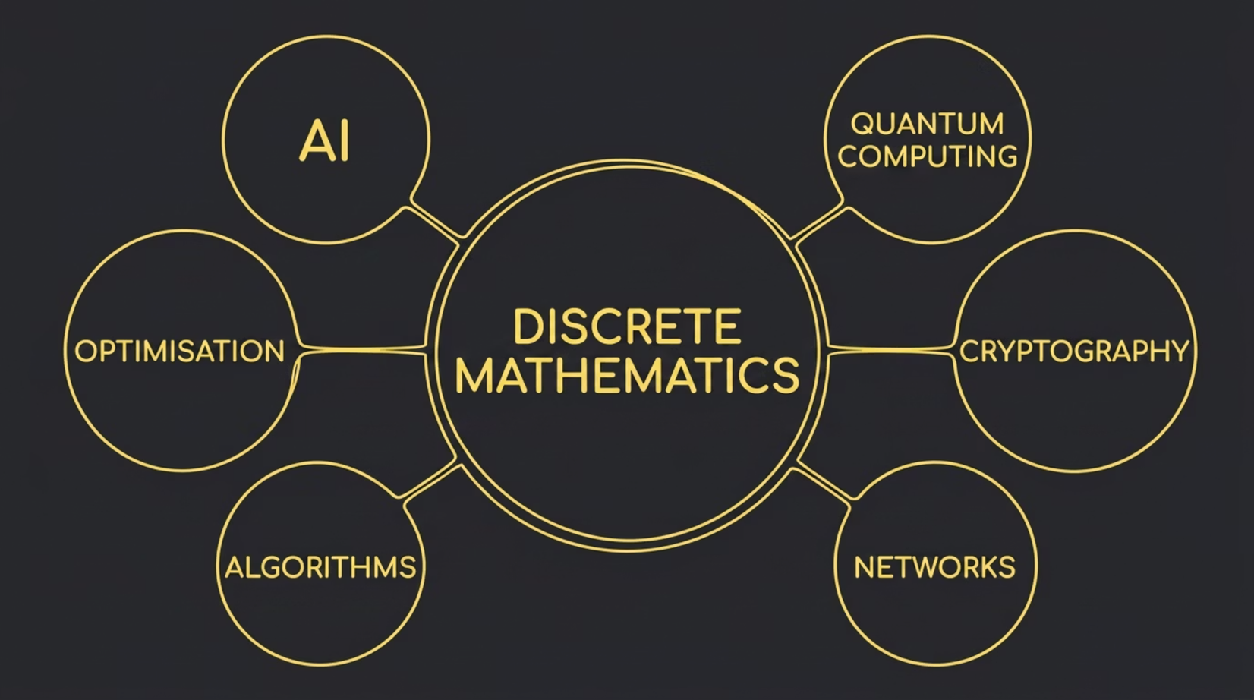

The Future is Discrete
Emerging fields amplify the need for discrete reasoning: AI models rely on discrete optimisation and graph representations; quantum computing introduces new discrete state models; secure distributed systems use combinatorial constructions. Mastery of discrete mathematics equips practitioners to navigate innovation with clarity and provable guarantees.
Notes:
10

Slide 11




The Enduring Power of Discrete Mathematics
Discrete mathematics is not an academic curiosity — it is the enduring framework beneath modern computation. Its principles provide clarity, enable proofs of correctness, and guide optimal system design. For anyone building or analysing digital systems, fluency in discrete ideas is a strategic advantage and a creative toolkit for shaping the future.
Learn
Apply
Innovate
Study logic, sets, proofs and combinatorics to build a solid foundation.
Use discrete tools to design algorithms, networks and secure systems.
Combine theory and practice to create reliable, efficient technology.
Notes:
11

Slide 12
THANK YOU

