Slide 1
Sports Club Automation System
Group: 1
1005001
1005004
1005005
1005007
1005010
ISD Project
CSE A1

Slide 2
Outlines
Fishbone Diagram
Data Flow Diagram
Feasibility Analysis

Slide 3
Subsystems
Communication
Social Interaction
Registration
Team Management
Online Store

Slide 4
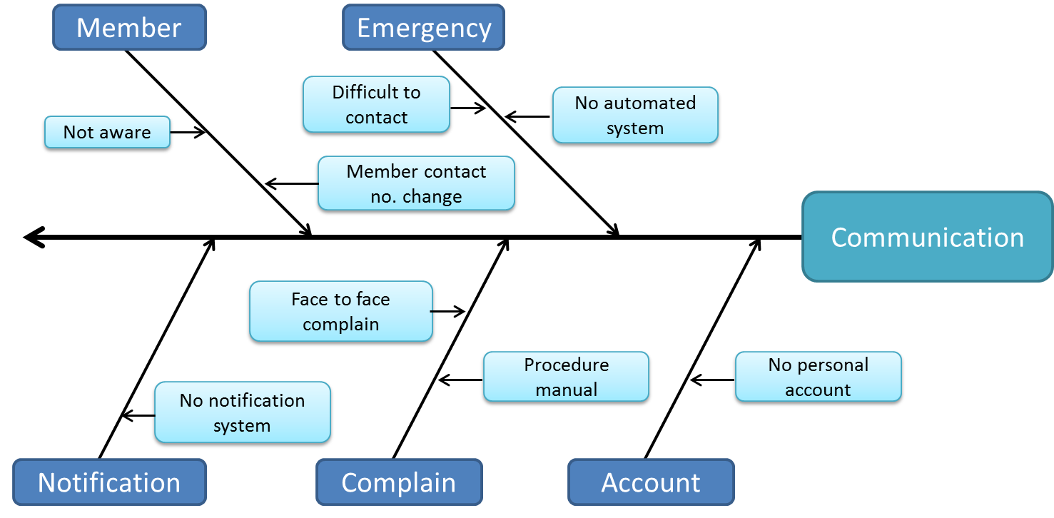
Fig: Fishbone Diagram for Communication Subsystem

Slide 5
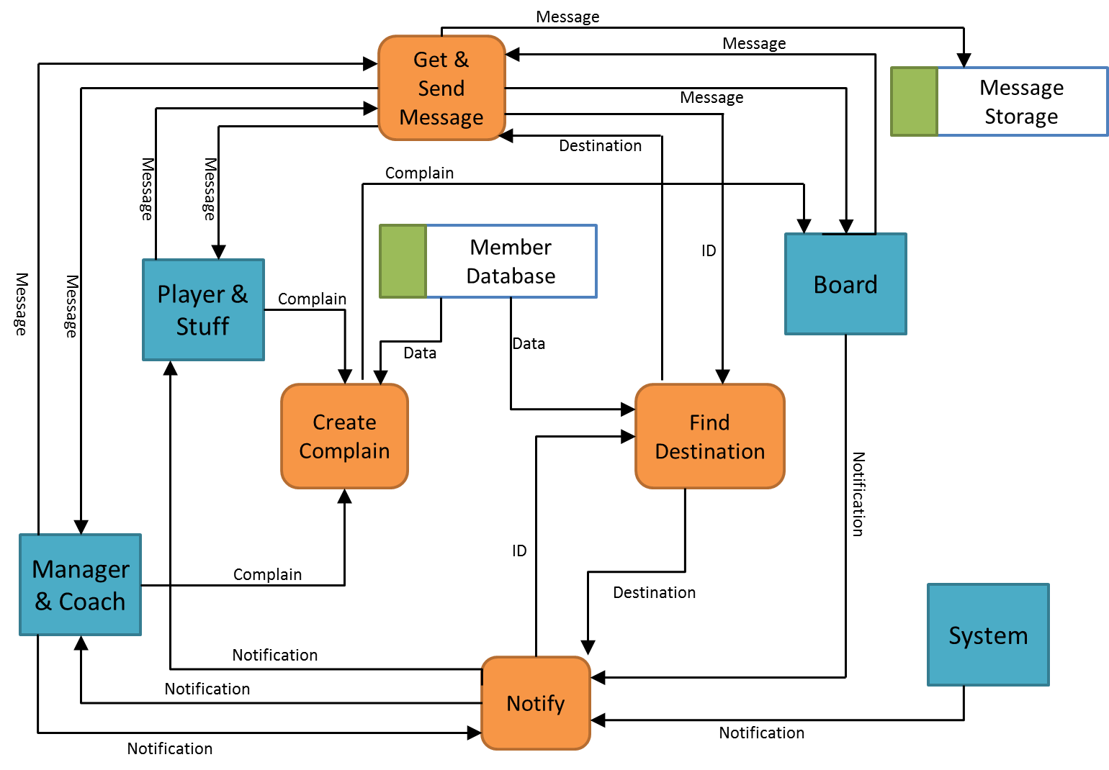
Fig: Data Flow Diagram for Communication Subsystem

Slide 6
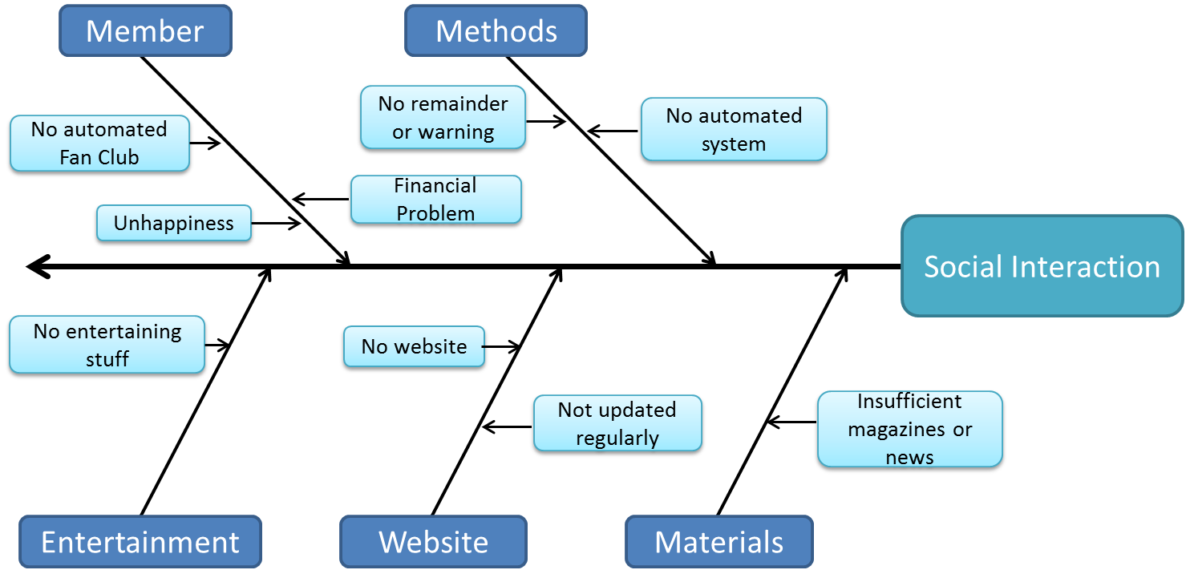
Fig: Fishbone Diagram for Social Interaction Subsystem

Slide 7
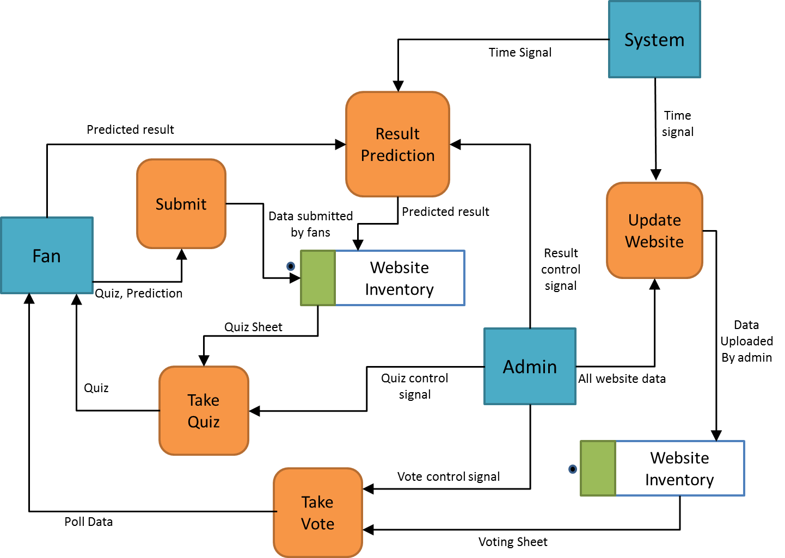
Fig: Data Flow Diagram for Social Interaction Subsystem

Slide 8
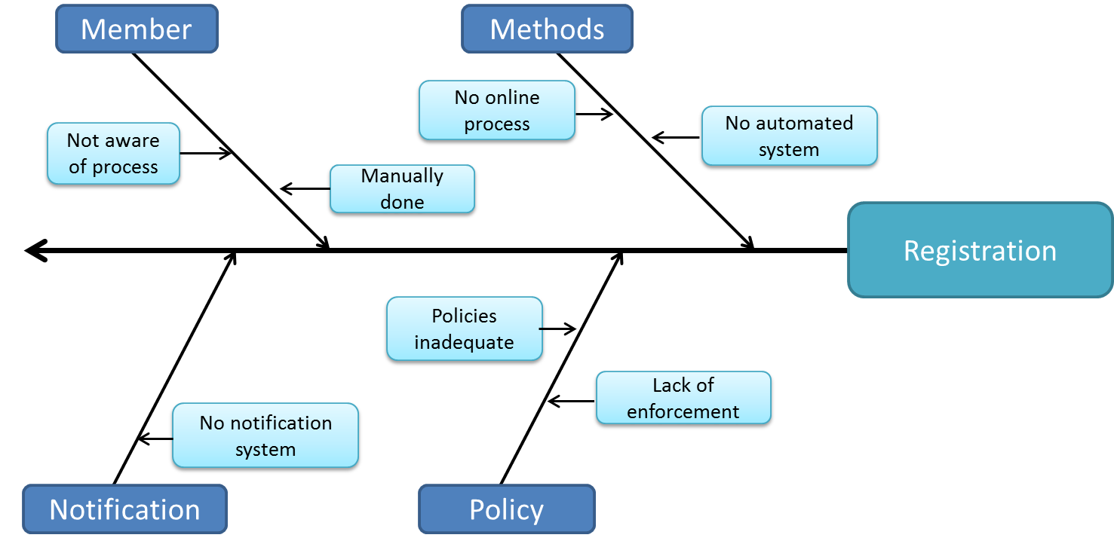
Fig: Fishbone Diagram for Registration Subsystem

Slide 9
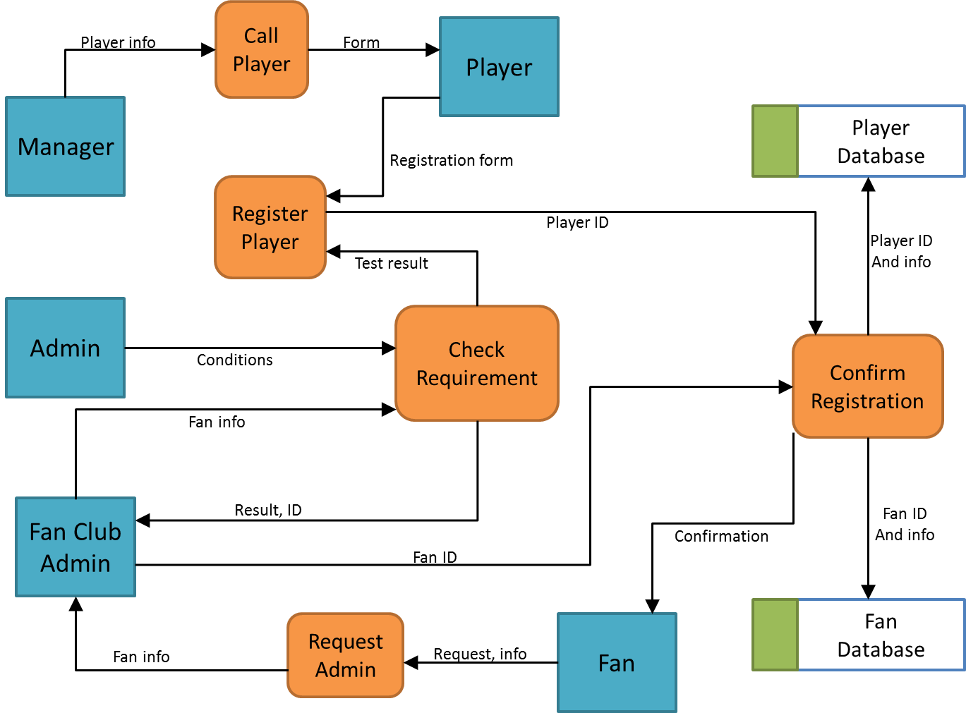
Fig: Data Flow Diagram for Registration Subsystem

Slide 10
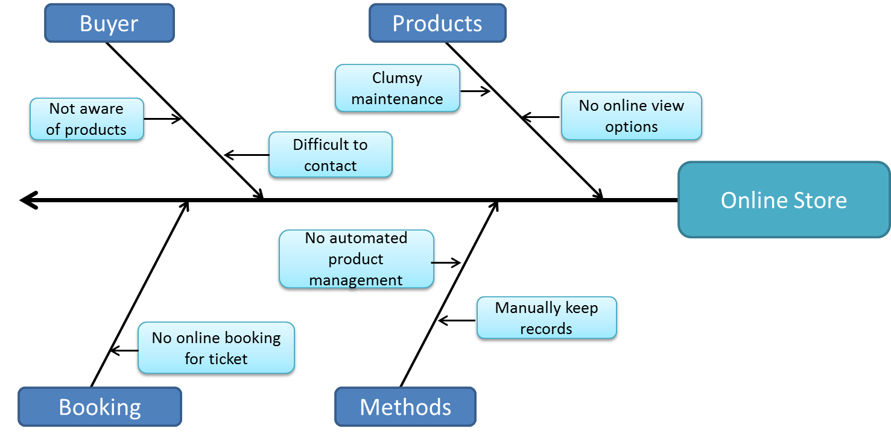
Fig: Fishbone Diagram for Online Store Subsystem

Slide 11
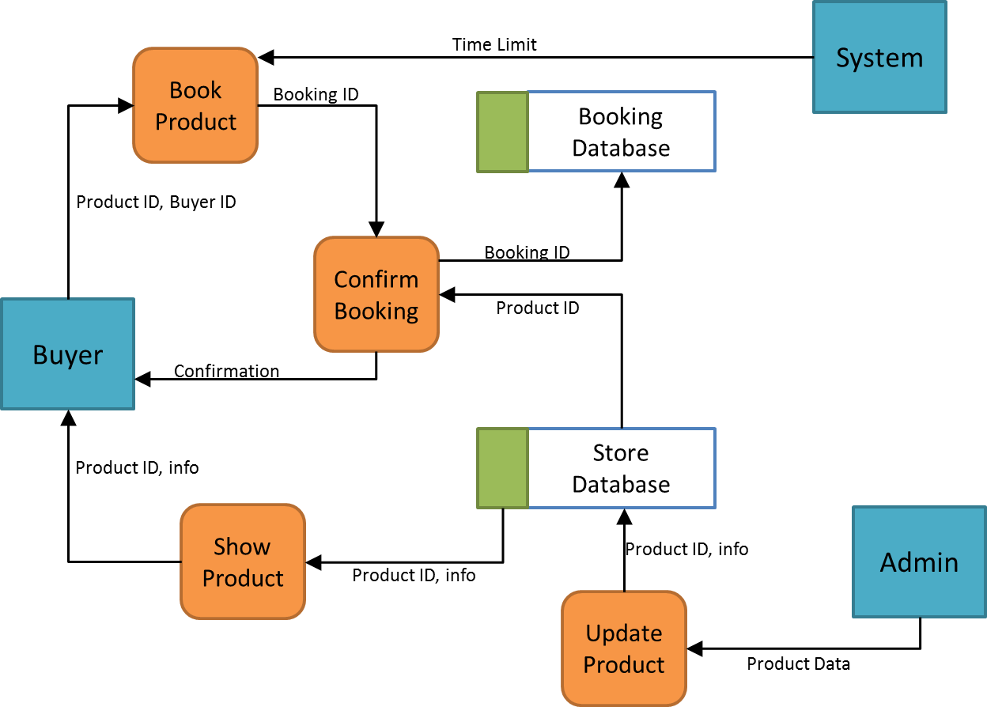
Fig: Data Flow Diagram for Online Store Subsystem

Slide 12
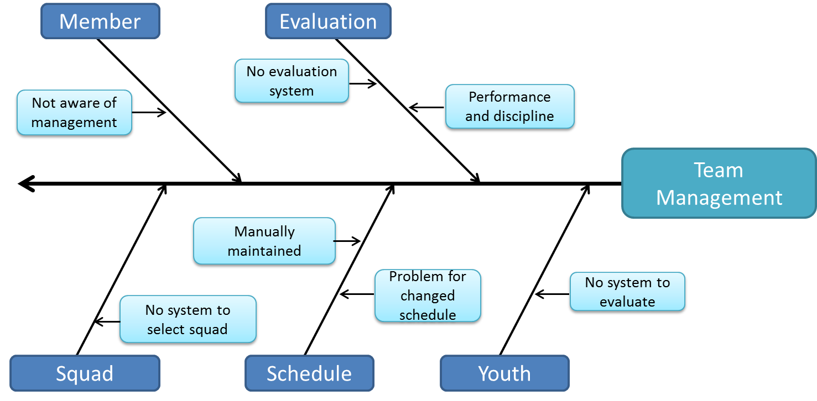
Fig: Fishbone Diagram for Team Management Subsystem

Slide 13
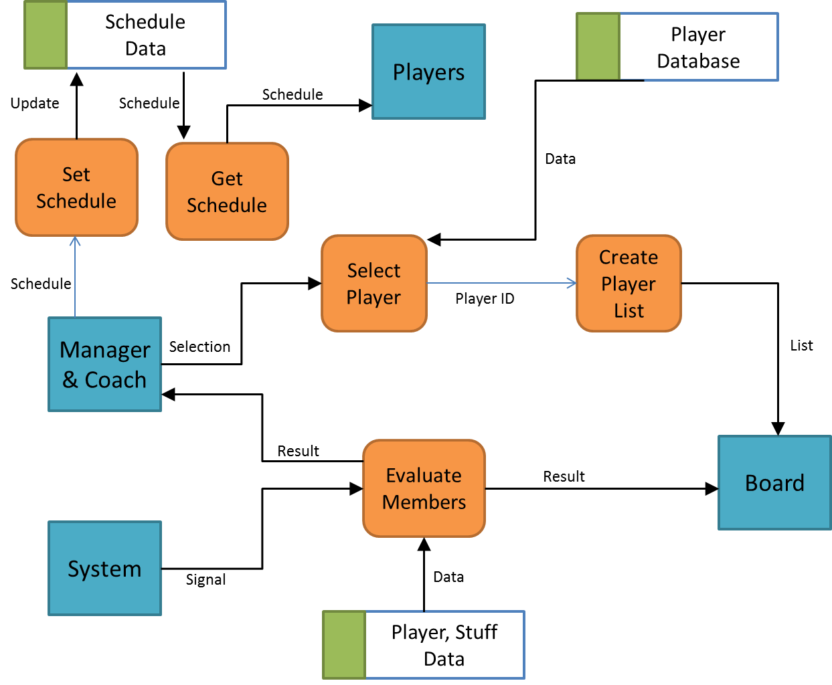
Fig: Data Flow Diagram for Team Management Subsystem

Slide 14
Feasibility Analysis
Operational Feasibility
Technical Feasibility
Cultural Feasibility
Economic Feasibility

Slide 15
1. Operational Feasibility
From Player and Staff’s perspective:
Player and Staffs need to learn how to communication subsystem. Hence training program is needed initially
They need to be aware of checking continuous evaluation of their performance.

Slide 16
1. Operational Feasibility
Benefit Players and Staffs will have:
Convenient way to communicate with other members
Be easily updated about other’s performance

Slide 17
1. Operational Feasibility
From Fans Perspective:
Proper advertisement is needed to get fans introduced with the benefits they can get from this system.

Slide 18
2. Technical Feasibility
PHP for server side scripting
MySQL for Database Management
Java for software based implementation
JavaScript for client side scripting
HTML, CSS for web designing

Slide 19
3. Cultural Feasibility
Management and Coach are not habituated
Training of staffs
Increasing popularity

Slide 20
4. Economic Feasibility
Preliminary Expenses
Software Development Cost………. 1,000,000 BDT
Hardware Cost..................................... 700,000 BDT
Advertisement…………………….….… 600,000 BDT
Web Server……………………….…….. 100,000 BDT
Internet and Mobile…………….…….. 600,000 BDT
Total………………………………..…… 3,000,000 BDT

Slide 21
4. Economic Feasibility
Yearly Expenses
Software Maintenance Cost…………… 150,000 BDT
Advertisement…………………………….. 250,000 BDT
Web Server…………………………………. 100,000 BDT
Internet and Mobile………………………. 400,000 BDT
Miscellaneous………….………………….. 100,000 BDT
Total…………………………………………. 1,000,000 BDT

Slide 22
4. Economic Feasibility
Membership Charge
Year | Income(BDT)
1st | 300*500= 150,000
2nd | 500*500= 250,000
3rd | 700*500= 350,000
4th | 1000*500= 500,000

Slide 23
4. Economic Feasibility
Advertisement on Website
Year | Income(BDT)
1st | 100*5000=500,000
2nd | 200*5500= 1,100,000
3rd | 350*6000= 2,100,000
4th | 500*7000= 3,500,000

Slide 24
4. Economic Feasibility
 | 1st Year | 2nd Year | 3rd Year | 4th Year
Expense | 3 million | 1 million | 1 million | 1 million
Revenue | 0.75 million | 1.35 million | 2.45 million | 4 million
Profit | -2.25 million | 0.35 million | 1.45 million | 3million

Slide 25
Tangible & Intangible Benefits
Tangible Benefits
Website Advertisement
Membership charge
Intangible Benefits
Easy Management
Fans’ Happiness
Convenient communication

