Slide 1
Sports Club Automation System
Group: 1
1005001
1005004
1005005
1005007
1005010
ISD Project
CSE A1

Slide 2
Topics
Collaboration Diagram
Class Diagram

Slide 3
Subsystems
Communication
Social Interaction
Registration
Tram Management
Online Store

Slide 4
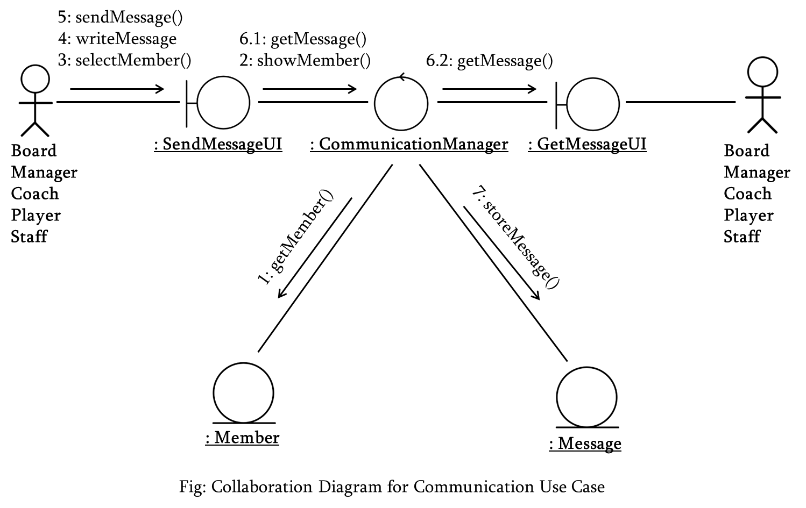
Communication Use Case

Slide 5
<<boundary>>
SendMessageUI
<<boundary>>
GetMessageUI
<<control>>
CommunicationManager
sendMessage()
writeMessage()
selectMember()
getMessage()
getMessage()
showMember()
<<entity>>
Member
<<entity>>
Message
memberName
…
messageId
time
…
1 *
getMember()
storeMessage()
Fig: Class Diagram for Communication Use Case

Slide 6
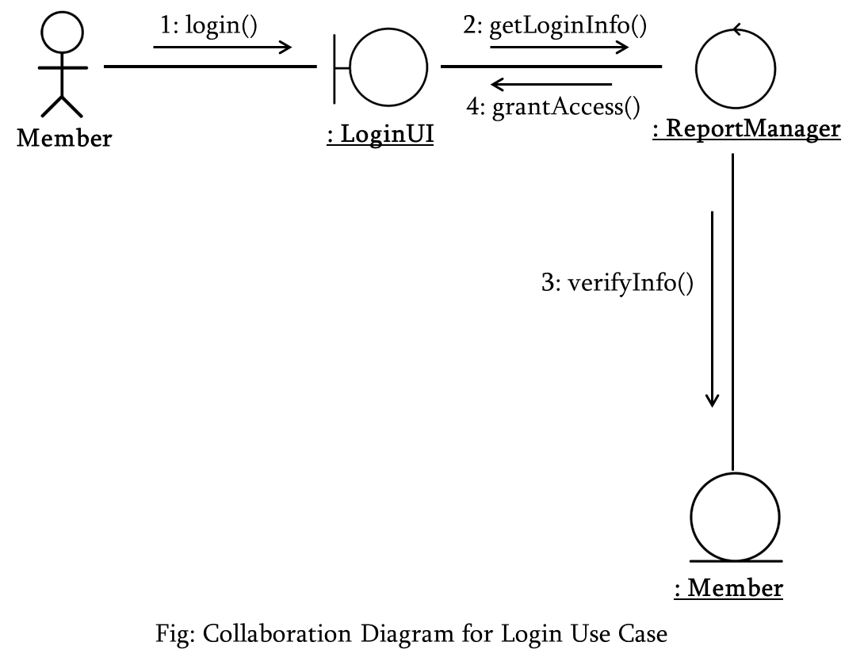
Login Use Case

Slide 7
<<boundary>>
LoginUI
<<control>>
ReportManager
login()
grantAccess()
getLoginInfo()
<<entity>>
Member
memberName
…
verifyInfo()
Fig: Class Diagram for Complain Use Case

Slide 8
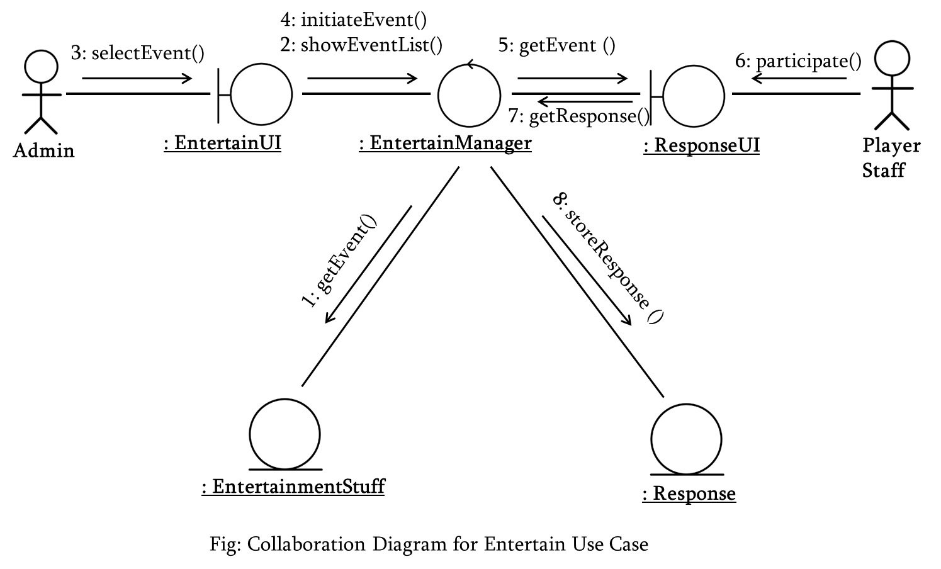
Entertain Use Case

Slide 9
Select()
Participate()
<<control>>
EntertainManager
<<boundary>>
Entertain UI
<<boundary>>
Response UI
initiateEvent()
showEventList()
getResponse()
<<entity>>
Entertainment Stuff
<<entity>>
Response
StuffID
…
eventID
…
getEvent()
getResult()
storeResponse()
getResponse()
Fig: Class Diagram for Entertain Use Case

Slide 10
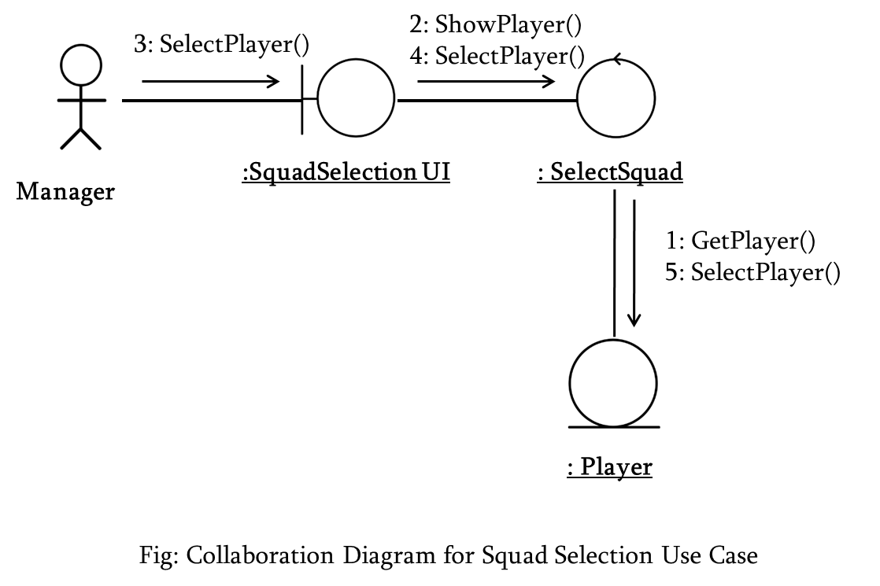
Squad Selection Use Case

Slide 11
<<boundary>>
SquadSelection UI
<<control>>
SquadSelection
selectPlayer()
ShowPlayer()
SelectPlayer()
<<entity>>
Player
PlayerName
…
GetPlayer()
SelectPlayer()
Fig: Class Diagram for Squad Selection Use Case

Slide 12
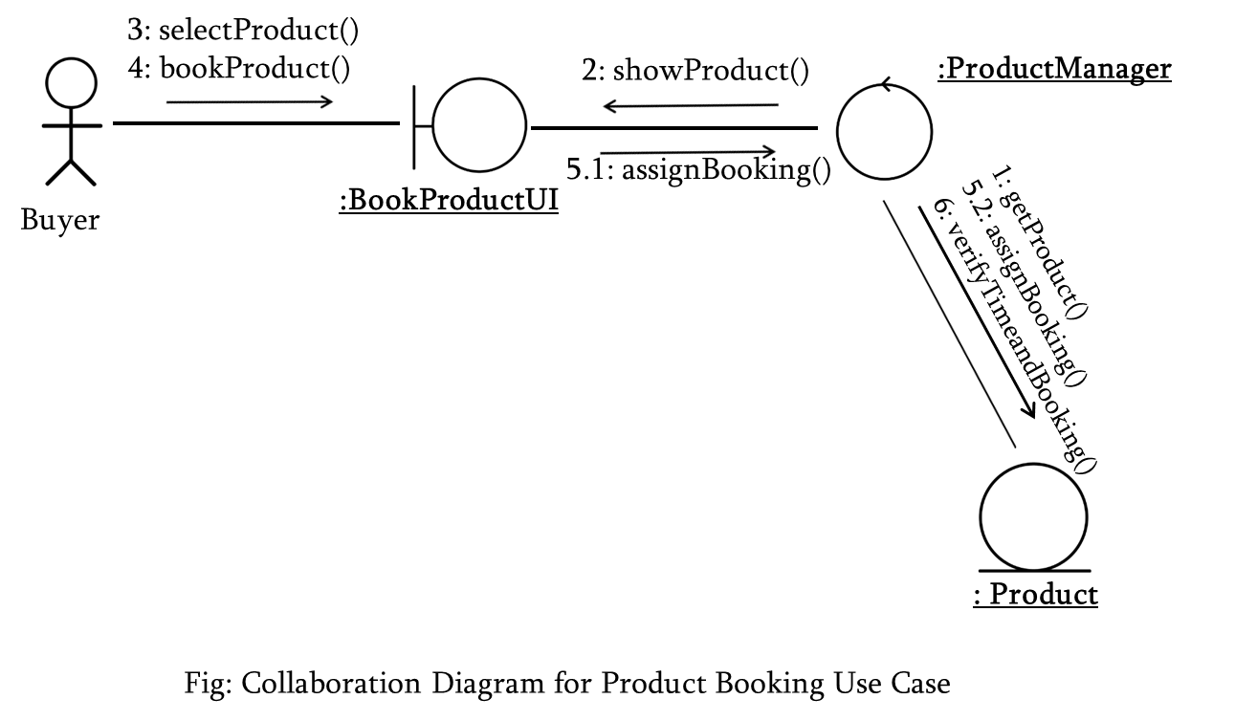
Product Booking Use Case

Slide 13
<<boundary>>
BookingUI
<<control>>
BookingManager
selectProduct()
bookProduct()
showProduct()
assignBooking()
<<entity>>
Product
productID
…
getProduct()
assignBooking()
verifyTimeand()
booking()
Fig: Class Diagram for Product Booking Use Case

Slide 14
Thank You

Slide 15
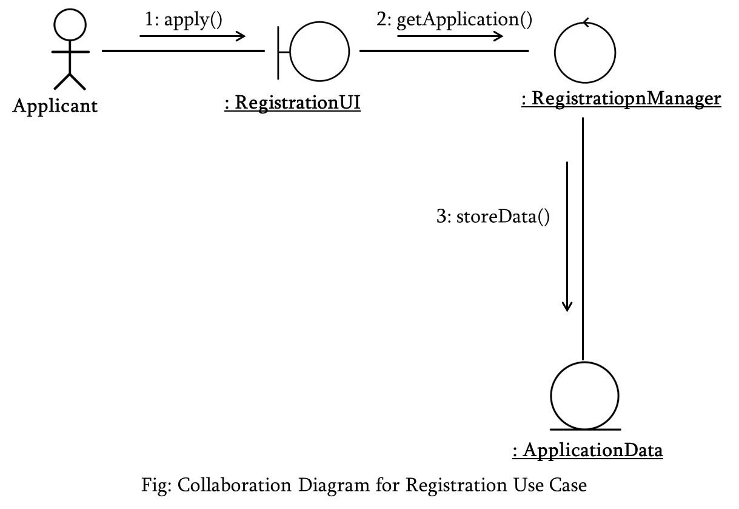
Registration Use Case

Slide 16
<<boundary>>
RegistrationUI
<<control>>
RegistrationManager
apply()
getApplication()
<<entity>>
ApplicationData
…
storeData()
Fig: Class Diagram for Product Registration Use Case

Slide 17
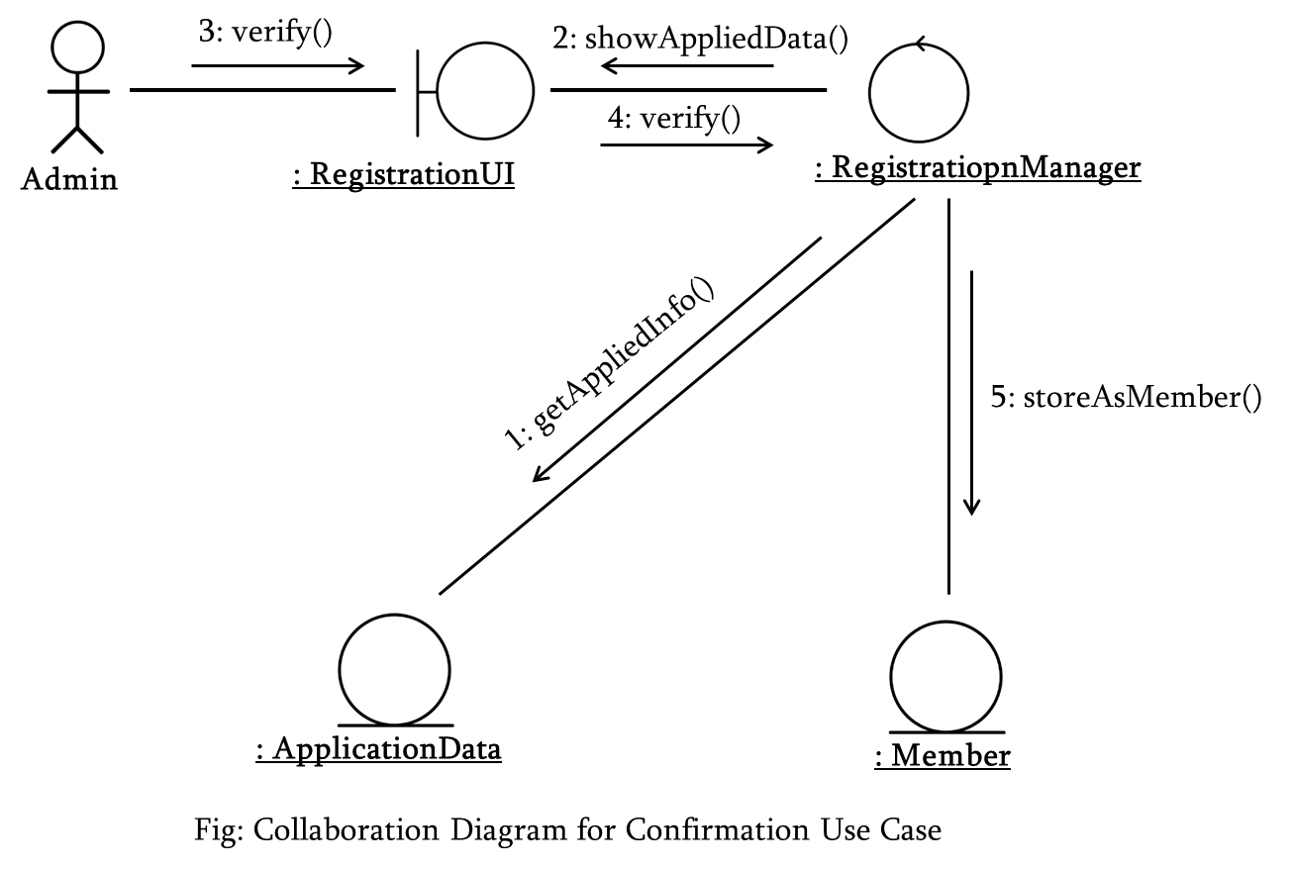

Slide 18
<<boundary>>
RegistrationUI
<<control>>
RegistrationManager
verify()
showAppliedData()
verify()
<<entity>>
ApplicationData
<<entity>>
Member
…
…
1 1
getAppliedInfo()
storeAsMember()
Fig: Class Diagram for Confirmation Use Case

Slide 19
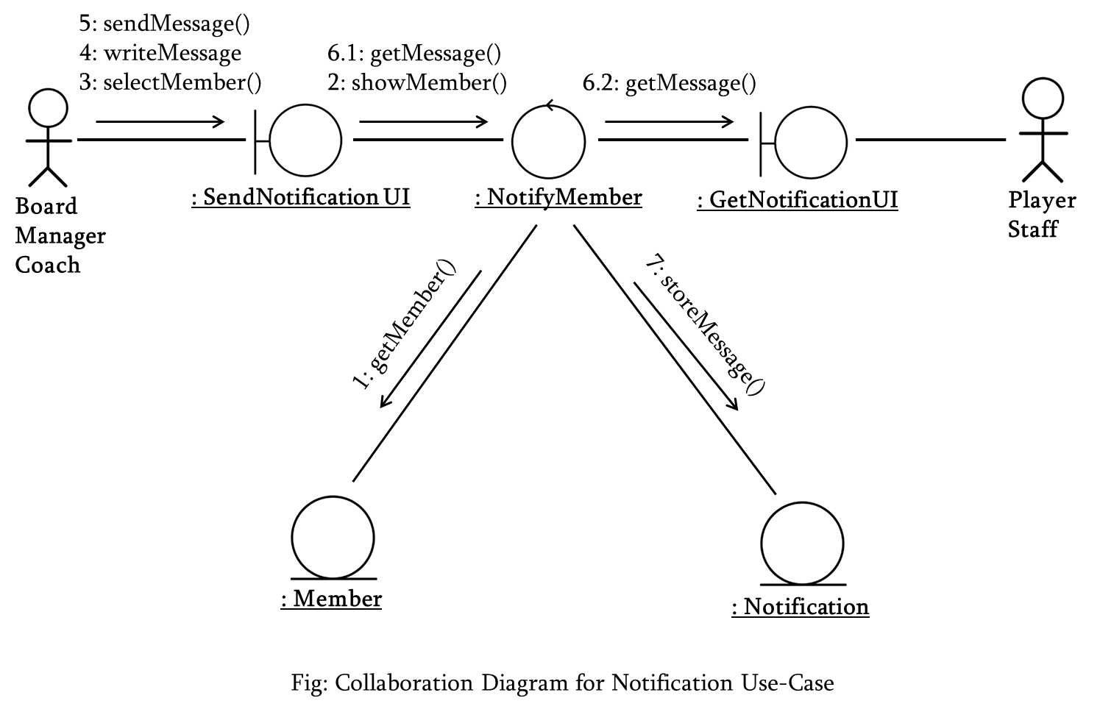

Slide 20
<<boundary>>
SendNotificationUI
<<boundary>>
GetMessageUI
<<control>>
CommunicationManager
sendNotification ()
writeMessage()
selectMember()
getNotification ()
getNotification ()
showMember()
<<entity>>
Member
<<entity>>
Notification
1 *
getMember()
storeNotification ()
Fig: Class Diagram for Notification Use Case

Slide 21
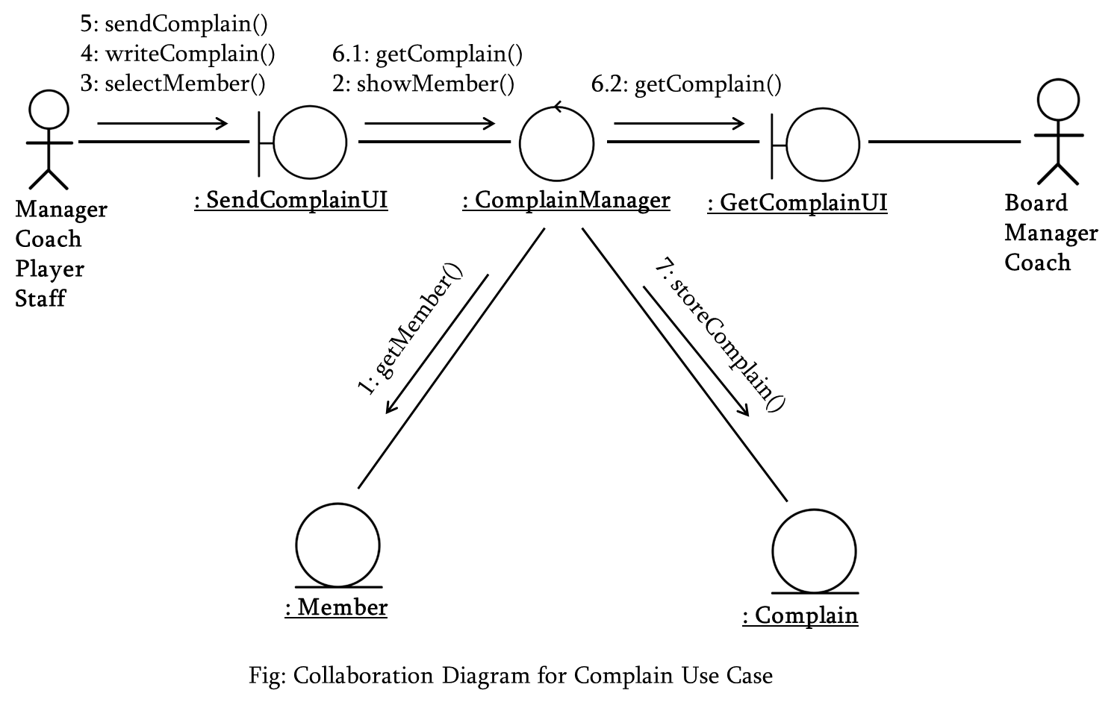

Slide 22
<<boundary>>
ComplainUI
<<boundary>>
GetComplainUI
<<control>>
ComplainManager
sendComplain ()
writeComplain()
selectMember()
getComplain ()
getComplain ()
showMember()
<<entity>>
Member
<<entity>>
Complain
1 *
getMember()
storeComplain ()
Fig: Class Diagram for Complain Use Case

Slide 23
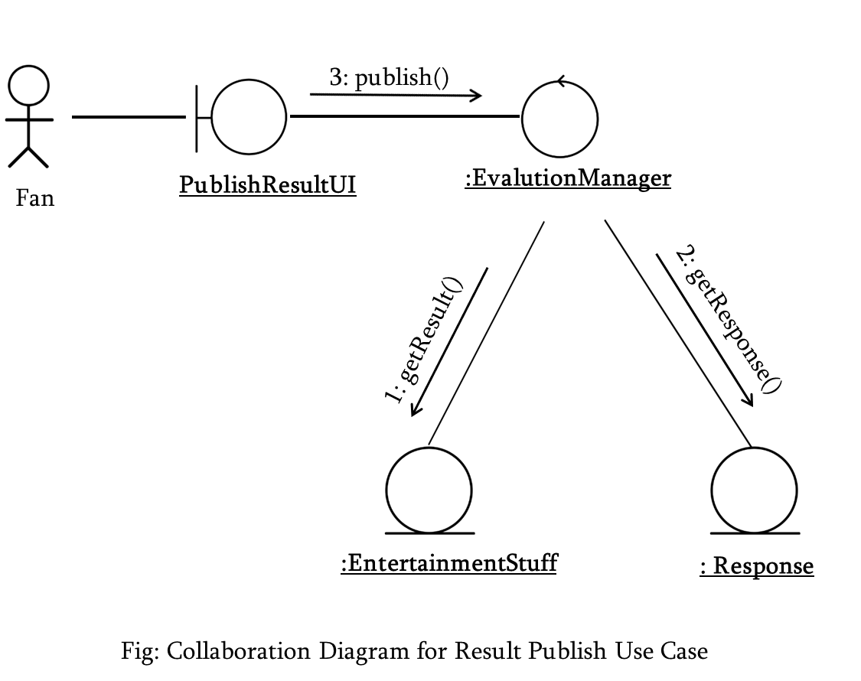

Slide 24
<<control>>
EvalutaionManager
<<boundary>>
PublishResultUI
Publish()
<<entity>>
Entertainment Stuff
<<entity>>
Response
StuffID
…
…
getEvent()
getResult()
storeResponse()
getResponse()
Fig: Class Diagram for Result Publish Use Case

Slide 25
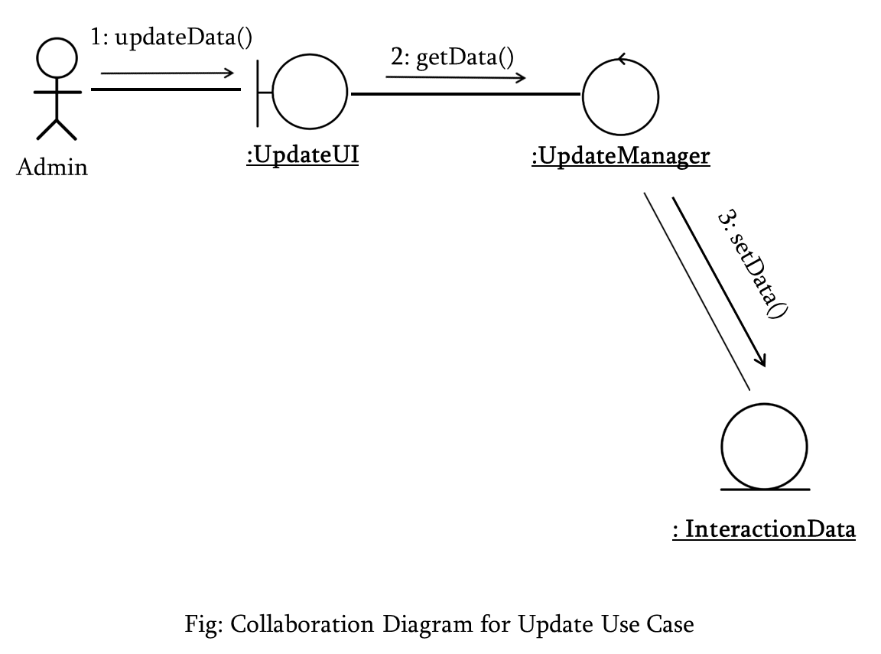

Slide 26
<<boundary>>
Update UI
<<control>>
UpdateManager
UpdateData()
getData()
<<entity>>
InteractionData
…
setData()
Fig: Class Diagram for Update Use Case

Slide 27
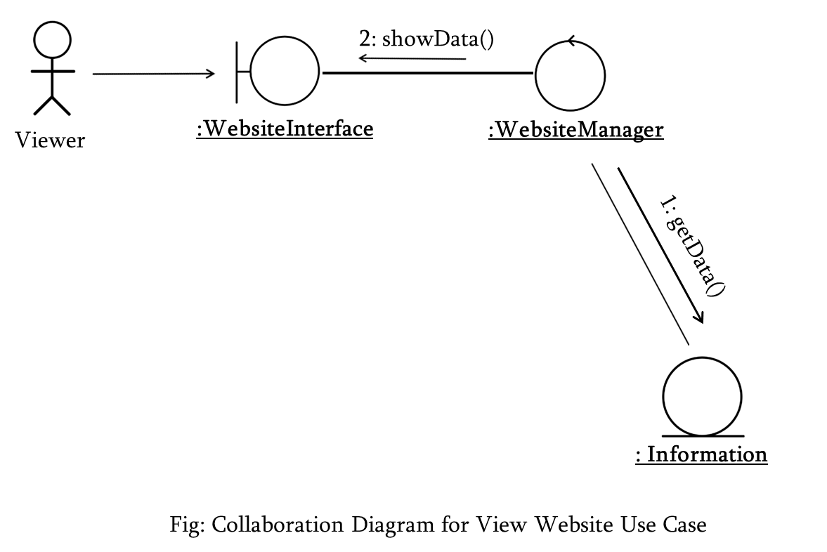

Slide 28
<<boundary>>
WebsiteInterface
<<control>>
WebsiteManager
showData()
<<entity>>
Information
…
getData()
Fig: Class Diagram for View Website Use Case

Slide 29
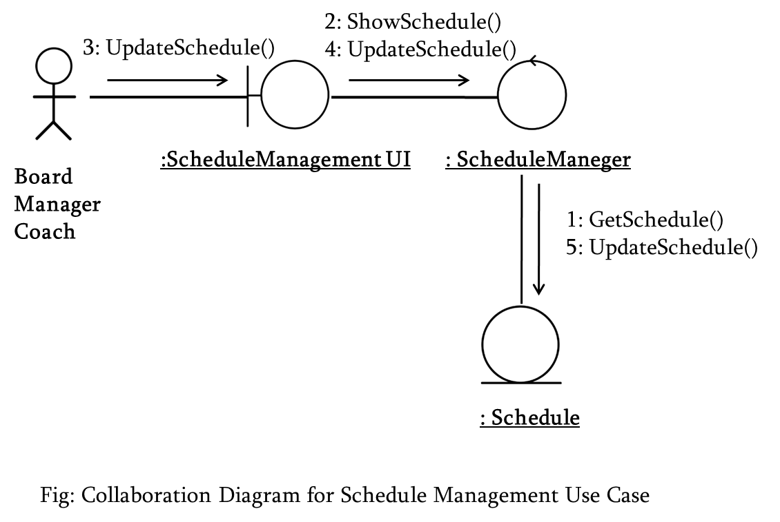

Slide 30
<<boundary>>
ScheduleManagement UI
<<control>>
ScheduleManager
ShowSchedule()
UpdateSchedule()
UpdateSchedule()
<<entity>>
Schedule
CurrentSchedule
….
GetSchedule()
UpdateSchedule()
Fig: Class Diagram for Schedule Management Use Case

Slide 31
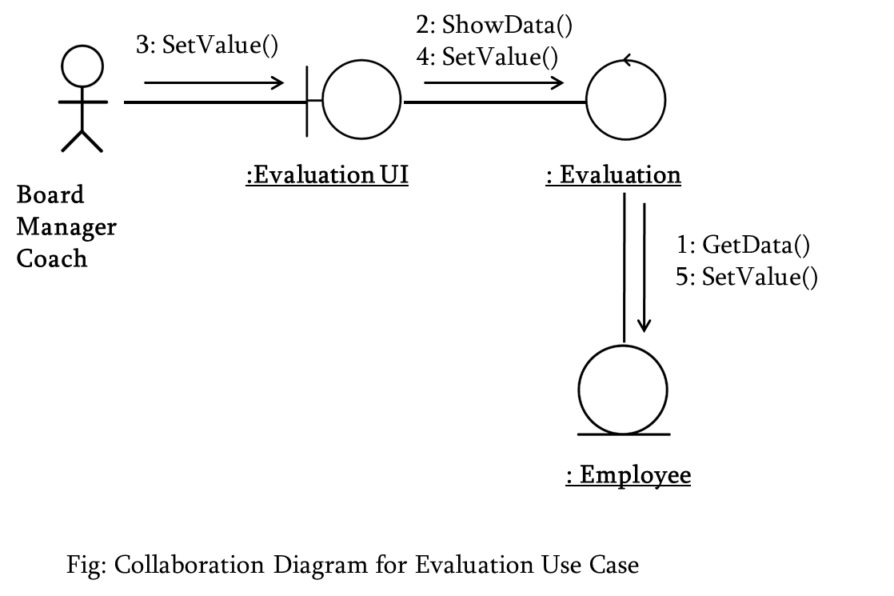

Slide 32
<<boundary>>
EvaluationaUI
<<control>>
Evaluation
SetValue()
ShowData()
SetValue()
<<entity>>
Employee
EmployeeName
….
GetData()
SetValue()
Fig: Class Diagram for Evaluation Use Case

Slide 33
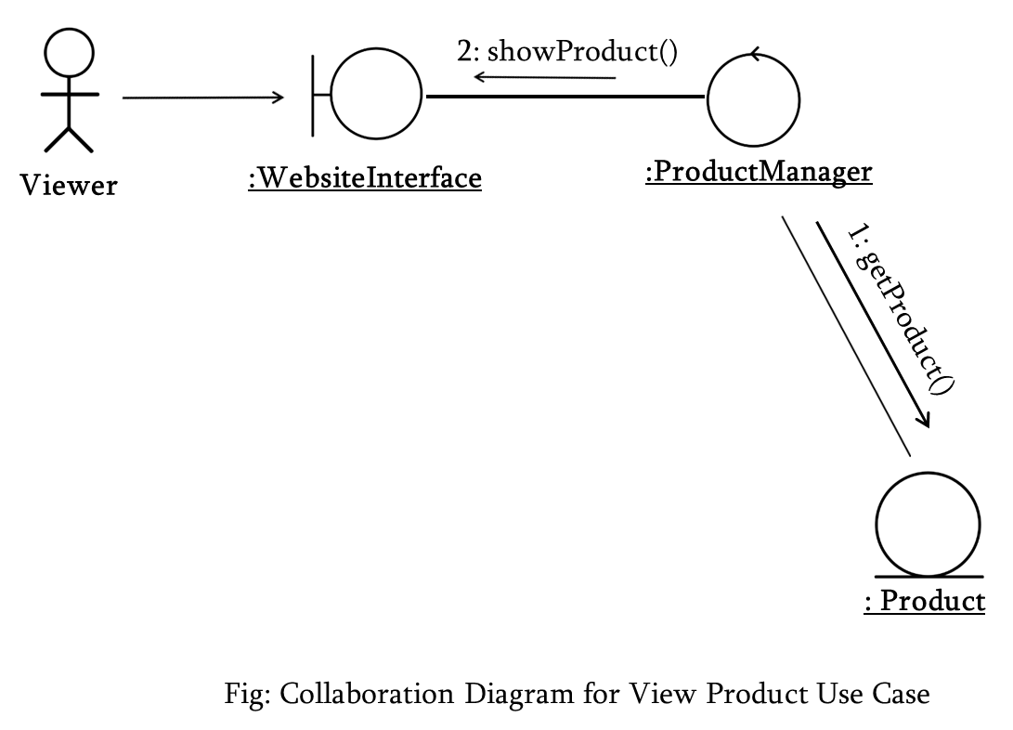
Online Store Subsystem

Slide 34
<<boundary>>
WebsiteInterface
<<control>>
ProductManager
showProduct()
<<entity>>
Product
…
getProduct()
Fig: Class Diagram for View Product Use Case

Slide 35
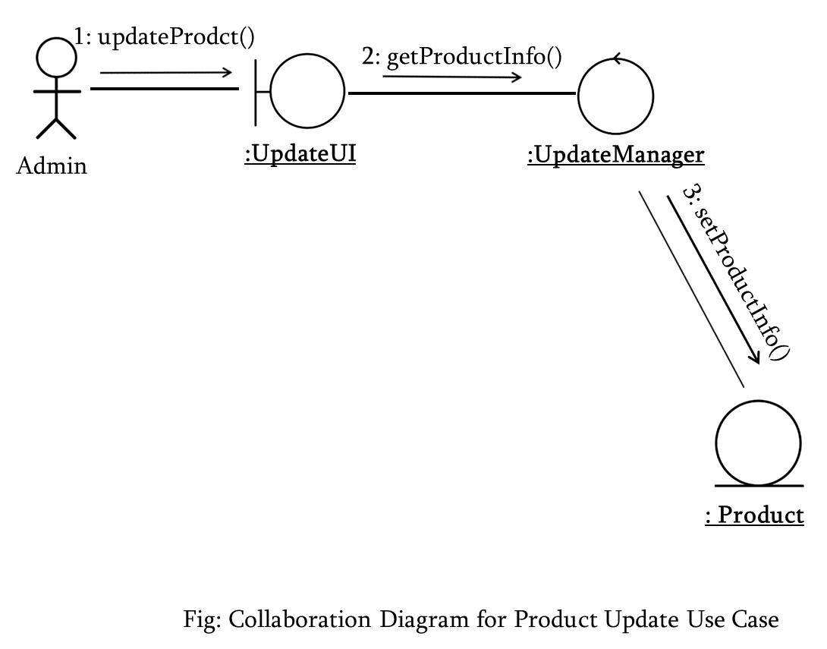

Slide 36
<<boundary>>
UpdateUI
<<control>>
UpdateManager
updateProduct()
getProductInfo()
<<entity>>
Product
…
setProductInfo()
Fig: Class Diagram for Product Update Use Case

