Slide 1
Sports Club Automation System
Group: 1
1005001
1005004
1005005
1005007
1005010
ISD Project
CSE A1

Slide 2
Topics
Sequence Diagram
Activity Diagram
State Chart Diagram

Slide 3
Subsystems
Communication
Social Interaction
Registration
Team Management
Online Store

Slide 4
Communication Subsystem
Use Cases:
Communication
Login
Notification
Complaint

Slide 5
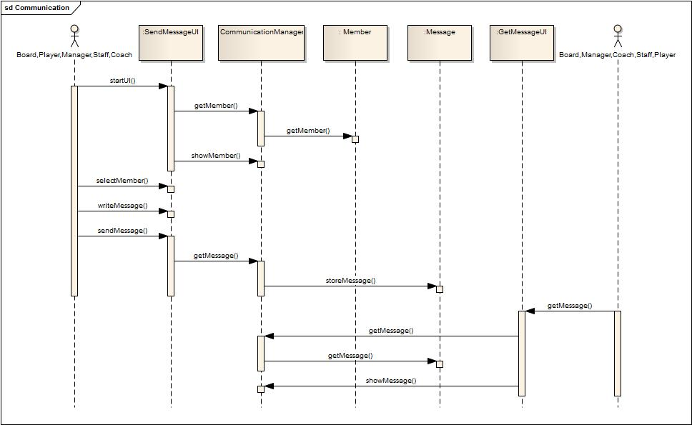
Sequence Diagram: Communication Use-Case

Slide 6
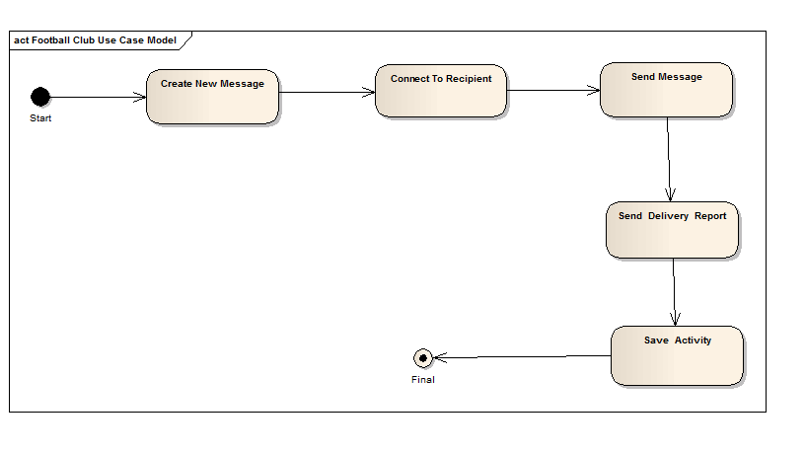
Activity Diagram: Communication Use-Case

Slide 7
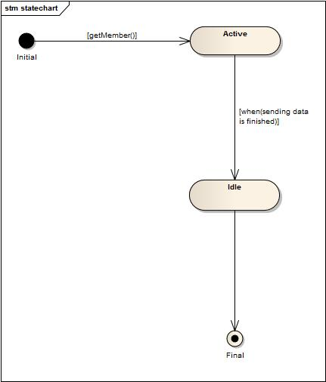
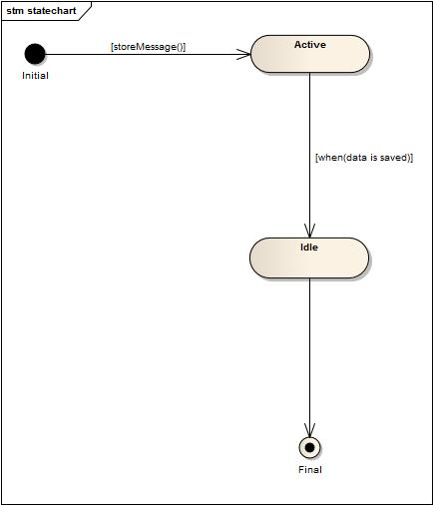
State Chart: Communication Use-Case
<<entity>>:Member
<<entity>>:Message

Slide 8
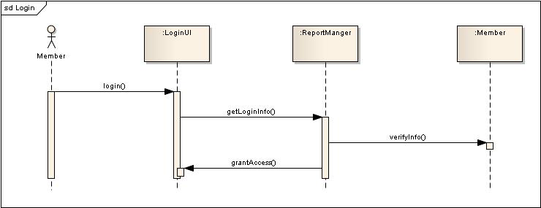
Sequence Diagram: Login Use-Case

Slide 9
Activity Diagram: Login Use-Case

Slide 10
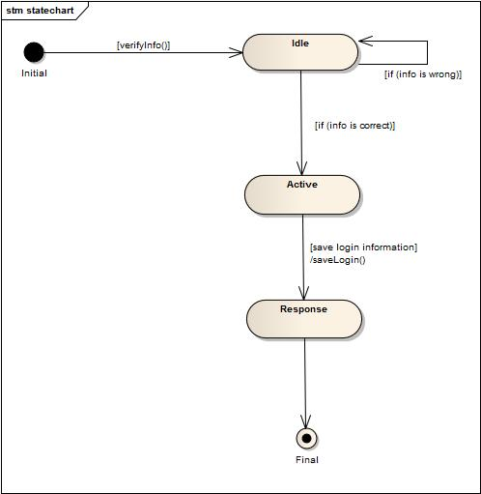
State Chart: Login Use-Case
<<entity>>:Member

Slide 11
Social Interaction Subsystem
Use Cases:
Entertain
Result Publish
Update
View Website

Slide 12
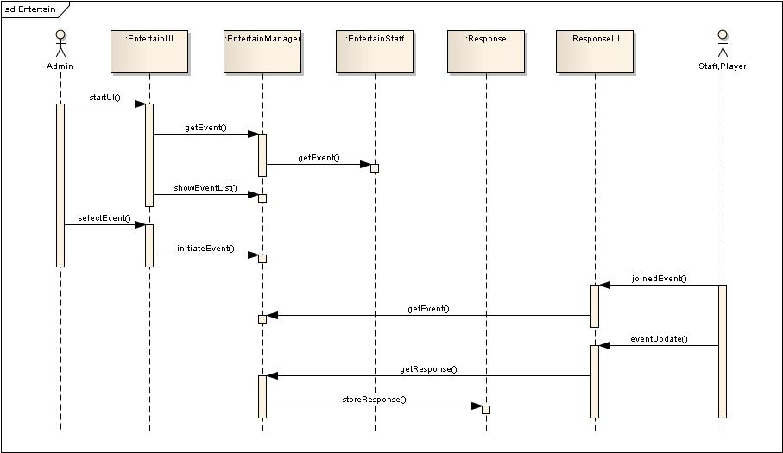
Sequence Diagram: Entertain Use-Case

Slide 13
Activity Diagram: Entertain Use-Case

Slide 14
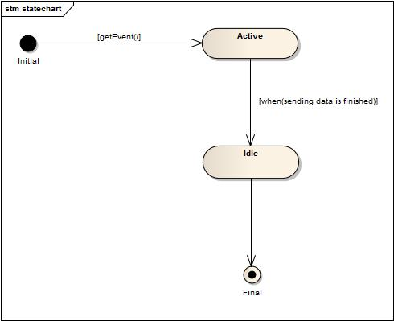
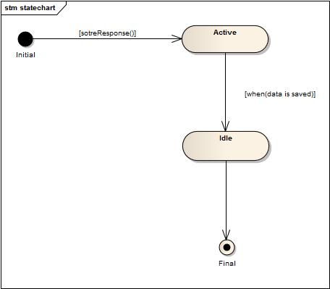
State Chart: Entertain Use-Case
<<entity>>:EntertainmentStuff
<<entity>>:Response

Slide 15
Team Management Subsystem
Use Cases:
Squad Selection
Schedule Management
Evaluation

Slide 16
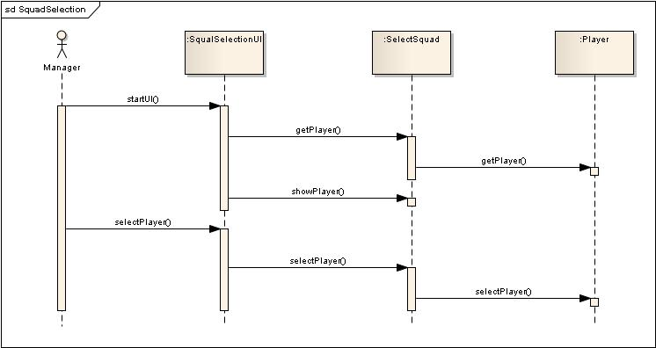
Sequence Diagram: Squad Selection Use-Case

Slide 17
Activity Diagram: Squad Selection Use-Case

Slide 18
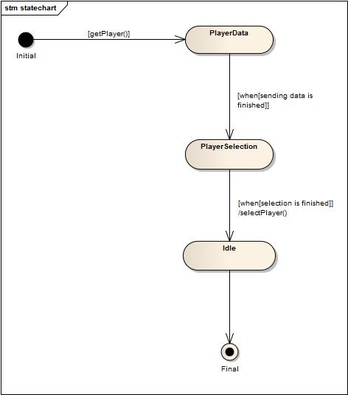
State Chart: Squad Selection Use-Case
<<entity>>:Player

Slide 19
Online Store Subsystem
Use Cases:
View Product
Product Booking
Product Update

Slide 20
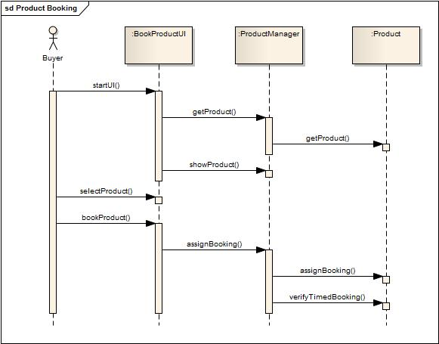
Sequence Diagram: Product Booking Use-Case

Slide 21
Activity Diagram: Product Booking Use-Case

Slide 22
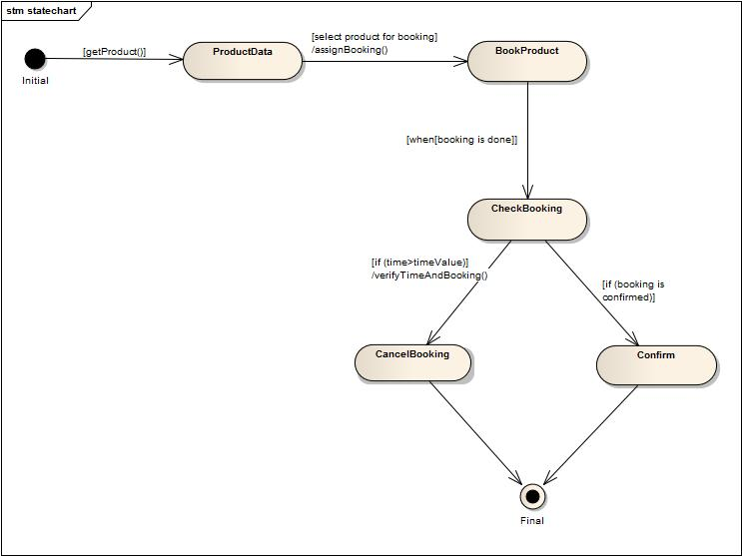
State Chart: Product Booking Use-Case
<<entity>>:Product

Slide 23
Thank You

Slide 24
Registration Subsystem
Use Cases:
Registration
Confirmation

Slide 25
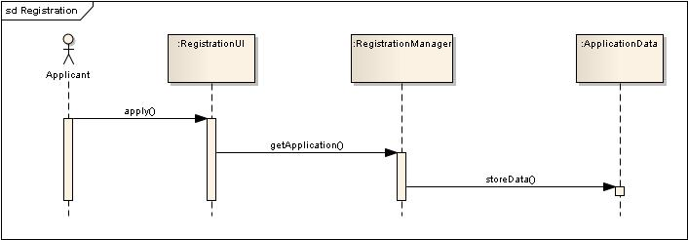
Sequence Diagram: Registration Use-Case

Slide 26
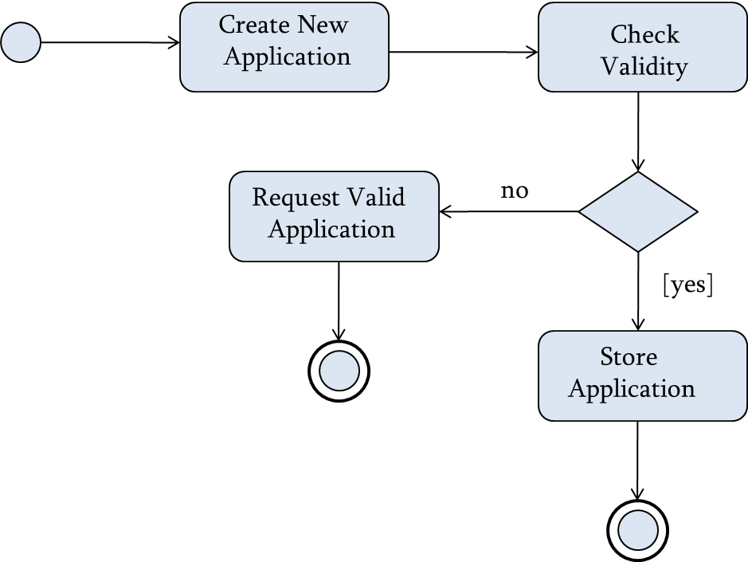
Activity Diagram: Registration Use-Case

Slide 27
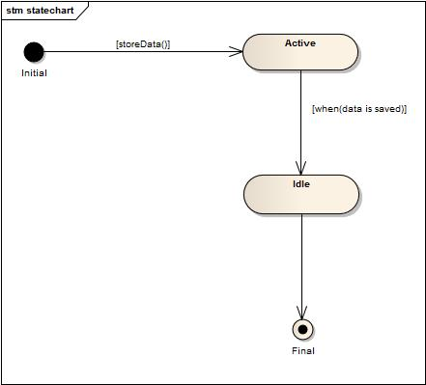
State Chart: Registration Use-Case
<<entity>>:ApplicationData

Slide 28
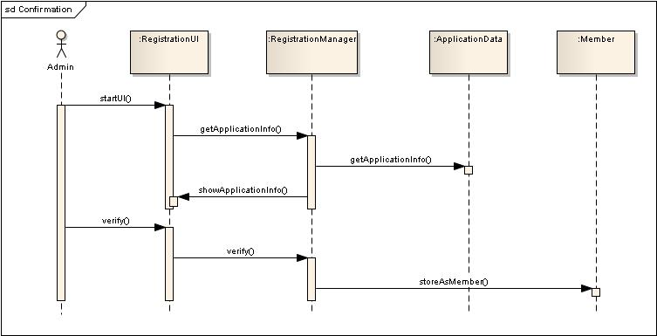
Sequence Diagram: Confirmation Use-Case

Slide 29
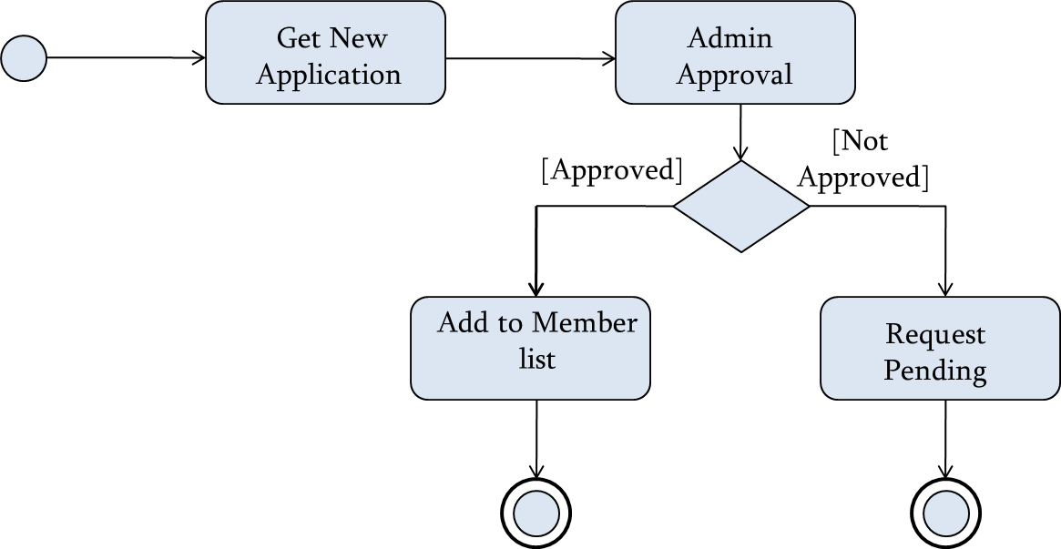
Activity Diagram: Confirmation Use-Case

Slide 30
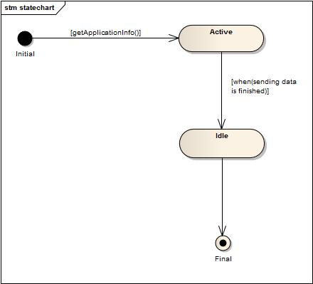
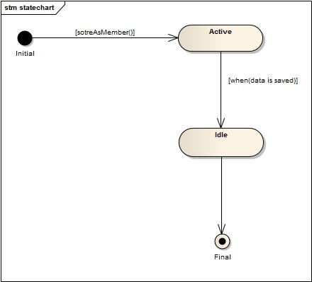
State Chart: Confirmation Use-Case
<<entity>>:ApplicationData
<<entity>>:Member

Slide 31
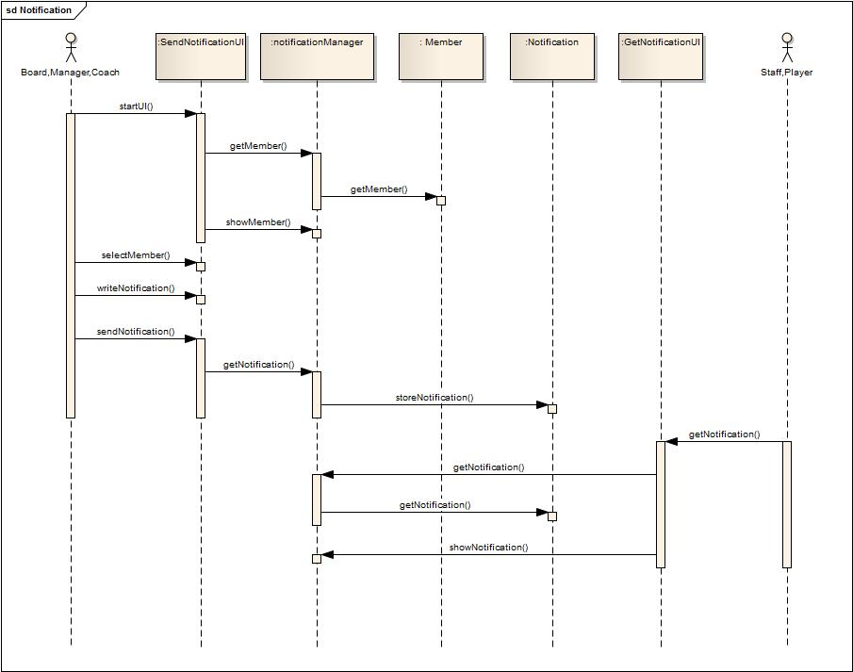
Sequence Diagram: Notification Use-Case

Slide 32
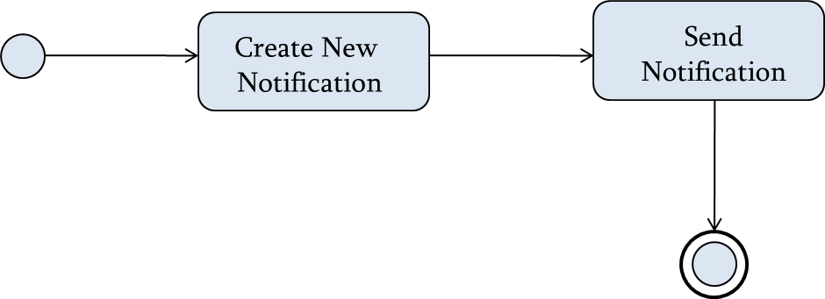
Activity Diagram: Notification Use-Case

Slide 33
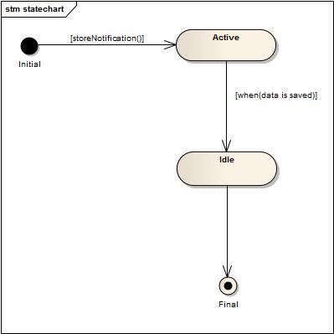
State Chart: Notification Use-Case
<<entity>>:Notification
<<entity>>:Member

Slide 34
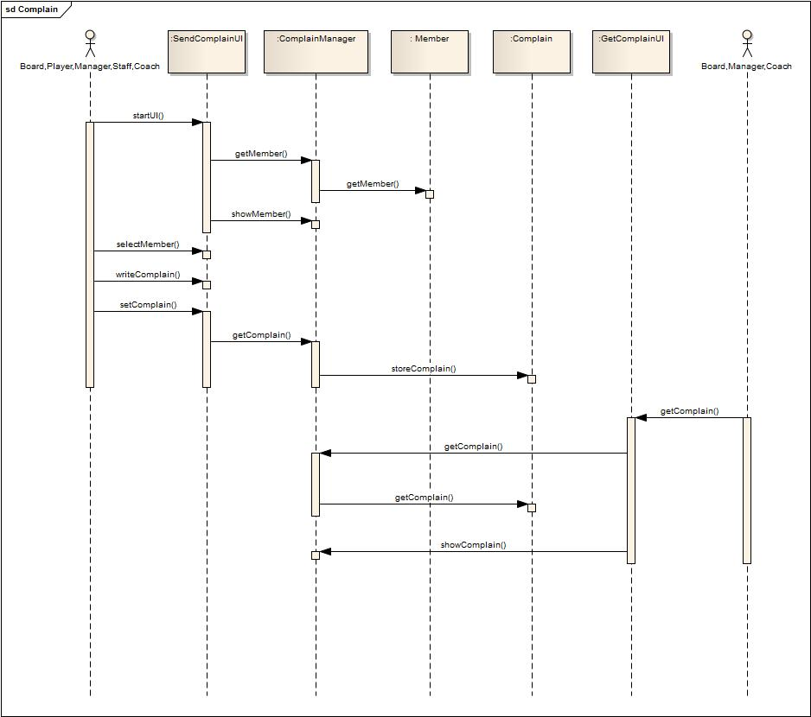
Sequence Diagram: Complain Use-Case

Slide 35
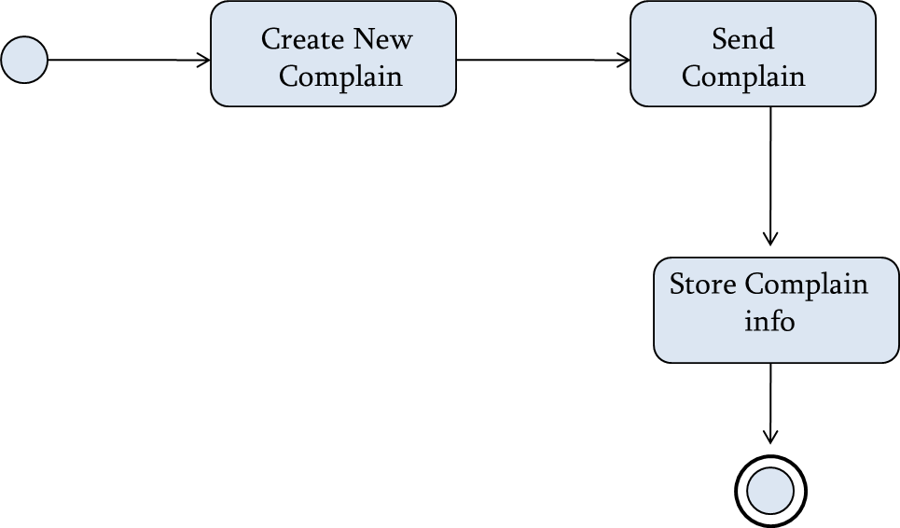
Activity Diagram: Complaint Use-Case

Slide 36
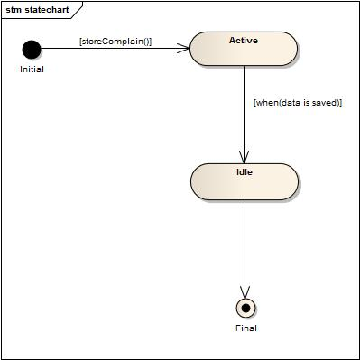
State Chart: Complaint Use-Case
<<entity>>:Complain
<<entity>>:Member

Slide 37
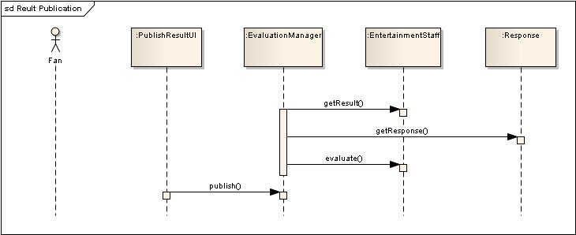
Sequence Diagram: Result Publish Use-Case

Slide 38
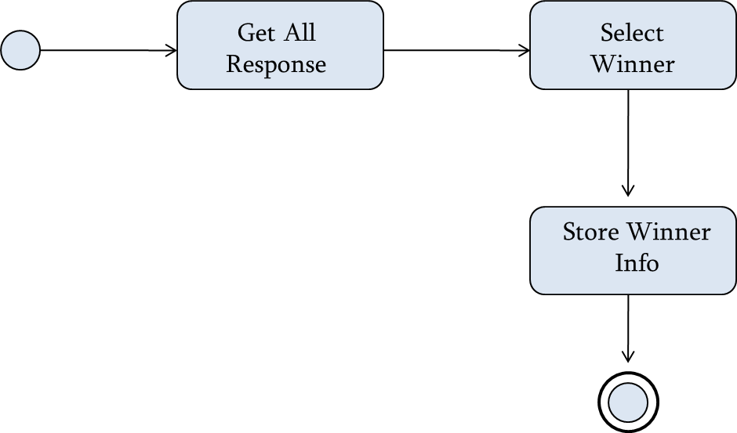
Activity Diagram: Result Publish Use-Case

Slide 39
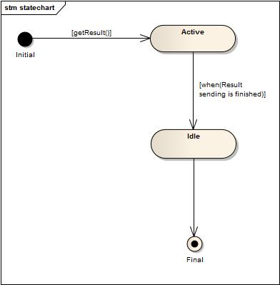
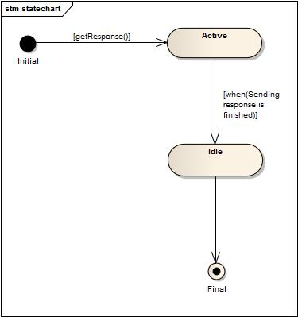
State Chart: Result Publish Use-Case
<<entity>>:EntertainmentStuff
<<entity>>:Response

Slide 40
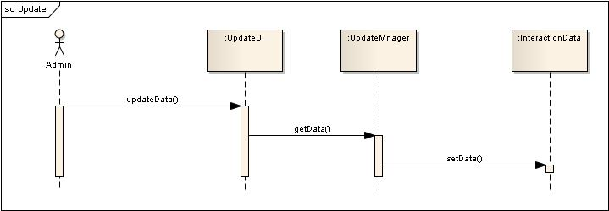
Sequence Diagram: Update Website Use-Case

Slide 41
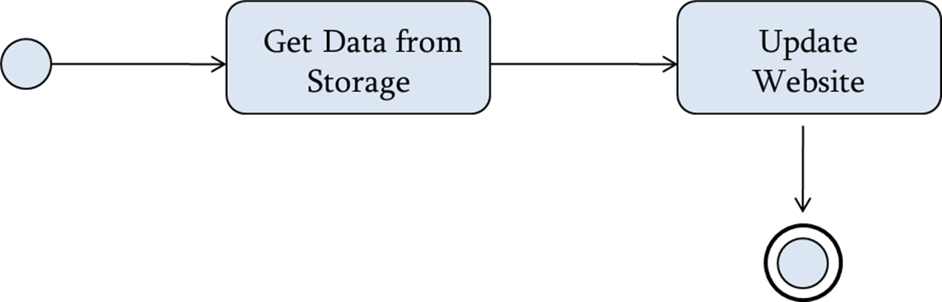
Activity Diagram: Update Website Use-Case

Slide 42
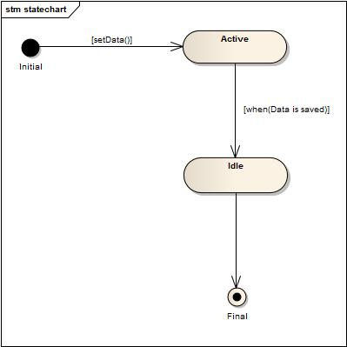
State Chart: Update Website Use-Case
<<entity>>:InteractionData

Slide 43
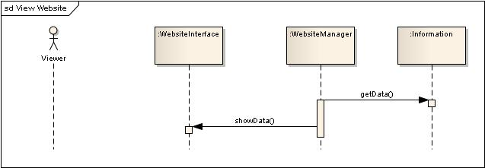
Sequence Diagram: View Website Use-Case

Slide 44
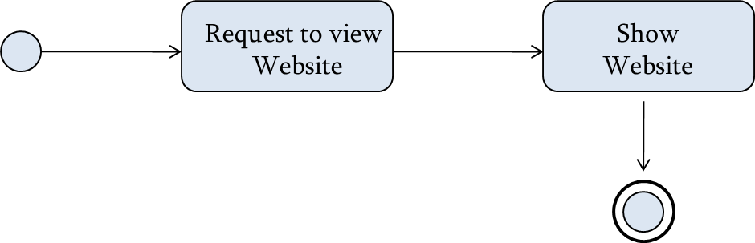
Activity Diagram: View Website Use-Case

Slide 45
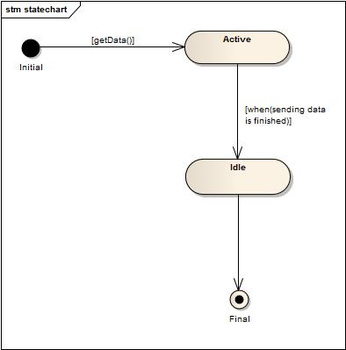
State Chart: View Website Use-Case
<<entity>>:Information

Slide 46
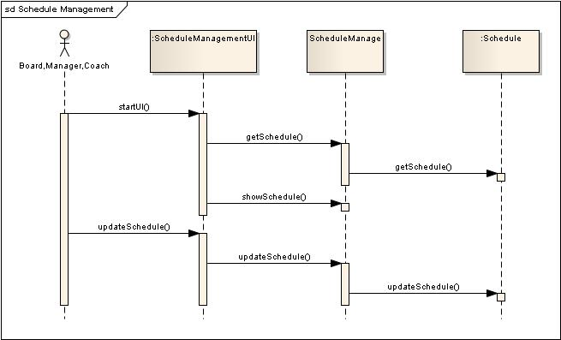
Sequence Diagram: Schedule Management Use-Case

Slide 47
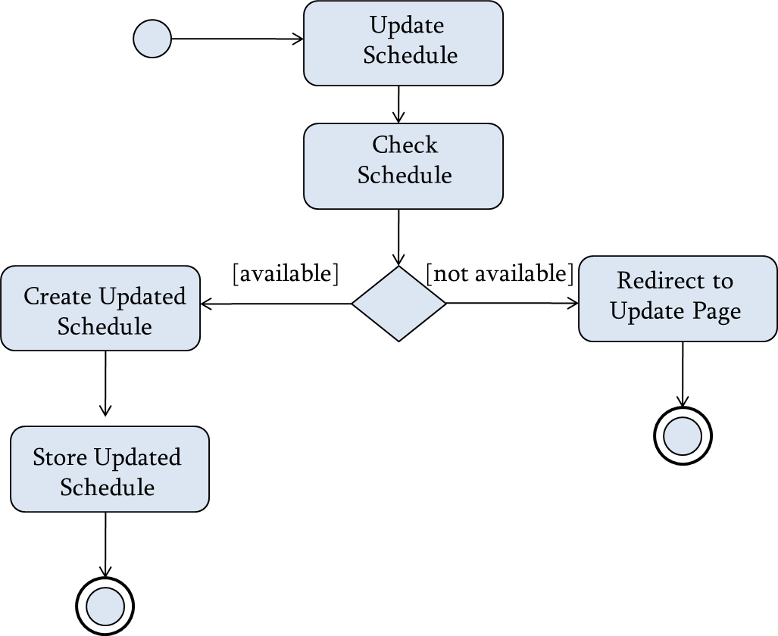
Activity Diagram: Schedule Management Use-Case

Slide 48
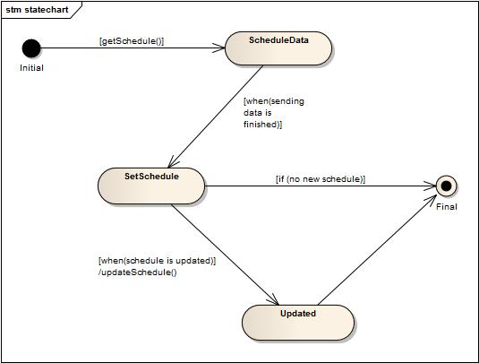
State Chart: Schedule Management Use-Case
<<entity>>:Schedule

Slide 49
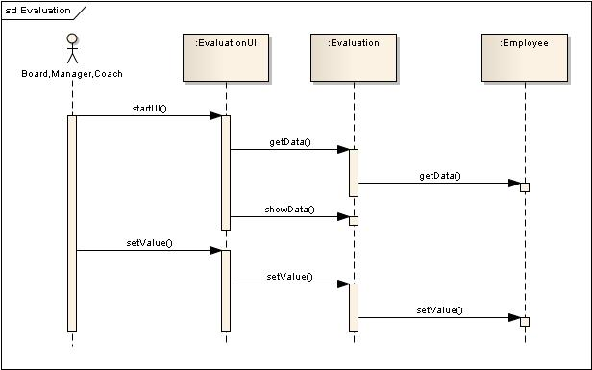
Sequence Diagram: Evaluation Use-Case

Slide 50
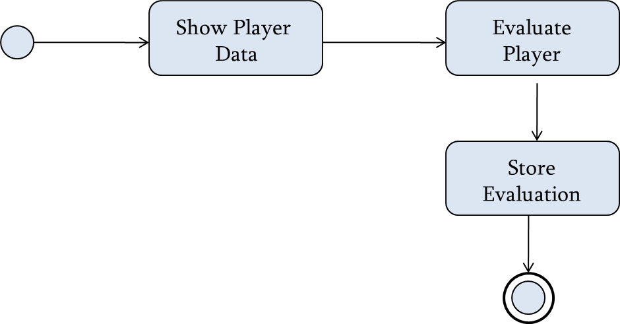
Activity Diagram: Evaluation Use-Case

Slide 51
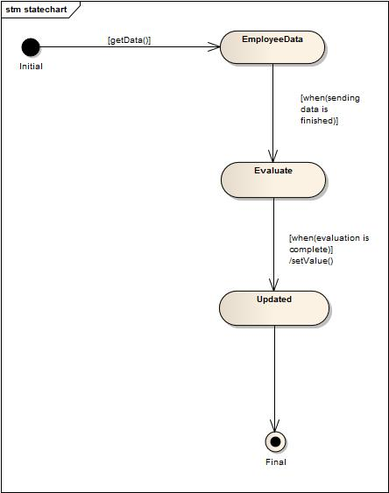
State Chart: Evaluation Use-Case
<<entity>>:Employee

Slide 52
Sequence Diagram: View Product Use-Case

Slide 53

Activity Diagram: View Product Use-Case

Slide 54

State Chart: View Product Use-Case
<<entity>>:Product

Slide 55
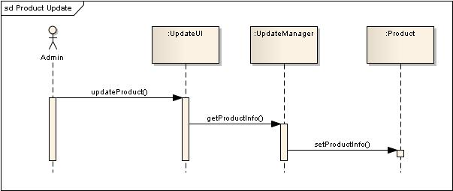
Sequence Diagram: Update Product Use-Case

Slide 56
Activity Diagram: Update Product Use-Case

Slide 57

State Chart: Update Product Use-Case
<<entity>>:Product

