Slide 1
Sports Club Automation System
Group: 1
1005001
1005004
1005005
1005007
1005010
ISD Project
CSE A1

Slide 2
Subsystems
Communication
Finance
Social Interaction
Team Management
Online Store

Slide 3
Actors
Management Board
Manager
Coach
Stuff
Player
Fan
Finance Manager
Online Product Manager
Warehouse Manager
Buyer
Admin
Public

Slide 4
Actors Glossary
Actor | Short-key
Board | BRD
Manager | MGR
Coach | CH
Stuff | STF
Player | PLR
Fan | FN
Finance Manager | FMGR
Online Product Manager | PMGR
Warehouse Manager | WMGR
Buyer | BYR
Admin | ADMIN
Public | PUBLIC

Slide 5
1. Communication Subsystem
Use-Case ID | Name | Description | Participant Actors and Roles
1.1 | Login | Log into member account | BRD, MGR, CH, PLR, STF can log into system via internet or mobile app
1.2 | Club Communication | Communicate between club members, send messages | BRD, MGR, CH, PLR, STF can contact with one another
1.3 | Notification | Notify members of different events and activities | BRD, MGR, CH, PLR, STF are notified different events
1.4 | Complain | Complain to coach, manager or Board | MGR, CH, PLR, STF can complain to respective higher ranks

Slide 6
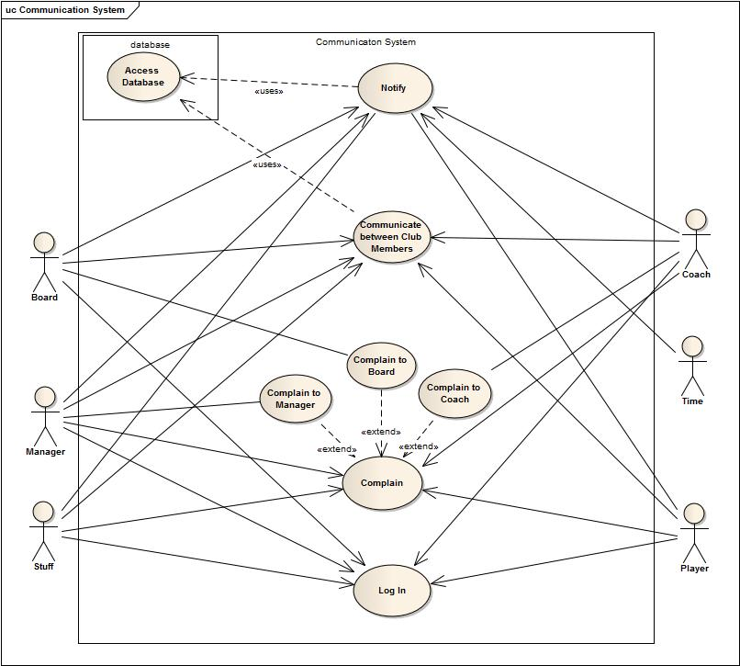
Use-Case Diagram of Communication Subsystem

Slide 7
1.1 Login
Use-Case name | Define route and price
Use-Case ID | 1.1
Priority | High
Primary Business Actor | BRD, MGR, CH, PLR, STF
Primary System Actor | BRD, MGR, CH, PLR, STF
Description | Actors can log in to account in the system via internet or mobile app
Trigger | Anyone of BRD, MGR, CH, PLR, STF

Slide 8
Typical course of events
Actor Action | System Action
1. Attempt to log in to system from internet or mobile app | 2. Verification and log in
 | 3. Show account to actor
4. Access personal account

Slide 9
Documentation of the use-case(1.1) course of events
Conclusion: concludes when logged into account
Post-condition: show actor the respective personal account to access communication
Implementation issues: GUI will be provided in the website to log in, a Mobile app will be provided to log in from mobile devices

Slide 10
1.2 Club Communication
Use-Case name | Define route and price
Use-Case ID | 1.2
Priority | High
Primary Business Actor | BRD, MGR, CH, PLR, STF
Primary System Actor | BRD, MGR, CH, PLR, STF
Description | Actors can communicate with one another by mobile & mail service according to their domain of access
Trigger | Anyone of BRD, MGR, CH, PLR, STF

Slide 11
Typical course of events
Actor Action | System Action
1. Access personal account to view events, schedule, activities and send messages or mail | 2. System uses database to get information of members upon request
 | 3. Messages or mail is sent to appropriate personnel
 | 4. Notifies sender
5. Sender receives confirmation

Slide 12
Documentation of the use-case(1.2) course of events
Conclusion: concludes when a message or mail is sent or logged out from account
Implementation issues: GUI for personal account, information, sending message or mail will be provided.

Slide 13
1.3 Notification
Use-Case name | Define route and price
Use-Case ID | 1.3
Priority | High
Primary Business Actor | BRD, MGR, CH, PLR, STF
Primary System Actor | TME, BRD, MGR, CH
Description | Actors are notified by the system via mobile and mail of messages, events and activities
Trigger | TME, BRD, MGR, CH

Slide 14
Typical course of events
Actor Action | System Action
 | 1. System sends notification to accounts
2. Receives notification through mobile or after logging into account

Slide 15
Documentation of the use-case(1.3) course of events
Conclusion: concludes when actor receives notification
Implementation issues: Notification will be shown in GUI in the personal account

Slide 16
1.4 Complaint
Use-Case name | Define route and price
Use-Case ID | 1.4
Priority | Medium
Primary Business Actor | BRD, MGR, CH
Primary System Actor | MGR, CH, PLR, STF
Description | PLR and STF can complain to CH, MGR; CH, MGR can complain to BRD
Trigger | MGR, CH, PLR, STF

Slide 17
Typical course of events
Actor Action | System Action
1. Write complain
2. Submit complain to CH, MGR or BRD according to their access of permission | 3. Sends the complain to requested actor
 | 4. Confirms complainer

Slide 18
Documentation of the use-case(1.4) course of events
Conclusion: concludes when a complaint is sent to appropriate personnel
Post-condition: Authority takes suitable steps for the complaint
Implementation issues: GUI to write and submit complaint will be provided

Slide 19
THANK YOU

Slide 20
2. Registration Subsystem
Use-Case ID | Name | Description | Participant Actors and Roles
2.1 | Registration | New registration by players or fans | PLR, FN registers
1.2 | Confirmation | ADMIN confirms registration | ADMIN confirm or reject registration

Slide 21
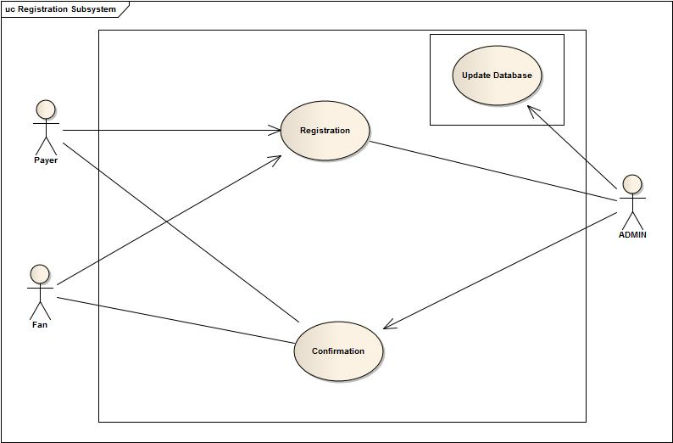
Use-Case Diagram of Registration

Slide 22
2.1 Registration
Use-Case name | Define route and price
Use-Case ID | 2.1
Priority | High
Primary Business Actor | ADMIN
Primary System Actor | PLR, FN
Description | PLR, FN register and request goes to ADMIN
Trigger | PLR, FN

Slide 23
Typical course of events
Actor Action | System Action
1. PLR, FN registers | 2. Request is sent to ADMIN
3. ADMIN receives request

Slide 24
Documentation of the use-case(2.1) course of events
Conclusion: Concludes when ADMIN receives request
Post-condition: Registration data is saved to system
Implementation issues: GUI will be provided to Player or fan for registration

Slide 25
2.2 Confirmation
Use-Case name | Define route and price
Use-Case ID | 2.2
Priority | High
Primary Business Actor | PLR, FN
Primary System Actor | ADMIN
Description | ADMIN confirms (accepts or rejects) registration
Trigger | ADMIN

Slide 26
Typical course of events
Actor Action | System Action
1. ADMIN confirms request | 2. Confirmation data is saved to system
 | 3. Confirmation is sent to requester

Slide 27
Documentation of the use-case(2.2) course of events
Conclusion: concludes when confirmation is sent to requester
Post-condition: registration phase ends

Slide 28
3. Social Interaction System
Use-Case ID | Name | Description | Participant Actors and Roles
3.1 | Login | Log into member account | FAN can log into personal account via internet
3.2 | Entertainment | Entertainment facilities for supporters | ADMIN may provide options for entertainment and FAN can use them
3.3 | Update website | Update website after winner selection | ADMIN will update website

Slide 29
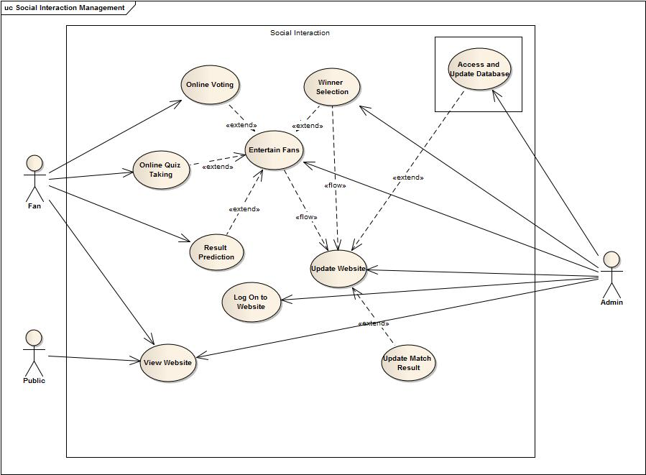
Use-Case Diagram of Social Interaction System

Slide 30
3.1 Login
Use-Case name | Define route and price
Use-Case ID | 3.1
Priority | High
Primary Business Actor | FAN
Primary System Actor | ADMIN, FAN
Description | FAN can log into their personal account
Trigger | ADMIN, FAN

Slide 31
Typical course of events
Actor Action | System Action
1. Attempt to log in to system from internet | 2. Verification and log in
 | 3. Show account to actor
4. Access entertainment section of website

Slide 32
Documentation of the use-case(3.1) course of events
Conclusion: concludes when logged into account
Post-condition: show actor the options he may participate
Implementation issues: GUI will be provided in the website to log in and for participation in different game or contest

Slide 33
3.2 Entertainment
Use-Case name | Define route and price
Use-Case ID | 3.2
Priority | High
Primary Business Actor | FAN
Primary System Actor | ADMIN
Description | ADMIN will provide different options for entertainment, FAN can be entertained
Trigger | ADMIN

Slide 34
Typical course of events
Actor Action | System Action
1. Participate in quiz, voting etc | 2. Update data for different contest
 | 3. Check time to stop game or contest
 | 4. Announce winner

Slide 35
Documentation of the use-case(3.2) course of events
Conclusion: concludes when winner of contest or game is announced
Post-condition: Update database and website to publish winner
Implementation issues: A section in website to publish winner’s info

Slide 36
3.3 Update Website
Use-Case name | Define route and price
Use-Case ID | 3.3
Priority | High
Primary Business Actor | PUBLIC
Primary System Actor | ADMIN
Description | ADMIN will update website
Trigger | ADMIN

Slide 37
Typical course of events
Actor Action | System Action
1. Update database after match-day, new fan member addition, winner of game selected | 2. Updates website from database

Slide 38
Documentation of the use-case(3.3) course of events
Conclusion: concludes when admin updates website
Implementation issues: GUI for admin to publish news in website

Slide 39
4. Team Management
Use-Case ID | Name | Description | Participant Actors and Roles
4.1 | Registration | Register team members in the transfer window and assign task to staff | MGR to register PLR and assign task to STF
4.2 | Squad selection | Selection of squad of 20 members before match-day | MGR,CH to select squad
4.3 | Evaluation | Accessing data of players and staff | MGR,CH,STF can access data of PLR, STF
4.4 | Schedule Management | Managing schedule for training and others | BRD, MGR,CH will determine schedule and PLR,STF will be informed

Slide 40
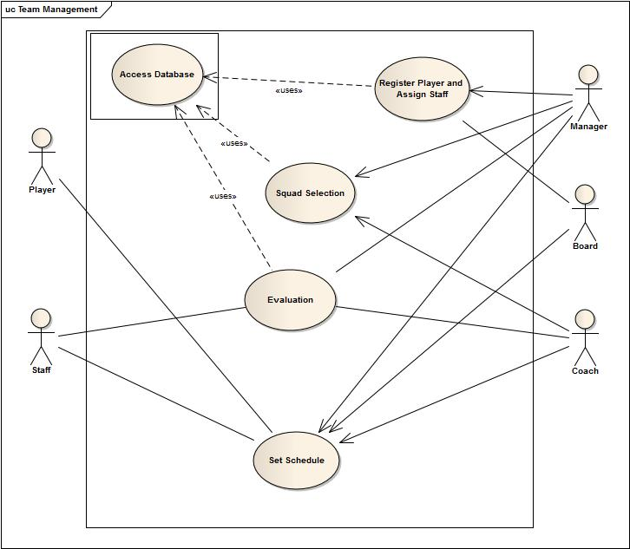
Use-Case Diagram of Team Management

Slide 41
4.1 Registration
Use-Case name | Define route and price
Use-Case ID | 4.1
Priority | High
Primary Business Actor | PLR
Primary System Actor | MGR
Description | MGR would complete registration process of PLR and assign task to STF
Trigger | MGR

Slide 42
Typical course of events
Actor Action | System Action
1. Registration form of a player is submitted | 2. Update database with the players info

Slide 43
Documentation of the use-case(4.1) course of events
Conclusion: concludes when database is updated with players’ info

Slide 44
4.2 Squad Selection
Use-Case name | Define route and price
Use-Case ID | 4.2
Priority | High
Primary Business Actor | PLR
Primary System Actor | MGR, CH
Description | MGR,CH select squad for next match
Trigger | MGR, CH

Slide 45
Typical course of events
Actor Action | System Action
1. Access Database and select players for next match | 2. Update database with selected squad

Slide 46
Documentation of the use-case(4.2) course of events
Conclusion: concludes when database is updated with selected players
Implementation issues: GUI for all players list and to select squad will be provided

Slide 47
4.3 Evaluation
Use-Case name | Define route and price
Use-Case ID | 4.3
Priority | High
Primary Business Actor | STF, PLR, CH
Primary System Actor | MGR, CH, BRD
Description | Retrieving data from database about players condition, progress and updating weekly evaluation
Trigger | MGR, CH, BRD

Slide 48
Typical course of events
Actor Action | System Action
1. Requests to view data about particular youth player | 2. System sends data about that player
3. Evaluate player according to performance and training | 4. System sends evaluation to players account

Slide 49
Documentation of the use-case(4.3) course of events
Conclusion: concludes when system sends information to players account
Implementation issues: GUI will be provided for weekly evaluation

Slide 50
4.4 Schedule Management
Use-Case name | Define route and price
Use-Case ID | 4.4
Priority | High
Primary Business Actor | CH, MGR, PLR, STF
Primary System Actor | PLR, STF
Description | MGR, CH manage schedule for PLR, STF
Trigger | BRD, PLR, MGR

Slide 51
Typical course of events
Actor Action | System Action
1. Update Schedule | 2. System notifies the change in actor’s account

Slide 52
Documentation of the use-case(4.4) course of events
Conclusion: concludes when system notifies changes in player account

Slide 53
5. Online Store Subsystem
Use-Case ID | Name | Description | Participant Actors and Roles
1.1 | Update Product | Updating product information: price, quantity etc. | WMGR and PMGR updates product information
1.2 | View Product | Shows available products in the online store | Buyers can view products in the store
1.3 | Product Booking | Booking for products, includes fancy club products and tickets | Buyers can book products or tickets
1.4 | Confirmation or cancelation | Confirmation or cancelation of booking | WMGR or PMGR confirms booking. After certain amount of time booking is cancelled.

Slide 54
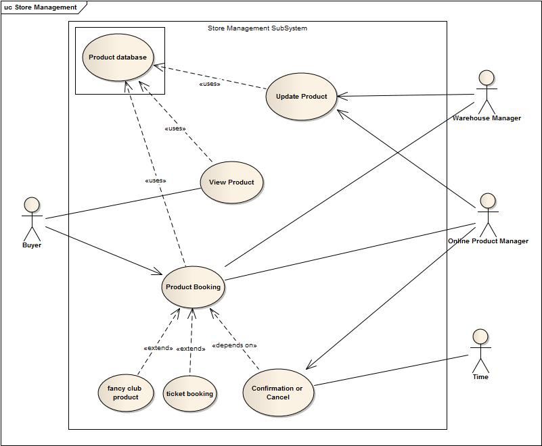
Use-Case Diagram of Online Store Subsystem

Slide 55
5.1 Update Product
Use-Case name | Define route and price
Use-Case ID | 5.1
Priority | High
Primary System Actor | WMGR, PMGR
Description | Actors can update information of products
Trigger | WMGR, PMGR

Slide 56
Typical course of events
Actor Action | System Action
1. Updates information of products | 2. Stores information in product database

Slide 57
Documentation of the use-case(5.1) course of events
Conclusion: concludes when product information is updated
Post-condition: Shows updated information in the View Product
Implementation issues: GUI will be provided to update information of products

Slide 58
5.2 View Product
Use-Case name | Define route and price
Use-Case ID | 5.2
Priority | High
Primary Business Actor | BYR
Primary System Actor | BYR
Description | BYR can view available products and tickets from store
Trigger | BYR

Slide 59
Typical course of events
Actor Action | System Action
1. BYR requests to view product in the online store | 2. Shows available products form product database

Slide 60
Documentation of the use-case(5.2) course of events
Conclusion: concludes when a buyer books products or leaves the store
Post-condition: If buyer books a product, then information is sent to Product Manager and Warehouse Manager
Implementation issues: GUI of online store will be provided

Slide 61
5.3 Product Booking
Use-Case name | Define route and price
Use-Case ID | 5.3
Priority | High
Primary Business Actor | BYR
Primary System Actor | BYR, PMGR, WMGR
Description | BYR can book products or tickets online
Trigger | TME, BRD, MGR, CH

Slide 62
Typical course of events
Actor Action | System Action
1. Views and books product or ticket | 2. Sends information to PMGR, WMGR about booking
 | 3. Confirms buyer about the booking status.

Slide 63
Documentation of the use-case(5.3) course of events
Conclusion: concludes when system confirms about booking
Post-condition: send information to PMGR and WMGR

Slide 64
5.4 Confirmation
Use-Case name | Define route and price
Use-Case ID | 5.4
Priority | High
Primary Business Actor | BYR
Primary System Actor | PMGR, TIME
Description | PMGR confirms about booking. After certain amount of time booking is cancelled and notified
Trigger | PMGR, TIME

Slide 65
Typical course of events
Actor Action | System Action
 | 1. Checks availability and confirms and notifies PMGR
2. PMGR accepts confirmation | 3. Sends confirmation to buyer
4. Cancels booking if time is over(optional) | 5. Notifies buyer that booking is cancelled(optional)

Slide 66
Documentation of the use-case(5.4) course of events
Conclusion: concludes when booking product is bought or booking is cancelled
Post-condition: Notify buyer about booking confirmation/cancelation

