Slide 1
Sports Club Automation System
Group: 1
1005001
1005004
1005005
1005007
1005010
ISD Project
CSE A1

Slide 2
Topics
ER Diagram
Triggers
Procedures

Slide 3
ER Diagrams

Slide 4
ERD for Employee & Schedule
Club
Has
Committee
Has
Hires
Contract
Has
Employee
ISA
Has
Player
Coach
Staff
Manager
Committee
Member
Coaches
sets
Plays For
Team
Serves
Schedule
Player
Statistics
Forms

Slide 5
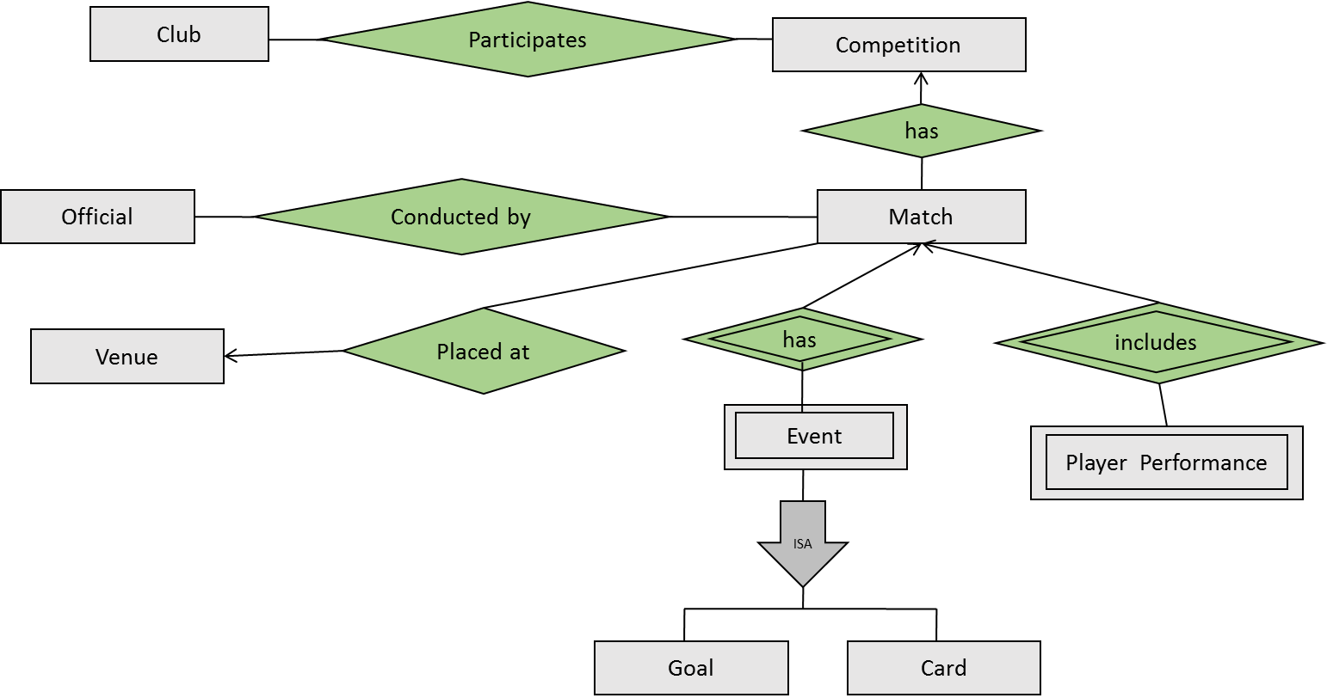
ERD for Match

Slide 6
ERD for Communication
sends
Message
User
makes
Complain

Slide 7
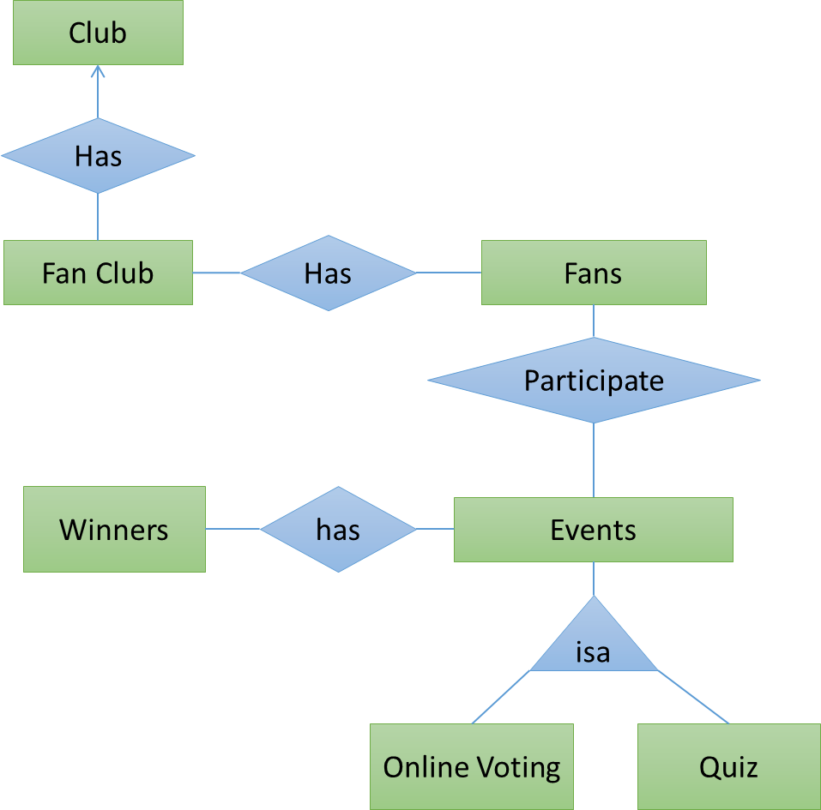
ERD for Fan Club

Slide 8
ERD for Product Booking
Makes
Contains
User
Booking
Item
has
User Account
ISA
Buyer Account
Employee Account
Manages

Slide 9
Schema

Slide 10
Match Information Database
Club
ClubID | char(10)
Name | varchar(50)
Venue | varchar(50)
Competition
CompetitionID | char(10)
Name | varchar(50)
Type | varchar(50)
Participates
ClubID | char(10)
CompetitionID | char(10)
Position | num(2)
Year | char(4)

Slide 11
Match
MatchID | char(10)
CompetitionID (fk) | char(10)
Date | date
Round | varchar(20)
Score | varchar(6)
Opponent ID (fk) | char(10)
Official
OfficialID | char(10)
Name | varchar(50)
Age | number(2)
Nationality | varchar(15)
Conducted_by
MatchID | char(10)
OfficialID | char(10)
Role | varchar(20)

Slide 12
Triggers

Slide 13
Enforce Deletion
Trigger Name | DELETE_PLAYER_INFO
Time of Execution | AFTER DELETE on PLAYER
Actions |  |  | Remarks
Commands | Attributes | Tables
DELETE | Player ID, Goal, Card, Match Played | Player Statistics | Delete the entire row associated with the player in the player statistics table

Slide 14
Update Attribute
Trigger Name | UPDATE_BOOKING
Time of Execution | AFTER UPDATE on BOOKING
Actions |  |  | Remarks
Commands | Attributes | Tables
UPDATE | END_DATE | BOOKING | Set END_DATE=DATE+ BOOKING_PERIOD in the BOOKING Table.

Slide 15
Prevent Change
Trigger Name | UPDATE_SCHEDULE
Time of Execution | BEFORE UPDATE on SCHEDULE
Actions |  |  | Remarks
Commands | Attributes | Tables
UPDATE | Time | SCHEDULE | Prevent update if there is a conflicting schedule and redirect to the conflicting row to enforce user to change it or keep both unchanged

Slide 16
Procedures

Slide 17
Listing of Members
Procedure Name | List_Member
Time of Execution | A member executes this function when he wants to send a message, notification or complain from his account
Input
Output | Member_list
Apply on | Member, SendMessageUI
Actions | Remarks
Select members from Member_list shown in user interface fetched from Member | First, user selects member from MEMBER, then he writes message in SendMessageUI and sends

Slide 18
Account Login
Procedure Name | Login_Account
Time of Execution | This function is executed when a person wants to sign in to account
Input | UserID, Password
Output | Member Account
Apply on | LoginUI
Actions | Remarks
Members enters UserID and Password in LoginUI | First, user enters UserID and Password and then system logs into his account if information is correct

Slide 19
Listing of Events
Procedure Name | List_Event
Time of Execution | Admin executes this function when an event is to be initiated
Input
Output | Event_list
Apply on | EntertainUI, EntertainmentStuff
Actions | Remarks
Admin selects event from Event_list shown in EntertainUI fetched from EntertainmentStuff | First, Admin enters in the user interface and then gets the Event_list and then he selects and initiates it

Slide 20
Thank You

Slide 21
Enforce Insertion
Trigger Name | INSERT_PLAYER_INFO
Time of Execution | AFTER INSERT on PLAYER
Actions |  |  | Remarks
Commands | Attributes | Tables
INSERT | Player ID, Goal, Card, Match Played | Player Statistics | Insert a row with attribute value ‘null’ associated with the player in the player statistics table

Slide 22
Enforce Deletion
Trigger Name | DELETE_EVENT_INFO
Time of Execution | AFTER DELETE on MATCH
Actions |  |  | Remarks
Commands | Attributes | Tables
DELETE | Time, Goal Scorer ID, Goal Scorer Name, Assist Player ID, Player Name, Player Id, Card type | GOAL, CARD | Delete the entire row associated with the player in the GOAL and CARD table

Slide 23
Enforce Insertion
Trigger Name | INSERT_EVENT_INFO
Time of Execution | AFTER INSERT on MATCH
Actions |  |  | Remarks
Commands | Attributes | Tables
INSERT | Time, Goal Scorer ID, Goal Scorer Name, Assist Player ID, Player Name, Player Id, Card type | GOAL, CARD | Insert a row with attribute value ‘null’ associated with the player in the GOAL, CARD table

Slide 24
Enforce Deletion
Trigger Name | DELETE_PLAYER_PERFORMANCE_INFO
Time of Execution | AFTER DELETE on MATCH
Actions |  |  | Remarks
Commands | Attributes | Tables
DELETE | Player ID, Goal, Card, Minutes Played, Total Pass, Assists | Player Performance | Delete the entire row associated with the player in the player performance table

Slide 25
Enforce Insertion
Trigger Name | INSERT_PLAYER_PERFORMANCE_INFO
Time of Execution | AFTER INSERT on MATCH
Actions |  |  | Remarks
Commands | Attributes | Tables
INSERT | Player ID, Goal, Card, Minutes Played, Total Pass, Assists | Player Performance | Insert a row with attribute value ‘null’ associated with the player in the Player Performance table

Slide 26
Listing of Players
Procedure Name | List_Player
Time of Execution | Manager executes this function when he selects players for squad
Input | AuthorizedID
Output | Player_list
Apply on | Player, SquadSelectionUI
Actions | Remarks
Manager selects player from Player_list shown in SquadSelectionUI fetched from Player | First, manager selects player from Player_list, then he selects players and adds to squad for a match

Slide 27
Listing of Products
Procedure Name | List_Product
Time of Execution | User or admin executes this function when he needs to see the products or update information
Input | AuthorizedID
Output | Product_list
Apply on | Product, ProductBookUI, UpdateProductUI
Actions | Remarks
User or admin select products from Product_list shown in interface fetched from Product | First, user or admin selects product from Product_list, then he selects product for booking or updating

Slide 28
Registration
Procedure Name | Register_Application
Time of Execution | When a player or fan applies for membership, this function is executed
Input | Application request
Output | Application_form
Apply on | RegistrationUI, ApplicationData
Actions | Remarks
Requests for application form in RegistrationUI | Player or fan enters information in the form and then it is sent to ApplicationData and saved

Slide 29
Listing of Applied Applications
Procedure Name | Application_verification
Time of Execution | This function is executed when admin verifies the applied members
Input | AuthorizedID
Output | Applied_list
Apply on | RegistrationUI, ApplicationData
Actions | Remarks
Admin select applied members from Applied_list fetched from ApplicationData | First, admin selects applied members and then confirms membership or rejects

Slide 30
Listing of Schedule
Procedure Name | Schedule_list
Time of Execution | This function is executed when a member wants to see schedule or authorized person wants to update it
Input | AuthorizedID
Output | Schedule_list
Apply on | ScheduleData, ScheduleManagementUI
Actions | Remarks
A member can view Schedule_list in user interface fetched from ScheduleData. | First, view request is performed by a member and Schedule_list is shown. An authorized person can change the schedule.

Slide 31
Player Performance
MatchID | char(10)
PlayerID (fk) | char(10)
Goals | number(2)
Assists | number(2)
Minutes | number(3)
Passes | number(4)
Card | char(5)
Venue
Venue ID | char(10)
Club ID (fk) | char(10)
Name | varchar(30)
Location | varchar(50)
Capacity | number(7)

Slide 32
Event
EventID | char(10)
MatchID | char(10)
Time | number(3)
Goal
EventID | char(10)
GoalScoredID | char(10)
AssistPlayerID | char(10)
ScorerName | varchar(30)
AssistName | varchar(30)
Card
EventID | char(10)
PlayerID | char(10)
PlayerName | varchar(30)
CardType | varchar(30)

Slide 33
Employee Database
Club
ClubID | char(10)
Name | varchar(30)
Venue | varchar(30)
Employee
EmployeeID | char(10)
Name | varchar(30)
Age | number(3)
Gender | char(6)
Contact | char(15)
Nationality | varchar(30)
Address | varchar(50)
Committee
CommitteeID | char(10)
Name | varchar(30)
ClubID (fk) | char(10)

Slide 34
Player
EmployeeID | char(10)
Position | varchar(20)
jersey | varchar(2)
Staff
EmployeeID | char(10)
Designation | varchar(30)
Coach
EmployeeID | char(10)
Designation | varchar(30)
Committee Memebr
EmployeeID | char(10)
Designation | varchar(30)

Slide 35
Team
TeamID | char(10)
Name | varchar(30)
Type | varchar(30)
Contract
EmployeeID | char(10)
ContractID | char(10)
StartDate | varchar(30)
EndDate | varchar(30)
Salary | number(7)
Player Statstics
PlayerID | char(10)
MatchPlayed | varchar(30)
Goals | number(4)
Assists | number(4)
YellowCard | number(4)
RedCards | number(4)
Schedule
ScheduleID | char(10)
StartTime | varchar(30)
EndTime | varchar(30)
Task | varchar(30)

Slide 36
Communication Database
User
UserID | char(10)
Password | varchar(30)
Message
MessageID | char(10)
Content | varchar(30)
ReciepentID (fk) | char(10)
Time | varchar(30)
Complain
ComplainID | char(10)
Content | varchar(30)
ReciepentID (fk) | char(10)
Time | varchar(30)

Slide 37
Fan Club
Fan
FanID | char(10)
Name | varchar(30)
Address | varchar(50)
Contact | varchar(15)
Fan Club
FanClubID | char(10)
Name | varchar(30)
Location | varchar(50)

Slide 38
Event
EventID | char(10)
StartTime | varchar(10)
EndTime | varchar(10)
Participate
FanID | char(10)
EventID | char(10)
Response | varchar(100)
Online Voting
Quiz
Winner
EventID | char(10)
FanID | char(10)
Rank | number(2)

Slide 39
Account
EmailID | varchar(50)
UserID(fk) | char(10)
Name | varchar(100)
Gender | Char(1)
ContactNo | varchar(15)
Address | HouseNo | varchar(10)
 | District | varchar(20)
 | PoliceStation | varchar(20)
 | PostOffice | varchar(20)
 | Country | varchar(20)

Slide 40
Booking
BookingID | char(10)
Date | DATE
End_Date | DATE
BuyStatus | Integer
Price | Float
Discount | Float
Item
ItemID | char(10)
ItemName | Varchar(20)
Price | Float
ArrivalDate | Date

Slide 41
EmployeeAccount
EmployeeID | char(10)
EmployeeType | varchar(10)
EmployeeSalary | Float
Manages
EmployeeID(FK) | char(10)
ItemID(FK) | char(20)
Contains
OrderID(FK) | char(10)
ItemID(FK) | char(10)

