Slide 1
Sports Club Automation System
Group: 1
1005001
1005004
1005005
1005007
1005010
ISD Project
CSE A1

Slide 2
Topics
User Interface Design

Slide 3
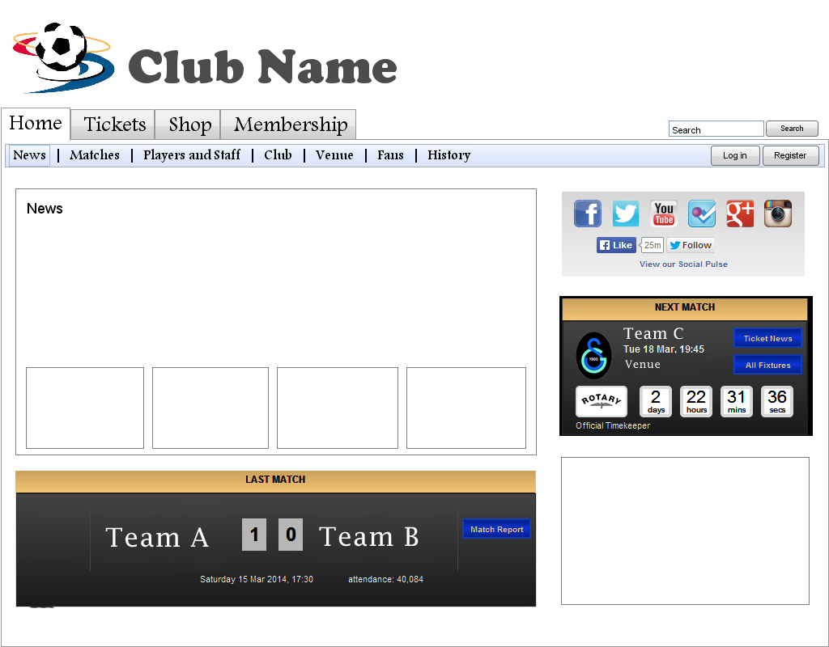
Home Page

Slide 4
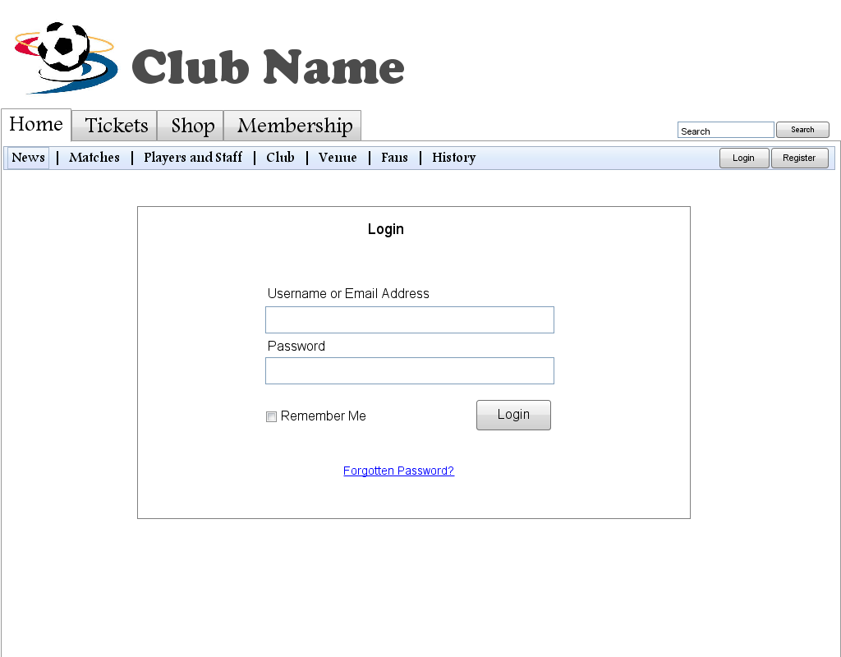
Login

Slide 5
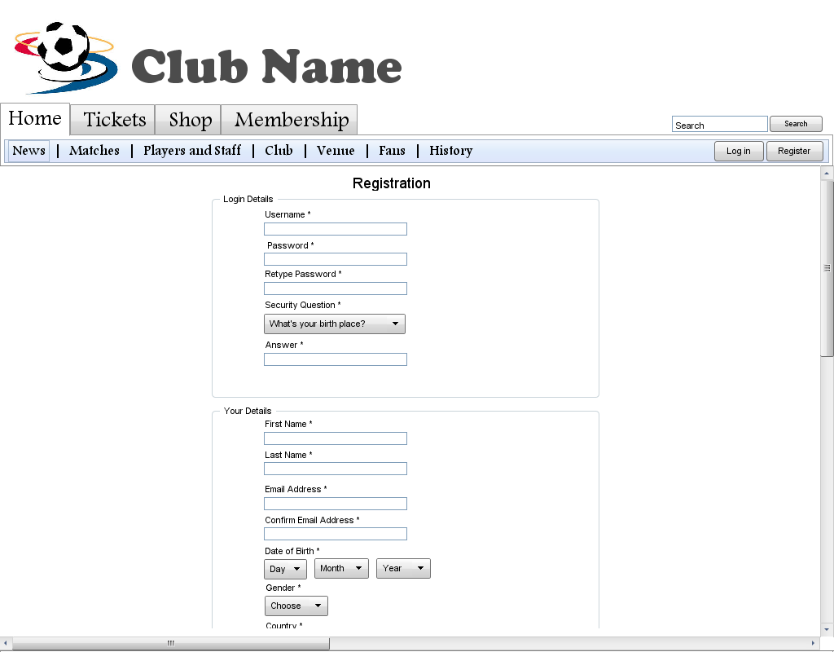
Registration

Slide 6
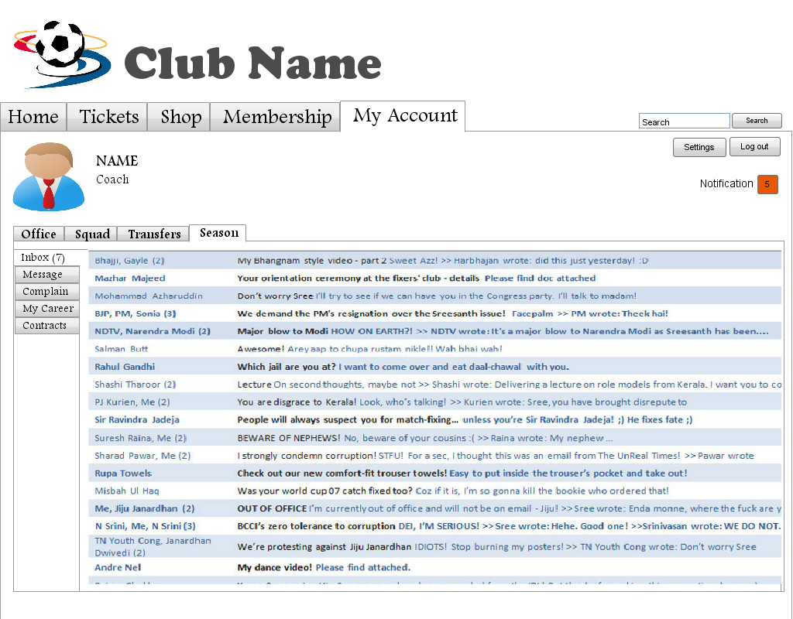
Coach Profile - Inbox

Slide 7
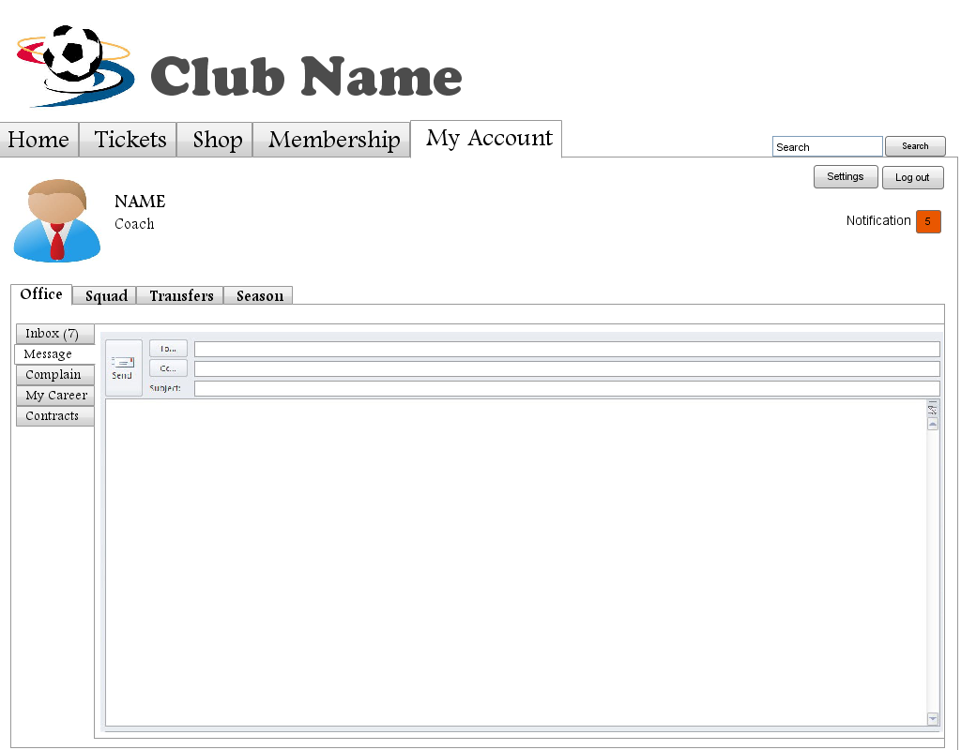
Coach Profile – New Message

Slide 8
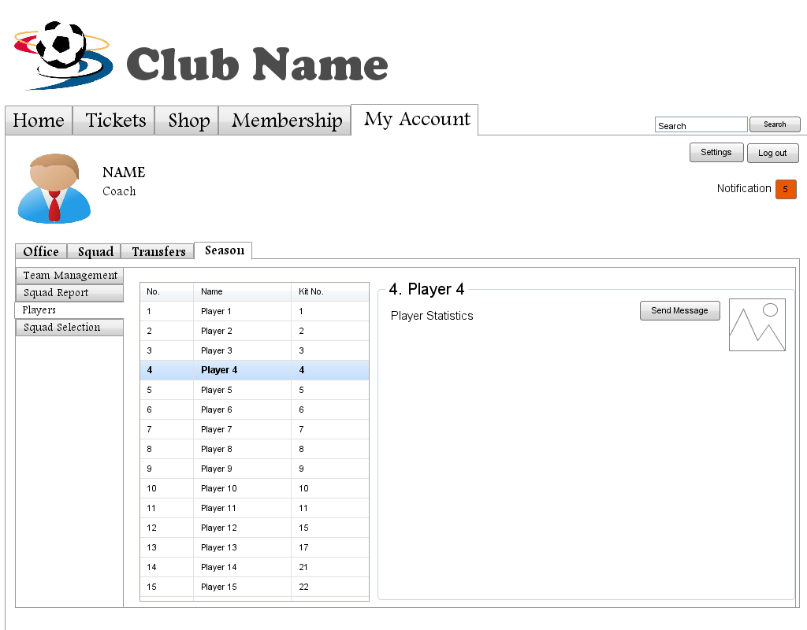
Coach Profile – Players’ Statistics

Slide 9
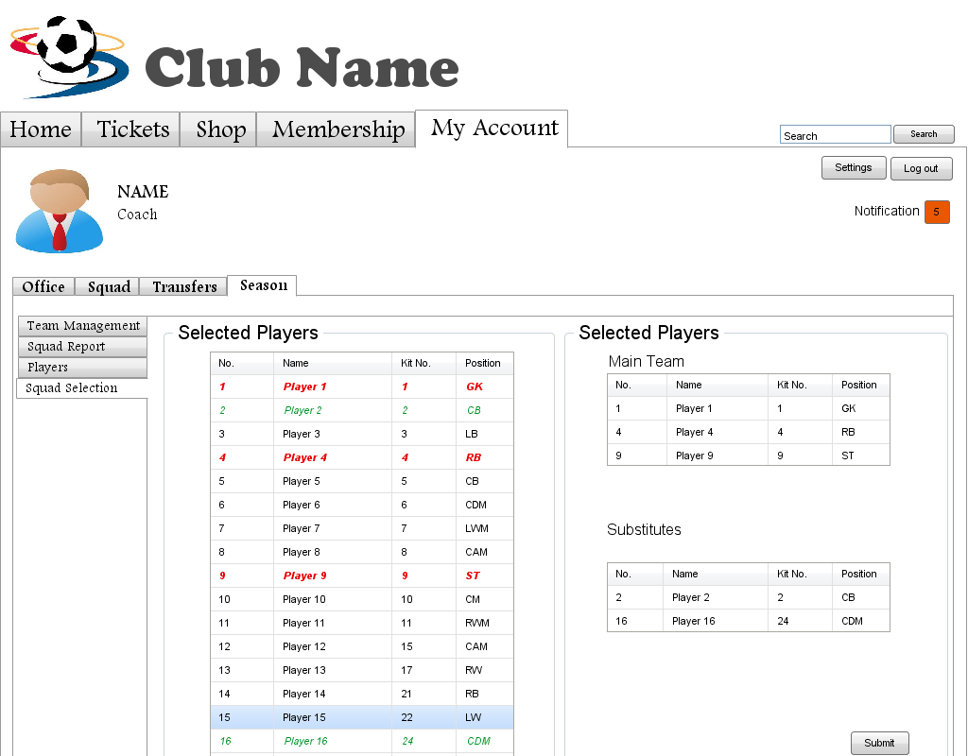
Coach Profile – Squad Selection

Slide 10
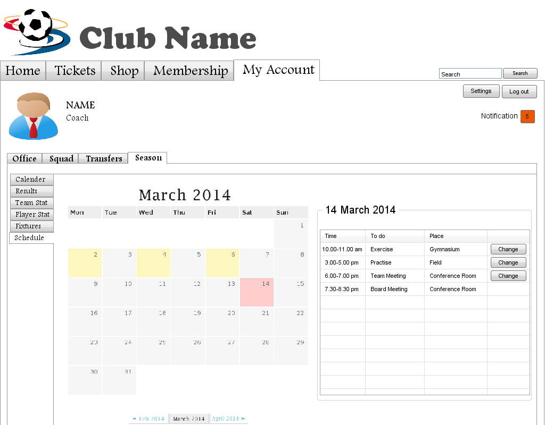
Coach Profile – Schedule Management

Slide 11
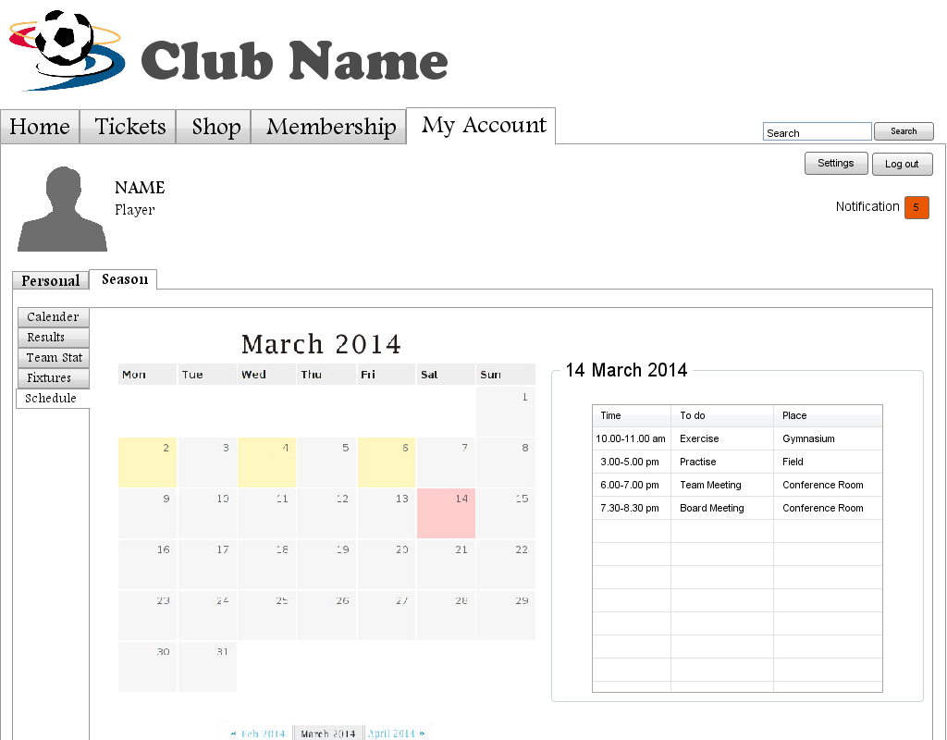
Player Profile - Schedule

Slide 12
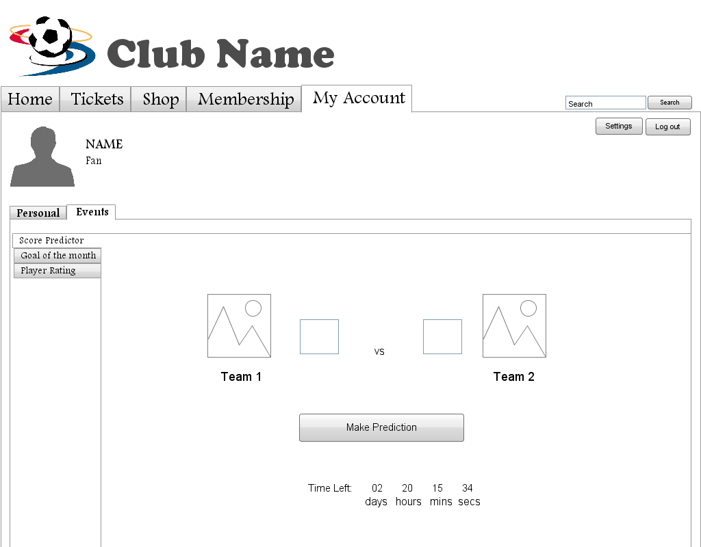
Fan Profile – Score Prediction

Slide 13
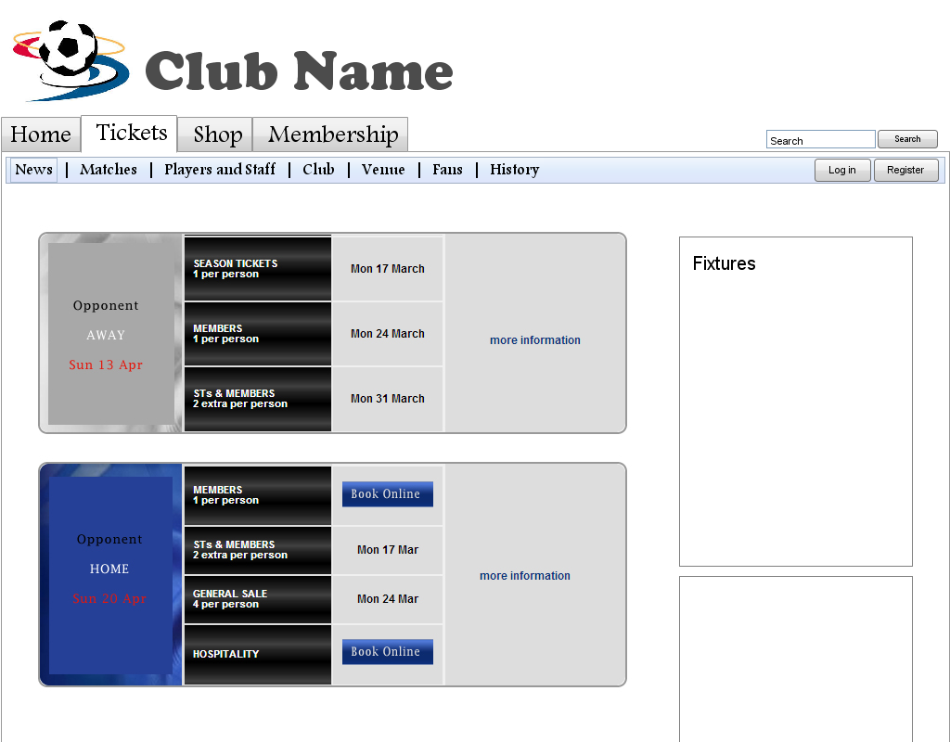
Tickets

Slide 14
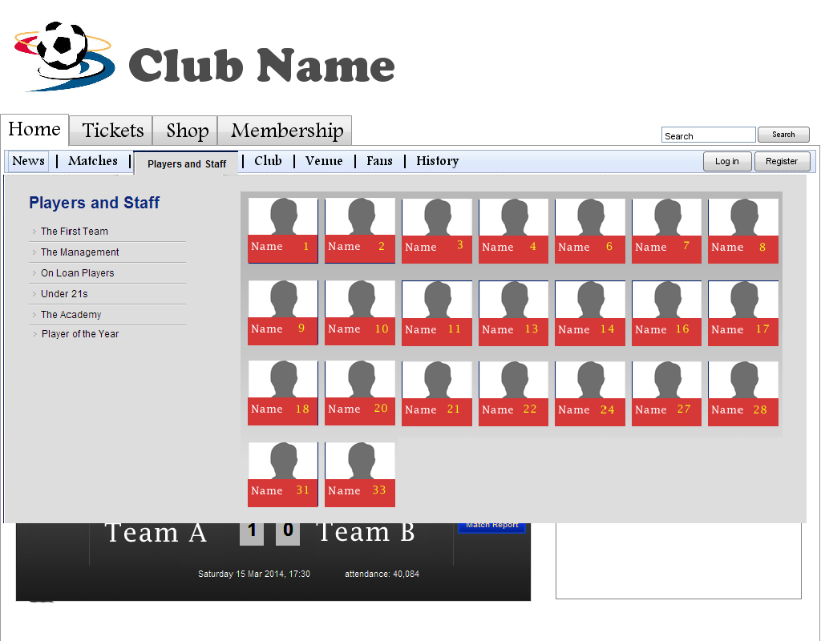
Player and Stuffs

Slide 15
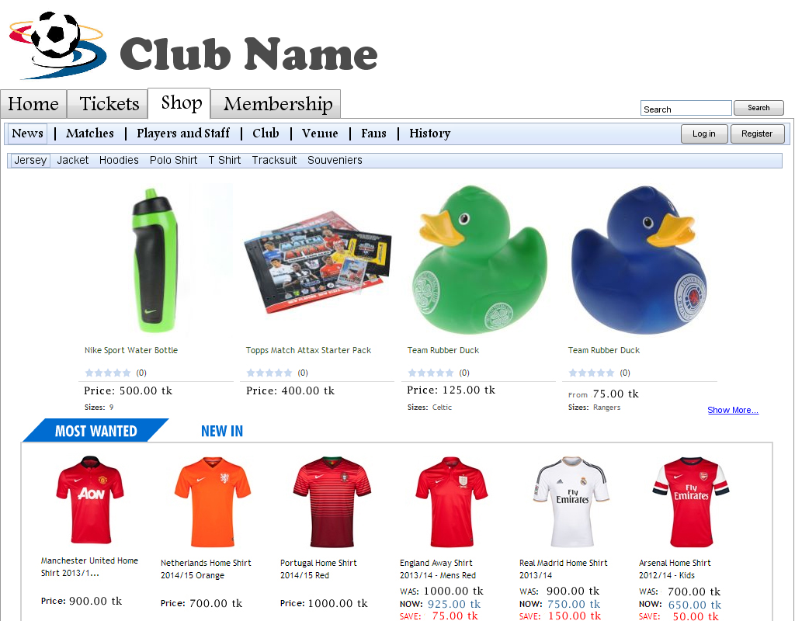
Online Store

Slide 16
Thank You

