Slide 1
Data Understanding & Data Preparation
How
Indexing of data by date and Coin name
Grouping data by coin name
What have we understood from data
Time series stationarity
Time series Seasonality or periodic trend
Top/Worst performer coins
Different features and their importance
Whether features are independent or dependent(derived)
Most volatile coin
Dead coins

Slide 2
Some stats about our dataset
Size – 69.4 MB
Total Objects – 702166
Unique Coins – 1514
Dead Coins – 300. #wrong
Most Influential Coin – Bitcoin

Slide 3
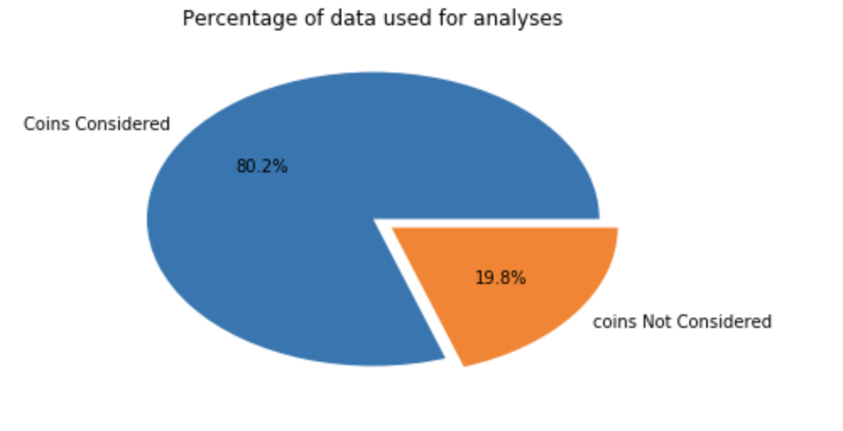
Data considered for analyses
19.8% of coins were having market value 0. Coin without market value is invaluable for us, so we have removed them from our analyses dataset.

Slide 4
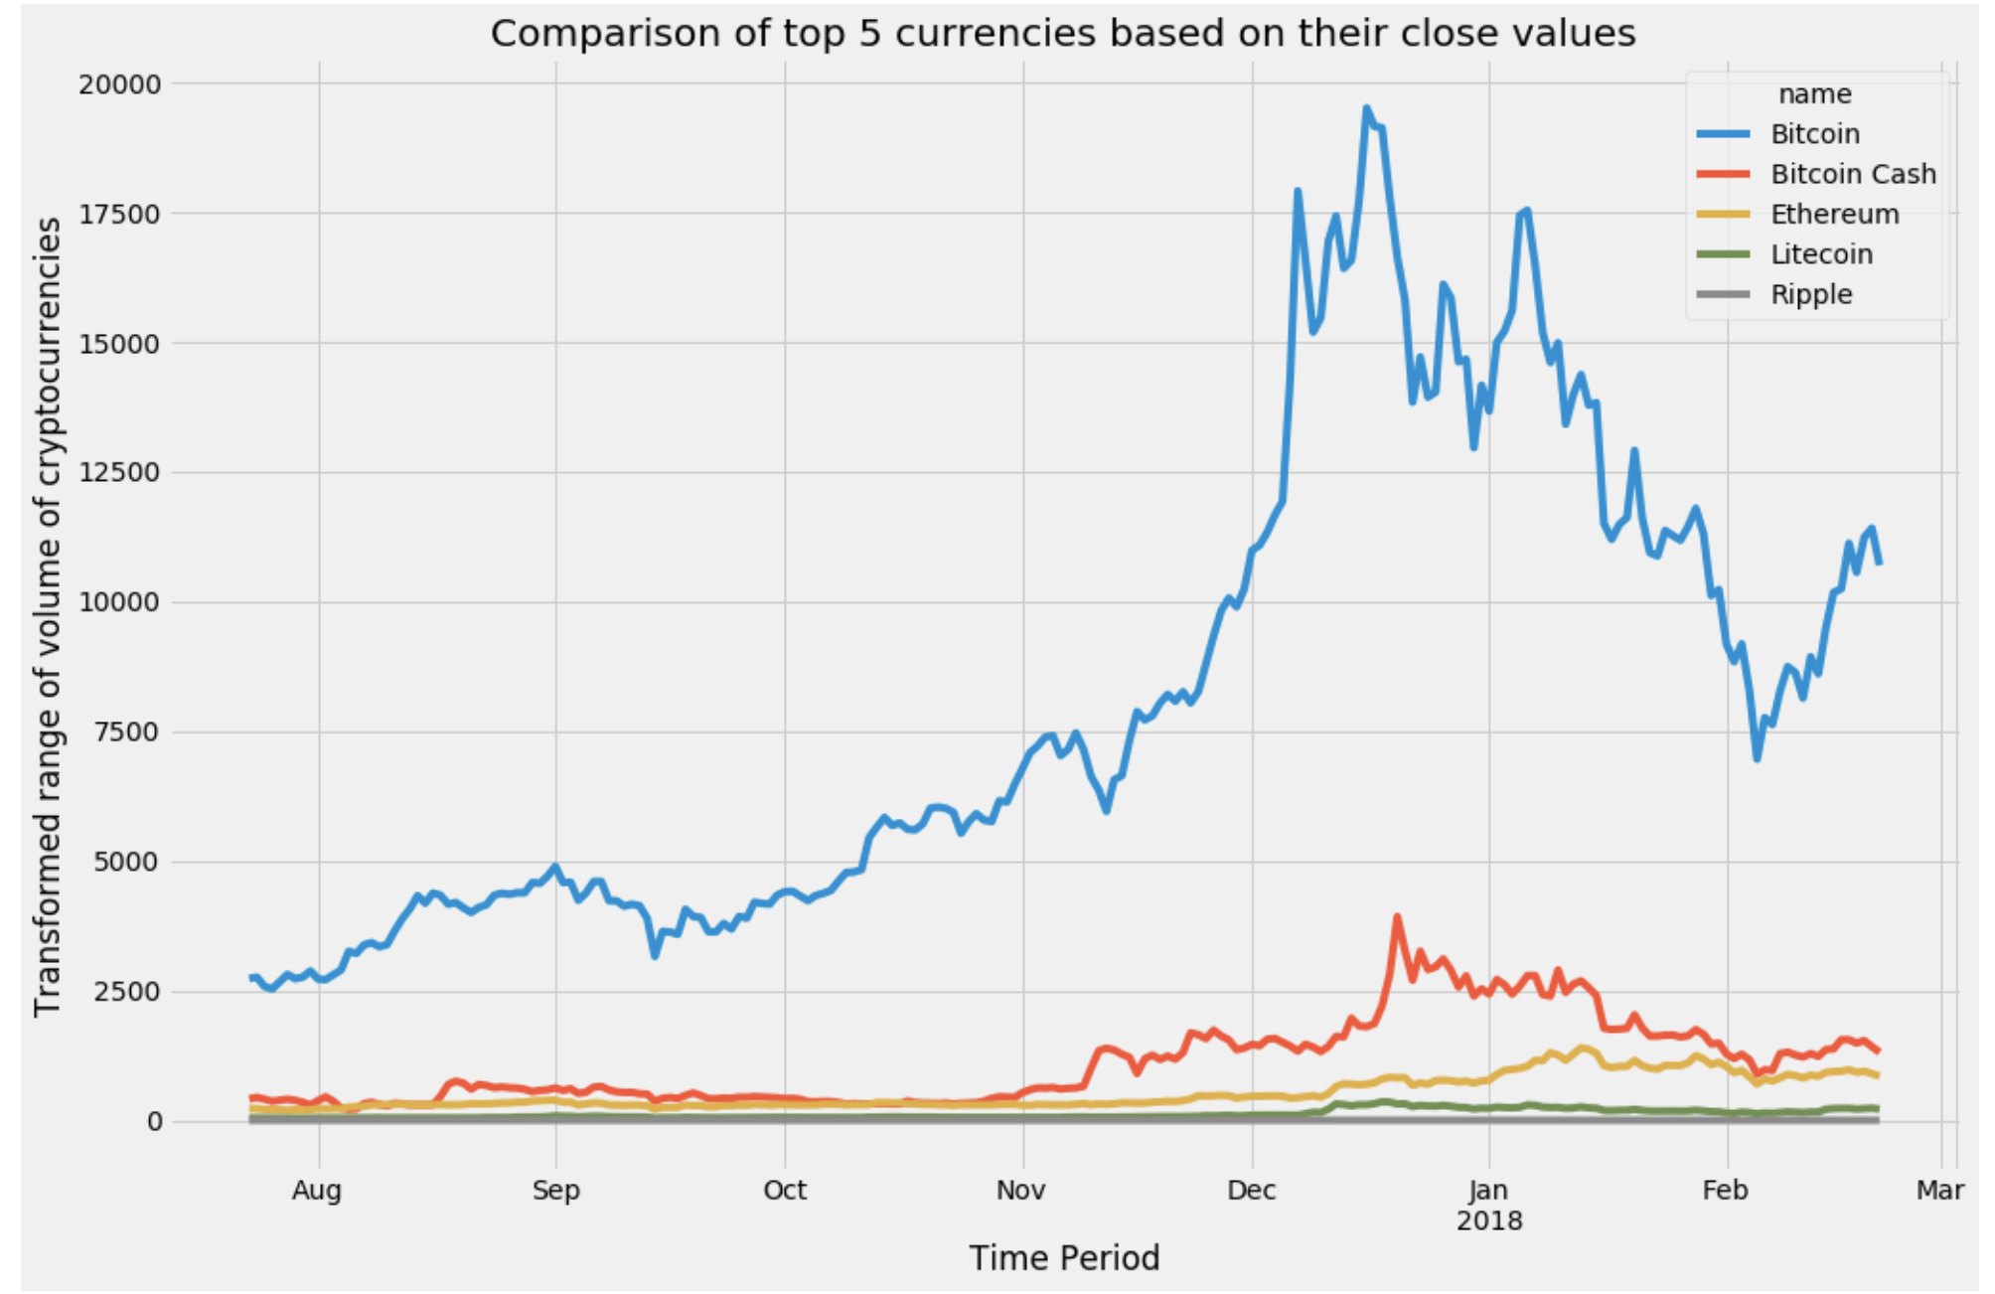
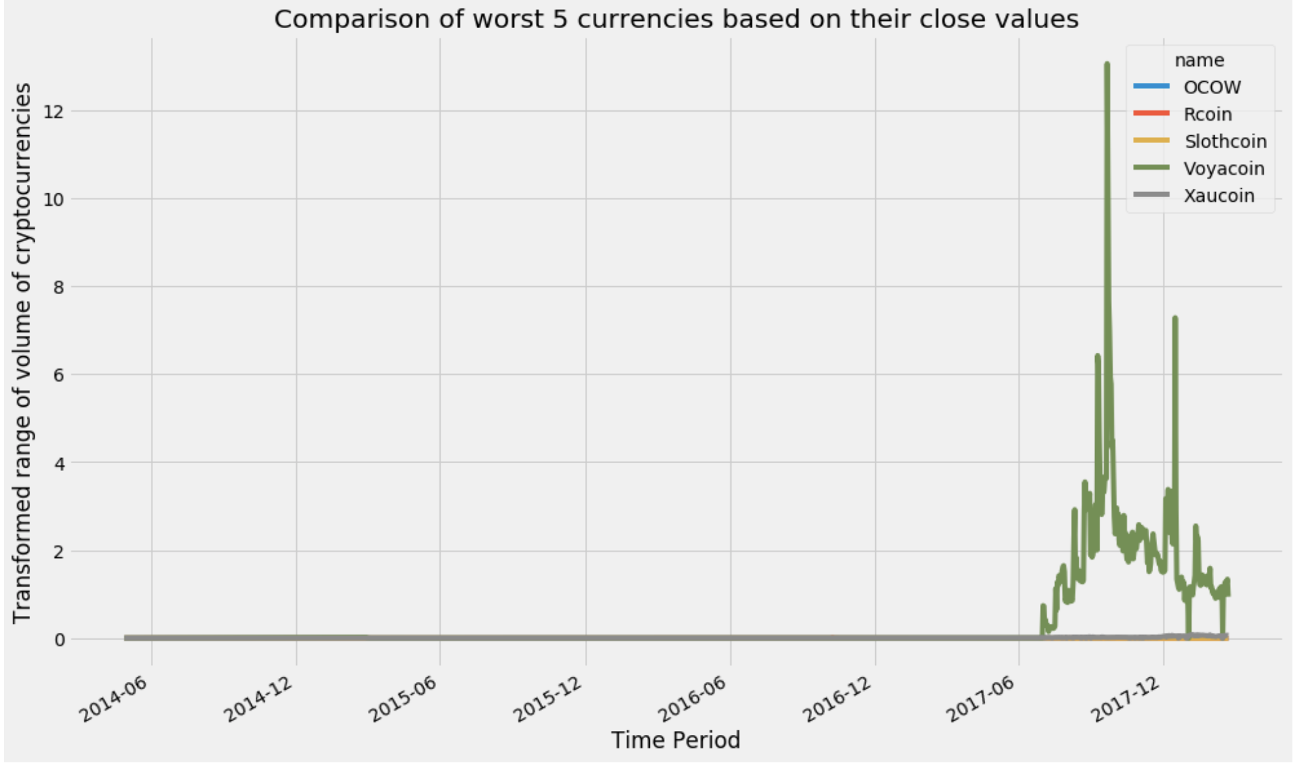
Top &Worst 5 valuable coins close price trend Evaluated on the basis of Market cap value

Slide 5
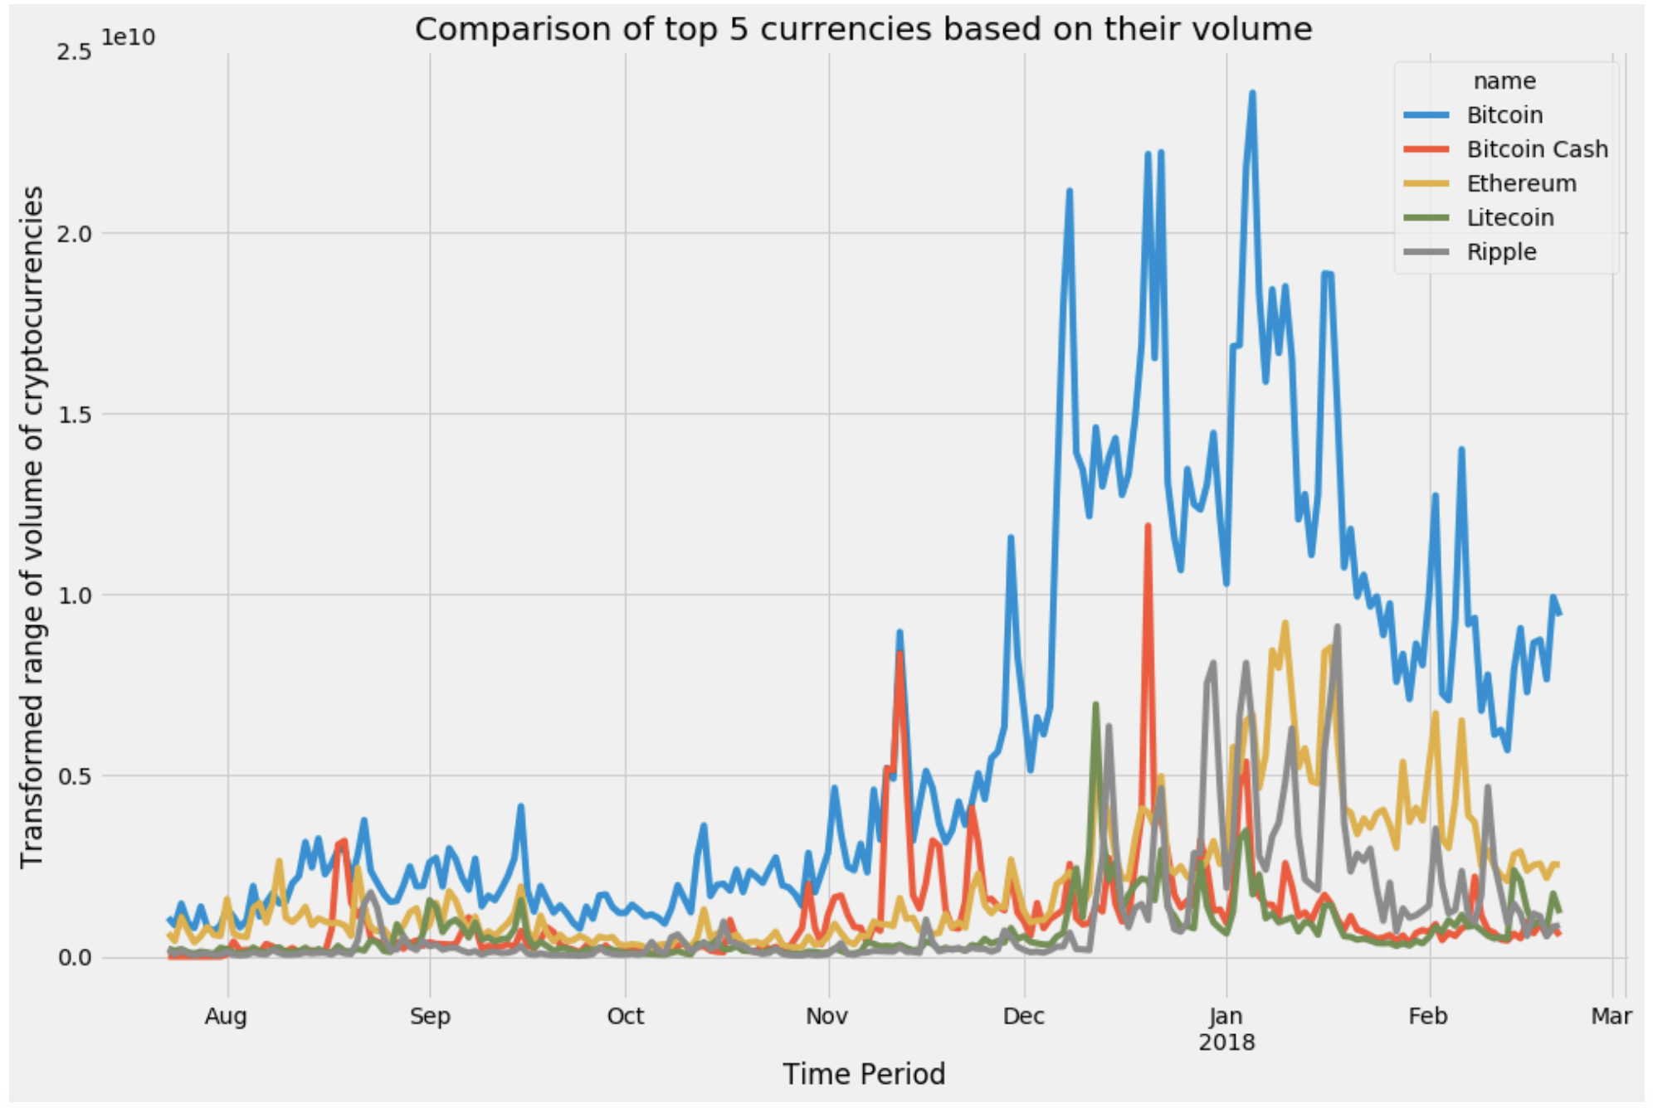
Coins in which people prefer to use Based on the number of transactions per day

Slide 6
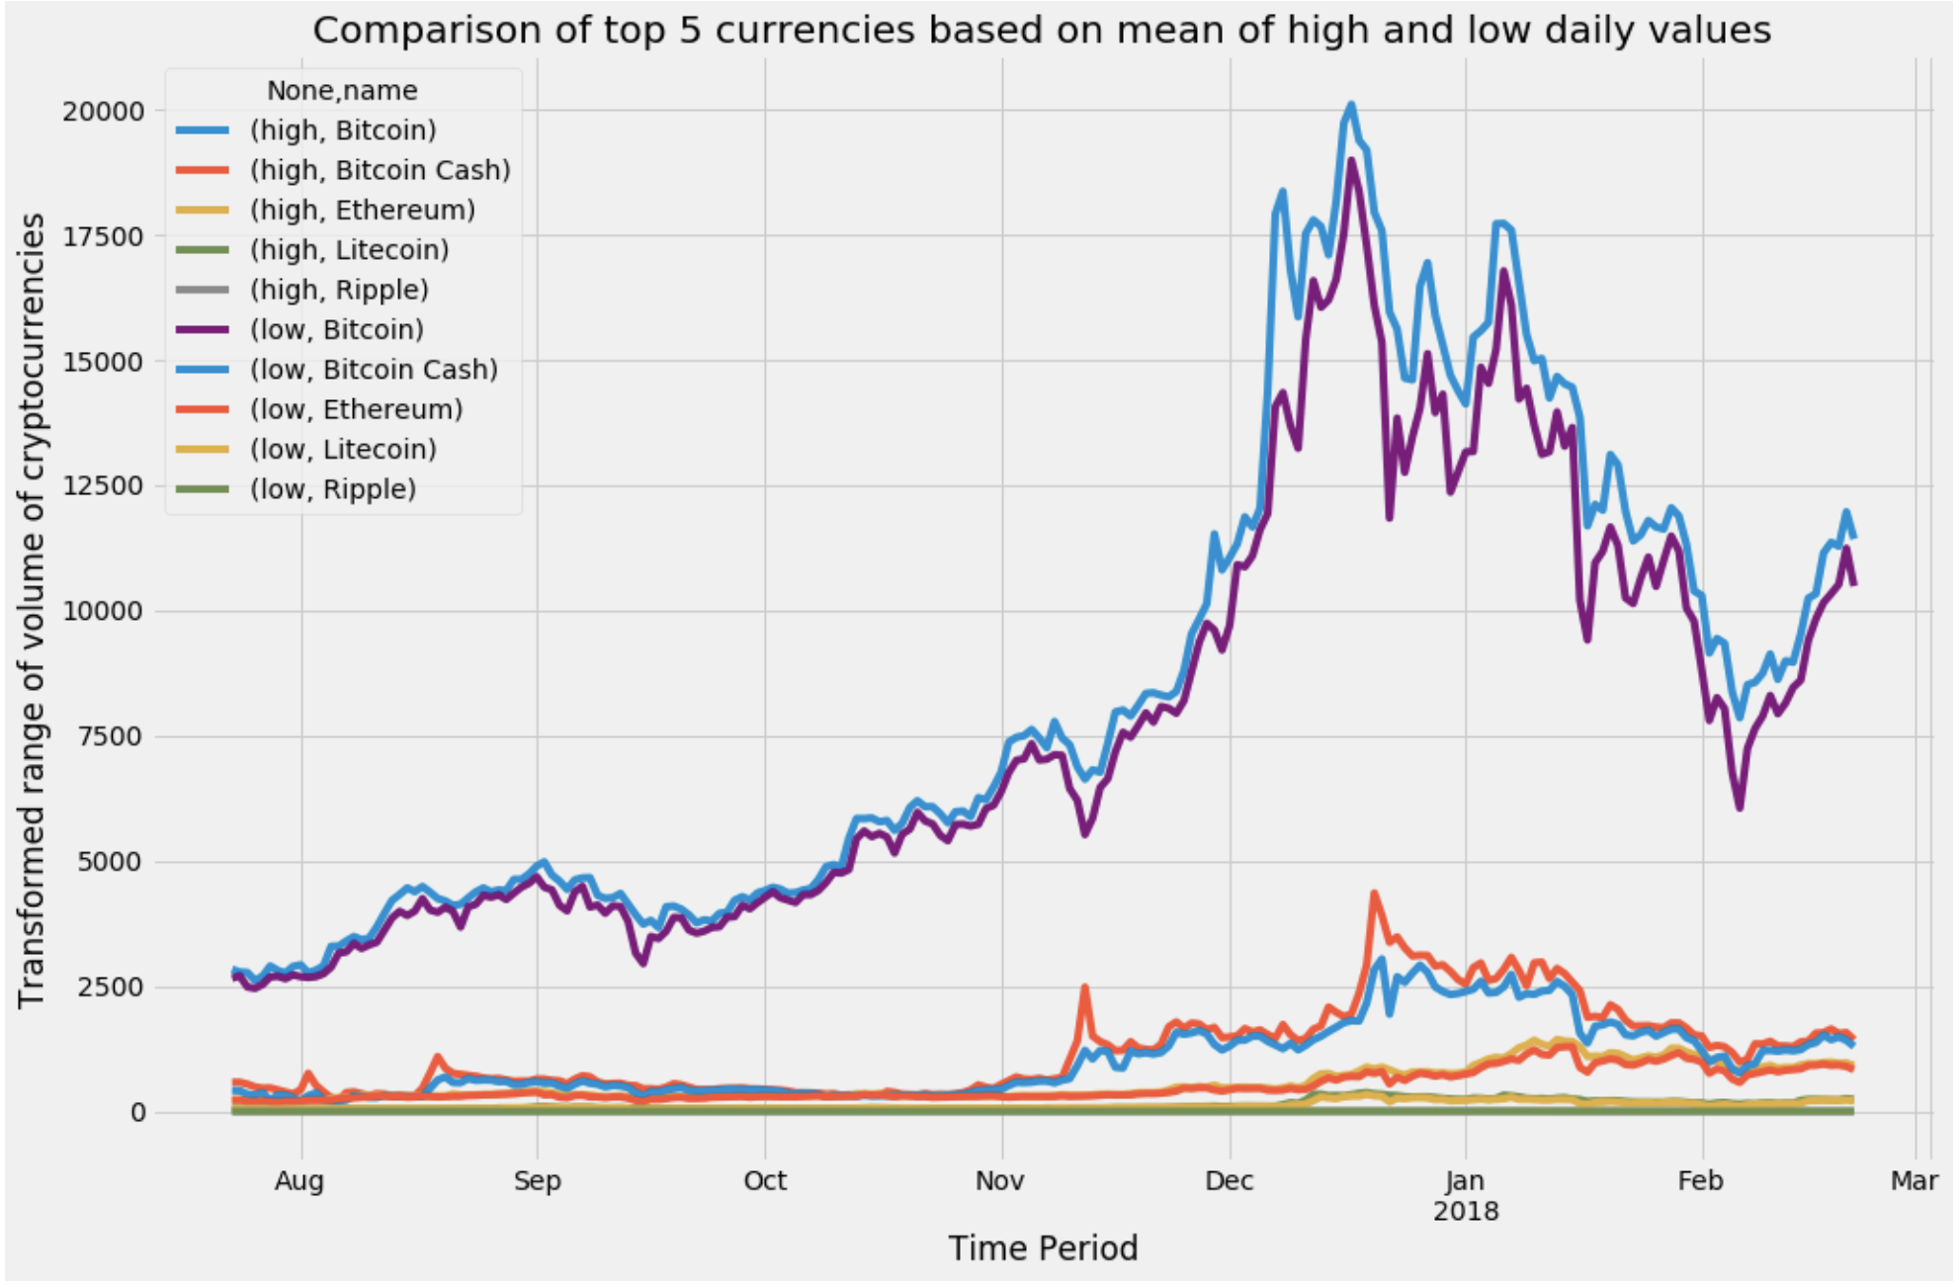
Volatility of top 5 coins
Gap between high and low represents volatility

Slide 7
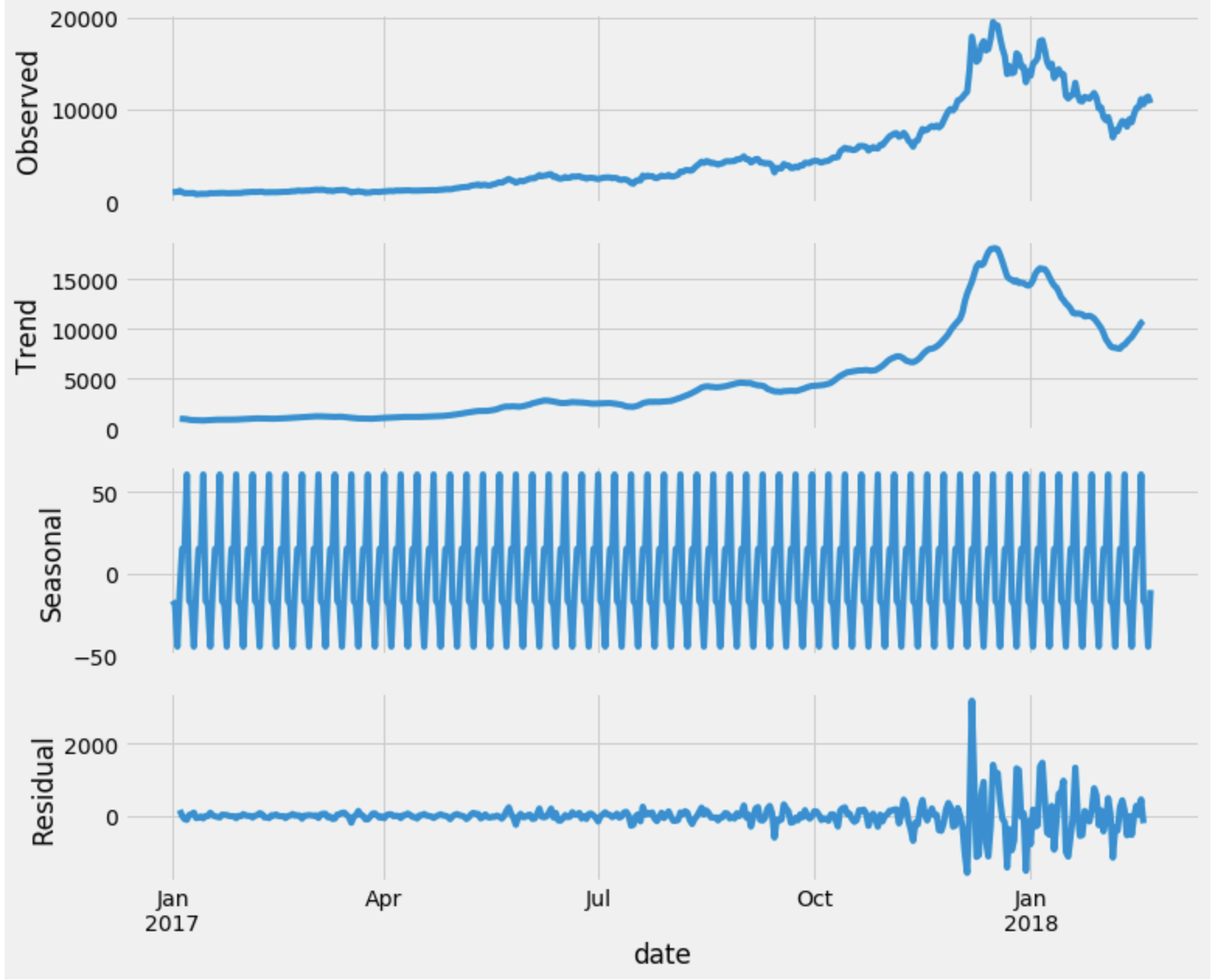
Seasonality
of
time series
Which is having
price information
only

Slide 8
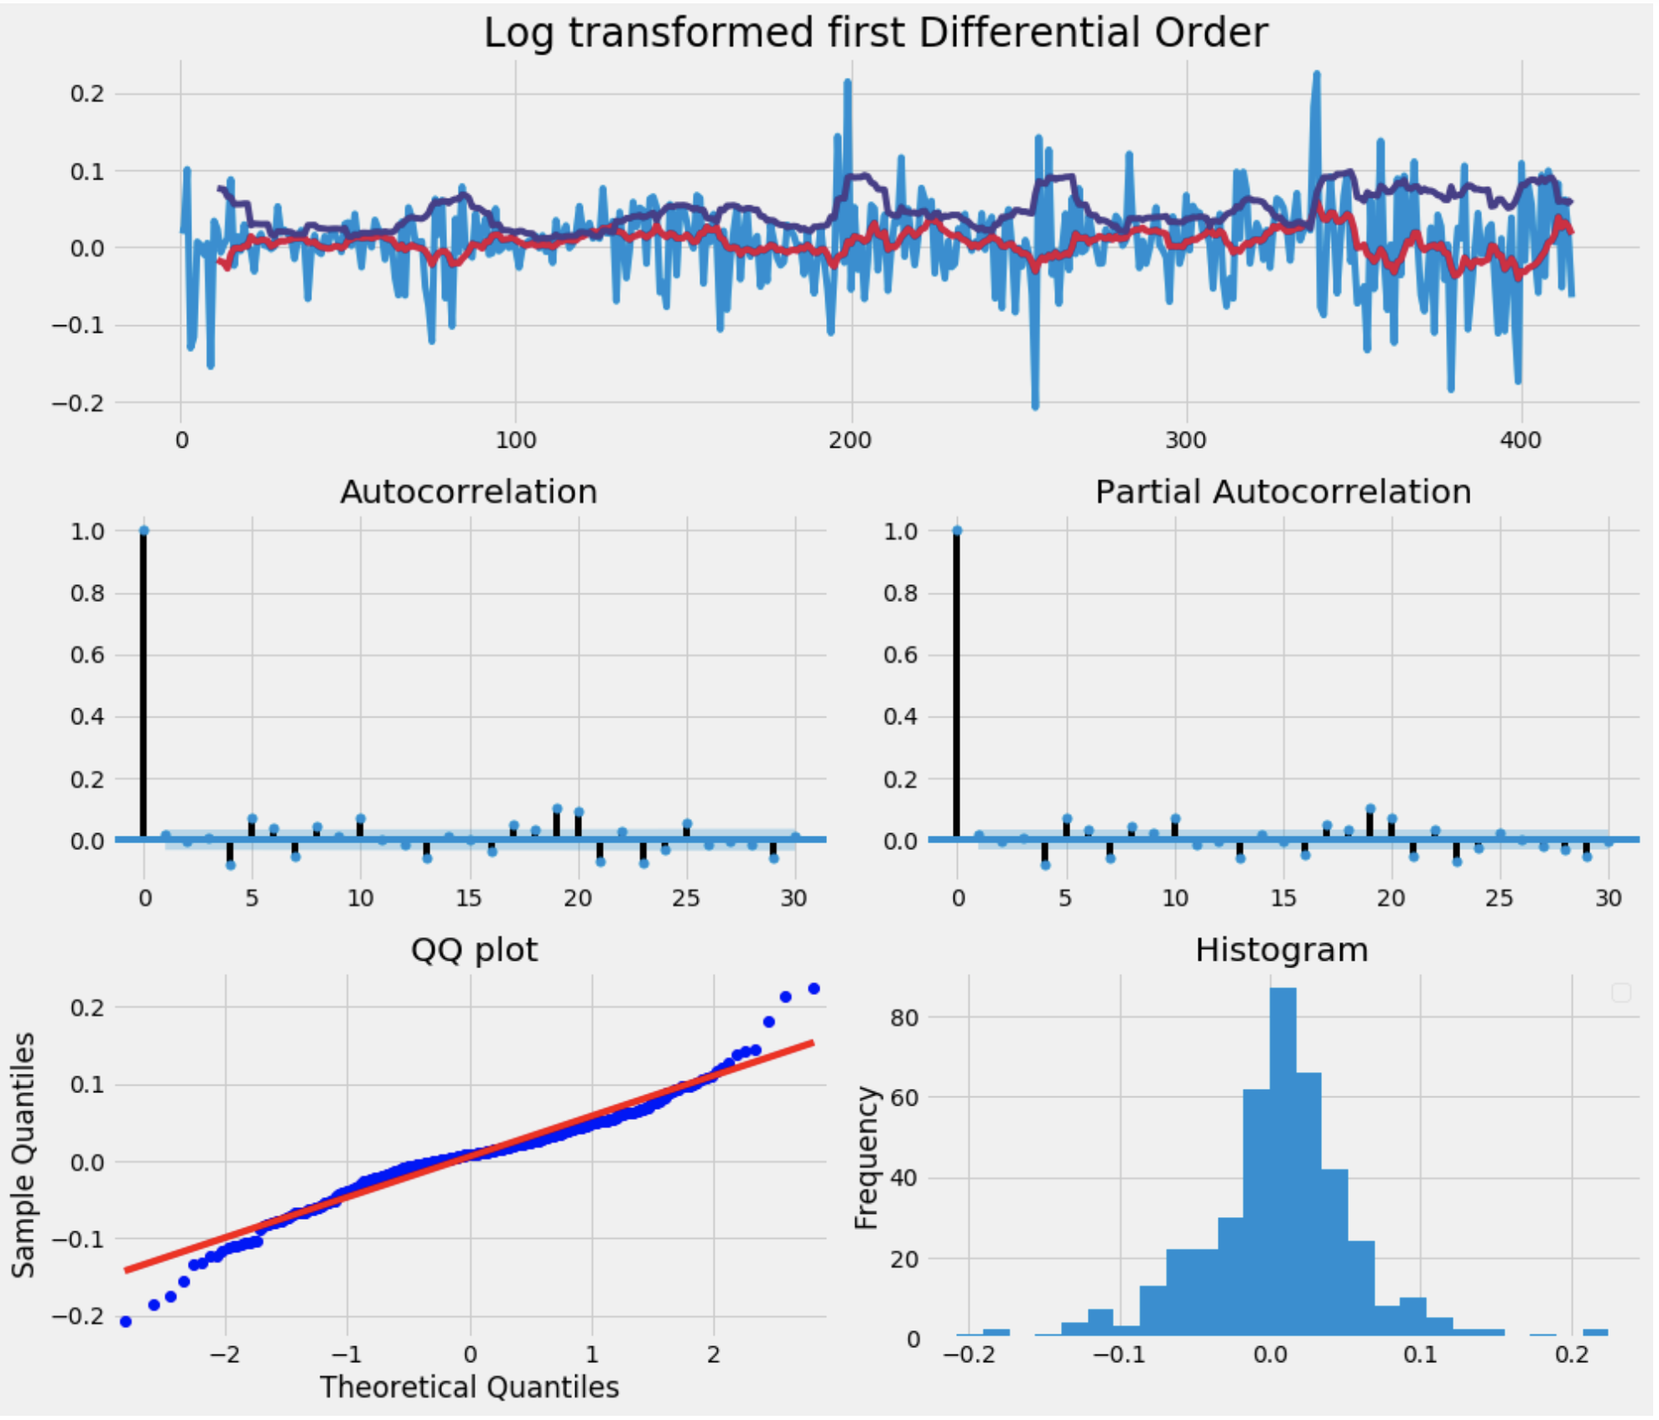
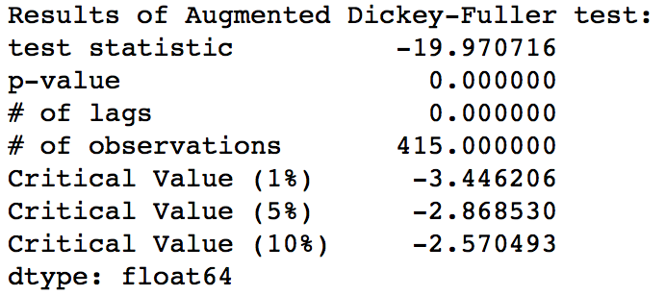
Transformed price series
to remove seasonality and
verified the resultant series
is fit for ARIMA model
by Dickey-Fuller test

Slide 9
Observation of Transformed series
Graph of autocorrelation and partial autocorrelation shows that log operation and first order difference on price series have resulted into a non stationary series.
The QQ plot and histogram shows that error are normally distributed.
Dickey fuller test confirms us the similar information.
Test statistics is below 5% of critical value
P-value is below 5% moving average

