Slide 1
The Spotify Data Analysis SQL Project Using PostgreSQL
The Spotify Data Analysis SQL Project is a comprehensive data analytics portfolio project designed to explore, clean, and extract meaningful business insights from a Spotify dataset. The end-to-end journey encompassed downloading raw data from Kaggle, performing data inspection and cleaning (such as handling anomalies like zero-duration tracks), and importing the structured dataset into a PostgreSQL database.
To address real-world analytical scenarios, the project formulated and solved 15 structured business questions divided into three distinct difficulty tiers (Easy, Intermediate, and Advanced) using advanced SQL queries.

Slide 2
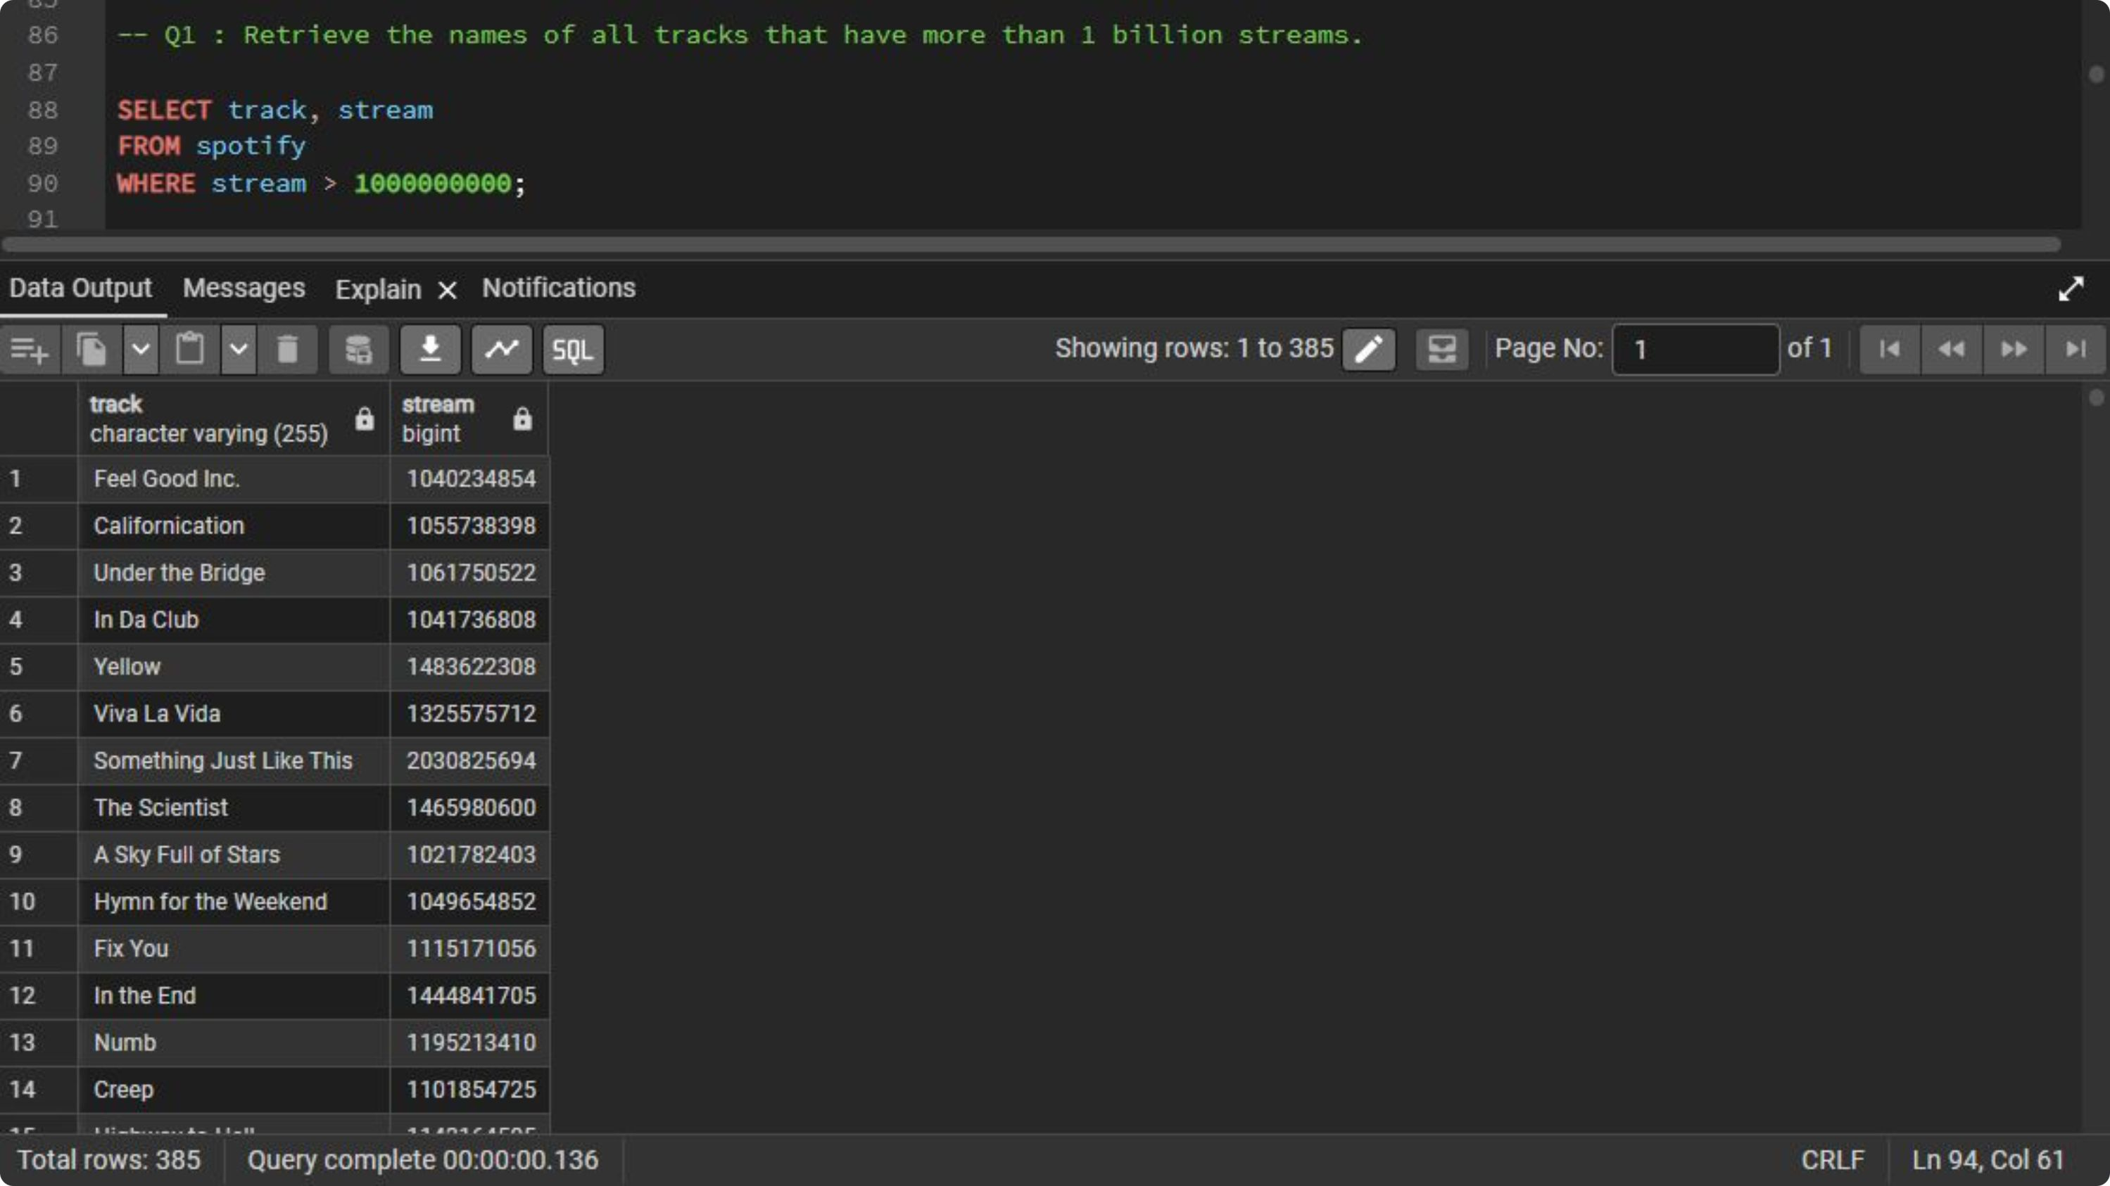

Slide 3
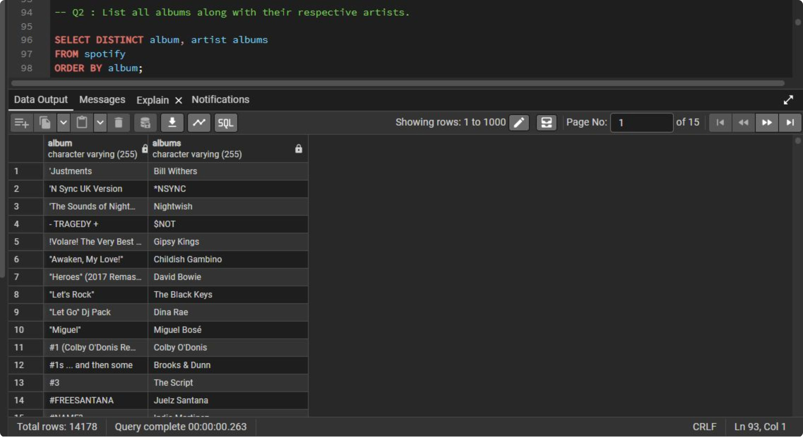

Slide 4
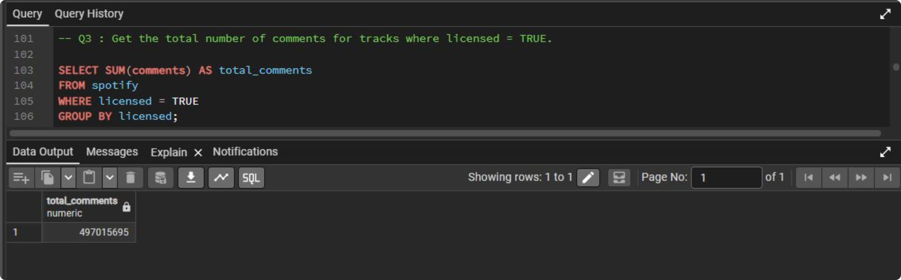

Slide 5
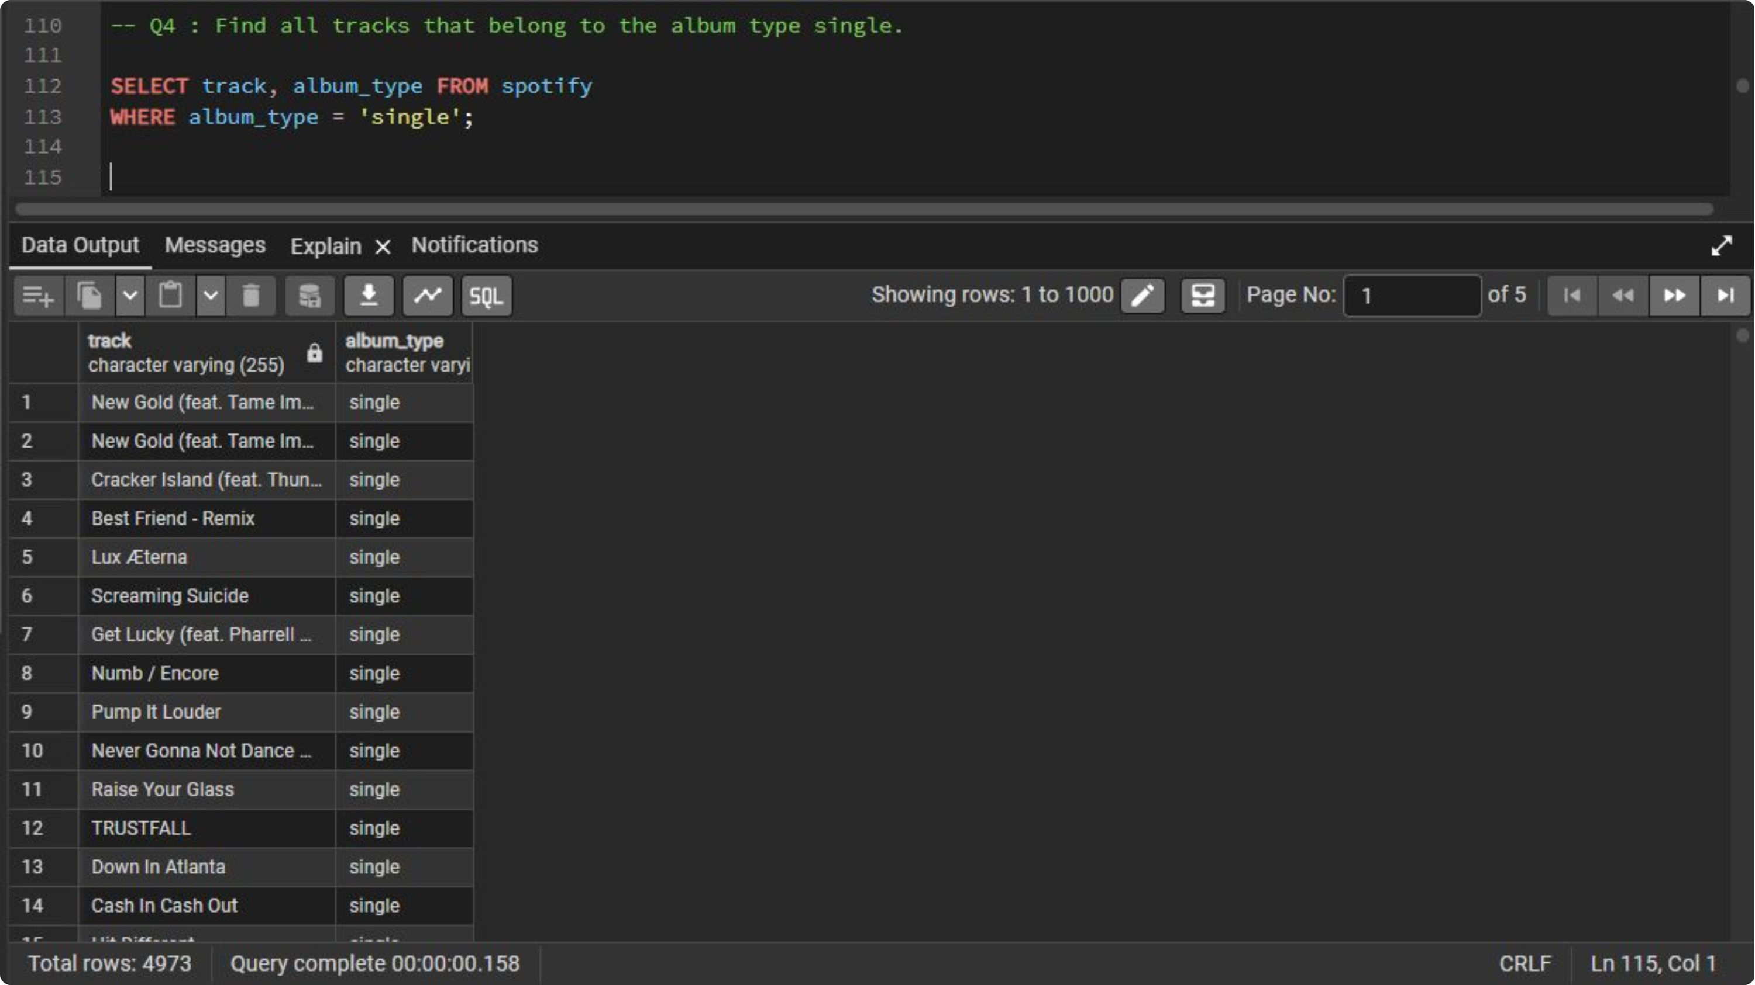

Slide 6
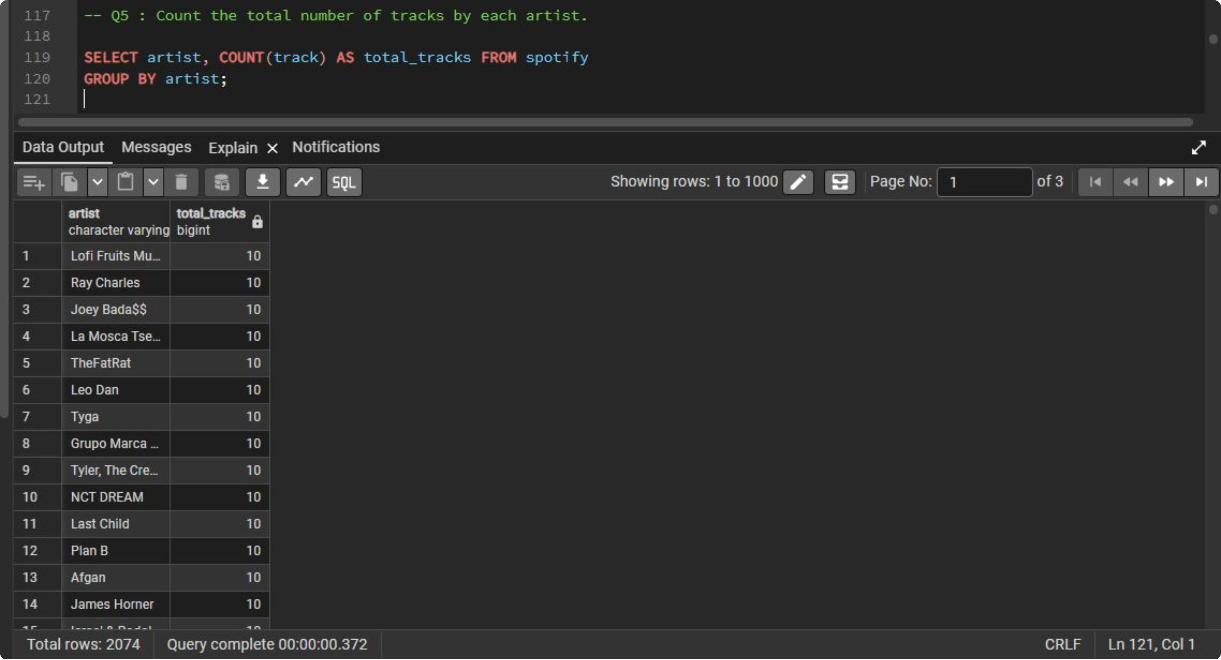

Slide 7
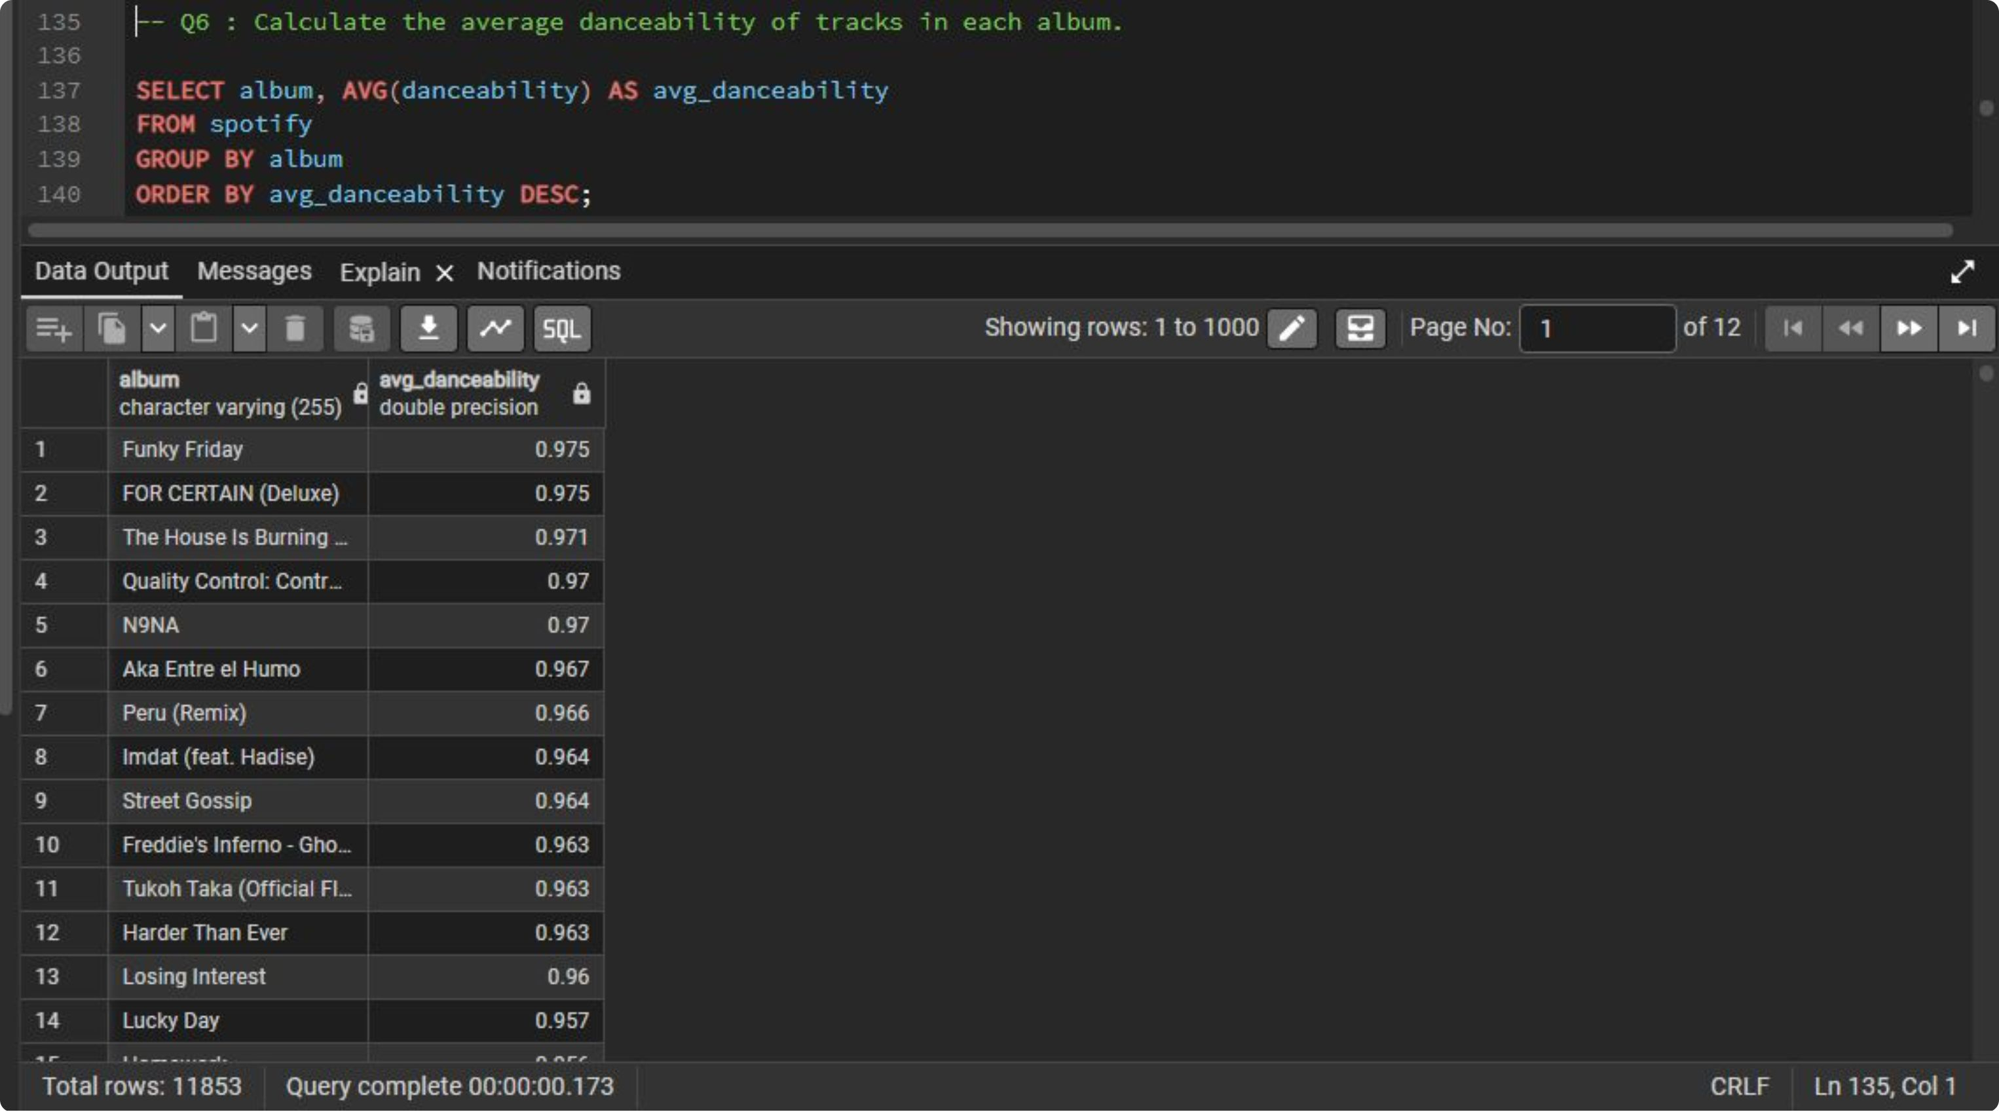

Slide 8
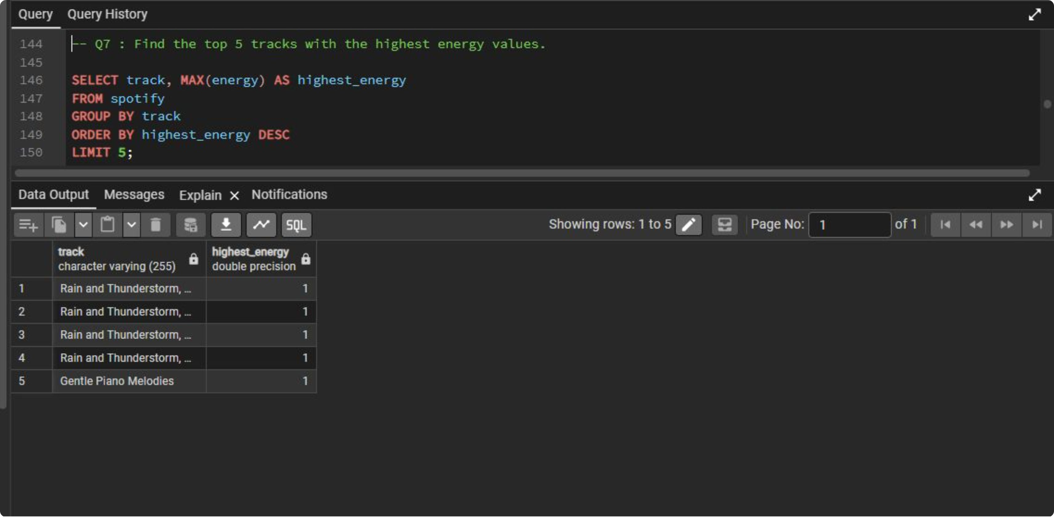

Slide 9
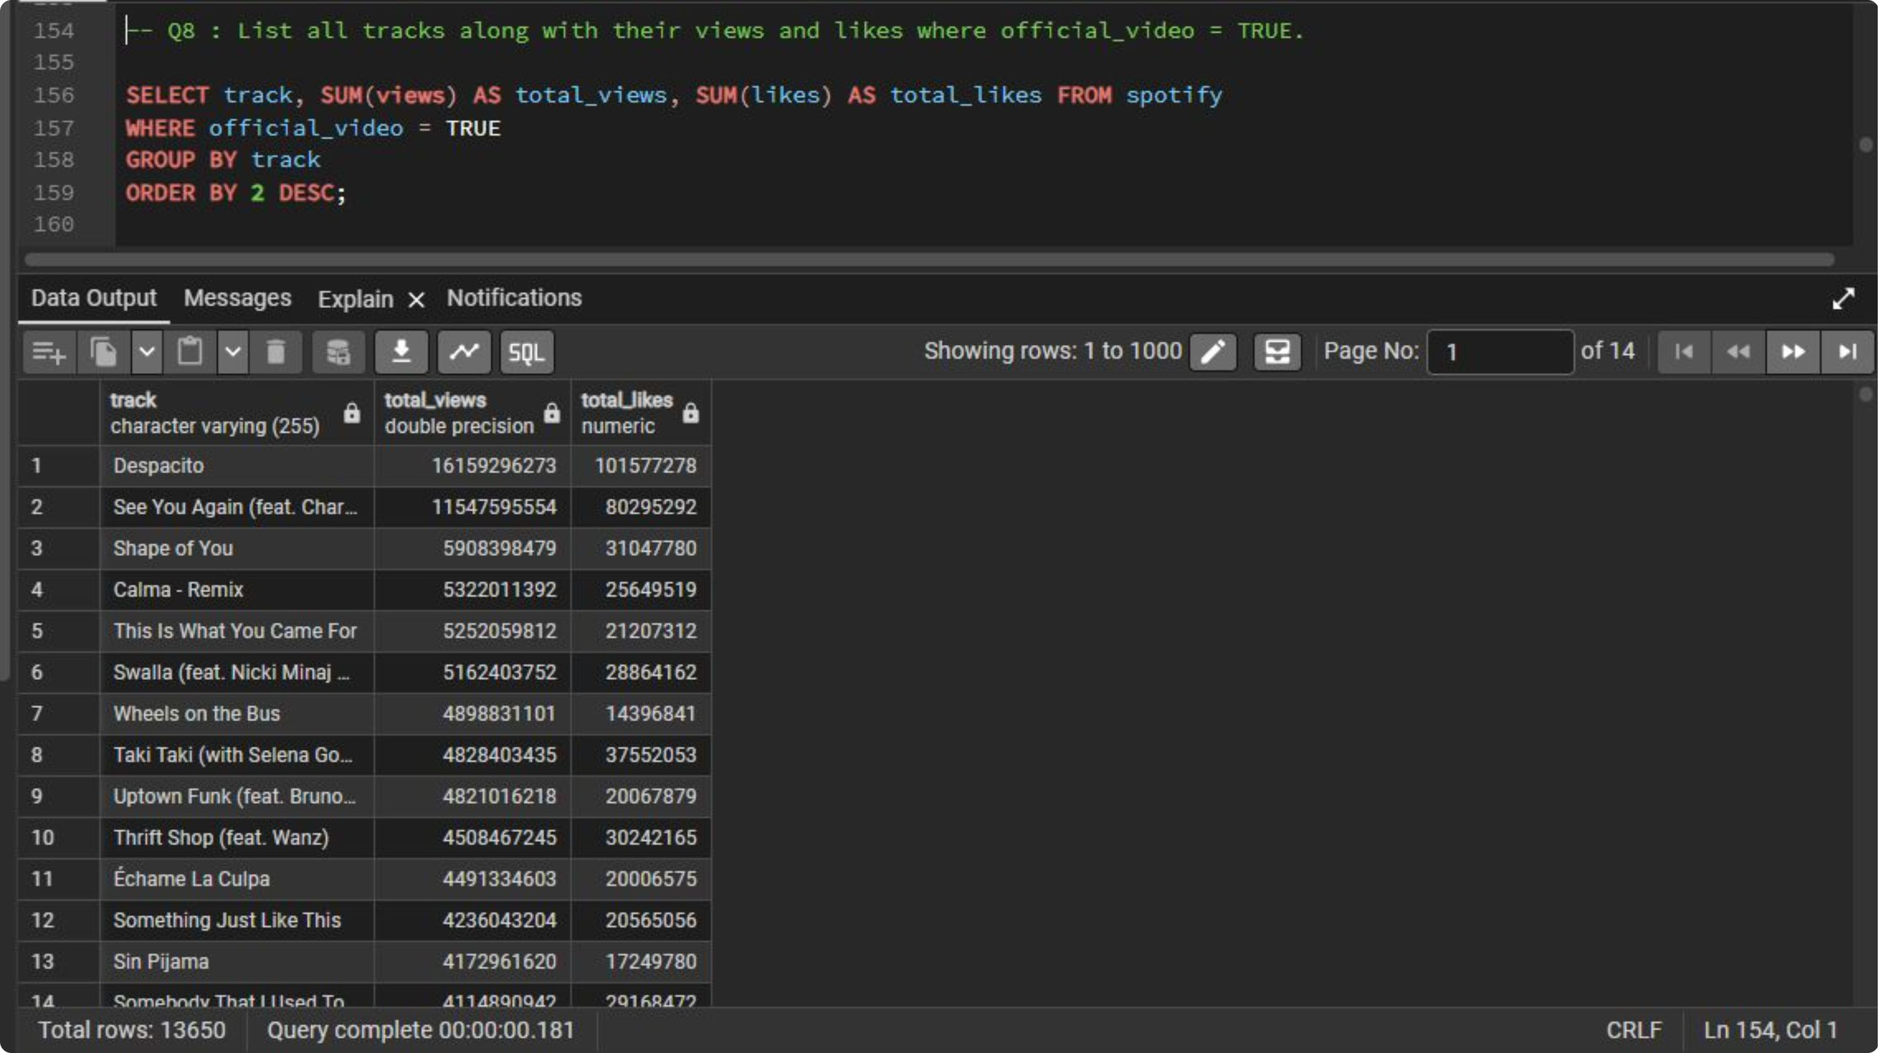

Slide 10
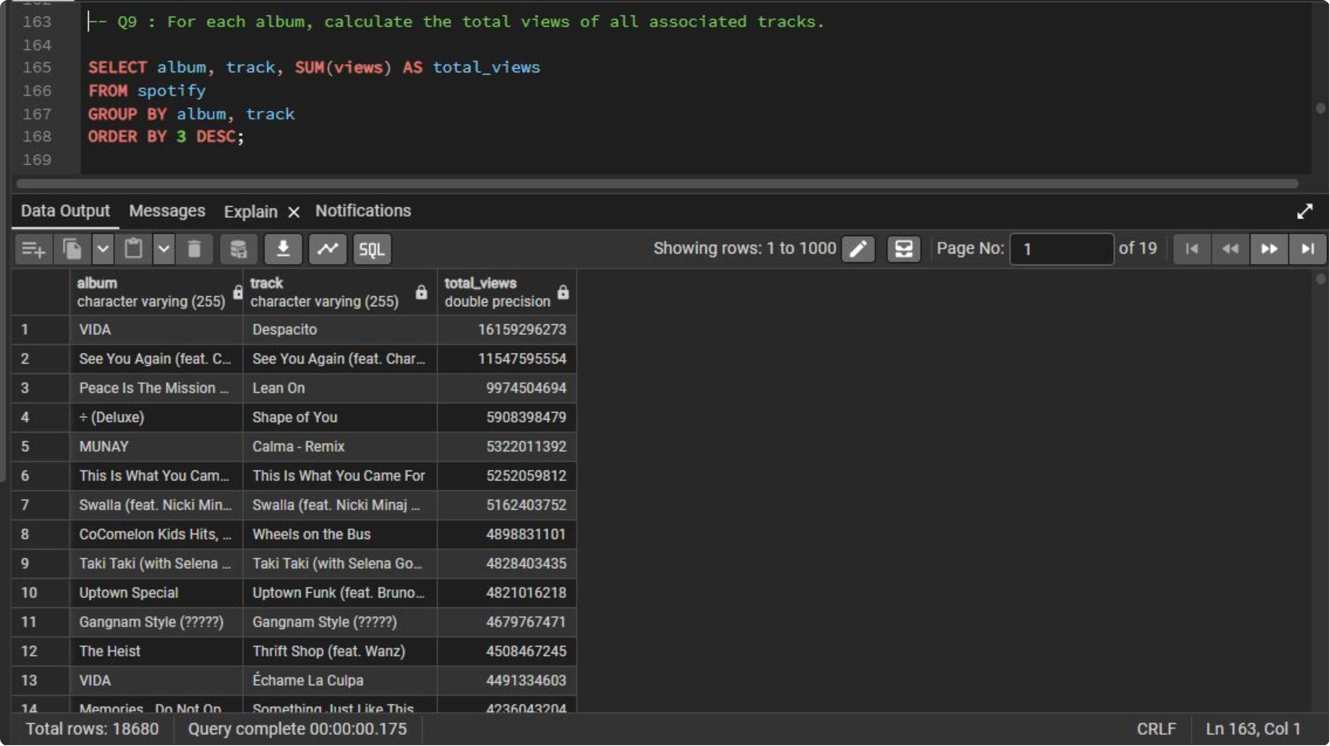

Slide 11
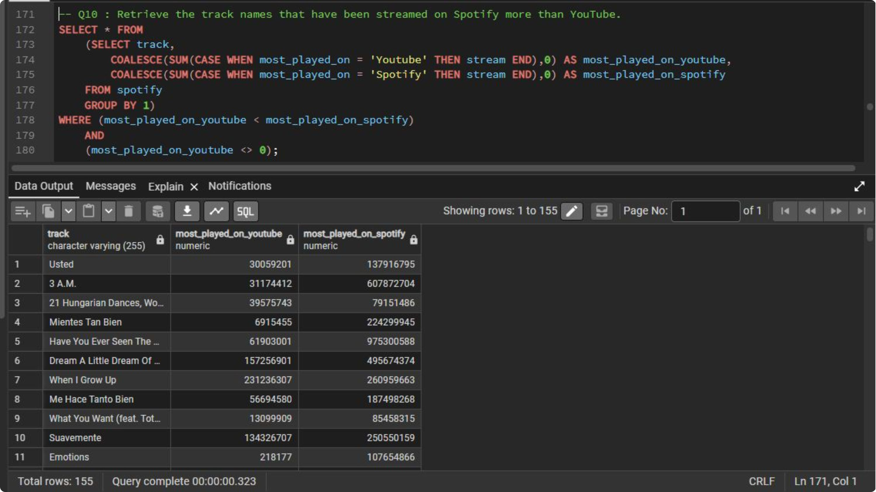

Slide 12
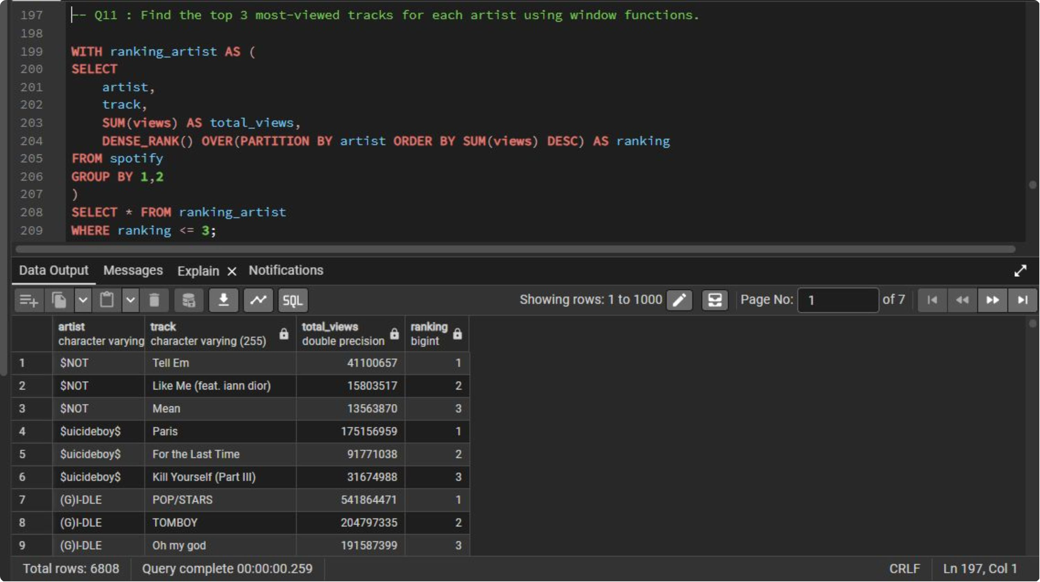

Slide 13
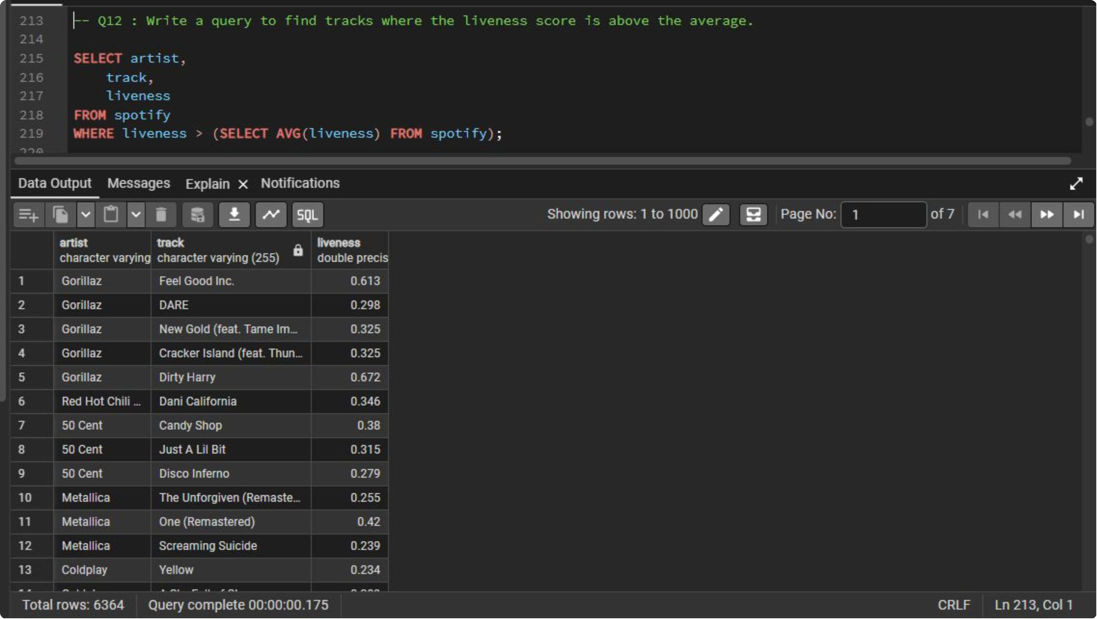

Slide 14
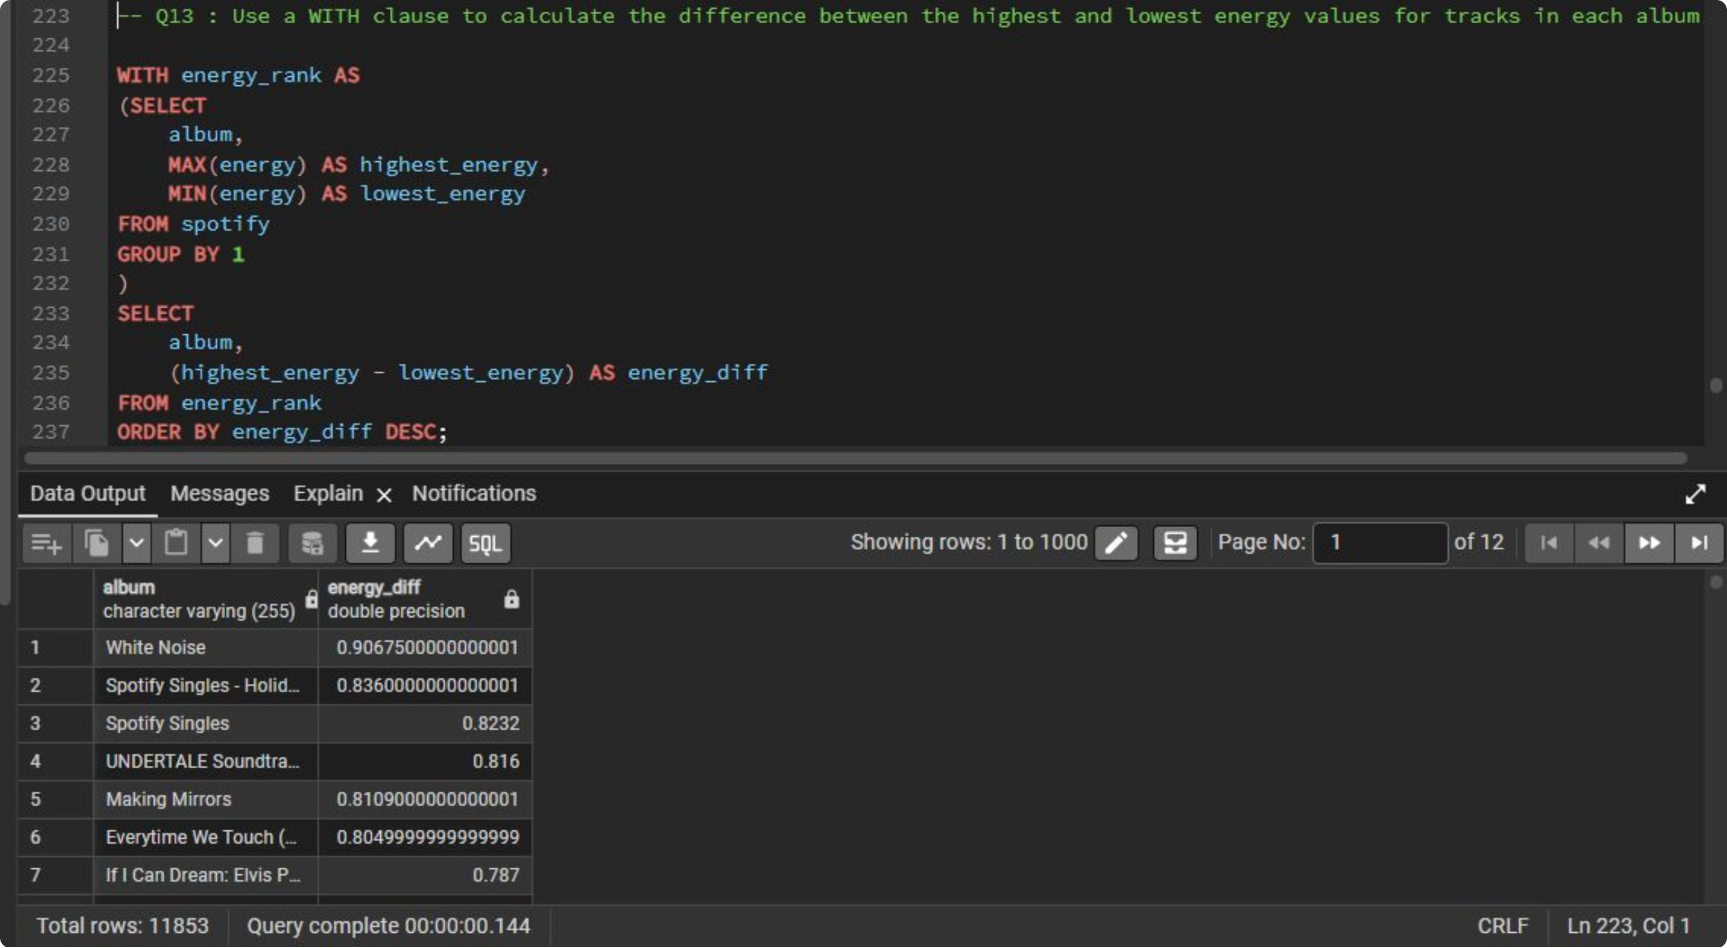

Slide 15
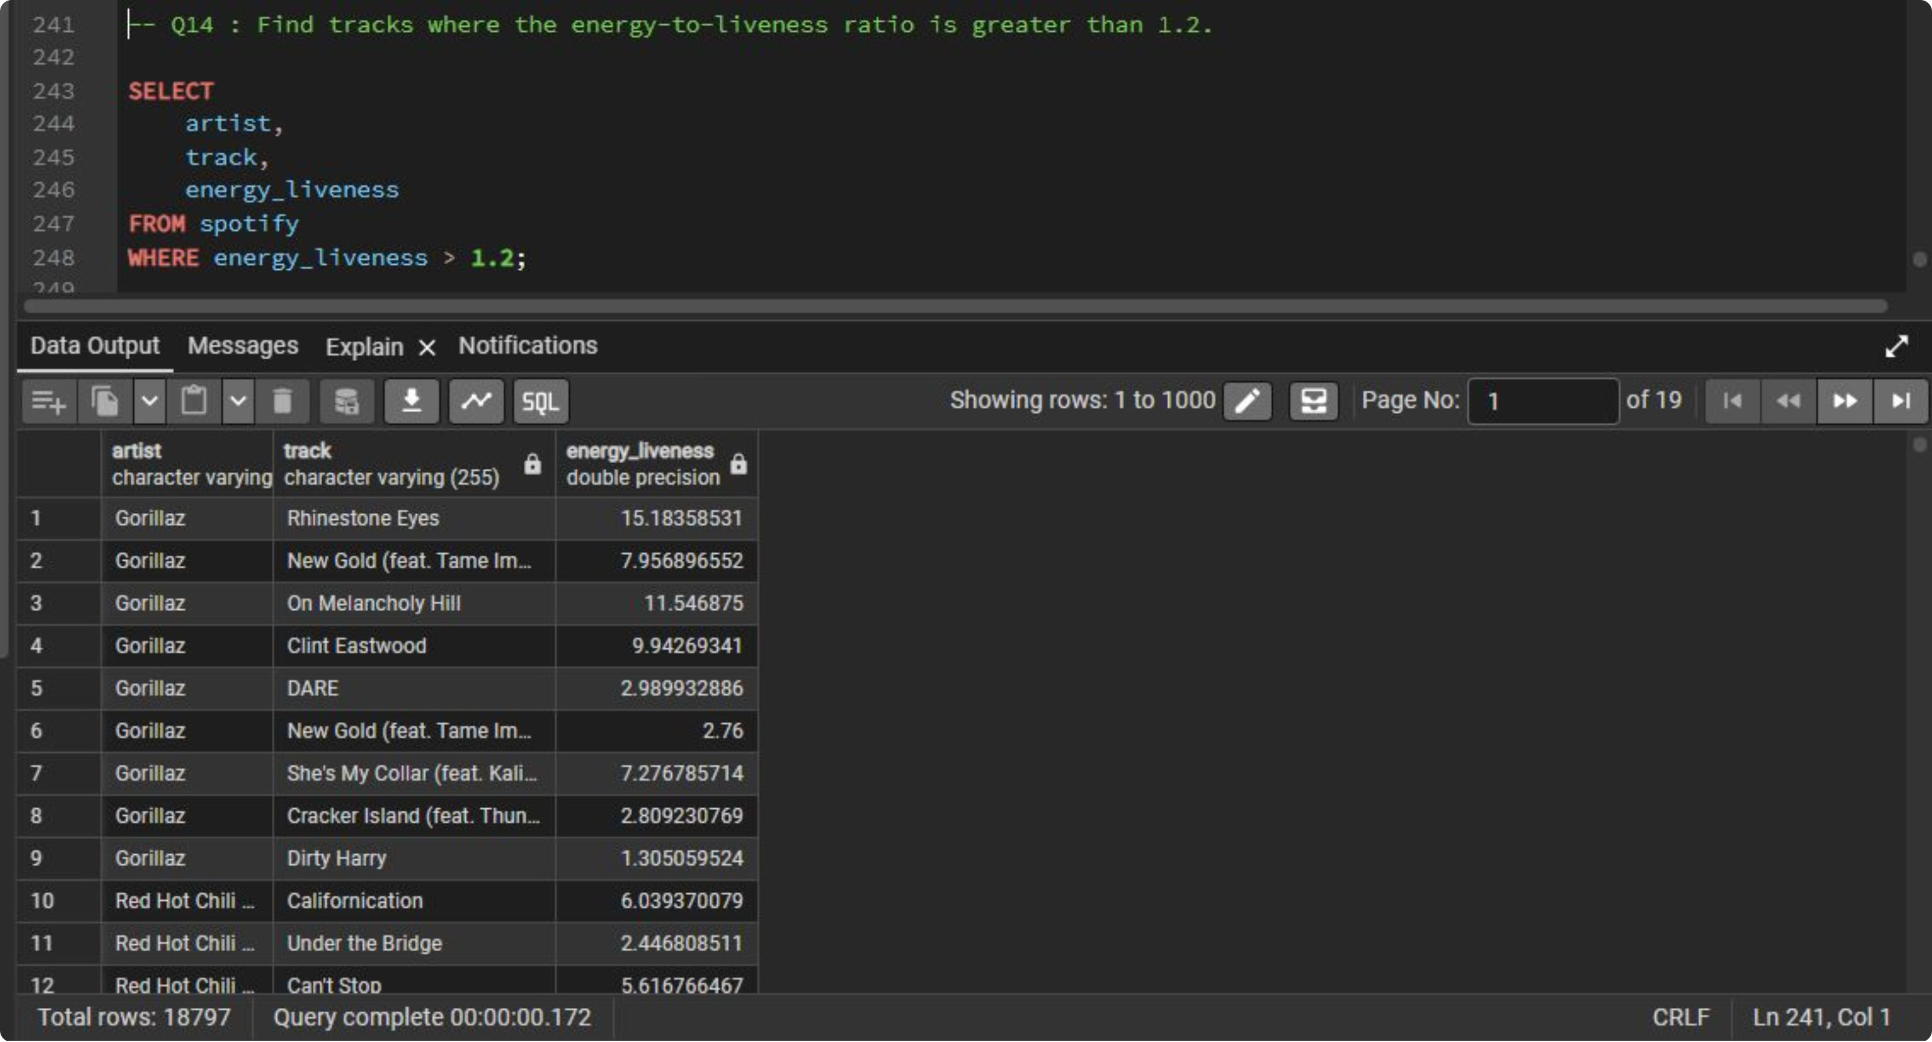

Slide 16
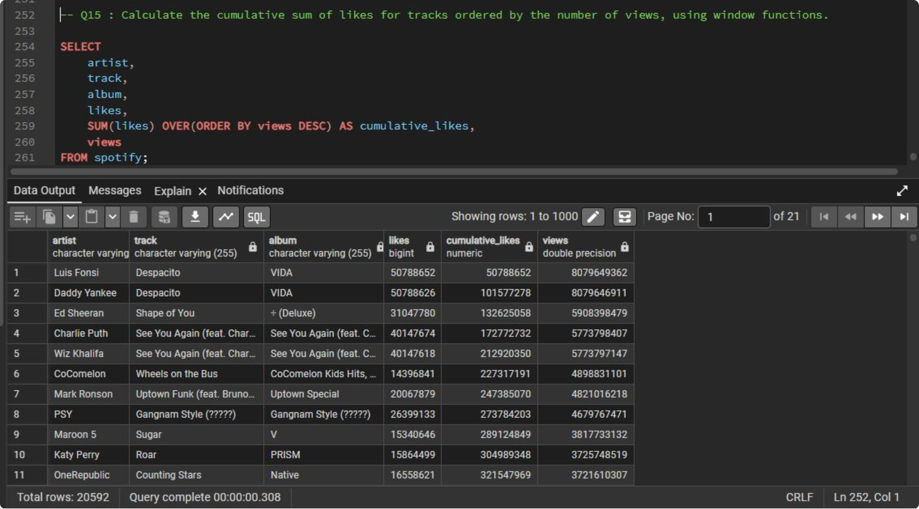

Slide 17
Project Outcome
This project significantly improved my ability to work with SQL in a real-world business context. Instead of focusing only on SQL syntax, I learned how to transform raw data into meaningful business insights by following a complete analytical workflow. From understanding the dataset and building a relational database to performing exploratory analysis, solving business problems, and documenting the entire process, this project strengthened my practical SQL skills and analytical thinking. It also provided valuable experience in presenting a professional, portfolio-ready data analytics project using industry-standard tools and best practices.

