Slide 1
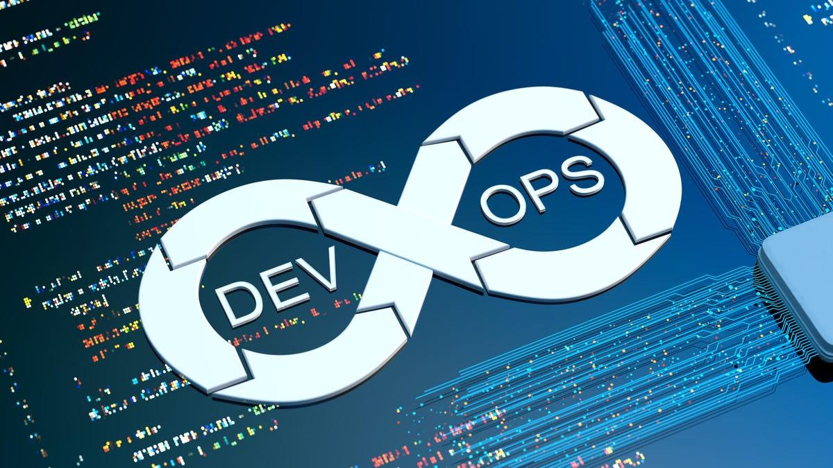
DevOps

Slide 2
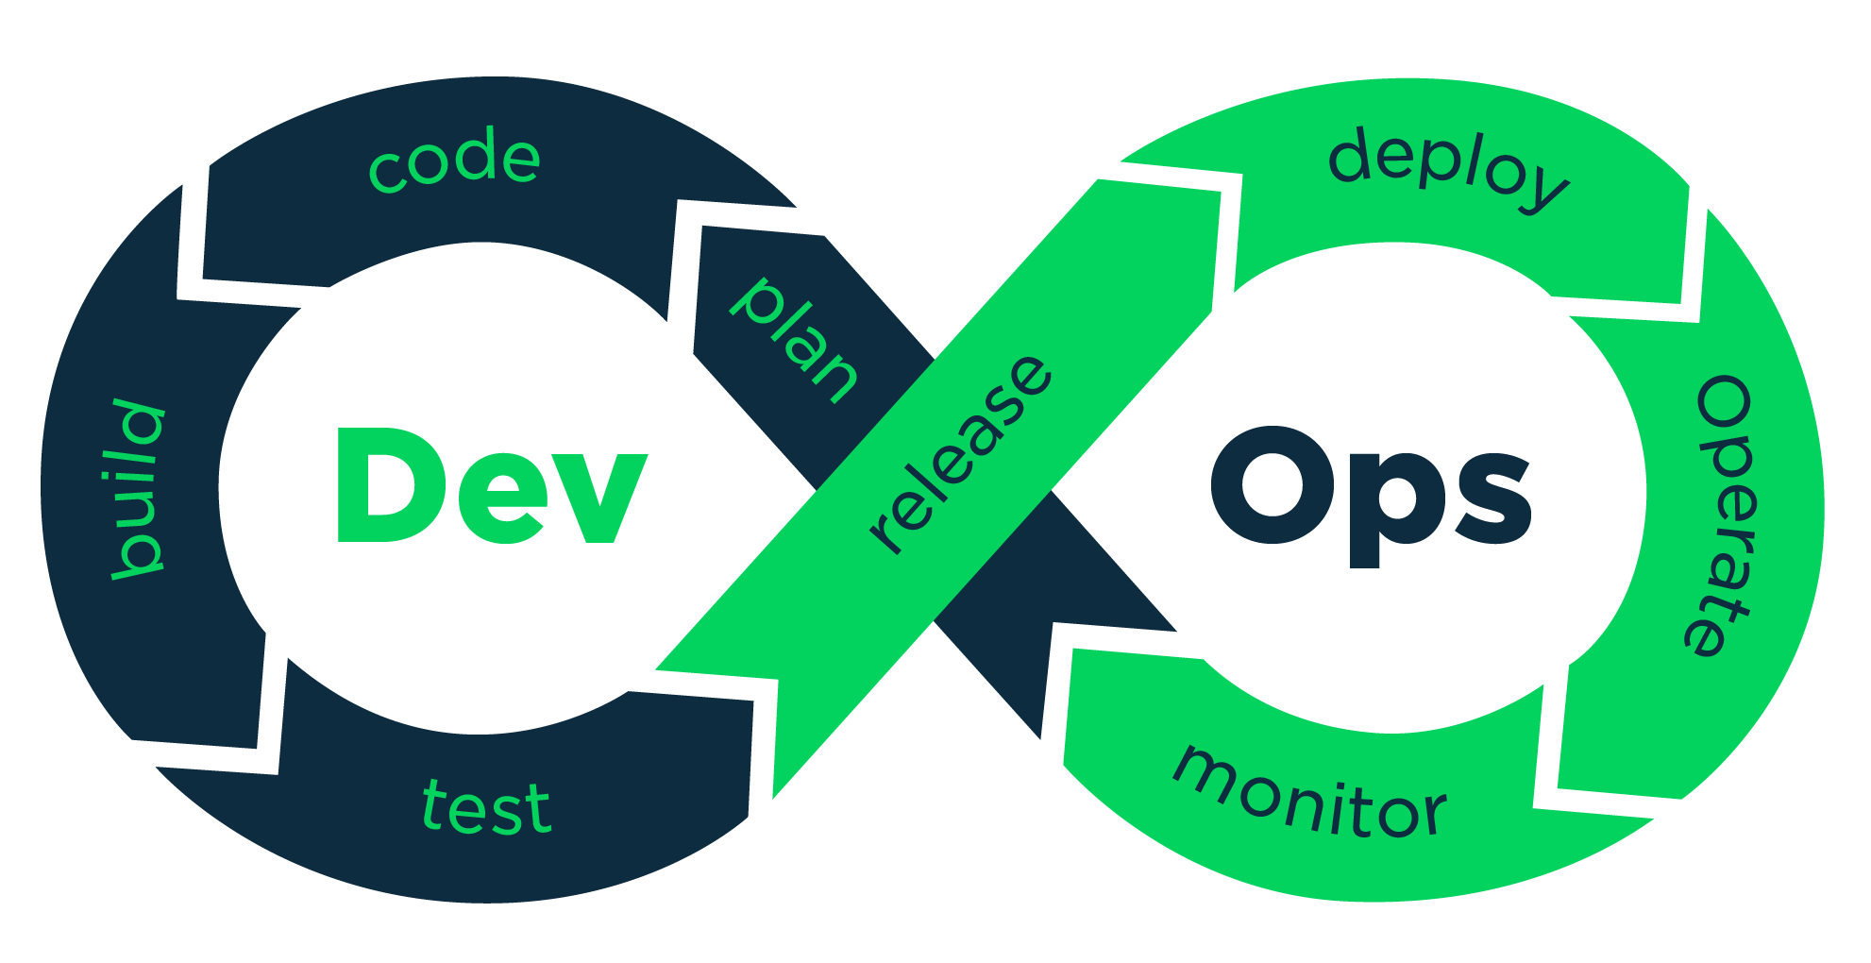
Things We are Going to Talk About
1.
What is DevOps?
2.
Why DevOps?
3.
DevOps Phases
4.
DevOps Tools
5.
DevOps Advantages
6.
Challenges of DevOps

Slide 3
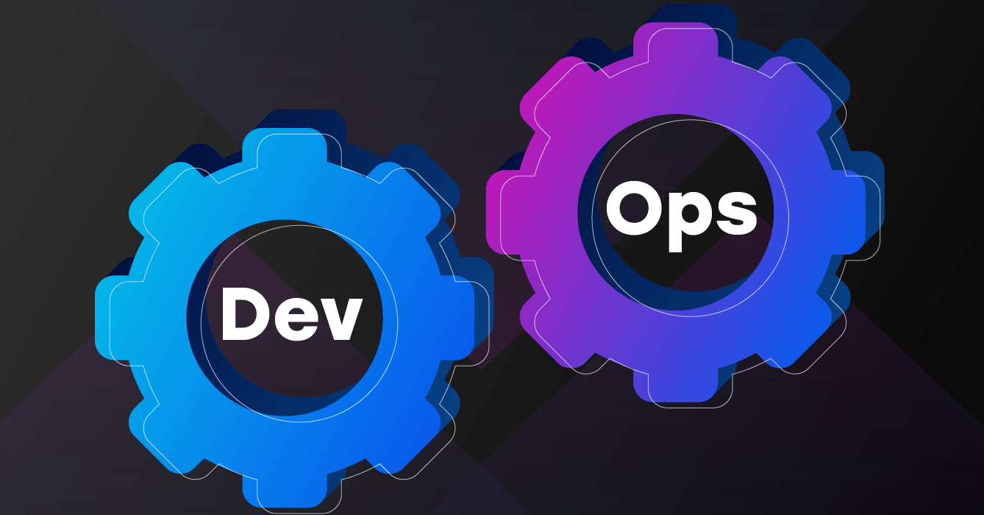
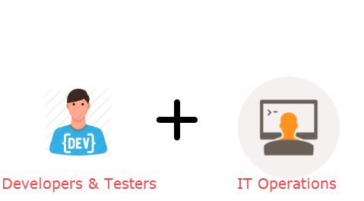
What is DevOps?
DevOps = Development + Operations
DevOps is a combination of development and operations. It is the practice of working together to ensure the quality and stability of software systems.

Slide 4
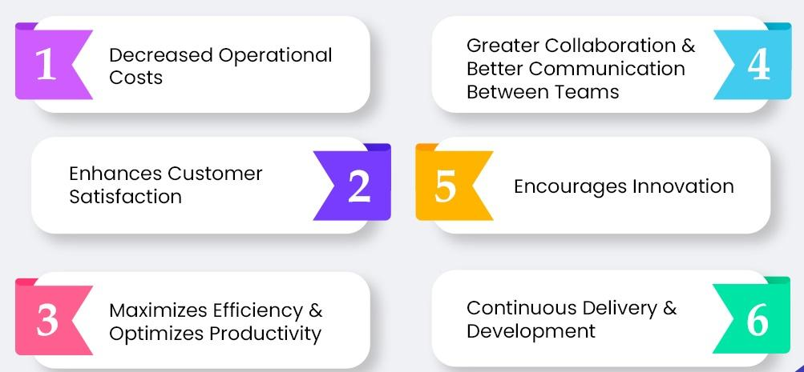
Why DevOps?

Slide 5
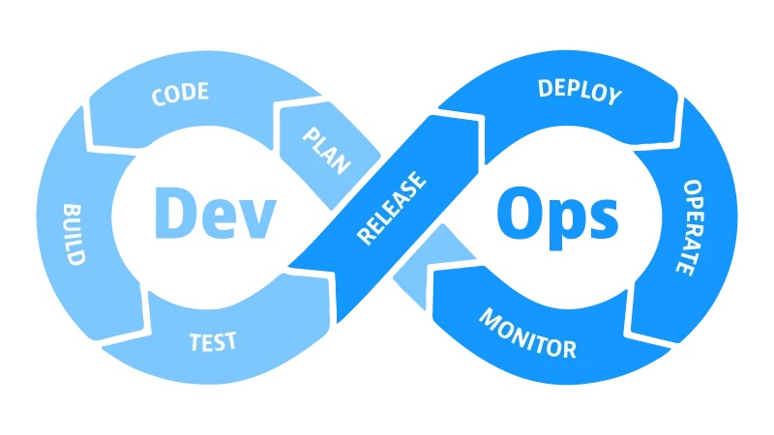
DevOps Phases
PLAN
CODE
BUILD
TEST
RELEASE
DEPLOY
OPERATE
MONITOR

Slide 6
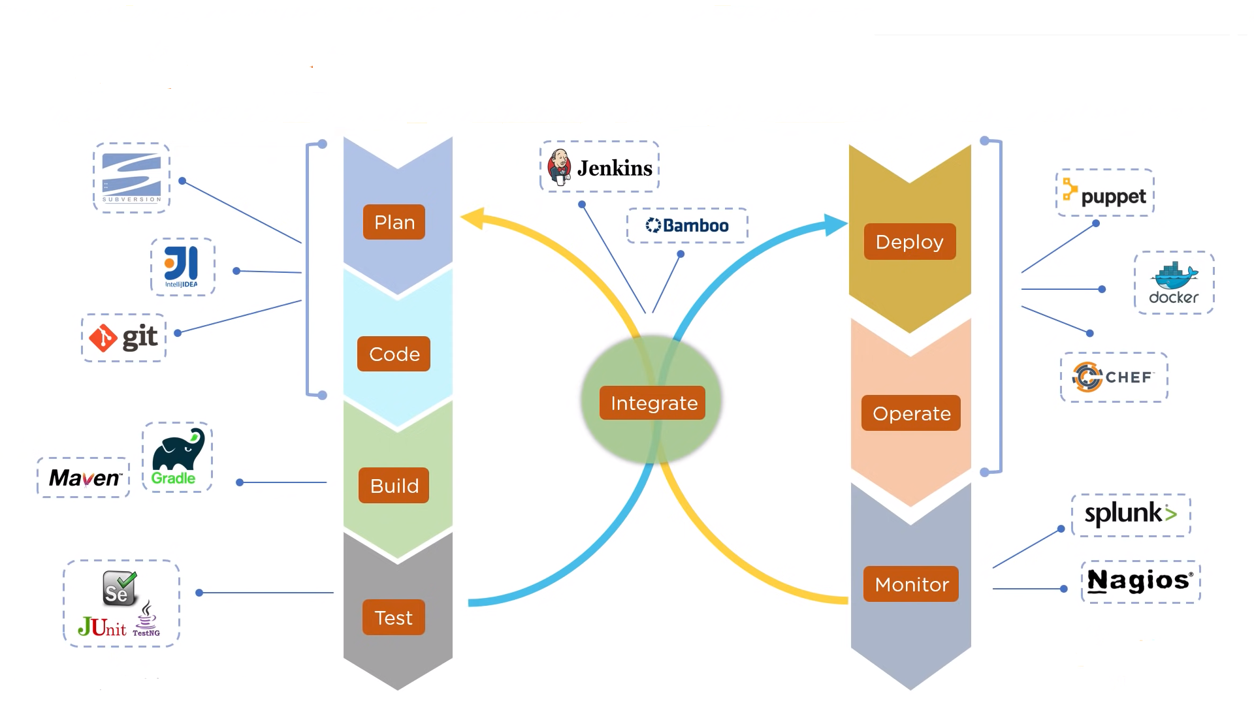
DevOps Tools

Slide 7
DevOps Advantages
Time Taken to create and deliver software is reduced
Complexity of maintaining an application is reduced
Improved collaboration between developers and operations team
Continuous integration and delivery ensure faster time to market

Slide 8
Challenges of DevOps
Complex and dispersed silos make collaboration more difficult
Product and service complexity hinders agile service delivery
Complex downstream systems cannot handle agile workrate
Failed changes cause unacceptable system-wide outages
Security, audit, and compliance are roadblocks to collaboration

Slide 9
THANKS!
Any questions?

