Slide 1
WAP
Wireless Application Protocol

Slide 2
TABLE OF CONTENTS.
01
02
03
04
05
06
Introduction and History of WAP
WAP Terms & Architecture
How WAP Works
Applications of WAP
Advantages & Disadvantages of WAP
Summary

Slide 3
What is WAP?
An open, global specification that empowers mobile users with wireless devices to easily access and interact with internet information and services instantly.
The wireless industry came up with the idea of WAP. The point of this standard was to show internet contents on wireless clients, like mobile phones.

Slide 4
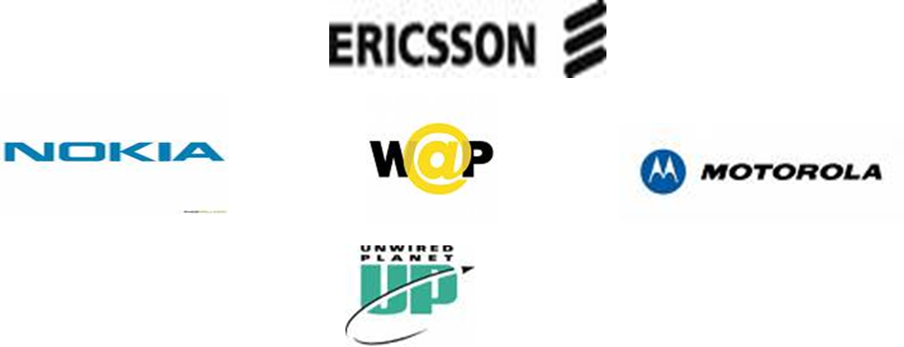
History of WAP
WAP is a global standard and not controlled by any single company, Ericsson, Nokia, Motorola and unwired planet founded the WAP forum in the summer of June 26, 1997 with the initial purpose of defining an industry-wide specification for developing application over wireless communication networks

Slide 5
Some Points on WAP
WAP stands for Wireless Application Protocol.
WAP is an application communication protocol.
WAP is used to access services and information.
WAP is inherited from Internet standards.
WAP is for handheld devices such as mobile phones.
WAP is a protocol designed for micro browsers.
WAP enables the creation of web applications for mobile devices.
WAP uses the markup language WML (not HTML) WML is defined as an XML 1.0 application.

Slide 6
WAP Terms
WAP Device
WAP Client
Application Server
Is used to access WAP applications and content. It might be a PDA, handheld computer.
Entity that receives content from Internet via a WAP Gateway. This is usually the WAP Browser.
Element in the network where the information or web/WAP applications resides.
WAP Gateways
WAP Browser
Intermediary element used to connect two different types of network. It receives request directly from the clients as if it actually were the origin server that clients want to receive the information form. The clients are usually unaware that they are speaking to the Gateway.
Software running on the WAP device that interprets the WAP content arriving from the internet and decides how to display it on WAP device.

Slide 7
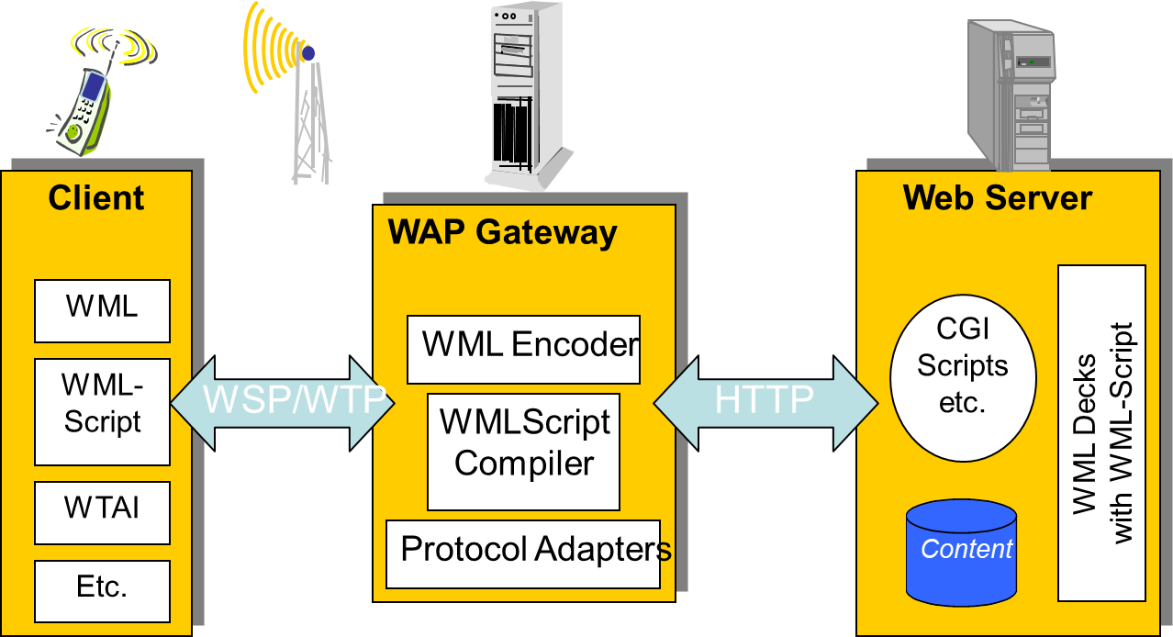
WAP Architecture

Slide 8
This is how you access internet via WAP
You turn on the device and open the minibrowser.
The device sends out a radio signal, searching for service.
A connection is made with your service provider.
You Select a website that you wish to view.
A request is sent to a gateway server using WAP.
The gateway server retrieves the information via HTTP from the Web site.
The gateway server encodes the HTTP data as WML.
The WML-encoded data is sent to your device.
You see the wireless Internet version of the Web page you selected.

Slide 9
Applications of WAP
Corporate Applications: Sales force automation where sales people use their WAP enabled handsets to get instant, direct access to the latest pricing, latest news, competitive information any time, anywhere.
Online Services:
Banking: Users can get their current balance, transfer funds between accounts and receive fax of a mini-statement.
Electronic Commerce: Subscribers can use their handset just like their PC to purchase products and services over the Web.

Slide 10
Applications of WAP Contd.
Prepaid Services: With a WAP-enabled phone, prepaid subscribers can see their current balance with the press of a button. By pressing another button, they can also recharge their account by entering a credit card or voucher number into the handset.
Personal Productivity
Email: Using WAP users can keep track of their email right from their handset.
Others include:
-Interactive Chat
-Auctions
-Games

Slide 11
Advantages of WAP
open standard, vendor independent.
network-standard independent.
transport mechanism–optimized for wireless data transmission.
application downloaded from the server, enabling fast service creation and introduction, as opposed to embedded software.

Slide 12
Disadvantages of WAP
Speed of access: All devices have slow access.
Limited or fragmented availability: Wireless web access is sporadic in many areas and entirely unavailable in other areas.
Price: Many technology limitations are being addressed by higher-end devices and services. But the entry price for a good wireless web palmtop with decent display, keyboard, and speed is easily $700 to $900, not including monthly access.
Lack of user habit: It takes some patience and overcoming the learning curve to get the hang of it -- connecting, putting in an address, typing. Users just aren't used to the idea and protocol yet.
Small screens: For web phones, there's an incredibly small viewing area.

Slide 13
SUMMARY
WAP provides a markup language and a transport protocol that open the possibilities of the wireless environment and give players from all levels of the industry the opportunity to access an untapped market that is still in its infancy.
Backed by 75 percent of the companies behind the world's mobile telephone market and the huge development potential of WAP, the future for WAP looks bright.

Slide 14
THANK YOU!
DO YOU HAVE ANY QUESTIONS?

