Slide 1
SEO
Friendly Website

Slide 2
Table of Contents
01
02
03
04
05
06
What is SEO
Types of SEO
SEO TOOLS
SEO Techniques & Strategy
Advantages & Disadvantages
Need of SEO

Slide 3
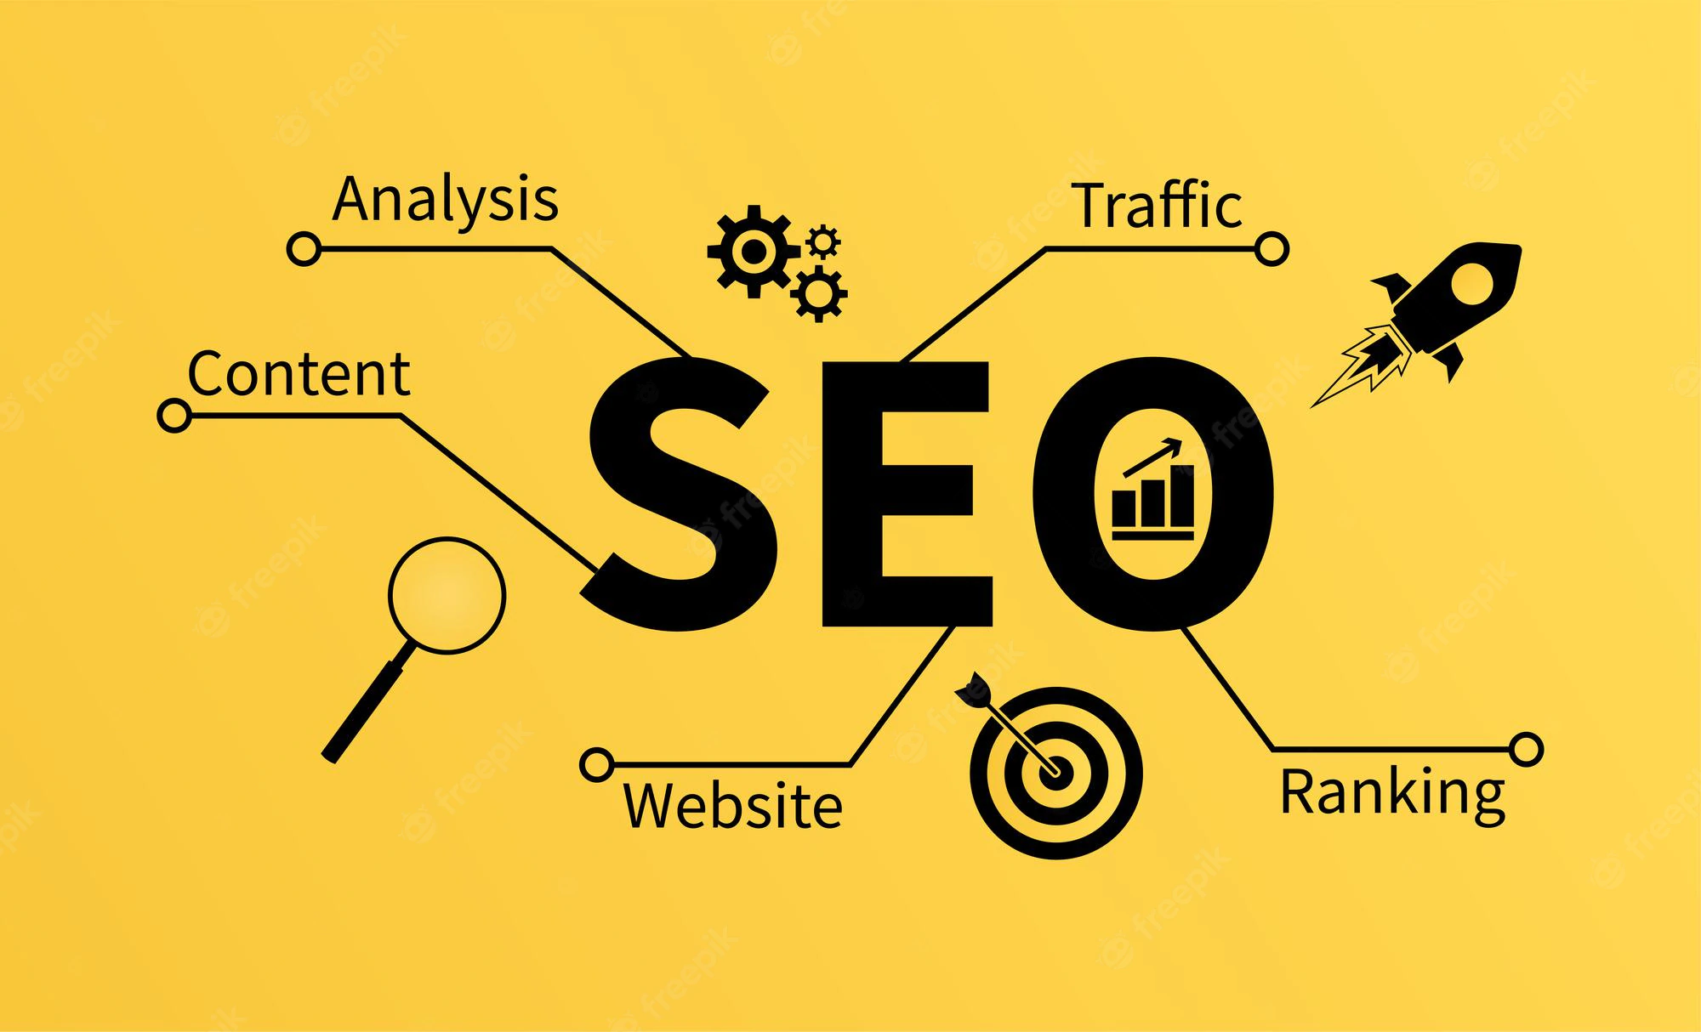
What is SEO?
SEO stands for “search engine optimization.” It is the process of getting traffic from the “free”, “organic”, “editorial” or “natural”search results on search engines.

Slide 4
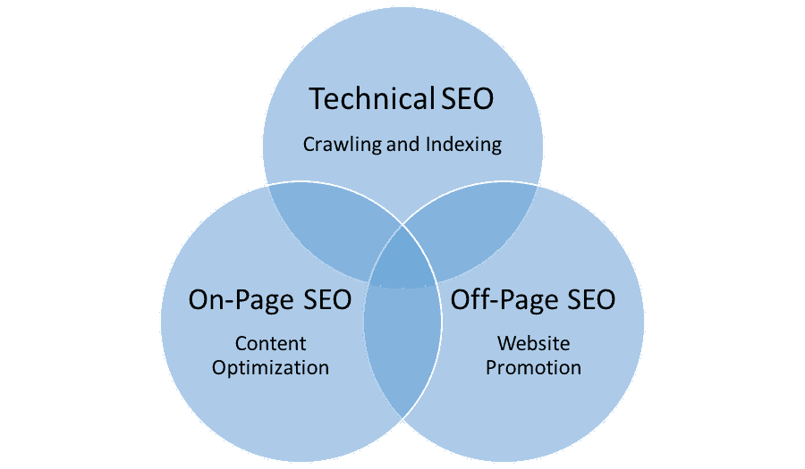
Types of SEO

Slide 5





SEO Tools
SEM Rush Rocks
KWFinder
Moz Pro
Ahrefs
Ubersuggest

Slide 6
SEO Techniques
Adult your site Framework
Data research via end user value
Create more optimized landing pages
Make your site responsive and mobile-friendly
Spy and Target competitor’s live keywords

Slide 7
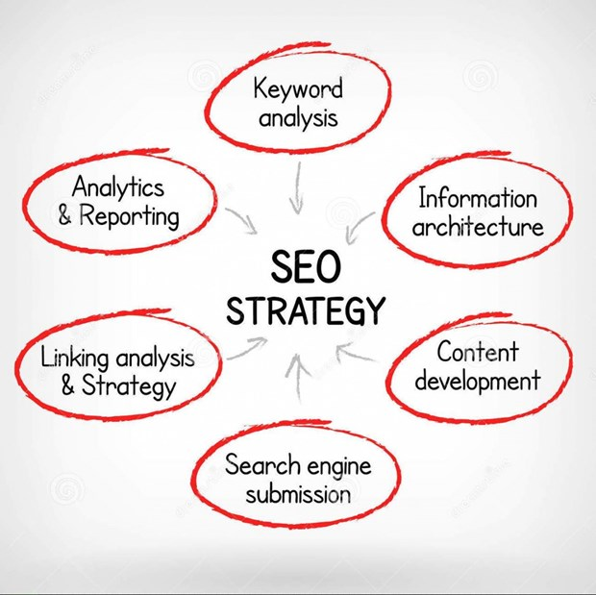
SEO Strategy
Define your target audience and their interests
Start creating recommendations
Categorized keyword research
Define Competitors
Prioritize and Summerize

Slide 8
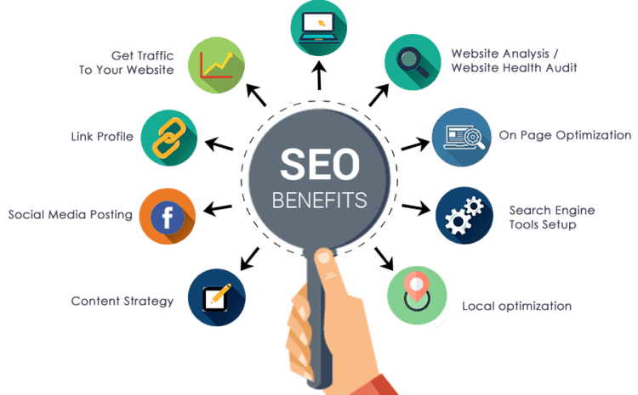
SEO Advantages

Slide 9
SEO Disadvantages
Results are not instant
SEO competition
Search penalty & algorithm updates
There is no secret technique
Learning SEO is important for the business.

Slide 10
Need of SEO
Seo helps to ensure that a site is accessible to a search engine and improves the chances that the site will be found by the search engine.
It is common practice for Internet users to not click through pages and pages of search results, so where a site ranks in a search is essential for directing more traffic toward the site. The higher a website naturally ranks in organic results of a search, the greater the chance that site will be visited by a user.

Slide 11
Thank You

