Slide 1
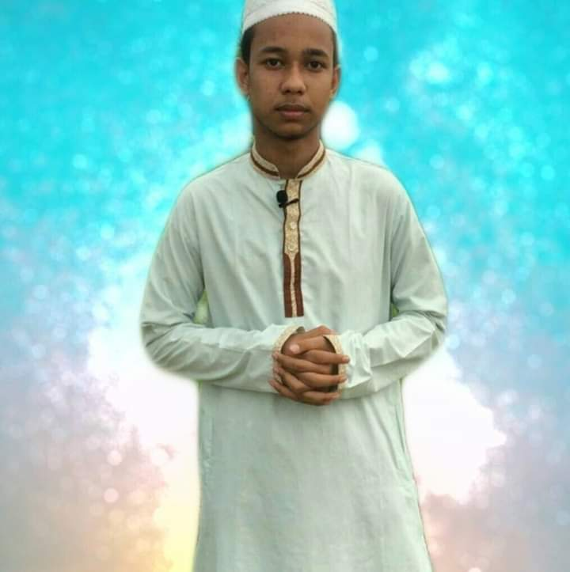



Sabbir ahmed
fahim
speaker,editor
01776446794
Sabbir ahmed fahim
Sabbir fahim
Jsc
Arab shah academy
2013 ( GPA 5)
Hifz
2014-2016
Education
Ssc
Sylhet ideal madrasah
2017-2019 Science(GPA5)
ENGLISH
language
SKILL
Graphic
designing

