Slide 1




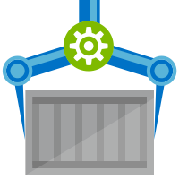
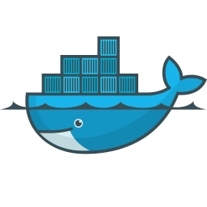
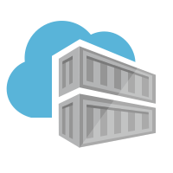


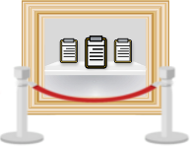


foo-service repository
New features, bug fixes happen on a feature branch. When the developer is ready to merge, they open a Pull Request to merge with master.
commit
feature branch
dev
foo-service repository
The pull request will build, test and create preview tagged Docker images and Helm chart with the pull request ID, which will get released to a temporary Kubernetes namespace
feature branch
dev
ops
image name ingress url ...
Azure Container Registry Build
http://foo-service-pr-12.xx.aksapp.io
pull request
Azure Container Registry
Azure Kubernetes Service
ChartMuseum
master branch
build, test and package
push
update helm chart
helm deploy
foo-service:pr-${build-id}
namespace: foo-service-pr-${build-id}
pull request CI (Build)
pull request CD (Release)

Slide 2

foo-service repository
After review of the pull request, when it gets merged, this will run the build pipeline again to generate the merged Docker image, Helm chart, etc. and release to Staging -> Pre-Prod -> Prod
feature branch
dev
ops
image name ingress url ...
Azure Container Registry Build
http://foo-service-pr-12.xx.aksapp.io
pull request
Azure Container Registry
Azure Kubernetes Service
ChartMuseum
master branch
build, test and package
push
update helm chart
helm deploy
foo-service:pr-${build-id}
namespace: foo-service-pr-${build-id}
pull request CI (Build)
pull request CD (Release)
merge
image name ingress url ...
Azure Container Registry Build
http://foo-service-staging.xx.aksapp.io
http://foo-service.xx.aksapp.io
Azure Container Registry
Azure Kubernetes Service
Azure Kubernetes Service
ChartMuseum
master branch
build, test and package
push
update helm chart
helm deploy
helm deploy
foo-service:${build-id}
namespace: staging
namespace: prod
merge to master CI (Build)
deploy to staging CD (Release)
deploy to prod CD (Release)
deploy to pre-prod CD (Release)

