Slide 1


IIT KANPUR
EE656
COURSE PROJECT
IMPLEMENTATION OF INTELLIGENT CONDITION BASED MONITORING USING ACOUSTIC SIGNALS FOR AIRCOMPRESSORS
Based on Verma et al., IEEE Transactions on Reliability, Vol. 65, No. 1, 2016
PRESENTED BY:
SABEEH MUHAMMED MC
ABHINAV GHOSH
AMAN AGRAWAL
HARSH VERMA
KHUSHI GODARA

Slide 2
IIT KANPUR
EE656
COURSE PROJECT
01 | Motivation & Problem Statement
02 | Objectives
03 | Dataset
04 | Overall Pipeline
05 | Feature Extraction
06 | mRMR Feature Selection
07 | OAO SVM Classification
08 | Experimental Results
09 | Discussion & Analysis
10 | Conclusion & Future Work
CONTENTS

Slide 3
Motivation &Problem Statement
THE PROBLEM:
Reciprocating air compressors run continuously in manufacturing plants, power stations, and chemical industries
Critical components — bearings, valves, pistons, rider belts — undergo progressive wear
Undetected faults propagate into severe mechanical failures → costly downtime + safety hazards
Traditional approach: scheduled maintenance → expensive and often unnecessary

Slide 4
Motivation &Problem Statement
THE SOLUTION:
Condition Based Monitoring (CBM): monitor the machine continuously, act only when a fault is detected
Use acoustic signals — non-invasive, sensitive to fault characteristics
Combine signal processing + machine learning for automatic, real-time fault identification
Result: earlier detection, lower cost, higher machine availability

Slide 5
Key distinction box (prominent):
The original paper by Verma et al. conducted an exhaustive comparative study — 11 signal transforms, 629 features, 6 feature selection methods, 3 multiclass SVM strategies.
After that analysis, the authors recommended a specific final operational strategy.
We implement exactly that recommended strategy — not the full comparative study.
WHAT WE CONSCIOUSLY SKIPPED:
PRE-PROCESSING (DATASET PROVIDED PRE-PROCESSED)
COMPARATIVE ANALYSIS OF REMAINING 6 TRANSFORMS
OAA AND DDAG MULTICLASS STRATEGIES
ALTERNATIVE FEATURE SELECTION METHODS (PCA, MIFS, BD ETC.)

Slide 6
Objectives
Extract multi-domain features using the 5 transforms recommended by the paper: FFT, DCT, STFT, WVD, WPT
Apply mRMR feature selection to reduce 414 features to 25
Train an OAO SVM with RBF kernel using grid search optimized hyperparameters
Validate using stratified 5-fold cross-validation
Match the paper's reported accuracy of ~99.50%

Slide 7
DATASET
LINK - HTTPS://WWW.IITK.AC.IN/IDEA/DATASETS/INDEX.HTML
LABEL
CLASS
PHYSICAL DESCRIPTION
DESCRIPTION
0
BEARING
CRACKS DEVELOPED IN BEARINGS
8 MACHINE STATE
1
FLYWHEEL
WEAR ON FLYWHEEL SURFACE
225 RECORDINGS PER STATE
1800 TOTAL RECORDINGS
2
CLASS
NORMAL OPERATION - NO FAULT
50 KHZ SAMPLING RATE
LEAKAGE INLET VALVE - AIR LEAKS DURING COMPRESSION
3
LIV
4
LOV
LEAKAGE OUTLET VALVE -DAMAGED OUTLET VALVE
EACH RECORDING: 50,000 SAMPLES @ 50 KHZ = 1 SEC DURATION
FORMAT: .DAT FILES, 24-BIT PCM
DATASET PROVIDED PRE-PROCESSED (FILTERING, CLIPPING, SMOOTHING, NORMALIZATION ALREADY APPLIED)
SENSOR: POSITION 8 OF 24 — IDENTIFIED AS MOST SENSITIVE VIA SENSITIVE POSITION ANALYSIS IN ORIGINAL PAPER
5
NEV
NON-RETURN VALVE - AIR LEAKS FROM TANK, EXTRA LOAD
6
PISTON
LOOSE PISTON RING CAUSES AIR LEAKAGE
7
RIDERBELT
BELT MISALIGNED WITH PULLEY
4

Slide 8
Overall Pipeline
PREPROCESSED ACOUSTIC SIGNAL
[STEP 1]
[STEP 2]
MULTI-DOMAIN FEATURE EXTRACTION
MRMR FEATURE SELECTION
FFT · DCT · STFT · WVD · WPT
414-DIMENSIONAL FEATURE VECTOR
414 FEATURES → TOP 25 FEATURES
→
[STEP 3]
[STEP 4]
HYPERPARAMETER OPTIMIZATION
OAO SVM + 5-FOLD CROSS VALIDATION
GRID SEARCH OVER C × Γ
→ FAULT CLASSIFICATION (8 CLASSES)
STEPS 1-4 = OUR COMPLETE IMPLEMENTATION
PRE-PROCESSING WAS PROVIDED - DATASET ALREADY CLEAN
EACH STEP'S OUTPUT FEEDS DIRECTLY INTO THE NEXT
FINAL OUTPUT: TRAINED MODEL FILES SAVED FOR TEST PHASE DEPLOYMENT
5

Slide 9
Feature Extraction
TRANSFROM
FULL
NAME
CLASS
PHYSICAL DESCRIPTION
MULTI-DOMAIN FEATURE EXTRACTION
FAST FOURIER TRANSFORM
GLOBAL FREQUENCY ENERGY -
SPECTRUM DIVIDED INTO 8 EQUAL BINS, NORMALIZED ENERGY PER BIN
FFT
8
BOTTOM TOTAL BAR:
FFT (8)
+ DCT (8)
+ STFT (72)
+ WVD (72)
+ WPT (254)
= 414 FEATURES PER RECORDING
DISCRETE COSINE TRANSFORM
ENERGY-COMPACTED FREQUENCY REPRESENTATION - REAL VALUED,
CONCENTRATES ENERGY IN FEWER COEFFICIENTS
DCT
8
STFT
SHORT TIME FOURIER TRANSFORM
72
TIME-VARYING FREQUENCY CONTENT -
HOW SPECTRAL CHARACTERISTICS
CHANGE OVER TIME USING HANN WINDOW
OUTPUT:
FEATURES.CSV - 1800 × 417 MATRIX
WHY WVD WAS DOWNSAMPLED?
WVD
WIGNER-VILLE DISTRIBUTION
72
HIGHEST-RESOLUTION TIME-FREQUENCY PICTURE
NO WINDOW SIZE TRADE-OFF, O(N²) COMPLEXITY. RESAMPLED TO 8192 POINTS FOR FEASIBILITY
WVD REQUIRED DOWNSAMPLING TO 8192 POINTS (FROM 50,000) DUE TO O(N²) COMPLEXITY - THIS PRESERVED THE 1-SECOND OBSERVATION WINDOW WITHOUT AFFECTING DIAGNOSTIC PERFORMANCE
WPT
WAVELET PACKET TRANSFORM
254
MULTI-RESOLUTION SUB-BAND ENERGY — DB4 WAVELET, 7 LEVELS, 254 NODES. DECOMPOSES BOTH LOW AND HIGH FREQUENCIES UNLIKE DWT
WHY 5 TRANSFORMS?
A SINGLE TRANSFORM CANNOT CAPTURE ALL FAULT SIGNATURES. DIFFERENT FAULTS MANIFEST AT DIFFERENT FREQUENCIES AND TIME INSTANTS. FIVE COMPLEMENTARY TRANSFORMS TOGETHER PROVIDE A COMPLETE DIAGNOSTIC PICTURE.
6

Slide 10
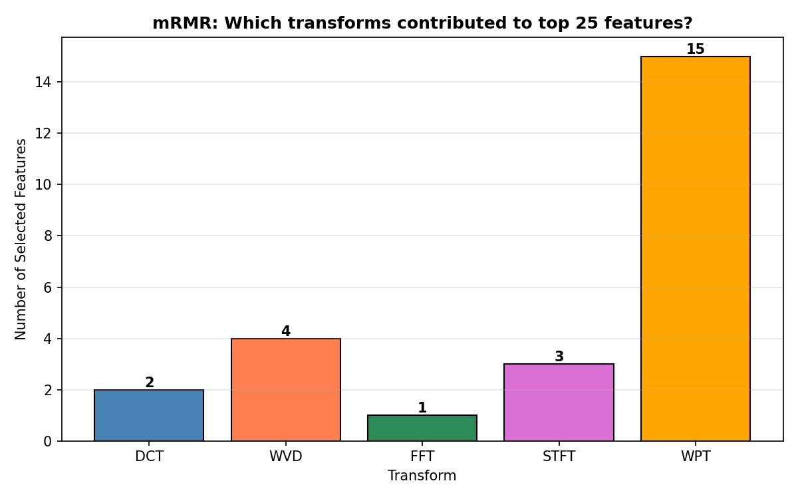
mRMR Feature Selection
WHY FEATURE SELECTION?
414 FEATURES → HIGH DIMENSIONALITY → CURSE OF DIMENSIONALITY → OVERFITTING RISK
MANY FEATURES ARE STATISTICALLY CORRELATED → REDUNDANT INFORMATION
SOLUTION: SELECT A SMALL, DIVERSE, INFORMATIVE SUBSET
mRMR CRITERION:
AT EACH STEP, SELECTS FEATURE F THAT MAXIMIZES:
Score(f) = I(f ; class) − (1/|S|) × Σ I(f ; s)
where:
I(f ; class) = mutual information between
feature and fault class → relevance
I(f ; s) = mutual information between f and
already-selected features → redundancy
S = set of already selected features
GREEDY ALGORITHM
SELECTS ONE FEATURE AT A TIME UNTIL 25 ARE CHOSEN.
RESULT
FEATURES THAT ARE MAXIMALLY INFORMATIVE ABOUT THE FAULT AND MAXIMALLY DIVERSE FROM EACH OTHER.
KEY FINDING CALLOUT:
WPT CONTRIBUTES 15 OUT OF 25 SELECTED FEATURES (60%) — CONSISTENT WITH PAPER'S TABLES VIII & IX. WPT'S MULTIRESOLUTION DECOMPOSITION OF BOTH HIGH AND LOW FREQUENCY SUB-BANDS MAKES IT THE MOST DISCRIMINATIVE TRANSFORM FOR FAULT DIAGNOSIS.
414 FEATURES → MRMR → 25 FEATURES (94% DIMENSIONALITY REDUCTION)
SAVED AS FEATURE_SELECT.PKL
7

Slide 11
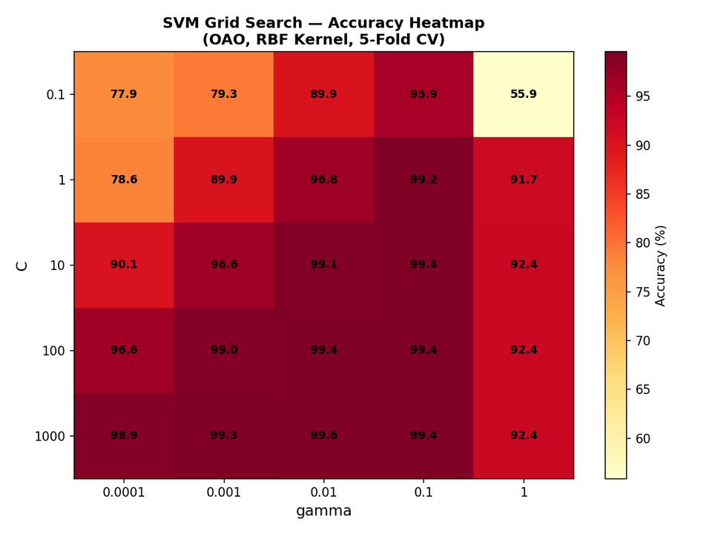
OAO SVM Classification
OAO SVM with RBF Kernel
WHY SVM?
MAXIMIZES MARGIN BETWEEN CLASSES
→ STRONG GENERALIZATION (VC DIMENSION THEORY)
RBF KERNEL HANDLES NON-LINEAR BOUNDARIES BETWEEN 8 FAULT CLASSES
K(X, X') = EXP(−Γ||X − X'||²)
PROVEN EFFECTIVENESS IN MACHINERY FAULT DIAGNOSIS LITERATURE
WHY OAO?
8 CLASSES → MULTICLASS STRATEGY NEEDED
OAO TRAINS ONE BINARY SVM PER CLASS PAIR: 8×7/2 = 28 BINARY CLASSIFIERS
FINAL PREDICTION BY MAJORITY VOTING
PREFERRED OVER OAA: OAA USES ALL 1800 SAMPLES PER CLASSIFIER → SLOWER, CLASS IMBALANCE
OAO USES ~450 SAMPLES PER CLASSIFIER → FASTER, BALANCED
GRID SEARCH
C ∈ {0.1, 1, 10, 100, 1000}
FEATURE_SELECT.PKL → 25 SELECTED FEATURE NAMES & INDICES
Γ ∈ {0.0001, 0.001, 0.01, 0.1, 1}
SCALER.PKL → STANDARDSCALER PARAMETERS
25 COMBINATIONS, EACH EVALUATED WITH 5-FOLD CV
SVM_MODEL.PKL → 28 TRAINED BINARY CLASSIFIERS
BEST: C = 1000, Γ = 0.01
8

Slide 12
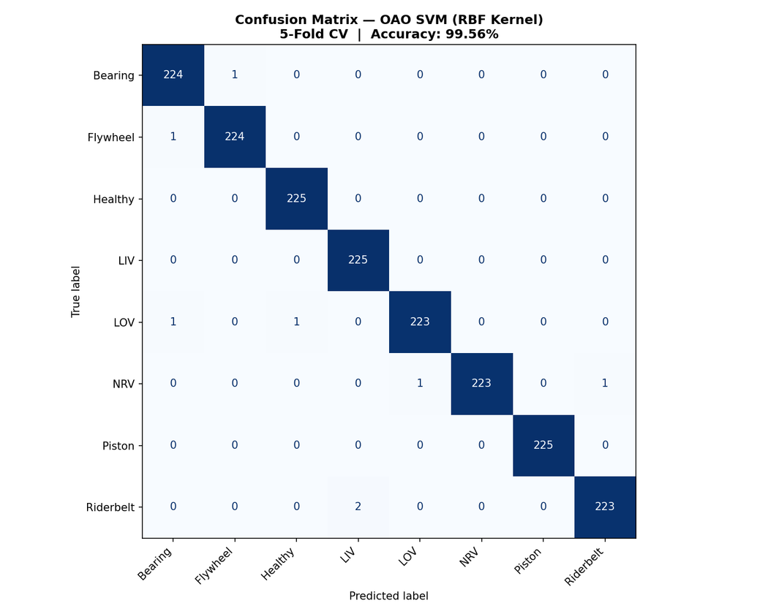
Experimental Results
99.56%
8/1800
C = 1000
Γ = 0.01
CLASS
RESULT
NOTE
FINAL ACCURACY (5-FOLD CV)
MISCLASSIFIED
BEST C
BEST Γ
HEALTHY
225/225
PERFECT
LIV
225/225
PERFECT
PISTON
225/225
PERFECT
BEARING
224/225
1 → FLYWHEEL
FLYWHEEL
224/225
1 → BEARING
LOV
223/225
1→BEARING, 1→HEALTHY
NRV
223/225
1→LOV, 1→RIDERBELT
RIDERBELT
223/225
2 → LIV
INSIGHT CALLOUT:
ALL MISCLASSIFICATIONS OCCUR BETWEEN ACOUSTICALLY SIMILAR FAULT TYPES — BEARING AND FLYWHEEL (BOTH ROTATING COMPONENT FAULTS), NRV AND LOV (BOTH AIR LEAKAGE FAULTS). THIS IS PHYSICALLY EXPECTED BEHAVIOUR, NOT A MODEL WEAKNESS.

Slide 13
Discussion
Comparison with Paper
WPT DOMINANCE
PARAMETER
VERMA ET AL.
(2016)
OUR
IMPLEMENTATION
WPT IS THE ONLY TRANSFORM THAT DECOMPOSES BOTH APPROXIMATION AND DETAIL COEFFICIENTS AT EVERY LEVEL
7 LEVELS → 254 SUB-BANDS → CAPTURES ENERGY AT VERY SPECIFIC NARROW FREQUENCY BANDS
DIFFERENT FAULTS AFFECT DIFFERENT SPECIFIC SUB-BANDS → WPT DETECTS THESE DIFFERENCES
DWT ONLY DECOMPOSES THE LOW-FREQUENCY BRANCH → MISSES HIGH-FREQUENCY FAULT SIGNATURES
SIGNAL TRANSFORMS
5
5
INITIAL FEATURES
414
414
SELECTED FEATURES
25
25
FEATURE SELECTION
mRMR
mRMR
COMPUTATIONAL NOTE
CLASSIFIER
OAO SVM, RBF
OAO SVM, RBF
WVD HAS O(N²) COMPLEXITY → RESAMPLED TO 8192 POINTS FROM 50,000
DID NOT AFFECT ACCURACY - FEATURES ARE NORMALIZED ENERGY RATIOS, NOT RAW SAMPLE VALUES
PRACTICAL ENGINEERING DECISION DEMONSTRATING REAL WORLD DEPLOYMENT CONSIDERATIONS
ACCURACY
~99.50%
99.56%

Slide 14
Conclusion
SUCCESSFULLY IMPLEMENTED THE COMPLETE OPERATIONAL FAULT DIAGNOSIS FRAMEWORK
RECOMMENDED BY VERMA ET AL. (2016)
MULTI-DOMAIN FEATURE EXTRACTION ACROSS 5 TRANSFORMS PRODUCED A COMPREHENSIVE 414-DIMENSIONAL FEATURE VECTOR
MRMR REDUCED DIMENSIONALITY BY 94% (414 → 25 FEATURES) WHILE PRESERVING DIAGNOSTIC INFORMATION
WPT CONTRIBUTED 15/25 SELECTED FEATURES — CONFIRMING ITS SUPERIOR DISCRIMINATIVE CAPABILITY FOR COMPRESSOR FAULT DIAGNOSIS
OAO SVM WITH RBF KERNEL ACHIEVED 99.56% ACCURACY - MATCHING AND MARGINALLY EXCEEDING THE PAPER'S 99.50%
ONLY 8 OUT OF 1800 RECORDINGS MISCLASSIFIED — ALL BETWEEN PHYSICALLY SIMILAR FAULT CLASSES
THE IMPLEMENTED FRAMEWORK VALIDATES THAT COMBINING MULTI-DOMAIN SIGNAL PROCESSING WITH INTELLIGENT MACHINE LEARNING PROVIDES AN ACCURATE, EFFICIENT, AND PRACTICALLY DEPLOYABLE SOLUTION FOR INDUSTRIAL FAULT DIAGNOSIS.

Slide 15
IIT KANPUR
EE656
COURSE PROJECT
THANK YOU !!

