Slide 1

QA Automation Middle Project
this project aims to automate testing for a web application to ensure its functionality, usability, and reliability across various features. By leveraging automated testing tools and. The project aims to ensure the quality and functionality of a simulated shopping website.
by Sabeel Elbedour

Slide 2
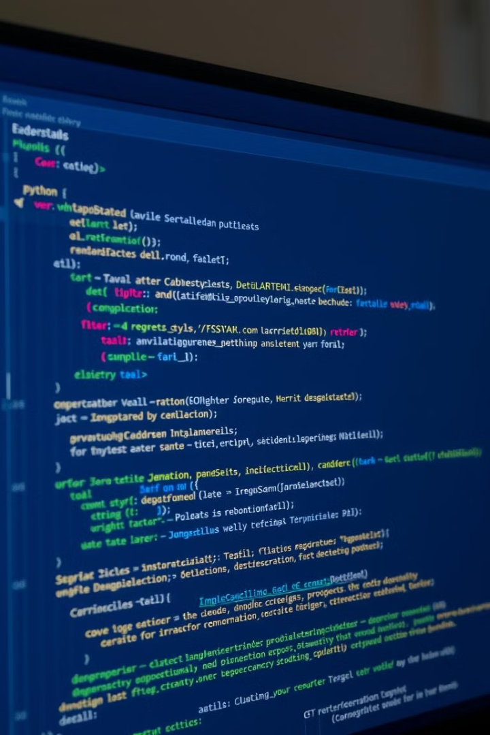
Methods and Libraries
Object-Oriented Programming
The project leverages the OOP methodology, allowing for code reusability and maintainability.
*
1
Selenium
2
Pytest
Selenium is a widely used automation framework, providing tools to interact with web browsers.
Pytest serves as a robust testing framework, enabling the creation of comprehensive test suites.
3
re
4
os
Regular expressions are utilized for pattern matching and data validation within the tests.
provides functions to interact with the operating system, enabling file, directory, and process management in a cross-platform way.

Slide 3
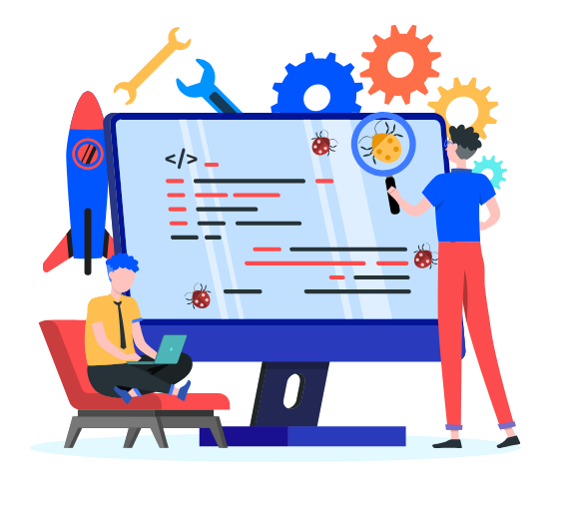
Categories and Tests
Home Page
Products
Recommended items Carousel
Search Term Verification - Saree
Back to Top button
Brands-polo
Subscription Verification
Product Count
Category Navigation
Search Term Verification-dress
Add Review on a product

Slide 4

Categories and Tests
Cart
UI-Nonfunctional
adding,
removing
verifying item counts
checking the total price in the shopping cart
Subscription section visibility
Verification of button color
font styles
font sizes
spelling accuracy
hover effects.
Contact Us
control titles text
insert details with invalid email
enter valid information
add file
home button functionality

Slide 5
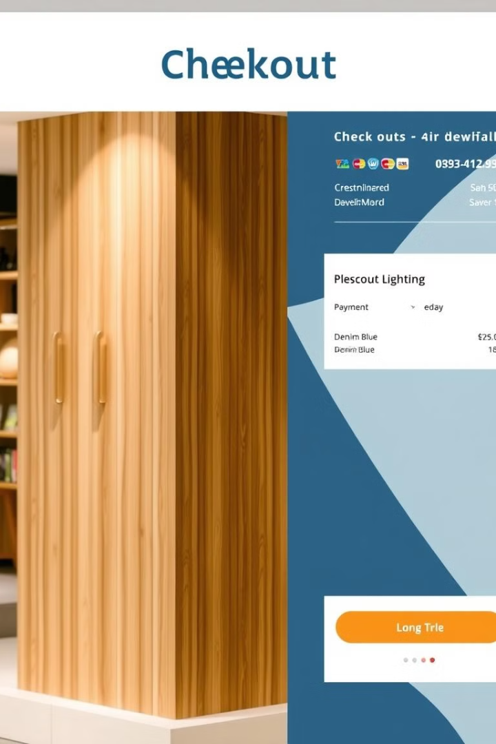
Categories and Tests
Checkout
Login/Sign In
Checkout page visibility after
login
Register valid username and password
Checkout login alert
Logout user
Login while Checkout
Register with empty fields
Place order
Register user with existing email
Verify address details
Delete account
Check empty cart after checkout
Login with incorrect details
Invoice download
Valid login

Slide 6
demo
Now I will present some of the test preforming automatically,
Code is written in python
On Visual Studio Code

Slide 7
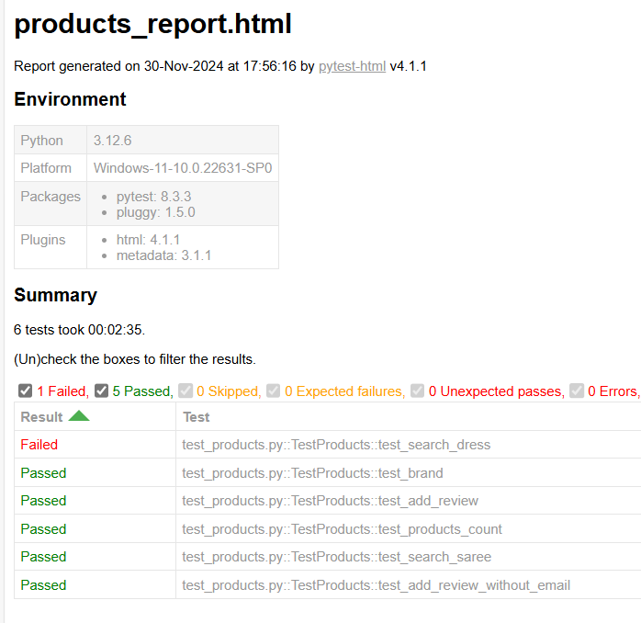
Html Report

Slide 8

Thank You

