Slide 1
STOCK MARKET PREDICTION

Slide 2
OUR TEAM
Mohd Sabeel Uddin Syed Arbaz Amena Sarah
1604-19-737-111 1604-19-737-101 1609-19-737-093
Under the Guidance of :
Dr. Gouri R. Patil
IT-Dept,MJCET

Slide 3
INTRODUCTION
In previous years, It was difficult to predict the stock market because lack of technology and knowledge. In present days, technology increases day by day and now we can predict the stock market easily when compared to past. We can predict stock price by analyzing the previous data by using machine learning techniques.

Slide 4
EXISTING SYSTEM
In existing method analysis we used convolutional neural network (CNN) for the classification. But, we got less training accurate results for the given data set. We should improvise the accuracy to get less false output results for the future predictions.

Slide 5
DISADVANTAGES OF EXISTING SYSTEM
Less amount of accuracy score
Small level Data Set
Applicable on Small level prediction work
Time taken is high

Slide 6
PROBLEM STATEMENT
This research on the stock market prediction is mainly used for predicting the stock market prices based upon date time datatype. This date time datatype is mainly used to sort out the problem which we’re facing regularly in selecting the company for investing in the stock market trading.

Slide 7
PROPOSED SYSTEM
In our proposed system, we are implementing K-means clustering.
We are collecting the past data sets for future prediction by using Random forest algorithm.
ADVANTAGES :
Accuracy level is high.
Time consumption is less.

Slide 8
K-MEANS CLUSTERING
Clustering is a type of unsupervised learning wherein data points are grouped into different sets based on their degree of similarity.
K-Means clustering is an unsupervised learning algorithm which groups the unlabeled data set into different clusters.
K-Means performs the division of objects into clusters that share similarities and are dissimilar to the objects belonging to another cluster.
The term ‘K’ is a number. You need to tell the system how many clusters you need to create. For example, K = 2 refers to two clusters.

Slide 9
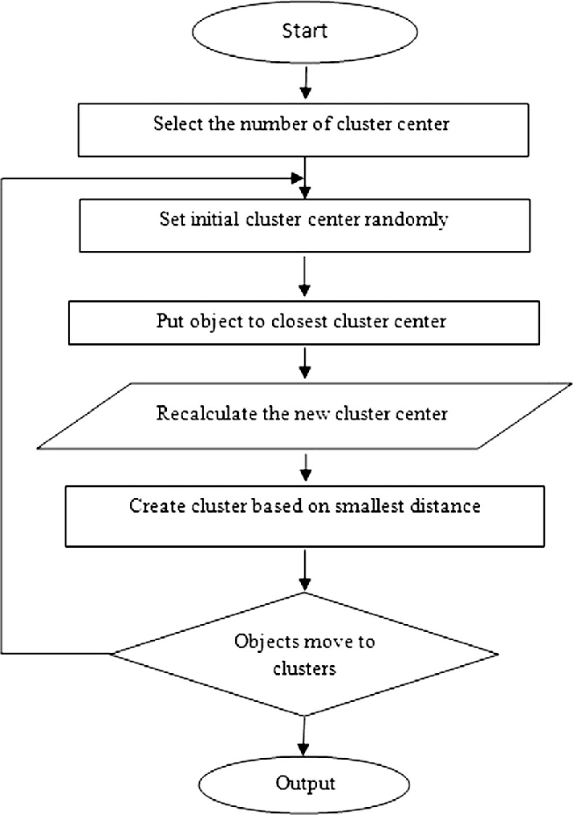
FLOW CHART

Slide 10
RANDOM FOREST ALGORITHM
Random Forest is a classifier that contains a number of decision trees on various subsets of the given dataset and takes the average to improve the predictive accuracy of that dataset. Instead of relying on one decision tree, the random forest takes the prediction from each tree and based on the majority votes of predictions, and it predicts the final output.

Slide 11
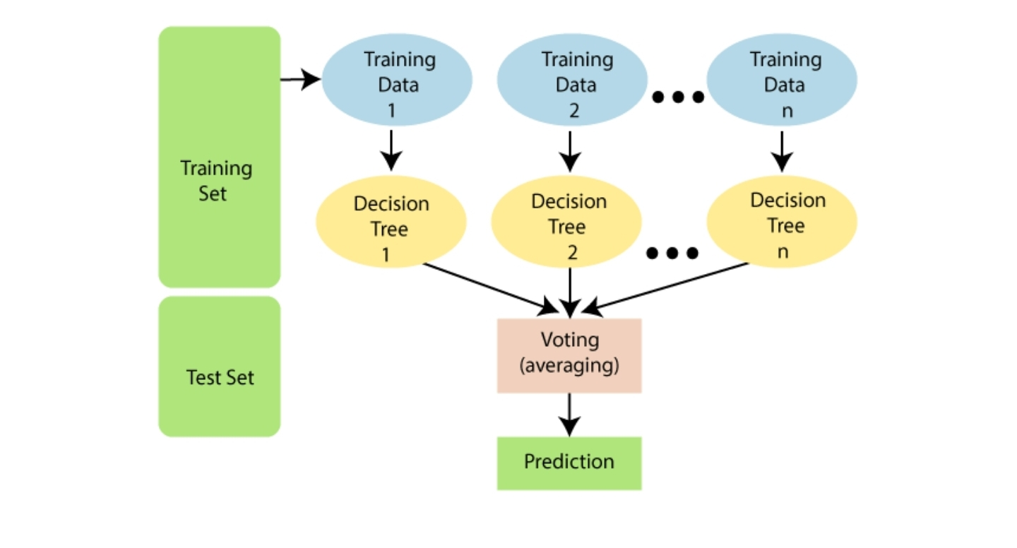

Slide 12
HOW DOES RANDOM FOREST ALGORITHM WORK?
Random Forest works in two-phase first is to create the random forest by combining N decision trees
And second is to make predictions for each tree created in the first phase.

Slide 13
Step-1: Select random K data points from the training set.
Step-2: Build the decision trees associated with the selected data points
Step-3: Choose the number N for decision trees that you want to build.
Step-4: Repeat Step 1 & 2.
Step-5: For new data points, find the predictions of each decision tree, and assign the new data points to the category that wins the majority votes.

Slide 14
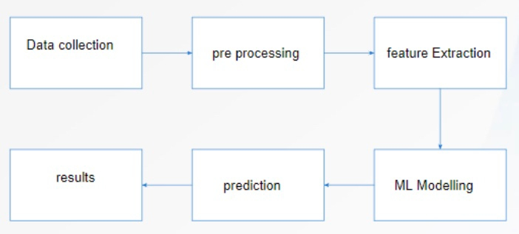
SYSTEM ARCHITECTURE

Slide 15
DATA COLLECTION
Our input data will be collected in a dataset format which is consisting of past records.
DATA PRE-PROCESSING
Formatting- improper data will be converted into a proper format.
Cleaning- filtering of data by eliminating all unwanted data present in our input .
Sampling – our filtered data will be divided into number of samples .

Slide 16
SYSTEM REQUIREMENTS
HARDWARE :
Windows 7,8,9,10,11
Ram 4GB
SOFTWARE :
Anaconda navigator
Python language
Jupyter notebook

Slide 17
LITERATURE SURVEY
S.NO
AUTHOR
TITLE
SOURCE
REFERENCE
Du Peng (Dalian Ocean University; Liaoning Dalian 1
Analysis of Investor Sentiment and Stock Market Volatility
Trend Based on Big Data Strategy.
In this paper, we survey of well known efficient regression approach to predict the stock market price
1.
IEEE XPLORE
Stock Market Prediction using Supervised Machine Learning
Techniques
2.
Zaharaddeen Karami ,Hayati Yassin , Rufai Yusuf Zakar
IEE XPLORE
Data set as a reference for Stock market price

Slide 18
AUTHOR
TITLE
SOURCE
REFERENCE
S.NO
CH.RAGA MADHURI ,MUKESH CHINTA,N V PHANI
KUMAR
Stock Market Prediction for Time-series Forecasting
using Prophet upon ARIMA
Filtering and analysing of the data
3.
IEEE XPLORE
4.
Stock Price Prediction Using CNN and LSTMBased Deep
Learning Models
IEE XPLORE
The data is being refered in a statistical way but limited to financial markets
Sidra Mehtab, Jaydip Sen

Slide 19
LITERATURE SURVEY
S.NO
AUTHOR
TITLE
SOURCE
REFERENCE
5.
Umadevi.K.S*, Abhijitsingh Gaonka, umadeviks R. Jagadeesh
Kannan
Analysis of Stock Market using Streaming data Framework
In this paper, we survey of well known efficient regression approach to predict the stock market price
IEEE XPLORE

Slide 20
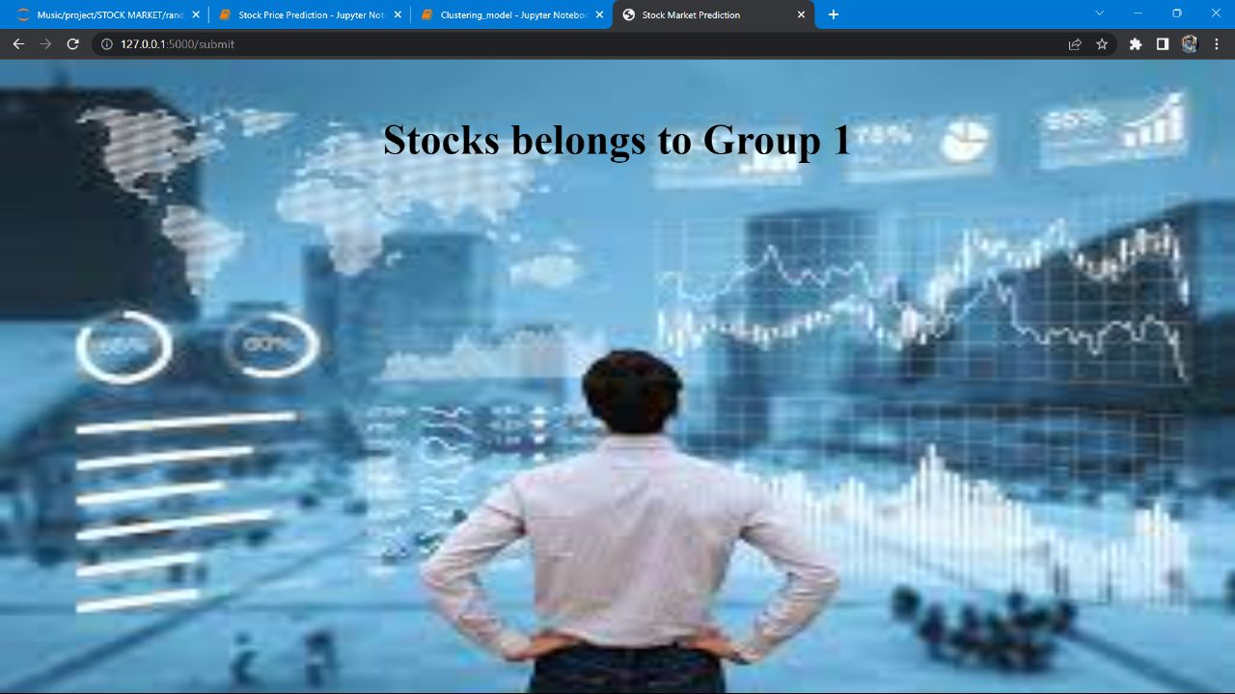
OUTPUT SCREENSHOTS
.

Slide 21
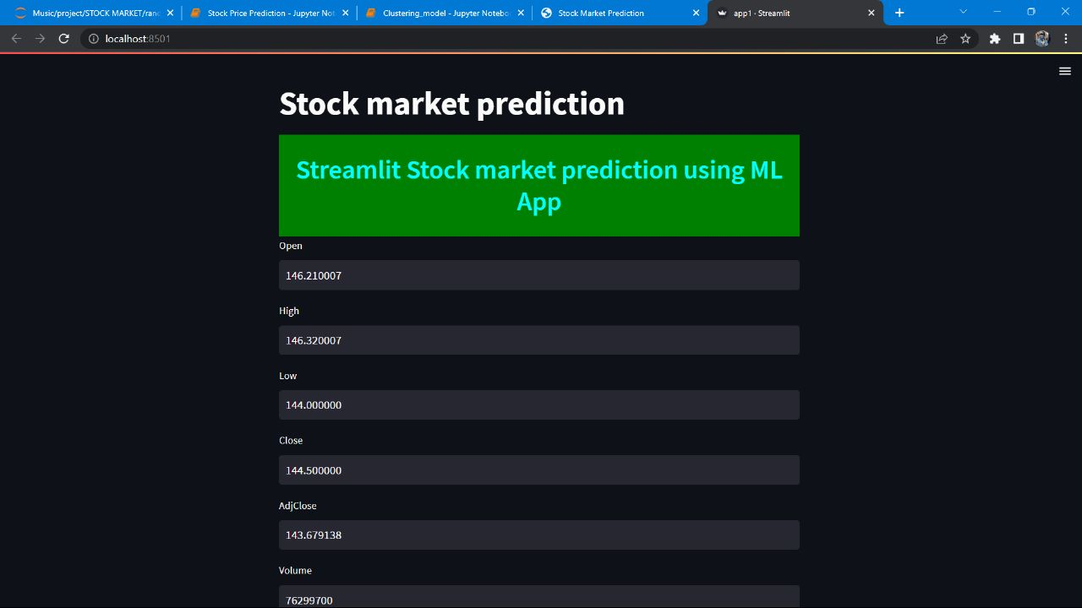

Slide 22
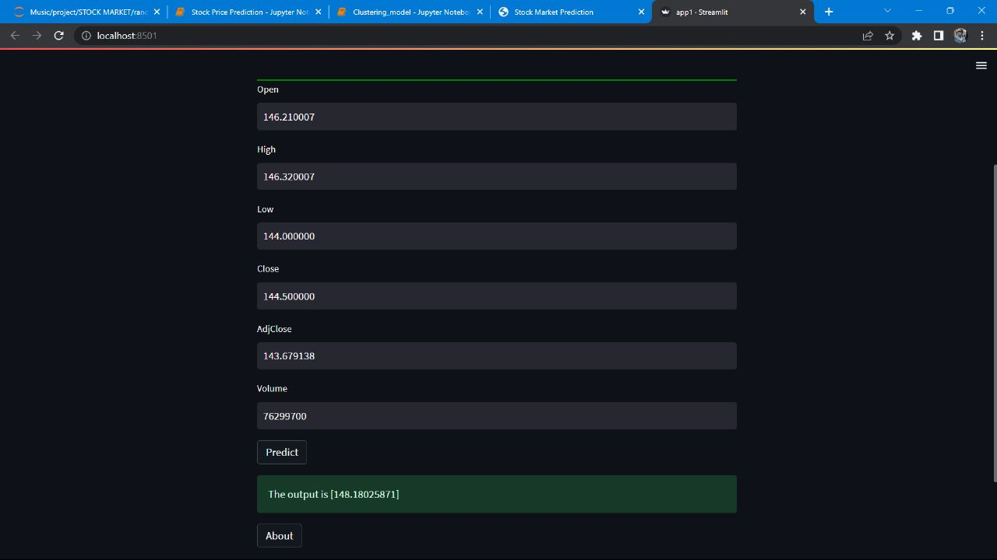

Slide 23
~ THANK YOU ~

