Slide 1

House Price Prediction using Random Forest Regressor
Presentation partners:
Tasadduq Hussain (CSC-21F-126)
And
Sabeen khan (CSC-21F-109)

Slide 2

Introduction
Project Overview:
The project aims to predict house prices in Dallas, TX using machine learning techniques, specifically Random Forest Regressor.
Predicting house prices accurately is crucial for real estate investors, buyers, and sellers alike.
Objective:
To develop a predictive model that estimates house prices based on various features such as crime rate, zoning, and other socio-economic factors.
Technologies Used:
Streamlit for creating an interactive user interface.
Python libraries including Pandas for data manipulation and Scikit-learn for machine learning.

Slide 3

Dataset Overview and Preprocessing
Dataset Description:
Utilizing the Brooklyn House Price Dataset which includes features like crime rate (CRIM), zoning (ZN), industrial proportion (INDUS), etc.
Target variable: MEDV (Median value of owner-occupied homes in $1000’s).
Data Preprocessing:
Data cleaned to remove missing values ensuring dataset integrity.
Features selected based on their relevance to house price prediction.

Slide 4
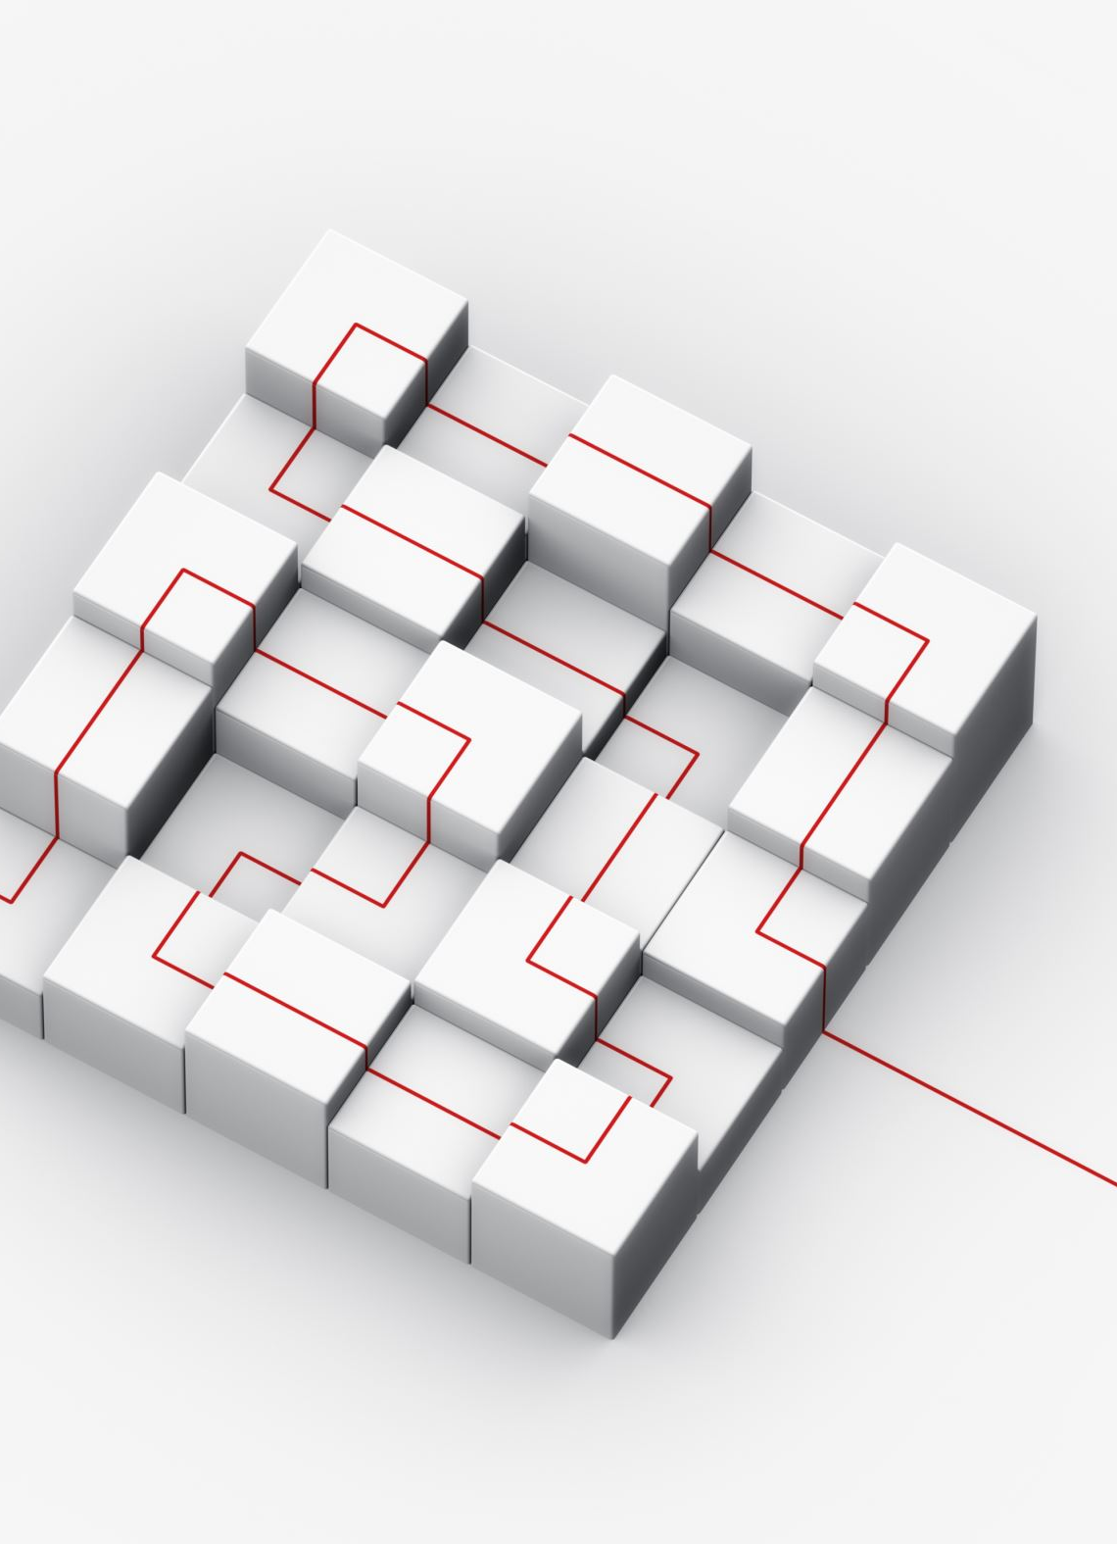
Methodology
Model Selection: Random Forest Regressor
Chosen for its ability to handle complex relationships and maintain good performance on various datasets.
Ensemble method combining multiple decision trees to improve prediction accuracy.
User Interface (UI) Design using Streamlit:
Streamlit used to create an intuitive UI allowing users to input parameters such as crime rate, zoning, and others.
Sidebar sliders used for dynamic parameter adjustment.

Slide 5

Model Training and Evaluation
Model Training:
Random Forest Regressor trained on features (X) and target variable (Y) from the dataset.
Cross-validation used to ensure robustness and generalizability of the model.
Model Evaluation:
Performance metrics such as RMSE (Root Mean Squared Error) and R-squared used to evaluate model accuracy.
Discuss achieved accuracy and insights gained from model evaluation.

Slide 6

Results and Predictions
Example of User Input:
Showcase how users interact with the UI by adjusting sliders for parameters like crime rate, zoning, etc.
Prediction:
Display a sample prediction result showing the estimated house price (MEDV) based on user inputs.

Slide 7

Conclusion
Summary of Findings:
Successfully developed a Random Forest Regressor model for predicting house prices in Dallas, TX.
Key factors influencing house prices identified through the model.

