Slide 1

Anemometer Data Comparison Dashboard
Project 3
Steph Abegg

Slide 2
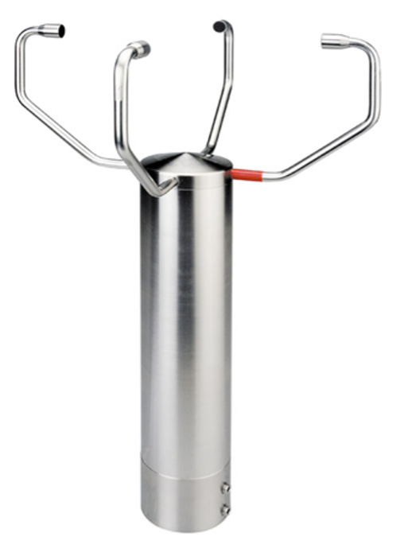
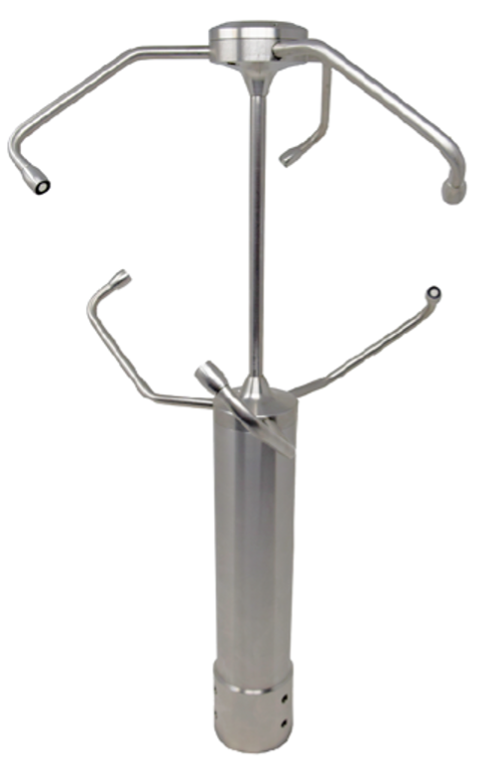
Research Question
Can 2D anemometer data such as temperature, wind direction, and wind speed can be used as a substitute for the equivalent measurements from a 3D anemometer?
This would be particularly beneficial during the times when a 3D anemometer is iced up (3D anemometers are more prone to icing up than 2D).
To address this question, we analyze data collected from a 2D anemometer and a 3D anemometer at the same location during the same 30-day time frame. The 15-minute averaged temperatures, wind directions, and wind speeds are directly compared via timeseries plots, regression analysis, and binning.
2D anemometer
3D anemometer

Slide 3
The Data
Data from a 2D anemometer and 3D anemometer.
Located in North Dakota at 47.8437 N, 102.8524 W, elevation 2300 ft above sea level.
Provided by LongPath Technologies, Inc. (Methane monitoring service based in Boulder, CO.)
Data spans 30 days from February 11, 2024 to March 11, 2024.
Measure on five-second intervals. Data averaged into 15-minute intervals.
The raw 2D anemometer data contains 472,048 rows. The raw 3D anemometer data contains 420,917 rows. After 15-minute intervals, 2344 rows.
The relevant columns include: Date and time; Number of internal data points used to compute the measurements corresponding to a single time; Temperature; Wind direction in degrees (North: 0°, East: 90°); Wind speed; Wind elevation (3D anemometer only).

Slide 4
Preparing the Data : Data Cleaning
The UTC time column was changed into a datetime64 format.
The seconds column was added to the UTC time.
Columns that were not needed for the analysis were removed.
Columns were renamed to clarify units (e.g. “temp” to “temp_C”, “wspd” to “wspd_mps”).
Rows with null values were dropped.
Any rows where the temperature was outside of -30°C to 30°C were removed (2D anemometer).
Any rows where the number of internal data points (‘n_pts’) was less than five were removed.
The data was checked for duplicate rows.
The wind speed from the 3D anemometer was adjusted to just the horizontal component multiplying by the cosine of the wind elevation.
The wind speeds for the 2D anemometer were corrected using the wind shear formula so the anemometers represented the same heights above the ground. (3D: 3m, 2D: 5.2m)

Slide 5
Preparing the Data : Adding Columns
Local time.
Date and hour of day, both in local time.
Minute. This was used for binning into 15-minute intervals.
Bin for 15-minute intervals, starting on the hour.
Cosines and sines of the wind direction. This was needed for the circular averaging of the wind direction over the 15-minute bins.
Temperature in degrees Fahrenheit.
Wind speed in miles per hour.

Slide 6
Preparing the Data : Joined Dataframe
New dataframes were created for each of the 2D and 3D anemometer data sets, by averaging temperature, wind direction, and wind speed over 15-minute intervals.
A dataframe was created via an outer join of the 15-minute averaged 2D anemometer data with the 15-minute averaged 3D anemometer data, joining on date, hour, and 15-minute bin.
For all but the four days where one or both of the anemometers were iced up, this gives a 1 to 1 comparison of measurements.
New columns were added for the differences between the 15-minute average 2D and 3D (2D-3D) wind speed, wind direction, and tempearture for the same 15-minute windows.

Slide 7
The Dashboard
https://sabegg2.github.io/Project3/

Slide 8
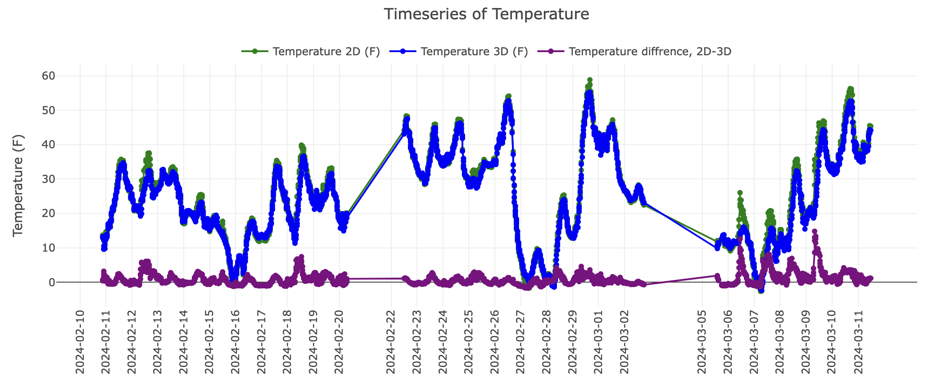
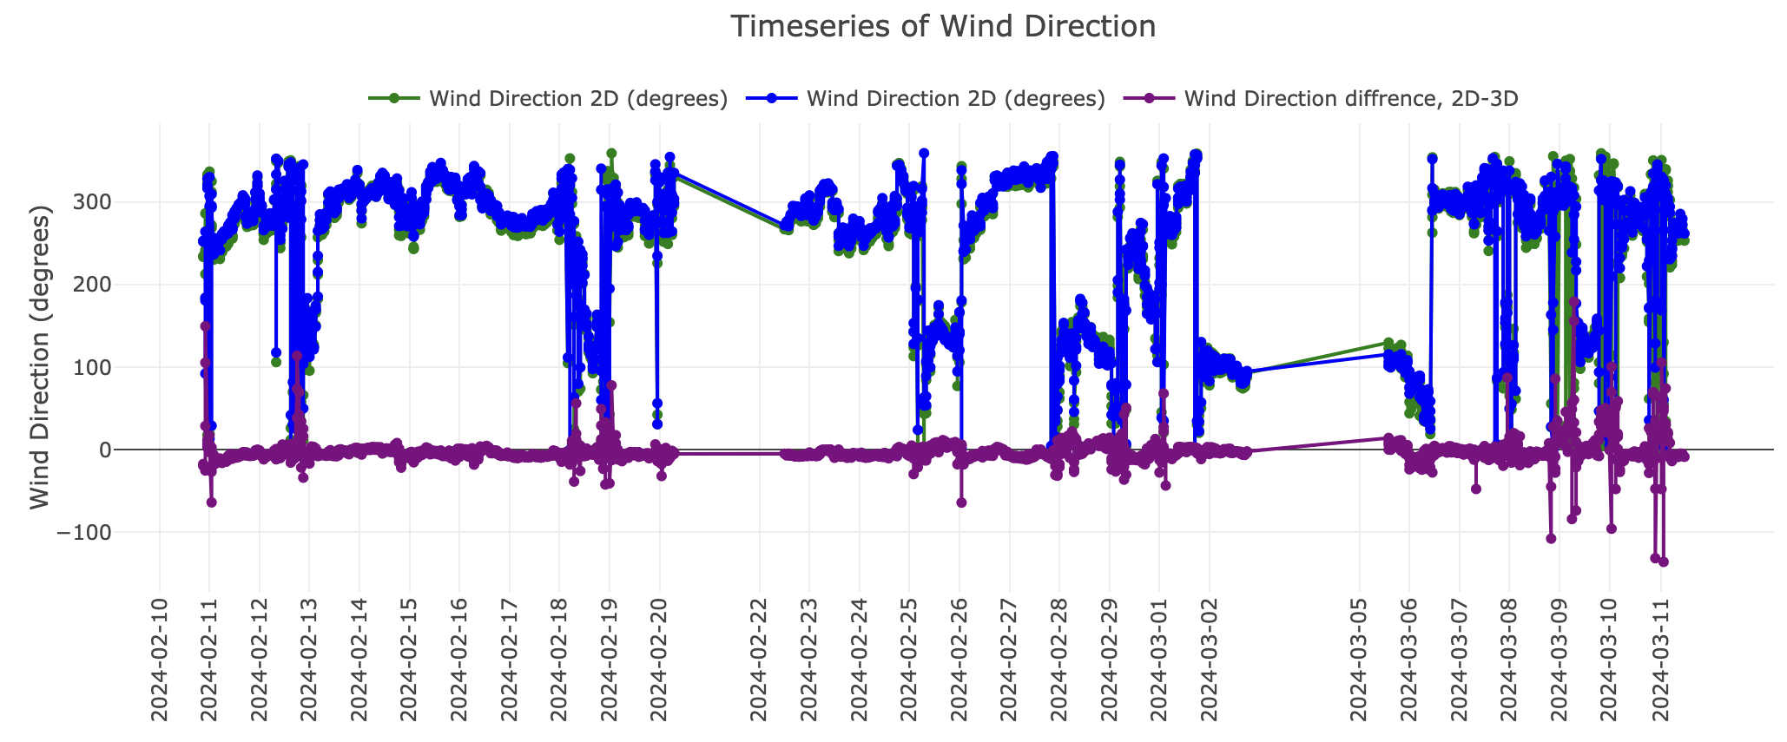
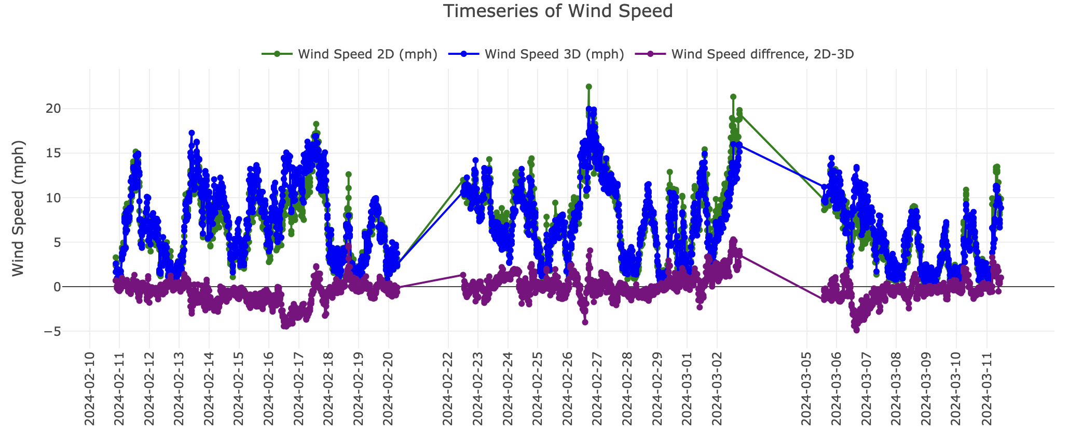
Analysis : Timeseries

Slide 9
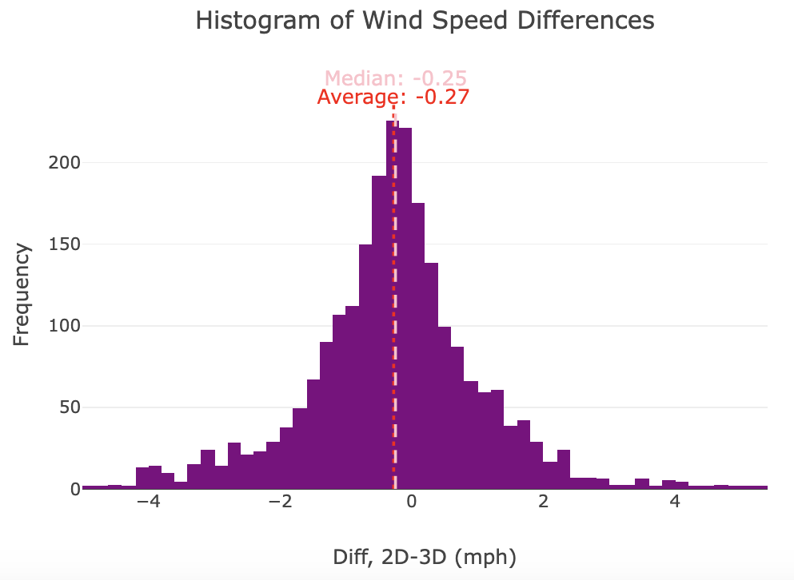
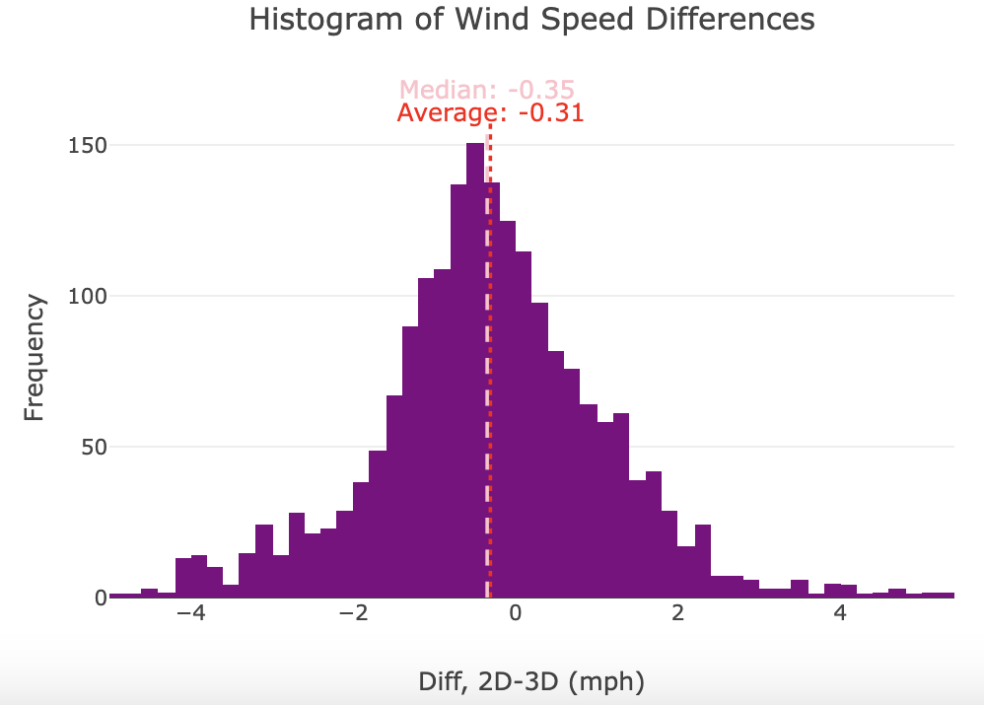
Analysis : Histograms of Wind Speed Differences (2D-3D)
All wind speeds
Wind speed > 1m/s (2.2 mph)

Slide 10
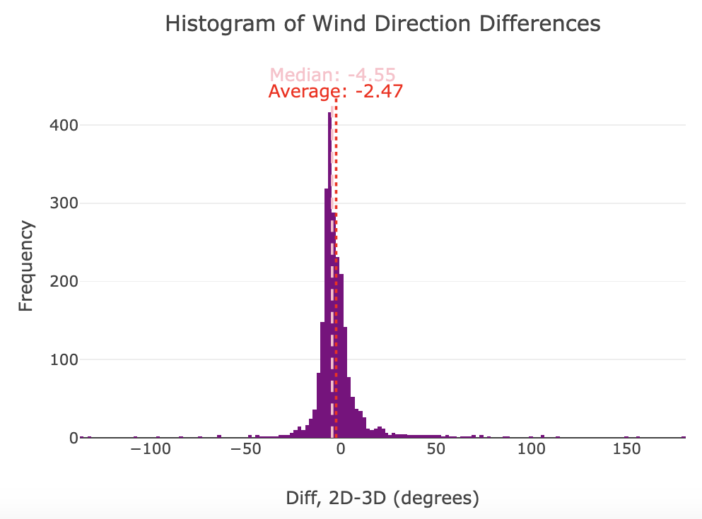
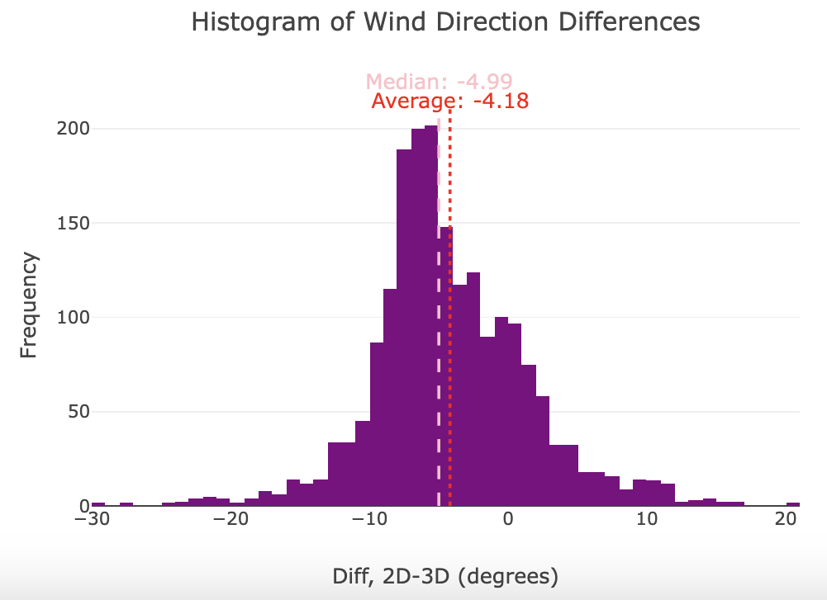
Analysis : Histograms of Wind Direction Differences (2D-3D)
All wind speeds
Wind speed > 1m/s (2.2 mph)

Slide 11
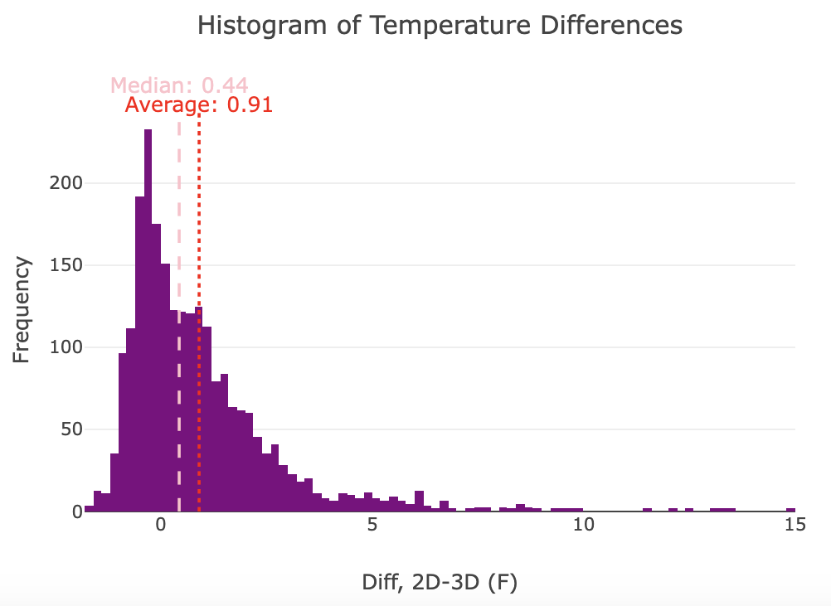
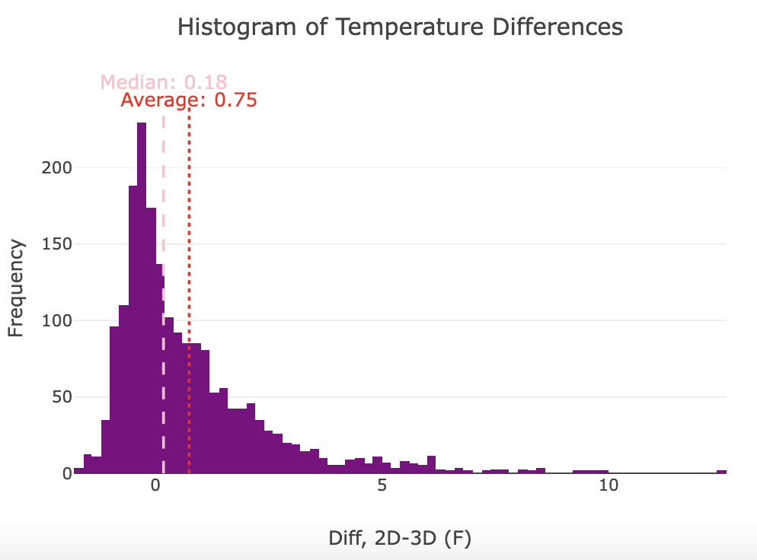
Analysis : Histograms of Temperature Differences (2D-3D)
All wind speeds
Wind speed > 1m/s (2.2 mph)

Slide 12
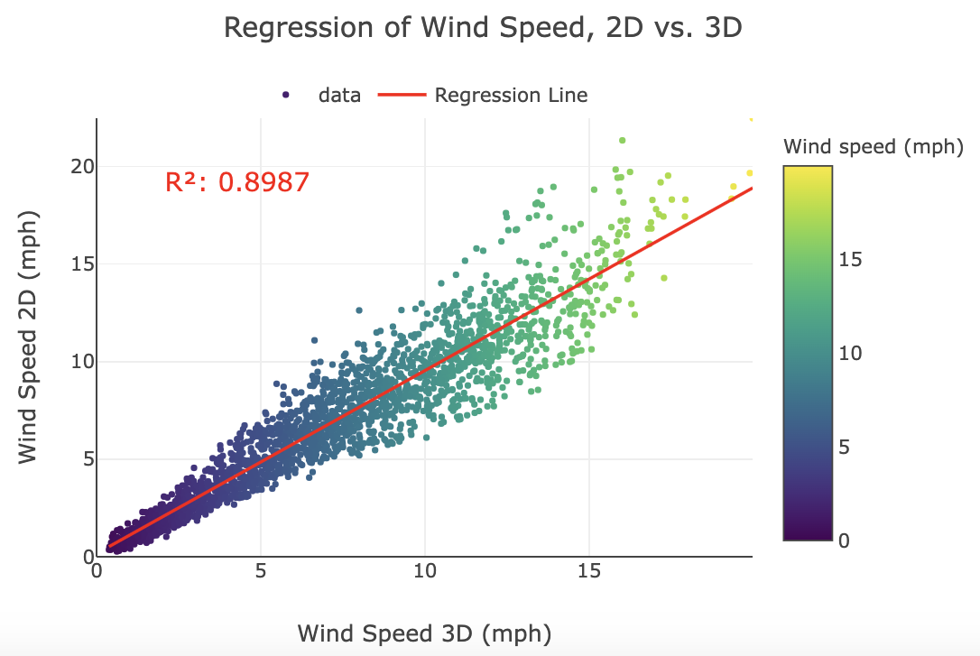
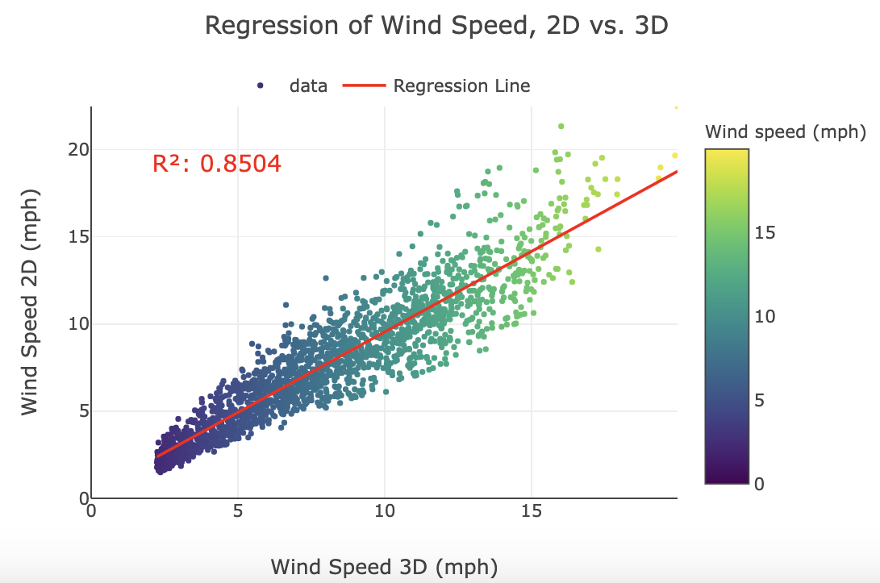
Analysis : Linear Regression Wind Speed (2D vs. 3D)
All wind speeds
Wind speed > 1m/s (2.2 mph)

Slide 13
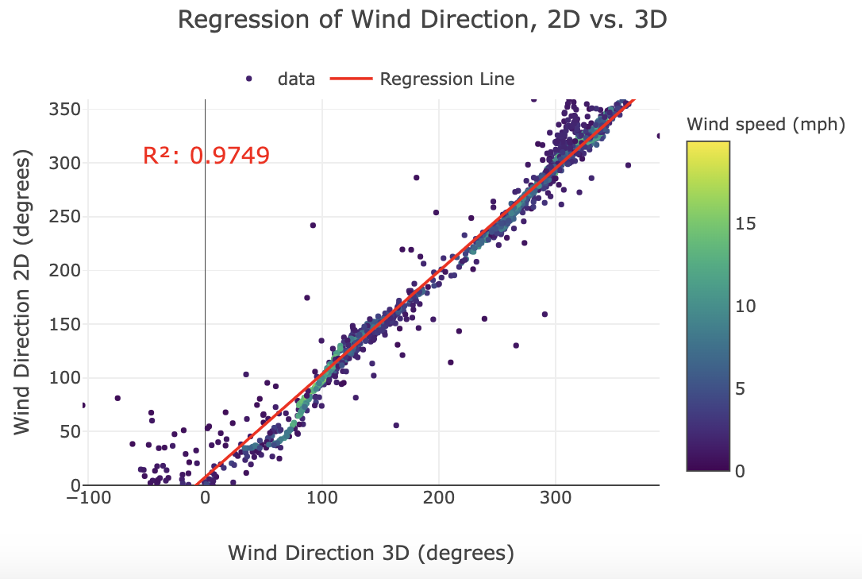
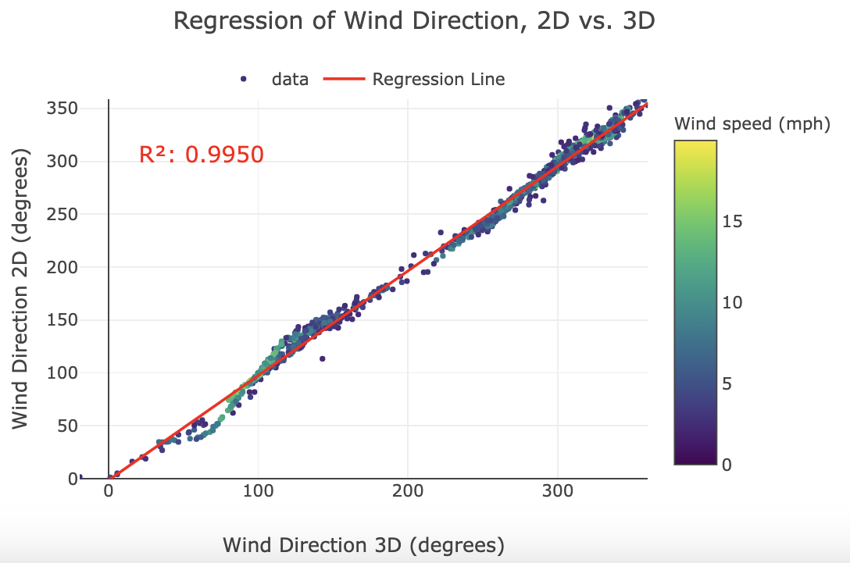
Analysis : Linear Regression Wind Direction (2D vs. 3D)
All wind speeds
Wind speed > 1m/s (2.2 mph)

Slide 14
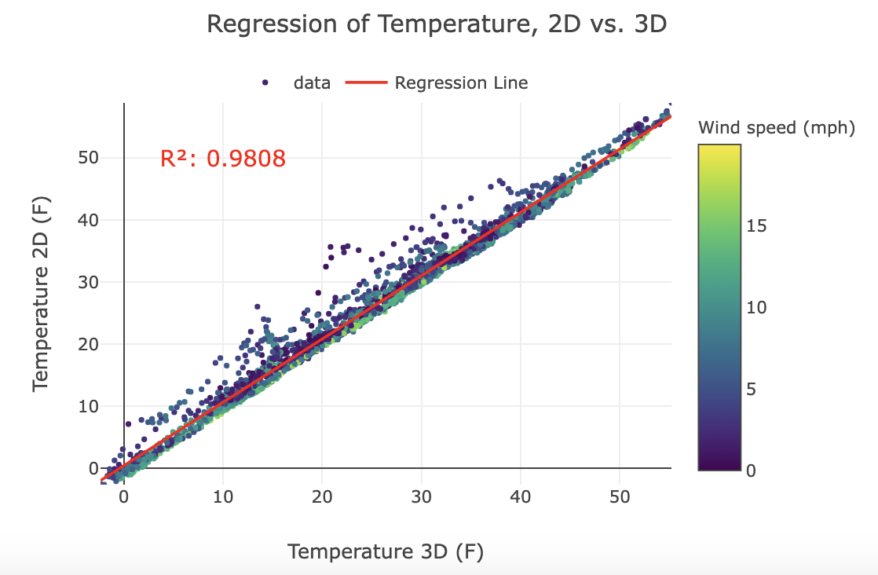
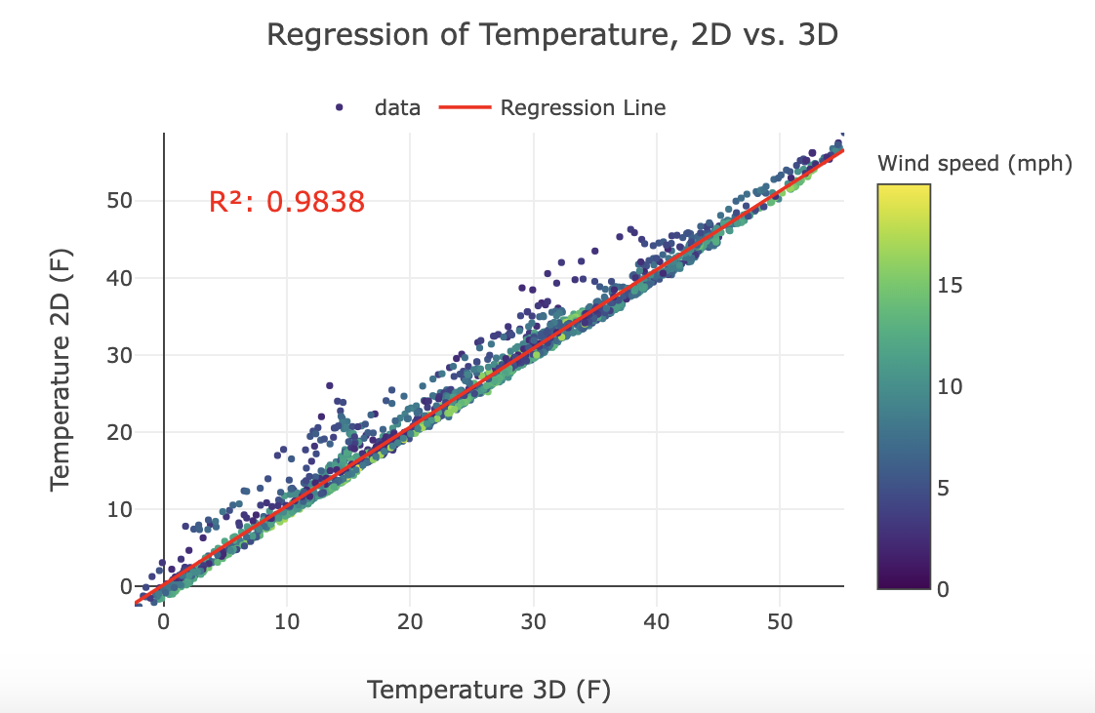
Analysis : Linear Regression Temperature (2D vs. 3D)
All wind speeds
Wind speed > 1m/s (2.2 mph)

Slide 15
Analysis : Conclusions
The measurements of wind speed, wind direction, and temperature from the 2D and 3D anemometer show themselves to be very similar and with a strong linear relationship.
There is some scatter in the data, but when averaged over time, the values are within a reasonable error tolerance.
Removing data with low wind speeds (less than 1m/s, the typical threshold for reliable measurements anyway) reduces the scatter.
This all suggests that the 2D anemometer data can be used instead of the 3D anemometer data if needed.

Slide 16
Assumptions Made in Study
The anemometers are oriented correctly and were in normal operation during the timespan of the datasets.
The wind shear formula applies to correcting the wind speeds for height.
Both anemometers are placed in the open and surrounded by similar terrain and not located close to any heat sink or source.
The anemometer data was collected for 30 days during the winter in North Dakota, when weather can be quite harsh. This analysis assumes that the weather and conditions do not affect the results. It also assumes that this 30-day window is representative of general behavior at any time.

Slide 17
Database, Library Not Covered In Class, Ethical Concerns
Stored data in a local database. To access the data, I wrote a Node.js server that queries my PostgreSQL database and serves the data over HTTP as a json file. For the data to display, my local server needs to be running.
I used three libraries not previously covered in class: pg, express, and cors. All were involved in interacting with PostgreSQL databases from a Node.js application.
Data is not considered confidential, since historical wind data is accessible to anyone who wants to install their own anemometer or from several local forecasting stations. No ethical issues with its usage since there is no identifying information about the site or persons involved.

Slide 18
?

