Slide 1

International Trade
Theory and Practice
国际贸易理论与实务
授课教师：詹 君 恒
Tel: 0595-28099925/22693331
Email: equ007@hotmail.com

Slide 2
INTRODUCTION
-Basic objective of this course
To understand basic international theories and concepts;
To understand the procedures of international trade;
To grasp the professional expressions and terms;
To enhance abilities in professional English;
Etc.

Slide 3
INTRODUCTION
-About test
1. There is a written test at the end of the course, which will charge 70% of your total score.
2. Other 30% will depend on your performance in class times through the whole semester and your homework.

Slide 4

Chapter 1
An Introduction to International Trade

Slide 5
Learning Objectives
1. To understand why international trade takes place;
2. To learn the differences between international trade and domestic trade;
3. To understand the history and importance of international trade;
4. To appreciate the opportunities offered by international trade;
5. To learn the history and importance of China’s foreign trade;
6. To learn the basic concepts in international trade.

Slide 6
§1. The need for International Trade

Slide 7
 The differences between international trade and domestic trade
The Fundamental characteristic that makes international trade different from domestic trade is that international trade involves activities that take place across national borders.
In Particular:

Slide 8
 The differences between international trade and domestic trade
1. Deals might have to be transacted in foreign languages and under foreign laws, customs and regulations;
2. Information may be difficult to obtain;
3. Culture differences have to be taken into account;
4. Control and communication systems are more complex;
5. Foreign currency transactions will be necessary. Exchange rate variations will affect international trade greatly;

Slide 9
 The differences between international trade and domestic trade
6. Risks levels might be higher in foreign market. Risks includes:
political risks (imposition of restrictions on imports, etc.);
commercial risks (market failure, products not appealing to foreign customers, etc.);
financial risks (adverse movements in exchange rates, etc);
transportation risks.
7. A broader range of management skills is needed.

Slide 10
 A brief history (The role of international trade in history)
Ever since the first national borders were formed, international trade has been conducted by nations and individuals. In many cases, international trade itself has been a major force in shaping borders and changing the world history.
 Please study this part after class to get a basic understanding of the history of international trade.

Slide 11
 Opportunities offered to firms by international trade
It helps firms to achieve economies of scale;
It hones firms competitive skills by meeting the challenge of foreign products.
☺ What other opportunities does international trade bring to firms? How about challenges?

Slide 12
§3. Basic Concepts in International Trade

Slide 13
1. Favorable balance of trade vs. unfavorable balance of trade
When nations export more than they import within a certain period (usually one year), they are said to have a favorable balance of trade (positive trade balance, trade surplus). When they import more than they export, an unfavorable balance of trade exists (negative trade balance, deficit).
Balance of trade is one of the most important compositions of current account of a nation’s balance of payment(收支平衡表）.

Slide 14
Link…
Current account (经常项目):the difference between exports of goods and services and imports of goods and services is known as the current account balance (or current account). If we denote the current account by CA, we can express this definition in symbols as:
CA=EX-IM.
When CA>0, a country has a current account surplus.
When CA<0, the country has a current account deficit.

Slide 15
Link…
Balance of payment (国际收支平衡表): An accounting record of all transactions made by a country over a certain time period, comparing the quantity of its own currency flowing out of the country and the amount flowing in. Commonly, it includes current account, capital account and financial account.

Slide 16
Table 1.1 China’s total value of import and export from 1981~2002 (PP. 16)
Please pick out the years that China had favorable balance of trade.
Is favorable balance of trade always good and unfavorable balance of trade always bad?

Slide 17
Visible trade 有形贸易 vs. invisible trade 无形贸易
(1) Visible trade: trade in goods (merchandise)
Why is trade in goods called ‘visible trade’?
-- Goods or merchandise can be seen.
-- It can be valued through customs records or data.
The share of international visible trade in 2001 was 80.6% of the total value of international trade.
SITC (Standard International Trade Classification) classifies international trade commodities into 10 categories, 63 chapters, 233 groups, 786 sections and 1924 items.

Slide 18
SITC Rev.3 (by UN Secretariat)
0 - Food and live animals
1 - Beverages and tobacco
2 - Crude materials, inedible, except fuels
3 - Mineral fuels, lubricants and related materials
4 - Animal and vegetable oils, fats and waxes
5 - Chemicals and related products, n.e.s.
6 - Manufactured goods classified chiefly by material
7 - Machinery and transport equipment
8 - Miscellaneous manufactured articles
9 - Commodities and transactions not classified elsewhere in the SITC

Slide 19
Table 1.2 (pp. 17)
Share of goods and commercial services in the total trade of selected regions and economies, 2001
In this table, world export did not equal to world import. Can you give it a reasonable explanation?

Slide 20
(2) Invisible trade: trade in services
Services generally include the following categories in the International Standard Industrial Classification (ISIC) system:
wholesale and retail trade, restaurants and hotels, transport, storage, communications, financial services, insurance, real estate, business services, personal service, community services, social services, and government services.

Slide 21
(2) Invisible trade: trade in services
It is extremely difficult to obtain accurate estimates of the value of the transactions of trade in services.
Since many services are not observable (“invisible”), the usual customs records or data are not available for valuing these transactions. It is likely that the value of trade in commercial services is underestimated.
International trade in services broadly consists of commercial services, investment income, and government services, with the first two categories accounting for the bulk of services.

Slide 22
General Agreement on Trade in Services (GATS)
服务贸易总协定
The creation of the GATS was one of the landmark achievements of the Uruguay Round, whose results entered into force in January 1995.
The GATS was inspired by essentially the same objectives as its counterpart in merchandise trade, the General Agreement on Tariffs and Trade (GATT):
creating a credible and reliable system of international trade rules;
ensuring fair and equitable treatment of all participants (principle of non-discrimination);
stimulating economic activity through guaranteed policy bindings;
and promoting trade and development through progressive liberalization.

Slide 23
Definition of trade in service
Paragraph 2 of Article I of the GATS defines trade in services as the supply of a service through any of 4 modes of supply:
Cross-border;
Consumption abroad;
Commercial presence in the consuming country;
And presence of natural persons.

Slide 24
(1) Cross-border supply of services (or “Mode 1”)
“Mode 1（跨界供应）” -- only the service itself crosses national frontiers. 即消费者在本国领土上，而在另一不同国家的供应商提供的服务却跨越国界的情况。
E.g. 跨国函授课程； 跨国远距离诊断

Slide 25
(2) Consumption abroad (or “Mode 2”)
“Mode 2（境外消费）” -- the supply of a service “in the territory of one Member to the service consumer of another Member”. 即一个消费者离开其本国领土并在另一国消费服务。
E.g. 境外旅游；境外学习语言课程

Slide 26
(3) Commercial presence (or “Mode 3”)
“Mode 3（商业存在）” : the supply of a service through the commercial presence of the foreign supplier in the territory of another WTO member. – It is probably the most important mode of supply of services, at least in terms of future development. 对于服务来说，境外商业存在的设立作为确保在生产和交付的各个阶段以及交付之后与出于其本土上的消费者保持密切联系的一种办法是必要的。
E.g. 代表处； 分支机构 -- establishment of branch offices or agencies to deliver such services as banking, legal advice or communications.

Slide 27
(4) Presence of natural persons (or “Mode 4”)
“Mode 4（自然人存在）” : the admission of foreign nationals to another country to provide services there, and the visiting persons involved may be employees of a foreign service supplier, or may be providing services as independent individuals. 这种模式在个人进入消费者领土提供服务时产生，而不论该个人代表的是其自己，还是其雇主。因此涉及两种不同的自然人类型——自营人员和雇员。
Ｅｇ．某一个外国公司派出一名审计人员进行金融审计服务；某一临时出访东道经济体的外国自营专业表演者提供娱乐服务；生产过程中的劳务输入（仅指非长期就业而言）

Slide 28
Table 1.3 (pp. 21)
Leading exporters and importers in world trade in commercial services, 2001
In 2001, the US. was the world’s largest exporter and importer of commercial services, accounting for 18.1% and 13% respectively.

Slide 29
2006年世界服务贸易进出口额前十位排序
单位：10亿美元 （Source: WTO）
国别 | 出口额 | 占比（%） | 增速(%） | 国别 | 进口额 | 占比（%） | 增速（%）
美国 | 387 | 14.3 | 9 | 美国 | 307 | 11.7 | 9
英国 | 223 | 8.2 | 9 | 德国 | 215 | 8.2 | 7
德国 | 164 | 6.1 | 11 | 英国 | 169 | 6.5 | 6
日本 | 121 | 4.5 | 12 | 日本 | 143 | 5.5 | 8
法国 | 112 | 4.1 | -2 | 法国 | 108 | 4.1 | 3
意大利 | 101 | 3.7 | 13 | 意大利 | 101 | 3.9 | 14
西班牙 | 100 | 3.7 | 8 | 中国 | 100 | 3.8 | -
中国 | 87 | 3.2 | - | 荷兰 | 78 | 3.0 | 7
荷兰 | 82 | 3.0 | 4 | 爱尔兰 | 77 | 3.0 | 11
印度 | 73 | 2.7 | 34 | 西班牙 | 77 | 2.9 | 18
世界 | 2710 | 100.0 | 11 | 世界 | 2620 | 100.0 | 10

Slide 30
2006年中国服务贸易发展状况
金额单位：亿美元, 增速单位％ （Source:国家外汇管理局 )
项 目 | 收 支 合 计 |  | 收 入 |  | 支 出 |  | 差额
 | 金额 | 增速 | 金额 | 增速 | 金额 | 增速
服务贸易总额 | 1928.3 | 22 | 920.0 | 24 | 1008.3 | 20 | -88.3
1.运输 | 553.8 | 26 | 210.2 | 36 | 343.7 | 21 | -133.5
2.旅游 | 582.7 | 14 | 339.5 | 16 | 243.2 | 12 | 96.3
3.通讯服务 | 15.0 | 38 | 7.4 | 52 | 7.6 | 27 | -0.2
4.建筑服务 | 48.0 | 14 | 27.5 | 6 | 20.5 | 27 | 7.0
5.保险服务 | 93.8 | 21 | 5.5 | 0 | 88.3 | 23 | -82.8
6.金融服务 | 10.4 | 240 | 1.5 | 0 | 8.9 | 459 | -7.4
7.计算机和信息服务 | 47.0 | 36 | 29.6 | 61 | 17.4 | 7 | 12.2
8.专有权利使用费和特许费 | 68.4 | 25 | 2.0 | 30 | 66.3 | 25 | -64.3
9.咨询 | 162.2 | 41 | 78.3 | 47 | 83.9 | 36 | -5.6
10.广告、宣传 | 24.0 | 34 | 14.5 | 34 | 9.5 | 34 | 5.0
11.电影、音像 | 2.6 | -10 | 1.4 | 3 | 1.2 | -21 | 0.2
12.其它商业服务 | 309.5 | 18 | 196.9 | 17 | 112.6 | 20 | 84.3
13. 别处未提及的政府服务 | 10.9 | -3 | 5.79 | 17 | 5.06 | -19 | 0.7

Slide 31
General trade system vs.
Special trade system
Systems of recording merchandise exports and imports – statistical system:
(1) General trade system: a system under which statistic figures are collected based on country territory. It covers all types of inward and outward movement of goods through a country or territory, including movements through customs warehouses and free zones.

Slide 32
Link … Customs warehouses
Customs warehouses(海关监管仓库): Also known as bonded warehouses (保税仓库）, which are utilized for storing goods until duties are paid or goods are otherwise properly released. Payment of customs duties is deferred until the goods enter the customs territory of a country. The goods are not subject to duties if reshipped to foreign points.

Slide 33
Link … Free zones
Free zones (保税区): Areas within a country ( a seaport, airport, warehouse or any designated area) regarded as being outside its customs territory. Importer may therefore bring goods of foreign origin into such an area without paying customs duties and taxes, pending their eventual processing, transshipment or re-exportation. In some countries like Japan, Holland, it is called bonded area.
Duty payments become due only if the merchandise is shipped into the country from the special trade zones.

Slide 34
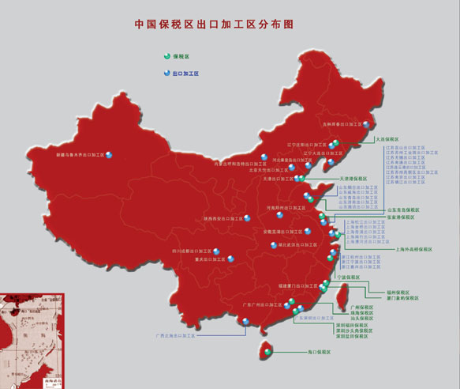

Slide 35
General trade system vs. special trade system
(2) Special trade system: a system under which statistic figures are collected based on customs territory. It covers all types of inward and outward movement of goods through a country or territory excluding movements through customs warehouses and free zones.

Slide 36
3. General trade system vs. special trade system
The two systems differ mainly in the way warehoused and re-exported goods are treated.
More than 90 countries or regions adopt the general system (e.g. China, Japan, the US, etc).
About 83 countries or regions adopt the special system (e.g. Germany, Italy, France, etc).
Which system’s statistical figures are larger? Why?

Slide 37
Value of international trade (of goods) vs.
Quantum of international trade (of goods)
(1) Value of international trade : it refers to the total value of international trade of goods, which is the total value of exports based on FOB price, that is, the sum up of the value of export of goods rather than the total value of foreign trade of all countries throughout the world. →☺ Please think about why?
The disadvantage of value of international trade:
→ As the prices of goods fluctuate frequently, the value of international trade cannot reflect the real development of international trade, thus the value of international trade in different period is incomparable directly.

Slide 38
4. Value of international trade (of goods) vs.
Quantum of international trade (of goods)
(2) Quantum of international trade: it is the value of international trade without the influence of the factor of price fluctuations. When the value of international trade in a certain period is divided by a price index in a fixed period, we get the quantum.
Example:
In 1950 (base period), the value of international trade is $60.7 billions. In 1997, the value is $5,450 billions.
The price index in 1997 was 600%.
So the quantum of international trade in 1997 was 5450/600%=$908 billion.

Slide 39
5. Direct trade vs. Indirect trade
Direct trade means transactions that are carried out directly between the producing countries and the consuming countries.
Indirect trade refers to transactions that are carried out indirectly, I.e. through a third country.

Slide 40
6. The commodity composition of trade
The commodity composition of foreign trade refers to the composition of all kinds of goods in a country’s import and export.
The commodity composition of trade usually reflects the level of economic development, the industrial structure of a nation or the whole world. It is classified by the UN’s SITC.

Slide 41
Statistical records
 Table 1.4 (pp. 26): The composition of China’s import & export commodities in 2001 (1-11)

Slide 42
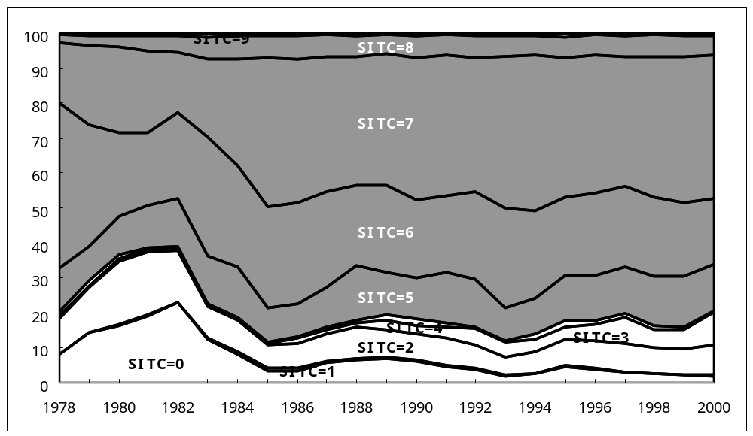
Import structure of China, 1978~2000, by first digit SITC, in percent

Slide 43
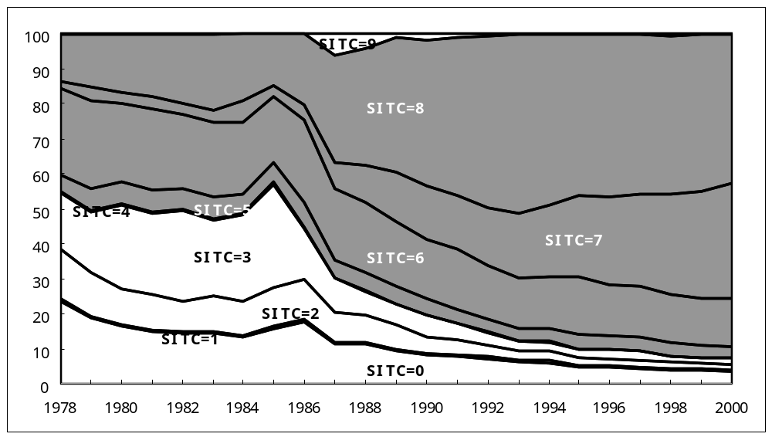
Export structure of China, 1978~2000, by first digit SITC, in percent

Slide 44
Statistical records
 Figure 1.1 (pp. 27): The relatively sluggish growth of primary products in world trade compared with the growth in manufactured goods.

Slide 45
7. Geographical composition of trade
 Table 1.6 (pp. 30) : The 10 largest countries are the source of almost 60% of world trade.
Table 1.5 (pp. 29) : Intra-and inter-regional merchandise trade, 2001.
What is the largest market for all regions’ exports?
Which region has the highest share of intra-regional trade？Can you give it a reasonable explanation?

Slide 46
8. The degree of dependence on foreign trade
The degree of dependence on foreign trade (外贸依存度） ： the value of foreign trade/GDP ，which is a comprehensive index of the ratio of export/GDP and the ratio of import/GDP.

Slide 47
8. The degree of dependence on foreign trade
Increase in the total value of foreign trade/GDP ratio indicates the higher dependence of a country’s GDP on foreign trade (or, increasing openness).
The higher the ratio of export/GDP, the greater the degree of the dependence of a country’s economy on the world market is.
The ratio of import/GDP indicates the degree of dependence of a country’s domestic market on import products as well as the degree of a country’s utilization of world resources in its economic development.

Slide 48
Table 1.7 (pp.32)
The degree of dependence on foreign trade for China, 1985~2000
Is high level of dependence on foreign trade good or bad to a country’s economic development?

