Slide 1
Boost DQN Agent’s Learning with fNIRS Data
Saber Bahranifard and Ellery Buntel
8/15/2022

Slide 2
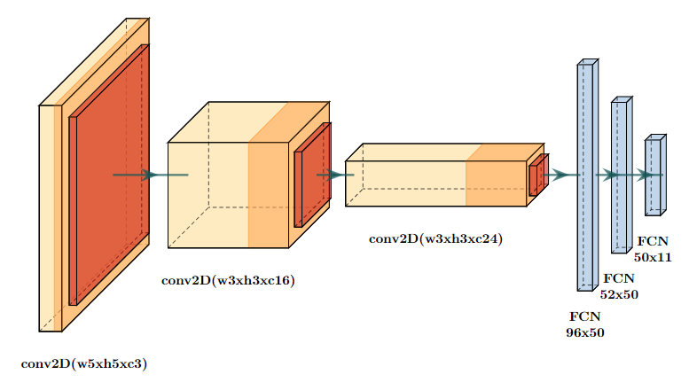
Introduction
Goal
DQN Agent Plays MS-PacMan
DQN Agent Plays LunarLander
Training the DQN agent from human demonstrations

Slide 3
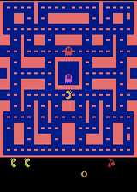
Experimental Environment
In the PacMan environment:
observation is an RGB picture of size 210x160. Each frame represents:
the position of the PacMan and ghosts
the position of rewards and goals
reward is a scalar float value
action is a scalar integer with only 9 possible values:
`0` — "no move"
`1` — "move right"
`2` — "move right"
`3` — "move left"
`4` — "move down"
`5` — "move upright"
`6` — "move upleft"
`7` — "move downright"
`8` — "move downleft"

Slide 4
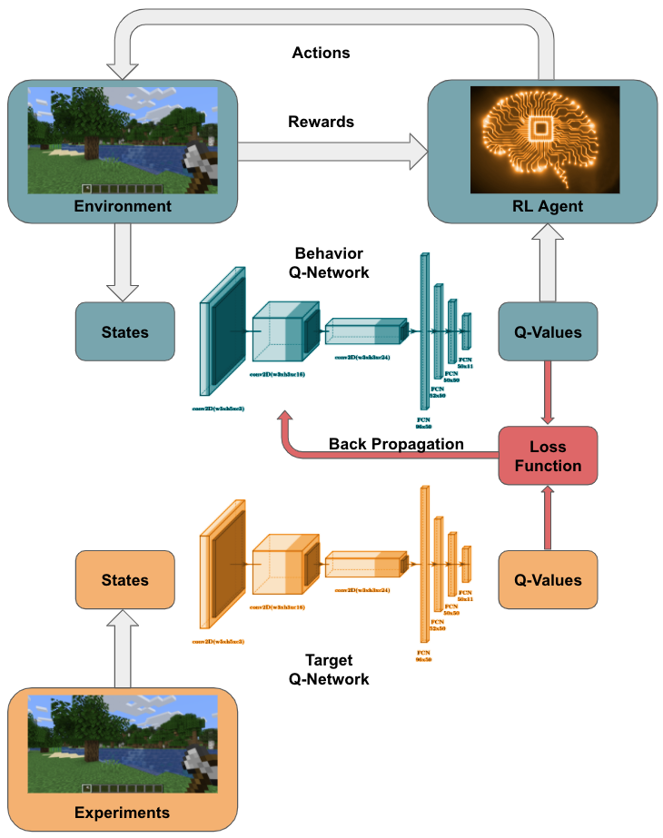
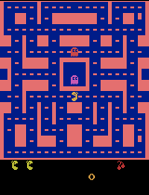
Approach
Deep Reinforcement Learning
ConvNet to approximate Q values (DQN)
Takes in play screenshots as states
Outputs Q-values per action
Learning from Demonstration (DQfD)
Two Q-Networks are used (Double DQN):
Behavioral Value
Target Value
Main Components
Q-networks
Prioritized Replay Buffer
Importance Sampling

Slide 5
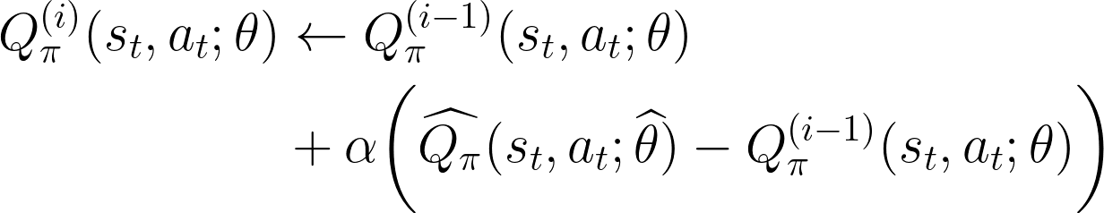


Problem Formulation
Q-value update is guaranteed to converge to optimal value (Bellman Equation)
is learned by behavioral network
Parameters are updated on each iteration of training
is learned by target network
Parameters are updated by learned parameters for behavioral network (with freq. of 𝜏)
Notes:
To formally formulate this problem, we adopt the standard Markov Decision Process (MDP)
Get the optimal action-value function Q∗ (s, a) in all states by solving the Bellman equation
Use a function approximator, an Neural Network in this case, to estimate Q-values
Two separate network are used:
A behavior network that is
a separate target network that is copied every τ steps from the regular network so that the target Q-values are more stable. Second, the agent adds all of its experiences to a replay buffer Dreplay, which is then sampled uniformly to perform updates on the network.
The double Q-learning update uses the current network to calculate the argmax over next state values and the target network for the value of that action.
*** Separating the value functions used for these two variables reduces the upward bias that is created with regular Q-learning updates***

Slide 6
Problem Formulation (cont.)
Loss Functions
1-step TD loss:
n-step TD loss:
Large margin loss:
L2 regularization loss
Notes:
DQfD initially pretrains solely on the demonstration data using a combination of temporal difference (TD) and supervised losses.
The supervised loss enables the algorithm to learn to imitate the demonstrator (to classify demonstrator’s actions).
Adding this loss grounds the values of the unseen actions to reasonable values, and makes the greedy policy induced by the value function imitate the demonstrator
If the algorithm pre-trained with only this supervised loss, there would be nothing constraining the values between consecutive states and the Q-network would not satisfy the Bellman equation, which is required to improve the policy on-line with TD learning
the TD loss enables it to learn a self-consistent value function from which it can continue learning with RL (to satisfy Bellman equation)
After pre-training, the agent starts interacting with the domain with its learned policy.

Slide 7
Implementation
Two Convolutional Neural Networks, Behavior and Target
Double Deep Q Learning to avoid maximization bias
Prioritized Replay Buffer using TD error
Importance Sampling
Notes:
We worked off a paper from DeepMind titled “Deep Q-Learning from Demonstrations”. We choose this paper because of it’s proven success on Minecraft by a group of students at Moscow’s Institute of Physics and Technology. The group applied this architecture to another MineRL task, TreeChop, in which an agent learns to cut down a few trees.
There’s quite a lot of moving parts, but the core concept is pretty simple: we use a replay buffer to store data from both experts and agents, and sample from the buffer to train our networks based on how important a sample is using the four loss functions mentioned previously. Sample importance is determined by the magnitude of the last TD error computed using that sample.

Slide 8


Algorithm
Algorithm
Initialization
Replay with Demo. data
Random weights for both networks
Hyperparameters
Pretraining (for k steps)
Sample mini-batch from replay buffer
Calculate loss J(Q) and its gradient
Update
With frequency update
Training
Sample an action from behavior policy
Play action and observe
Store into the replay buffer
Sample a mini-batch of size n from replay buffer with prioritization
Calculate loss J(Q) and its gradient
Update
With frequency update
Notes:
Very briefly, the algorithm works like this: we load demonstration data into the replay buffer and train exclusively on demonstration data for a fixed number of steps using double-q learning. From there, we start generating episodes and entering them into our replay buffer, while also sampling data from the buffer to train on.

Slide 9
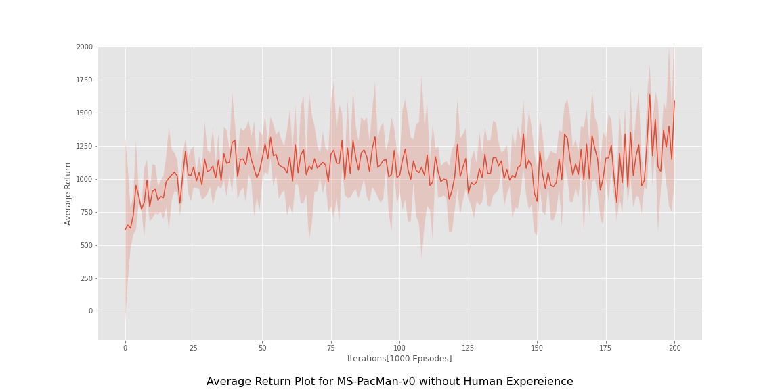
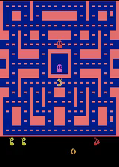
Results – MS-PacMan-v0

Slide 10
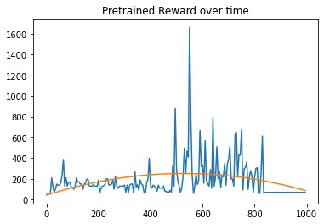
Results from Pre-training on Human Experiments – MS-PacMan-v0

Slide 11

Issues Faced
Training with JUST a few human experiments didn’t converge
More human experiments is needed
fNIRS data was not ready

Slide 12
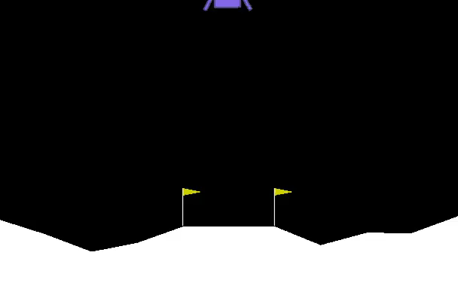
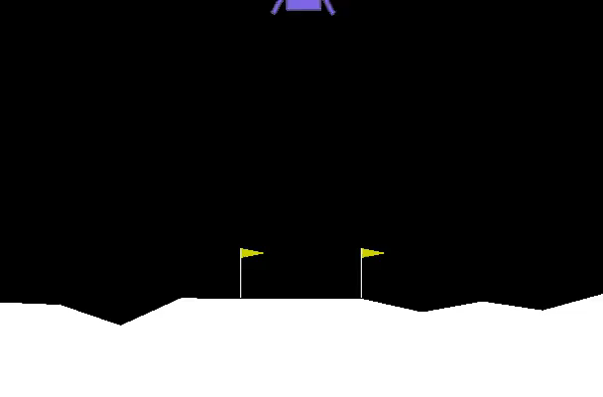
Training LunarLander-v0
random Agent for 100,000 Episodes
Trained DQN Agent for 100,000 Episodes

Slide 13
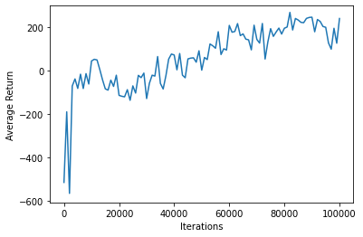
Trained DQN Agent - LunarLander-v0

Slide 14

Thank You!

Slide 15
Questions?

Slide 16
References
[1] | Todd Hester, Matej Vecerik, Olivier Pietquin, Marc Lanctot, Tom Schaul, Bilal Piot, Dan Horgan, John Quan, Andrew Sendonaris, Ian Osband, et al. Deep q-learning from demonstrations. In Thirty-Second AAAI Conference on Artificial Intelligence, 2018.
[2] | Schaul, T.; Quan, J.; Antonoglou, I.; and Silver, D. 2016. Prioritized experience replay. In Proceedings of the International Conference on Learning Representations, volume abs/1511.05952.
[3] | Volodymyr Mnih, Koray Kavukcuoglu, David Silver, Alex Graves, Ioannis Antonoglou, Daan Wierstra, and Martin Riedmiller. Playing atari with deep reinforcement learning, 2013.

