Slide 1





TaiESM – TIMCOM Diagnostic
Lalu Mantigi Wana Paksi
Notes:
Lalu

Slide 2
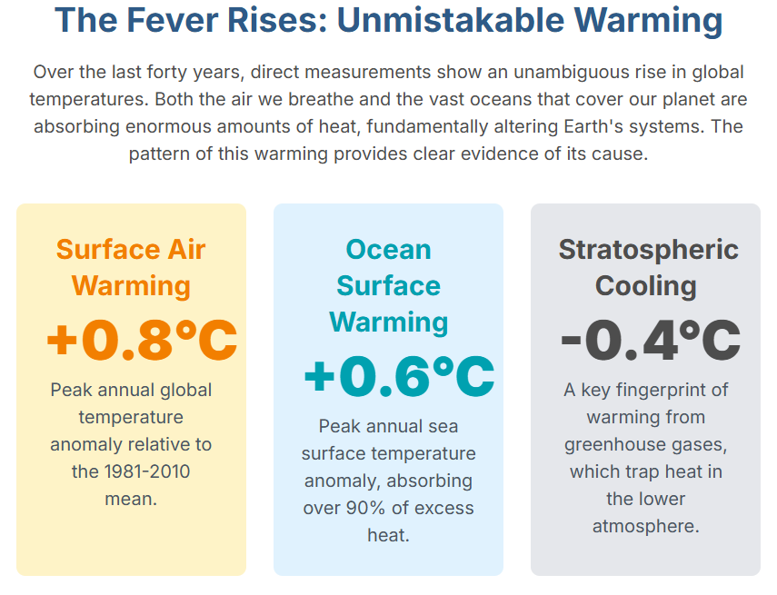

Slide 3
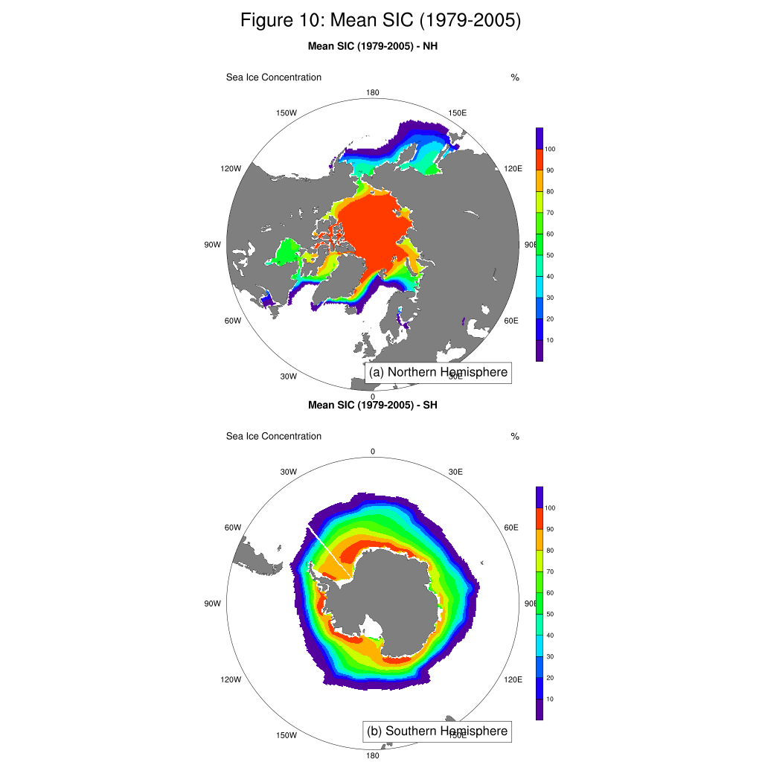
SIC

Slide 4
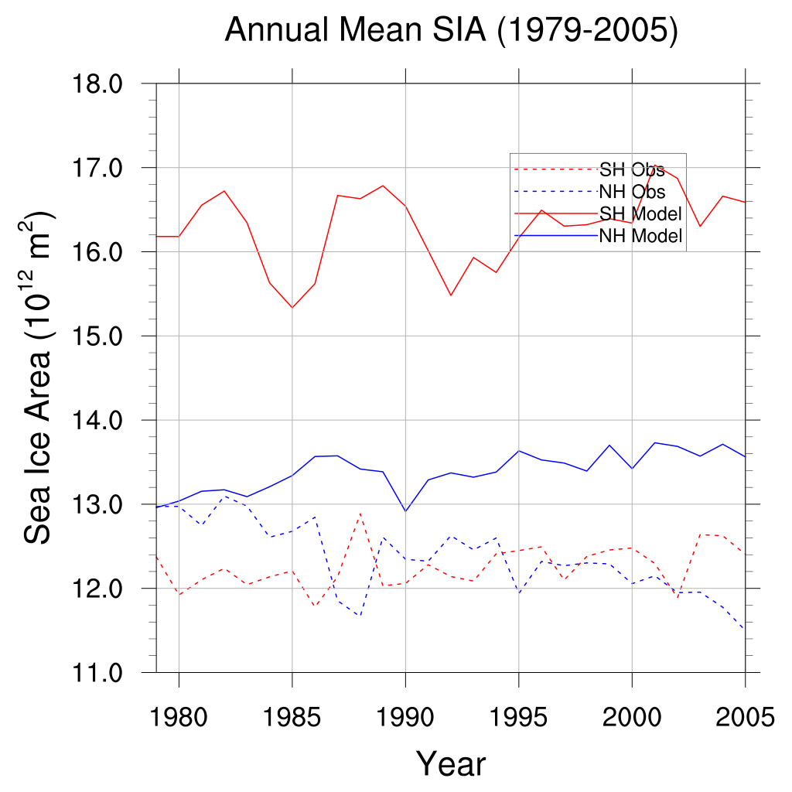
SIA
Antarctic Sea Ice Trend: Observations
show a slight increase, while the model simulates a sharp decrease.
Model Inaccuracy: The model’s inability to capture the observed Antarctic sea ice expansion is a significant unsolved puzzle in climate science.
Critical Error: The model’s prediction of Antarctic sea ice is not only inaccurate but also directionally wrong.

Slide 5
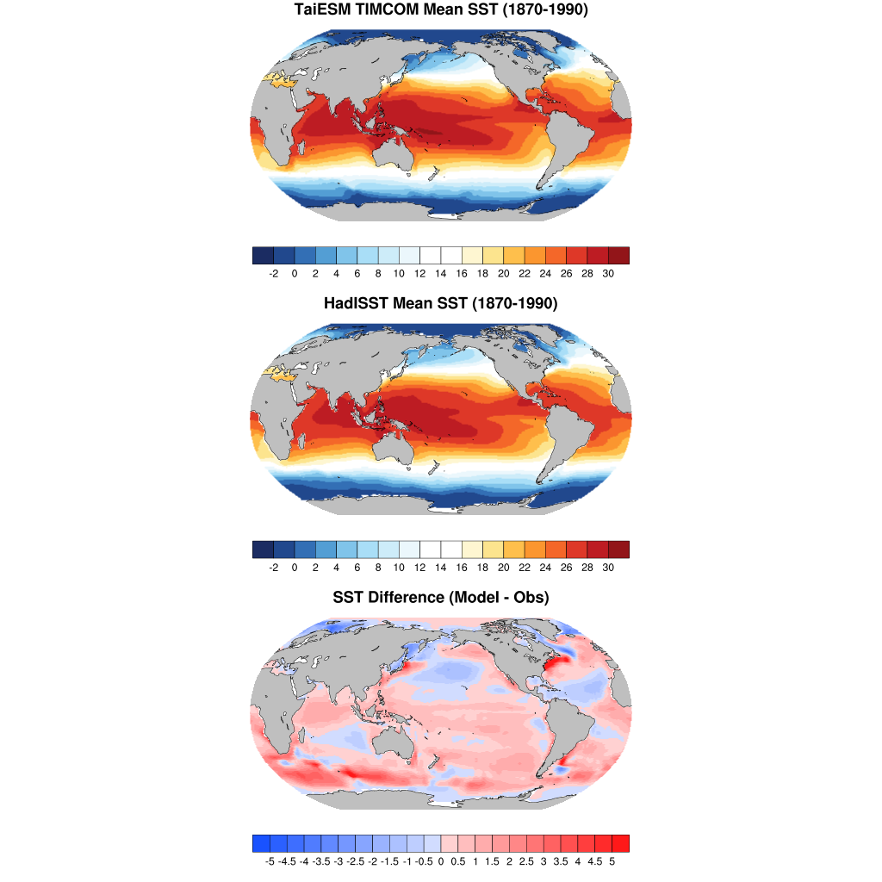
SST
Southern Ocean Warm Bias: The model overestimates temperature by more than 3 degrees Celsius in the Southern Ocean.
North Atlantic Cold Bias: The model underestimates temperature in the North Atlantic, indicating a weaker than observed Atlantic Meridional Overturning Circulation (AMOC).
Coastal Upwelling Warm Bias: The model overestimates temperature along the western coasts of South America and Africa due to difficulties in resolving oceanic upwelling processes.

Slide 6
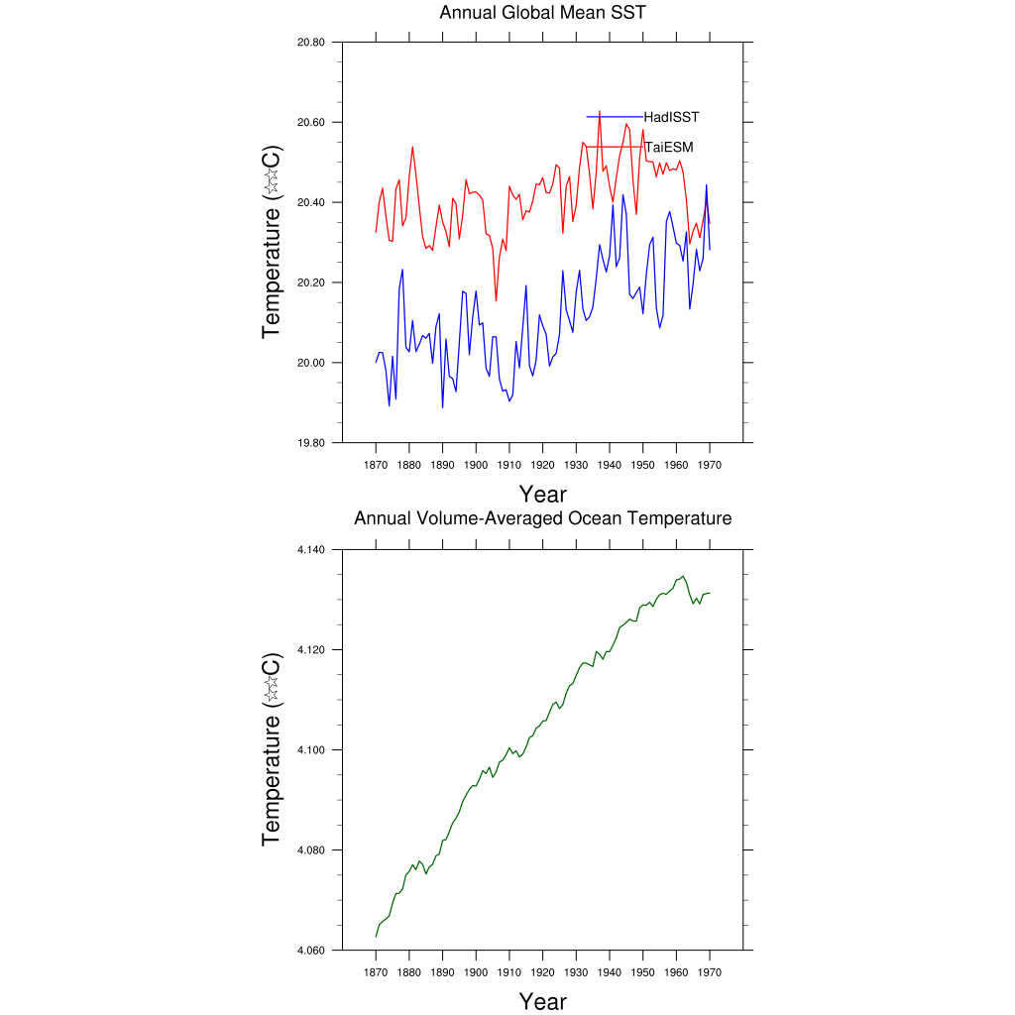
SST & VAT
Global Warming Evidence: Two graphs show the warming of the planet: one for the ocean’s overall temperature (VAT) and one for the sea surface temperature (SST).
Ocean Temperature Trend: VAT shows a smooth, upward trend, indicating the ocean’s absorption of excess heat trapped by greenhouse gases.
Sea Surface Temperature Trend: SST also shows a long-term warming trend, but with more variability due to natural cycles like El Niño and La Niña.

Slide 7
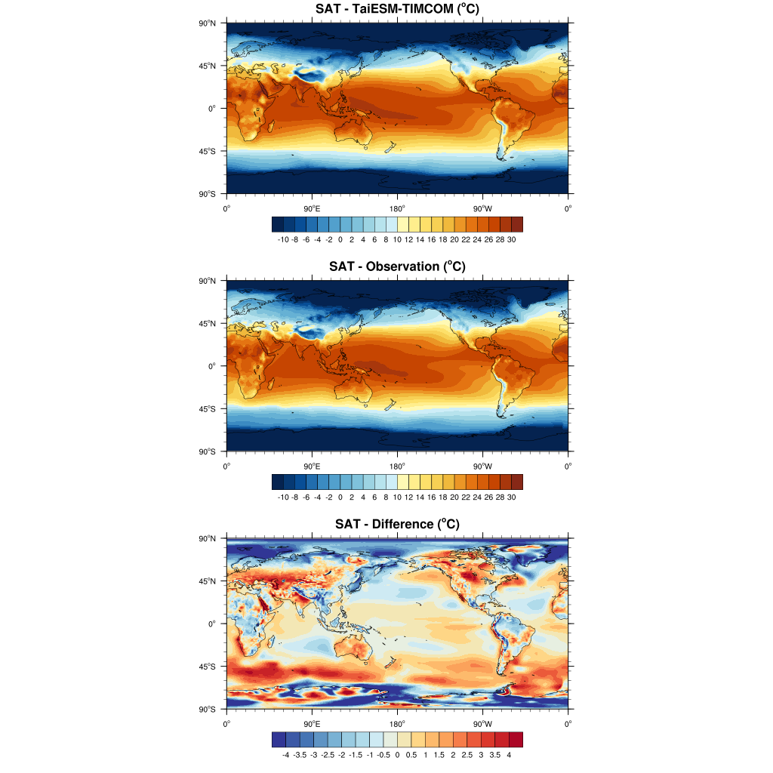
SAT
Model Credibility Test: The figure compares simulated Surface Air Temperature from TaiESM-TIMCOM against observed historical record.

Slide 8
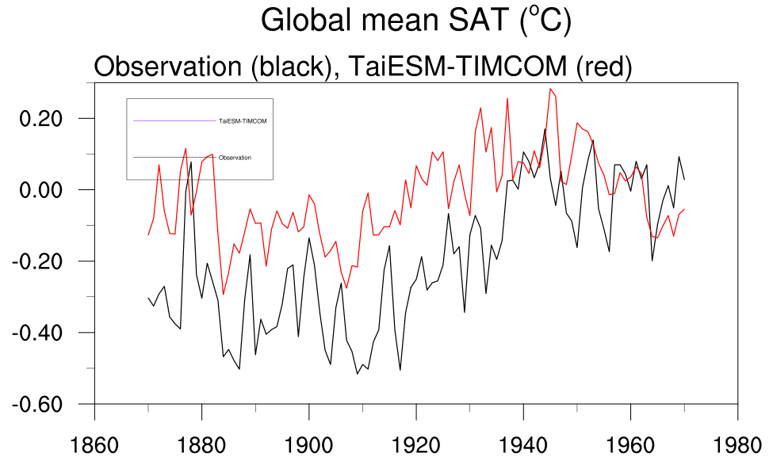
SAT
Post-1950 Agreement: The model accurately simulates the warming trend driven by greenhouse gases, indicating a realistic climate sensitivity.
Pre-1950 Warm Bias: The model consistently overestimates temperature by 0.3 degrees Celsius, potentially due to an underestimation of the cooling effect of industrial aerosols.

Slide 9
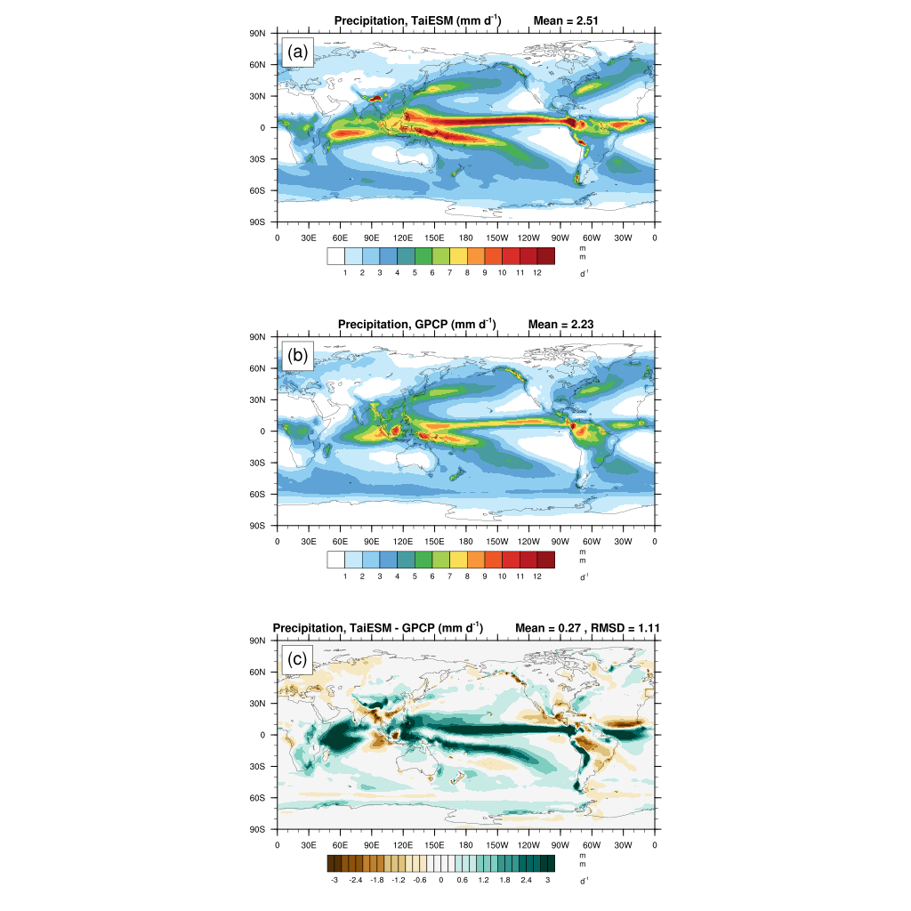
PRECIPITATION
Double ITCZ Bias: The model produces an extra rain belt south of the equator, a persistent and challenging issue in climate modelling.
Other Precipitation Biases: The model overestimates rainfall in the Maritime Continent and underestimates it over tropical landmasses like the Amazon.
Coupled Ocean-Atmosphere System: The Double ITCZ is linked to sea surface temperature biases, highlighting the interconnectedness of the system.

