Slide 1
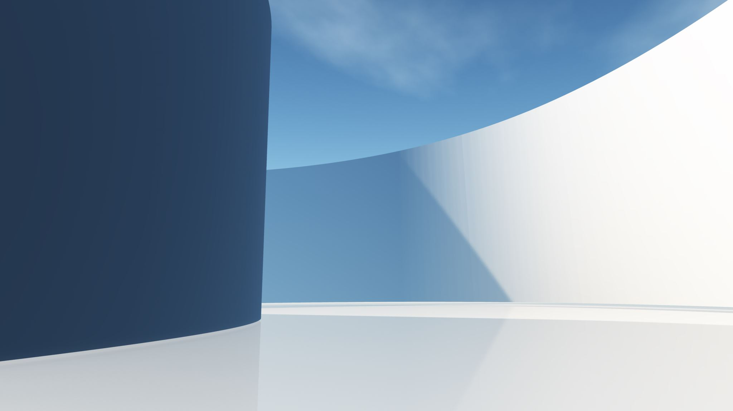
Checkpoint Web Fundamentals
1.How does the web work?
2.What do you need to be a web developer?
3.Why did you choose to learn web development?

Slide 2
How the web works
How the web works provides a simplified view of what happens when you view a webpage in a web browser on your computer or phone.
This theory is not essential to writing web code in the short term, but before long you'll really start to benefit from understanding what's happening in the background.

Slide 3
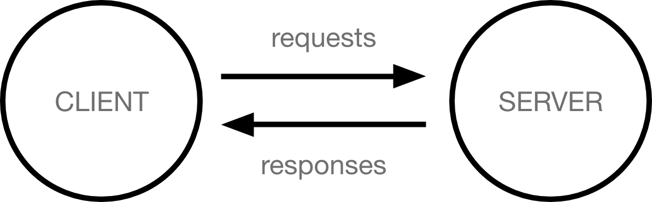
Clients and servers
Computers connected to the internet are called clients and servers. A simplified diagram of how they interact might look like this:
Clients are the typical web user's internet-connected devices (for example, your computer connected to your Wi-Fi, or your phone connected to your mobile network) and web-accessing software available on those devices (usually a web browser like Firefox or Chrome).
Servers are computers that store webpages, sites, or apps. When a client device wants to access a webpage, a copy of the webpage is downloaded from the server onto the client machine to be displayed in the user's web browser.

Slide 4
So what happens, exactly?
The browser goes to the DNS server, and finds the real address of the server that the website lives on (you find the address of the shop).
The browser sends an HTTP request message to the server, asking it to send a copy of the website to the client (you go to the shop and order your goods). This message, and all other data sent between the client and the server, is sent across your internet connection using TCP/IP.
If the server approves the client's request, the server sends the client a "200 OK" message, which means "Of course you can look at that website! Here it is", and then starts sending the website's files to the browser as a series of small chunks called data packets (the shop gives you your goods, and you bring them back to your house).
The browser assembles the small chunks into a complete web page and displays it to you (the goods arrive at your door — new shiny stuff, awesome!).

Slide 5

What do you need to be a web developer?
The best first step to becoming a Web Developer is to start learning web development fundamentals, including an understanding of HTML (Hypertext Markup Language), CSS (Cascading Style Sheets), and JavaScript.
Many aspiring Web Developers are now using coding bootcamps to fast-track the learning process. Coding bootcamps have thrived because they are short, immersive, and focused on outcomes and employment – their goal is to develop job-ready skills as efficiently as possible, making them an increasingly worthwhile investment for a would-be Web Developer. According to the job site Indeed, four out of five companies in the U.S. have hired a graduate from a coding bootcamp.
In fact, the practical advantages of coding bootcamps are only getting clearer over time. For one thing, the field of web development naturally attracts people from all other fields, many of them making mid-career transitions – people for whom a clear and efficient path to skills expansion is a top priority. Further, employers increasingly value skills and experience over education, placing anyone who can prove their abilities on more equal footing with Developers holding a college degree.
It’s important to note that Web Developers – more than most other fields – must be committed to ongoing learning to stay on top of changes in web development and programming languages, tools, and trends. This makes mid-career retraining a must whether or not it’s the line of work you started out in.

Slide 6
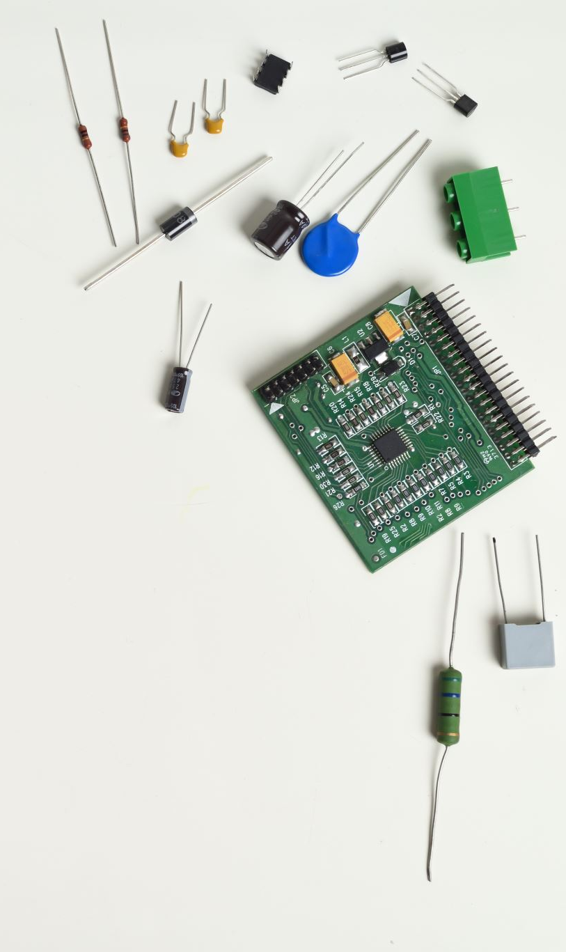
Why did you choose to learn web development?
Web development is an in-demand skill in every industry sector. Whether you want to work at a startup tech company, in healthcare, finance, creative agency, for the public sector, or a mixture of all these, learning web development gives you the opportunity to get your foot in the door anywhere.
Why do you choose to learn web development?
Web development gives you the opportunity to express yourself creatively on the internet. If you have an idea you would like to try as you discover your web dev skills, try it out. Web dev is a fun, creative experience.

