Slide 1
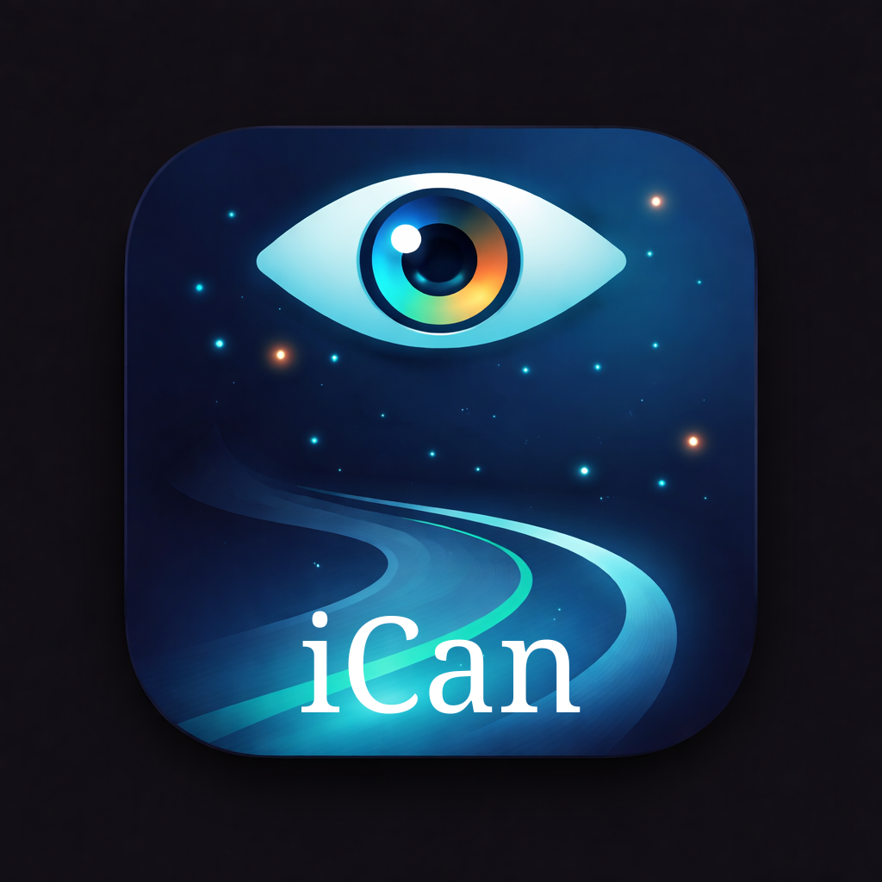
FINAL DESIGN PROJECT
iCAN
Assistive navigation system for safer independent mobility
ECE 441 Spring 2026 · Smart and Connected Embedded System Design
Instructor: Prof. Jafar Saniie
Ariel Nyamien
Aiden Verdin
Alex Stokrp
Saber Garibi
CANE + EYE + APP
iCAN · Group 5 · ECE 441 Spring 2026
1
Notes:
Open with the project identity: iCAN is a connected assistive navigation ecosystem, not just a smart cane. Mention final deliverable context and team.

Slide 2
Executive snapshot
What we built and why it matters
Problem
Solution
Impact
Traditional white canes detect ground-level obstacles well but miss head-height hazards, provide limited distance context, and do not integrate navigation or scene awareness.
iCAN combines directional obstacle sensing, haptic feedback, BLE telemetry, mobile accessibility UX, and an optional camera-based scene description layer.
The system extends perception ahead of the user, preserves hands-free interaction, and moves compute-heavy AI to the phone for better latency, battery use, and upgradability.
Cane
Eye
App
User
LiDAR + ultrasonic + IMU + haptics
ESP32-S3 camera + BLE image stream
Flutter + BLE + TTS + AI vision
Spatial audio + haptics
Design principle: keep immediate safety feedback local, use the phone for richer context.
Notes:
Frame the system in one sentence: iCAN pairs immediate local safety feedback with phone-based intelligence.

Slide 3
Navigation gaps we are targeting
The device focuses on hazards that are hard to perceive with a standard cane.
Why this is embedded systems work
40%
43%
2m+
The problem requires sensing, timing, power management, BLE communication, actuator feedback, and user-safe failure behavior — not just an app.
blind individuals report head-height collisions
visually impaired users successfully complete street crossings
target detection range ahead of the user
Head-height hazards
Distance ambiguity
Situational awareness
Navigation load
branches · signs · shelves · awnings
near vs. far obstacles need different urgency
text · people · scene layout · landmarks
turns must not mask obstacle alerts
iCAN · Group 5 · ECE 441 Spring 2026
2
Notes:
Use this slide to connect the human problem to the engineering requirements: sensing range, feedback encoding, and safety prioritization.

Slide 4
System overview
Two embedded devices and one accessibility-first mobile client.
iCAN Cane
Local AI
Arduino Nano ESP32
LiDAR + ultrasonic
IMU + haptics + GPS
Apple Vision
CoreML depth/object
On-device fallback
BLE
Mobile App
Flutter client
BLE control plane
TTS + scene description
iCAN Eye
BLE image chunks
Cloud AI
XIAO ESP32-S3 Sense
OV2640 camera
JPEG image stream
Gemini vision
When online/user-selected
Notes:
Describe the split: cane handles real-time safety; eye captures scene imagery; app orchestrates BLE, speech, and AI backend selection.

Slide 5
User interaction flow
Immediate haptics first; speech when richer context is needed.
1
2
3
4
5
Walk normally
Detect hazard
Optional capture
Phone interprets
Act safely
Cane continuously samples obstacle sensors and IMU.
Firmware maps obstacle side and distance into haptic urgency.
User triggers iCAN Eye for a scene description.
App receives image data and chooses local/cloud AI path.
User receives directional vibration and spoken spatial context.
Safety priority rule: local obstacle alerts must override slower navigation or AI descriptions.
Notes:
Walk through a realistic use case. Stress that the system is not trying to replace the cane; it extends feedback.

Slide 6
Hardware architecture
Sensors and actuators map directly to user-facing feedback.
Cane controller
Obstacle sensing
Motion + health
Feedback
Arduino Nano ESP32 coordinates sensing, BLE telemetry, event detection, and haptic output.
TF-Luna/ToF and ultrasonic sensing provide near/far and head/waist-level obstacle coverage.
LSM6DSOX IMU supports fall detection/orientation; pulse and battery telemetry support monitoring.
DRV2605L and vibration motors encode direction and urgency through touch.
LiDAR/ToF
Ultrasonic
IMU
GPS
BLE
Haptics
head-height + spatial grid
lower obstacle zones
yaw + fall events
location + guided nav
app telemetry
left/right/top motors
BOM highlights: Arduino Nano ESP32, XIAO ESP32-S3 Sense, TF-Luna/ToF, ultrasonic sensors, LSM6DSOX, DRV2605L, vibration motors, GPS, Li-Po batteries.
Notes:
Covers the report requirement for hardware, sensors, actuators, and system constraints.

Slide 7
Obstacle detection → haptic language
The user should feel direction, distance, and urgency without looking at a screen.
Left/right ultrasonics
Top LiDAR/ToF
IMU sweep filter
Haptic driver
waist-level obstacles
side-specific alerts
head-height hazards
branches/signs/awnings
reduces false positives
from natural cane motion
distance-scaled
pulse/intensity patterns
2–4 m: intermittent pulse
1–2 m: continuous vibration
<1 m: strong vibration
Feedback rule: the closest safety event wins over navigation guidance.
iCAN · Group 5 · ECE 441 Spring 2026
3
Notes:
Explain the tactile language. Distance and side are turned into vibration patterns, not text.

Slide 8
Cane firmware structure
Modular firmware keeps sensing, events, power, and feedback testable.
Sensor layer
Event detection
State manager
Response layer
App telemetry
LiDAR · ultrasonic · IMU · pulse · GPS · battery
obstacle side · fall flag · low battery · sensor health
normal · low power · emergency · sleep
haptic · LED · buzzer · BLE notify
battery % · BPM · yaw · GPS · status
Power management
Safety behavior
Protocol discipline
Firmware documentation reports sleep modes that reduce idle draw from always-active behavior into staged low-power states.
Fall alert logic avoids indefinite buzzer activation and caps emergency behavior to prevent battery drain.
A shared BLE protocol file mirrors packet fields in C++ firmware and Dart app code to avoid mismatch bugs.
Evidence source: firmware/protosmart_cane STATUS_REPORT, DEPLOYMENT_CHECKLIST, and protocol/ble_protocol.yaml.
Notes:
This slide maps directly to software/hardware integration and original code contributions.

Slide 9
iCAN Eye: scene awareness pipeline
Camera hardware captures the world; the phone turns it into speech.
ESP32-S3 Eye
BLE stream
Phone vision
Speech
OV2640 capture
button trigger
JPEG chunks
sequence numbers
Apple Vision
Depth + objects + OCR
4–6 sentence
spatial description
Layer 1 perception
Layer 2 understanding
Layer 3 speech synthesis
OCR, scene classification, human detection, depth estimation, and object boxes run as structured perception.
A VLM backend adds holistic image interpretation when local model or cloud mode is available.
The app converts perception into short, practical, clock-position guidance.
Notes:
This is the “wow” software slide: phone-side AI makes the embedded camera useful without forcing the ESP32 to run heavy models.

Slide 10
Mobile app architecture
Flutter app as the accessible command center.
Accessibility-first UI
BLE services
Speech loop
WCAG AAA-oriented theme, Semantics wrappers, large controls, VoiceOver/TalkBack design.
Dual-device connection management, image reassembly, telemetry streams, saved device IDs.
TTS output, voice-command direction, and scene-description history for repeatable feedback.
HomeViewModel
BleService
SceneService
VisionChannel
TTS
state orchestration
scan/connect/packets
backend selection
Swift/CoreML bridge
audio output
Tech stack: Dart/Flutter, Provider MVVM, GoRouter, flutter_blue_plus, CoreML/Vision Swift channels, Gemini fallback.
iCAN · Group 5 · ECE 441 Spring 2026
4
Notes:
Ground this in the actual repo QA technical briefing.

Slide 11
BLE protocol and data model
A shared protocol keeps firmware and app behavior aligned.
Cane service
Eye service
Packet discipline
Navigation commands, obstacle alerts, IMU telemetry, cane status, GPS data.
Instant text, JPEG image stream, capture/profile/status commands.
Little-endian telemetry, explicit fields, and documented image sequence headers.
App → Cane
Cane → App
App → Eye
Eye → App
App → User
NAV_LEFT
NAV_RIGHT
STOP
obstacle
fall flag
battery
CAPTURE
LIVE_START
PROFILE
text
image chunks
speech
alerts
haptics
Single source of truth: protocol/ble_protocol.yaml mirrors firmware/shared/ble_protocol.h and lib/protocol/ble_protocol.dart.
Notes:
Use this as the systems engineering proof: packet names, directions, and payload fields exist in the repo.

Slide 12
Power, packaging, and constraints
The design is constrained by weight, runtime, weather, and user comfort.
Runtime target
Physical layout
Weather & durability
Safety
Prior deck target: 8–10 hour operating goal; firmware emphasizes staged power modes and battery telemetry.
Handle houses haptic motors; sensors mount below/top of handle with wiring strain relief and shock mounting.
Prior design target includes IP65-style considerations: gaskets, venting, connectors, and robust mounting.
Failsafe behavior: obstacle alerts remain local; cloud AI is optional, not required for basic safety.
Active
Use case
Low power
Emergency
100% duty
mixed sensing
reduced draw
bounded alert
Notes:
Talk about engineering tradeoffs: runtime, weight, durability, and local fallback behavior.

Slide 13
Security and responsible design
Assistive technology must be useful without becoming invasive.
Privacy
Safety
Transparency
Security
Image processing is designed to run locally when possible; cloud vision is a selected/fallback path, not the only path.
The cane’s local obstacle feedback does not depend on internet access, cloud services, or a perfect AI caption.
The app should speak concise spatial context and avoid overclaiming uncertain detections.
BLE command scope is narrow: navigation commands, telemetry, capture/status, and documented packet formats.
Ethical design stance
Prioritize user autonomy, preserve safety-critical functions offline, and make AI assistance explainable enough to trust but bounded enough not to mislead.
iCAN · Group 5 · ECE 441 Spring 2026
5
Notes:
This slide supports both final presentation expectations and later ethics/report work.

Slide 14
Related work and differentiation
iCAN is positioned between simple smart canes and phone-only navigation aids.
System
Strength
Gap
iCAN response
Traditional white cane
Reliable, low-cost, passive
Limited range; poor head-height detection
iCAN extends sensing while preserving cane use
WeWalk / smart canes
Commercial precedent for connected cane systems
High cost; limited customization
Course prototype explores open, modular architecture
Phone-only vision apps
Powerful AI descriptions
No immediate tactile obstacle feedback
iCAN separates local safety from rich scene context
Wearable navigation systems
Hands-free perception
Can be bulky or opaque
iCAN uses cane + necklace + phone split
Notes:
Keep this concise. It satisfies related work/comparison without spending too much presentation time.

Slide 15
Implementation progress and validation evidence
The project has working software structure and documented firmware verification paths.
Mobile app
iCAN Eye
Cane firmware
Repo
Flutter app includes BLE service, accessible screens, scene-description service, TTS, device pairing, settings, and diagnostic screens.
Firmware was refactored into camera, BLE, and main orchestration modules with build environments for main, camera, and BLE stream testing.
ProtoSmartCane v2.0 documentation covers battery monitoring, sleep modes, haptic driver, fall alert handling, and deployment checks.
Codebase and docs are centralized in GitHub for review.
Verification currently documented
PlatformIO build environments for iCAN Eye modules
Shared BLE protocol mirrored across firmware/app
App architecture briefing with dependencies and file structure
Deployment checklist for hardware field tests
Project repo: https://github.com/saberrg/ican
Notes:
Be careful not to overclaim live field-test results. Present this as implementation and validation evidence.

Slide 16
Recorded demo plan
Use the 5+ minute demo block to prove the system, not just describe it.
1
2
3
4
Cane sensing
BLE telemetry
Eye capture
Accessibility UX
Show obstacle approach and haptic direction/intensity response.
Show app connection/status and battery/IMU/alert fields.
Trigger capture and show image/description flow.
Demonstrate spoken output, large controls, and blind-user-oriented flow.
Suggested timing: ~8–9 minutes slides + ~5–6 minutes demo = under 15 minutes total.
iCAN · Group 5 · ECE 441 Spring 2026
6
Notes:
This is tactical: it tells the team exactly what to record for the required video.

Slide 17
Remaining work and future improvements
The final system has a clear path from prototype to deployable assistive device.
Hardware field trial
Guided navigation
Vision optimization
Safety review
Validate sensor placement, vibration interpretation, battery estimates, and comfort in walking tests.
Integrate Mapbox/walking directions and tune haptic turn timing around obstacle override rules.
Benchmark local VLM quality/latency and improve spatial descriptions with depth + object fusion.
Improve privacy controls, BLE pairing rules, and failure-mode documentation.
Prototype → verified demo → user-centered field testing → refinement → deployable design
Prototype
Demo
Field test
Refine
Deploy
Notes:
Future work should sound credible and prioritized, not like feature creep.

Slide 18
Team member work contributions
Final report and presentation must clearly describe each member’s tasks.
Ariel Nyamien
Aiden Verdin
Alex Stokrp
Saber Garibi
Power and hardware design: sensor/actuator selection, packaging constraints, electrical integration support.
Controls and embedded systems: firmware logic, sensor processing, state behavior, hardware testing support.
Hardware and circuit design: schematic/BOM support, packaging, sensor placement, physical integration.
Software/app architecture: Flutter app, BLE protocol integration, AI vision pipeline, repo documentation.
Note: confirm/edit contribution wording before final submission so it matches the team’s actual work split.
Notes:
This slide is intentionally editable. Saber/team should confirm exact contribution wording before submission.

Slide 19
Conclusion
iCAN extends mobility feedback without taking control away from the user.
A practical assistive navigation system should be immediate, understandable, and resilient.
Immediate
Understandable
Resilient
Obstacle feedback is local and tactile, so basic safety does not depend on cloud AI.
Haptics encode side/distance; speech describes spatial context in plain language.
The cane, eye, and app are modular, documented, and independently testable.
iCAN is a connected ecosystem: embedded sensing for safety, mobile compute for intelligence, and accessible feedback for the user.
iCAN · Group 5 · ECE 441 Spring 2026
7
Notes:
End with the core claim: local safety + mobile intelligence + accessibility-first feedback.

Slide 20
References and source material
Key sources used for the final deck.
Bourne et al., “Global prevalence of blindness and vision impairment,” The Lancet Global Health, 2017. https://doi.org/10.1016/S2214-109X(17)30293-0
iCAN GitHub repository and project documentation: https://github.com/saberrg/ican
Nano ESP32 / XIAO ESP32-S3 / sensor datasheets listed in prior project references and BOM.
Apple Core ML and Vision documentation for on-device perception pipeline.
Moondream project reference for VLM experimentation: https://github.com/vikhyat/moondream
ECE 441 final project requirements and evaluation material from Canvas.
Notes:
References slide can be expanded if required by the team report/paper, but keep it concise for the presentation.

