Slide 1
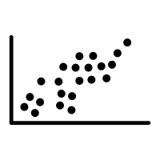
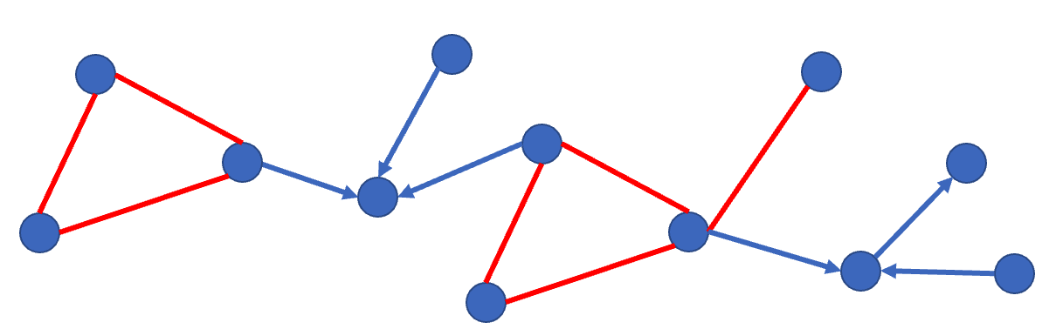
Heterogenous Data
Causal Discovery
Identification Analysis
Bounds on the causal effect
Actions/Intervetions
Experiment Design

