Slide 1

Tutrtle Games: exploratory analysis
LSE_DA301_Presentation_Sabrina_Golonka

Slide 2
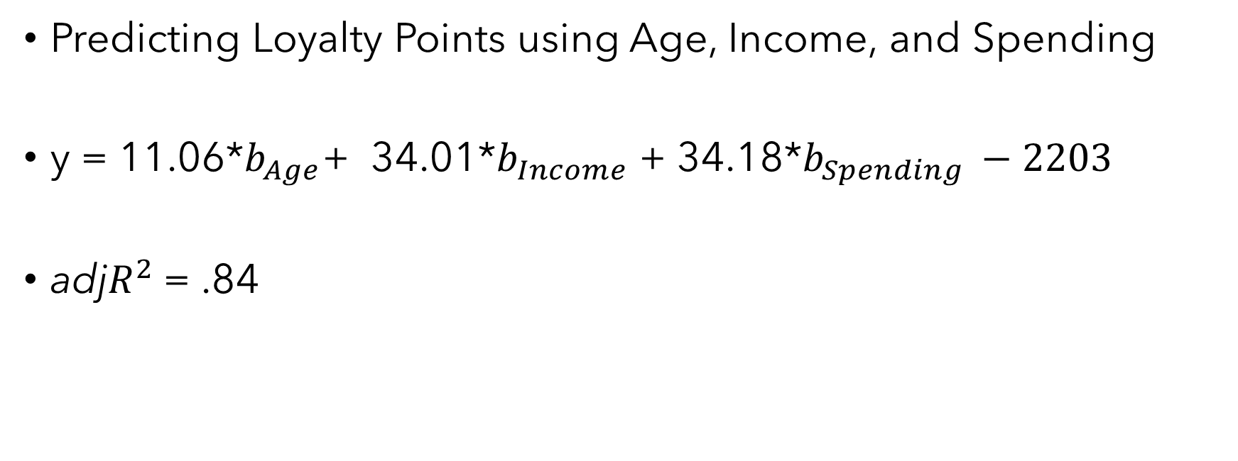
Activity 1
Predicting Loyalty Points using Age, Income, and Spending
y = 11.06*$b_{Age}$+ 34.01*$b_{Income}$ + 34.18*$b_{Spending }−2203$
adj$R^{2}$ = .84

Slide 3
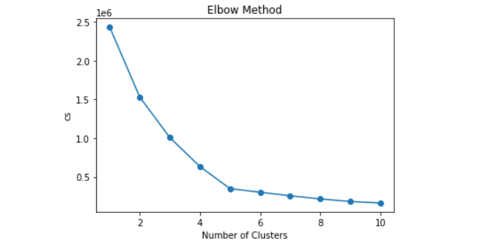
Activity 2
Cluster analysis of income x spending

Slide 4
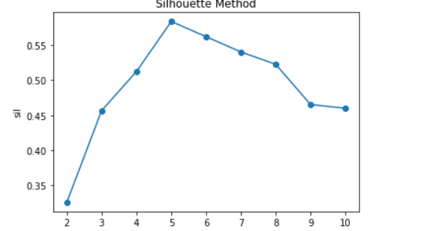

Slide 5
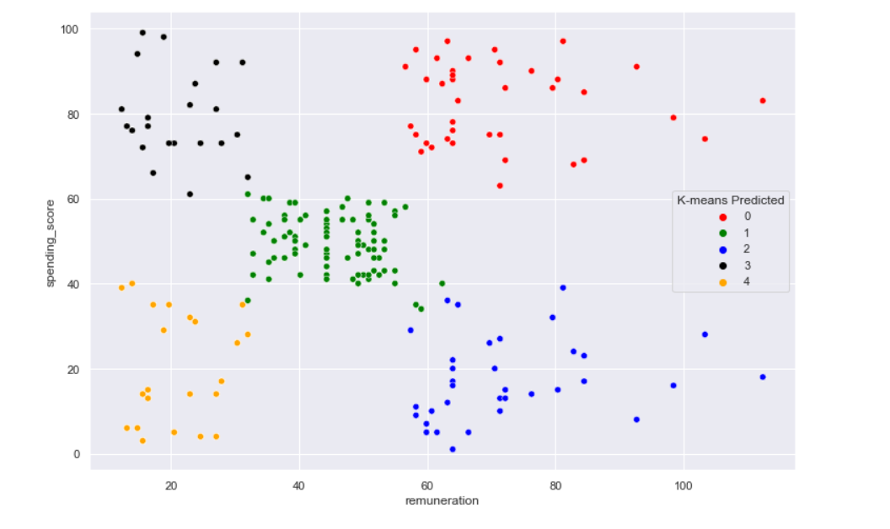

Slide 6
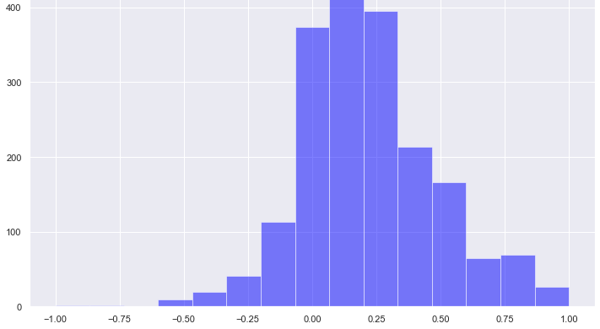
Activity 3
Sentiment Analysis of Product Reviews

Slide 7
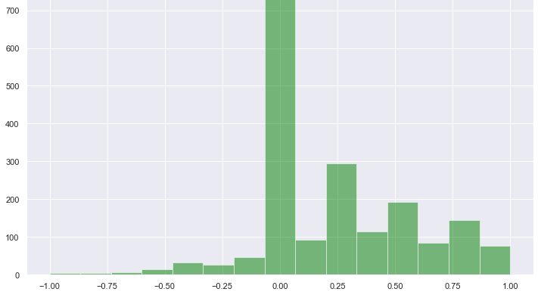

Slide 8


Slide 9


Slide 10
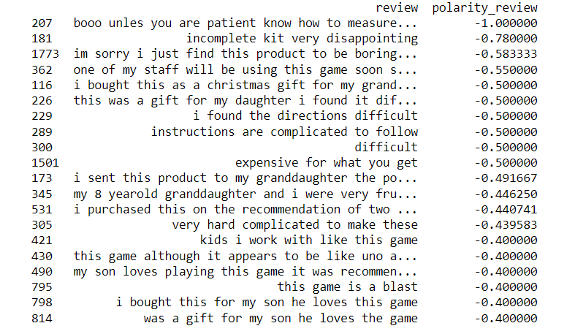

Slide 11
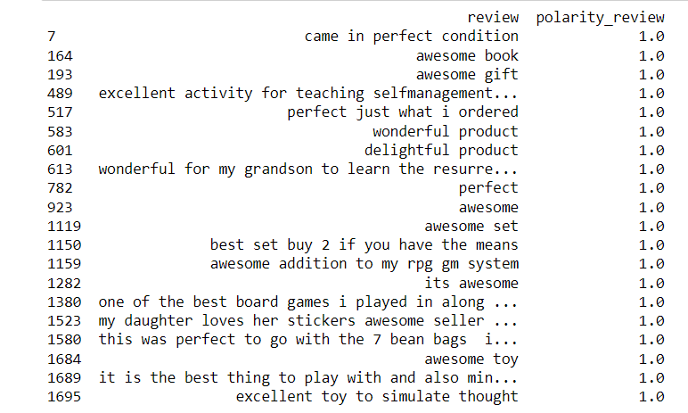

Slide 12
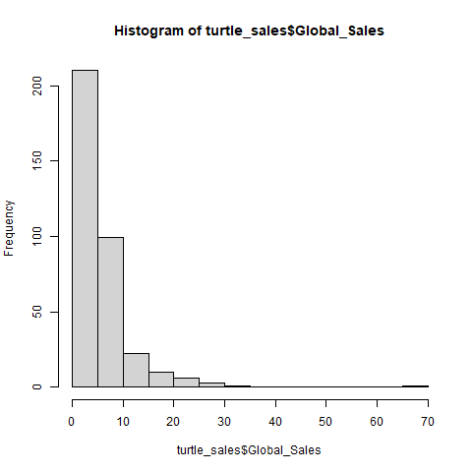
Global Sales
Activity 4
Product Sales Trends

Slide 13
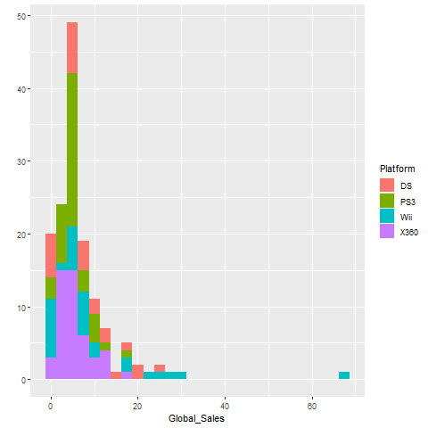
Global Sales of top four platforms

Slide 14
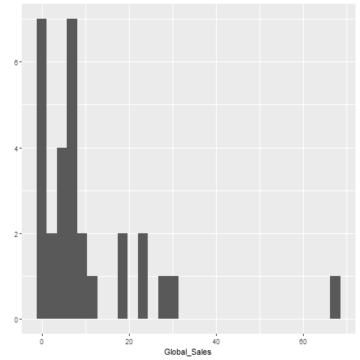
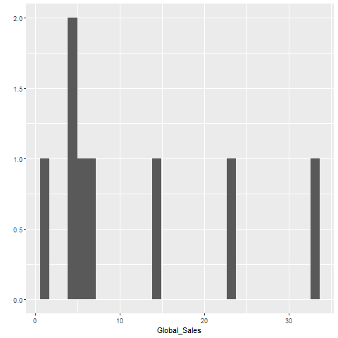

Slide 15
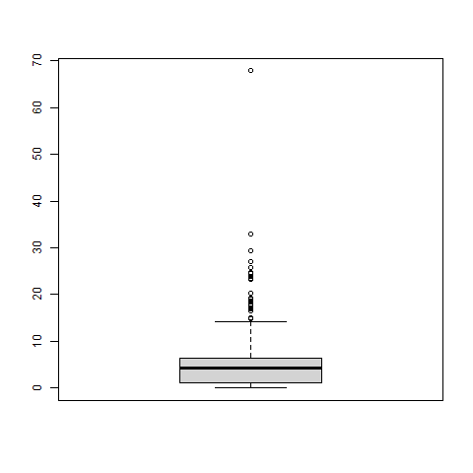
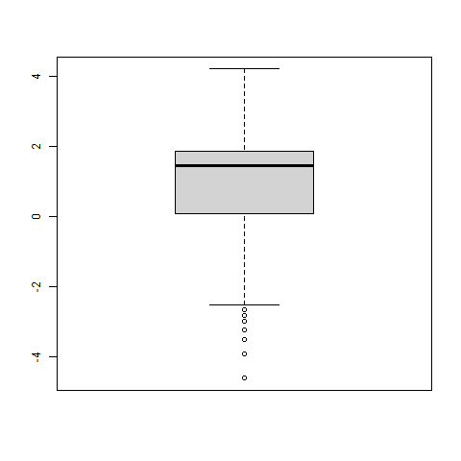
Activity 5
Relationship between Global and Regional Sales

Slide 16
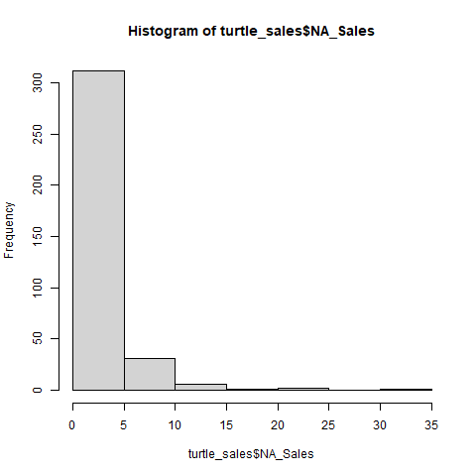
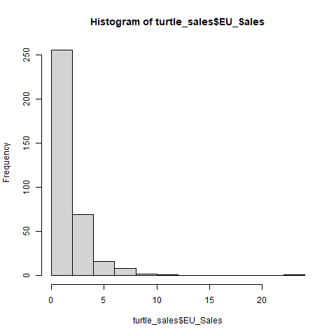

Slide 17
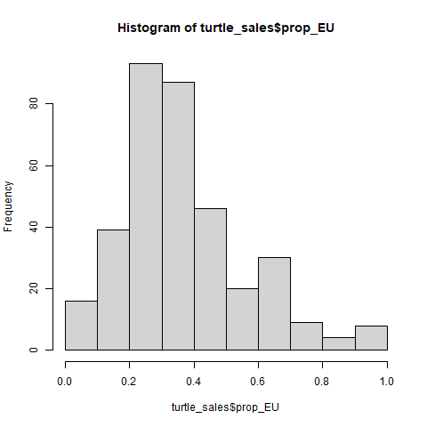
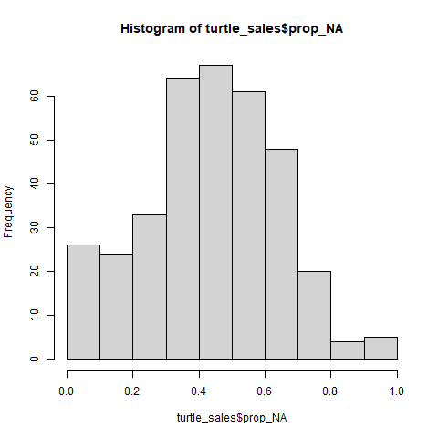

Slide 18
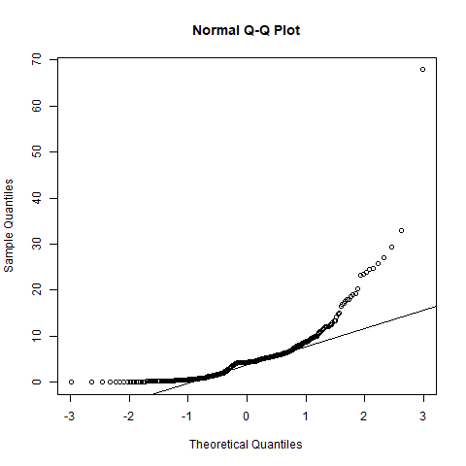
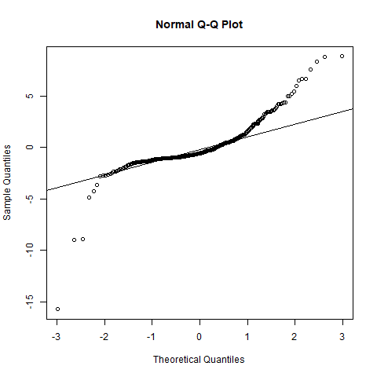
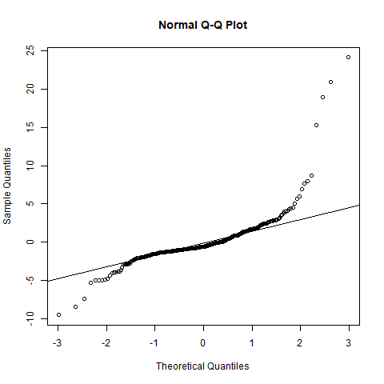

Slide 19

Activity 6
Predicting Global Sales using Regional Sales
y = 1.55*$b_{NA}$+ 1.34*$b_{EU}$ + 0.22
adj$R^{2}$ = .97
F(2,349) = 5398, p < .0001

Slide 20
NA Sales | EU Sales | Predicted Global | Observed Global | Difference
2.26 | .97 | 5.02 | 3.53 | 1.49
2.73 | .65 | 5.32 | 4.32 | 1.00
3.93 | 1.56 | 8.40 | 6.04 | 2.36
22.08 | .52 | 35.14 | 23.21 | 11.93
34.02 | 23.80 | 84.84 | 67.85 | 16.99

Slide 21
Loyalty: Predicted by Income and Spending, slightly by Age
Income and Spending cluster in 5 groups
Reviews/Summaries: Neutral to Positive
NA sales greater than EU. Wii is top selling platform
Sales distributions are skewed. Regional sales covary strongly with Global sales
Global Sales: Predicted by NA and EU sales

