Slide 1
GROUP 2
CIFAR-10 Image Classification
A journey from a simple CNN to transfer learning
Team members
Domien
Sabeur
Lab Project
Image Classification with CNNs

Slide 2
What we did, in one slide
9
88.94%
2.75%
models trained
from scratch → transfer learning
best test accuracy
(custom CNN — Model 8)
smallest train-test gap
(transfer learning — Model 9)
The story
Start simple — one Conv layer gets us to ~55% test accuracy.
Go deeper — VGG-style blocks + BatchNorm + Adam push us past 75%, but the model starts overfitting.
Regularize — dropout, data augmentation and L2 bring test accuracy to ~89%.
Cheat (smartly) — transfer learning with VGG16 gives us 87% with the smallest gap.
Group 2 • CIFAR-10 CNNs
2 / 10

Slide 3
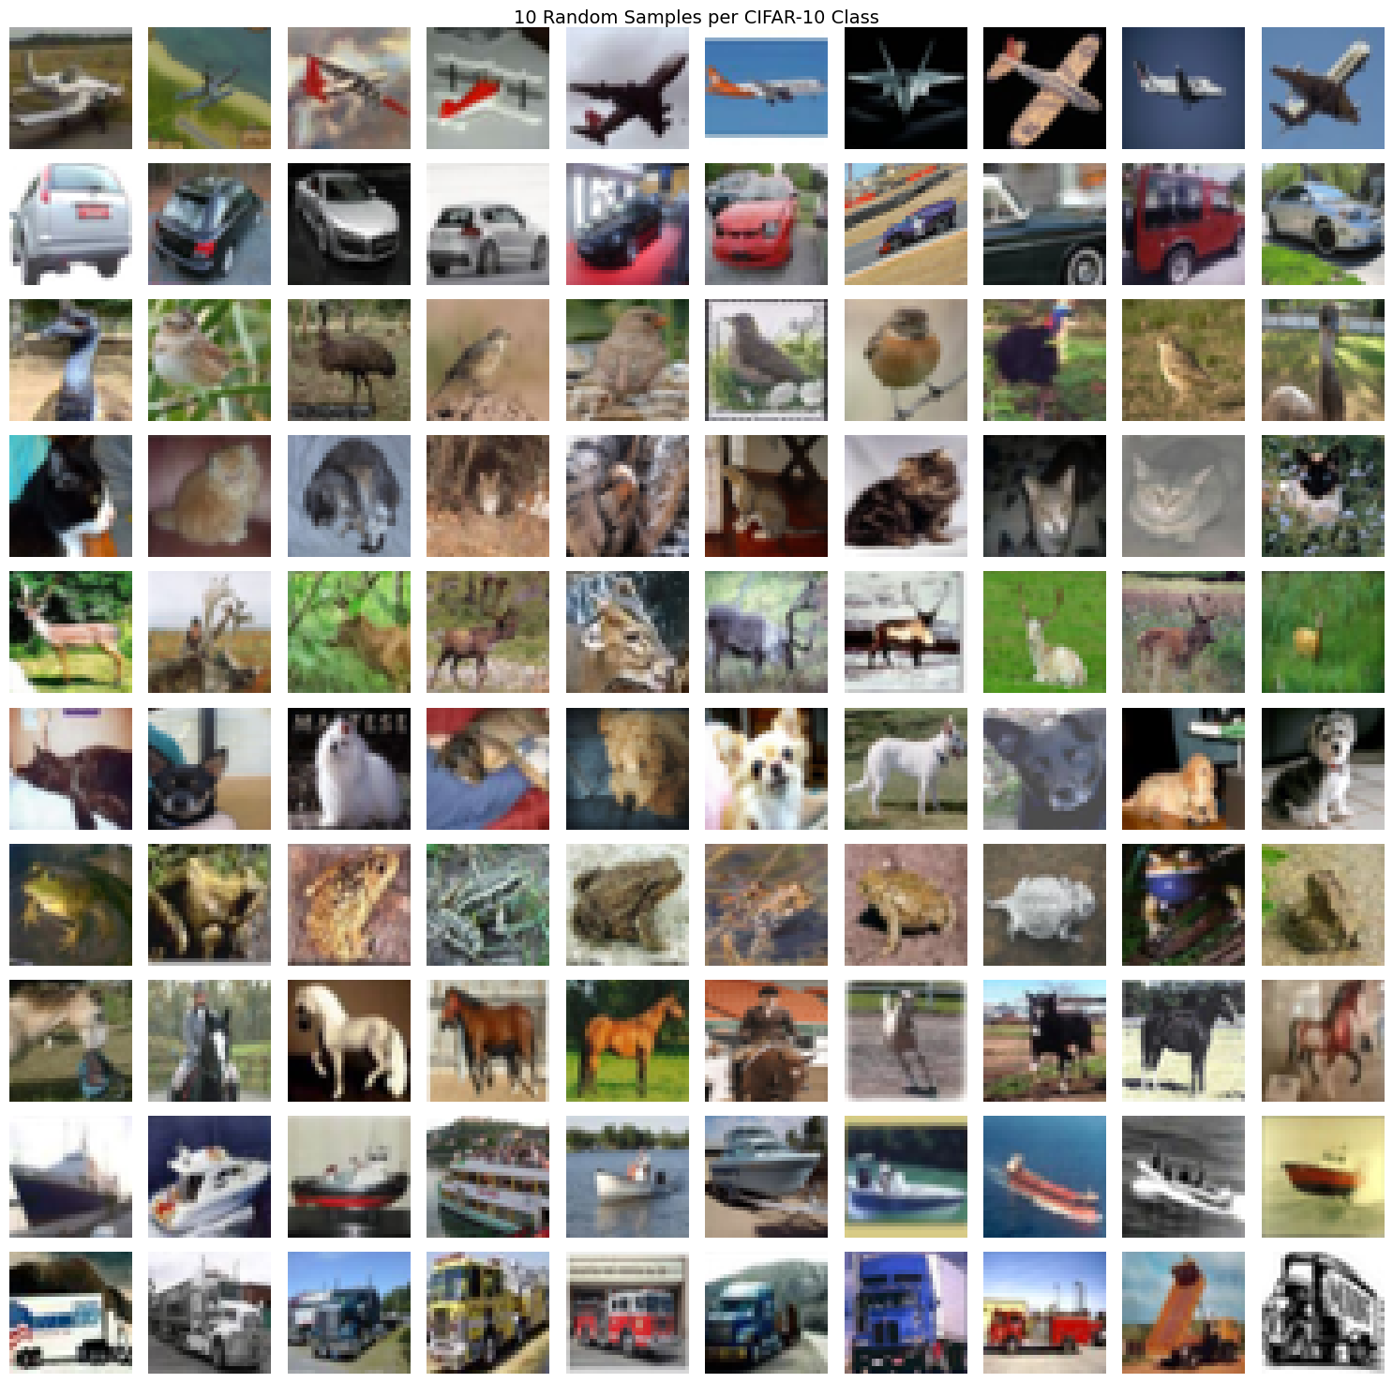
The dataset — CIFAR-10
60,000 tiny colour images
50,000 training • 10,000 test
32 × 32 pixels, 3 colour channels (RGB)
10 balanced classes — 6,000 images per class
The 10 classes
airplane
automobile
bird
cat
deer
dog
frog
horse
ship
truck
Group 2 • CIFAR-10 CNNs
10 random samples from each class
3 / 10

Slide 4
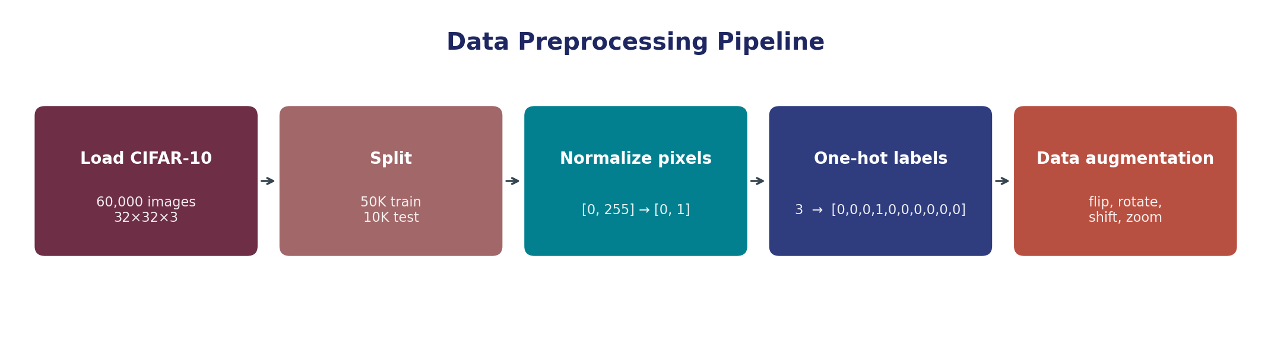
Preparing the data
Normalize
One-hot
Augmentation
Scale pixels from 0–255 to 0–1. Gradients behave better.
Turns class 3 into [0,0,0,1,0,0,0,0,0,0]. Needed for the softmax loss.
Random flips, rotations and shifts — effectively a larger training set, fights overfitting.
Group 2 • CIFAR-10 CNNs
4 / 10

Slide 5
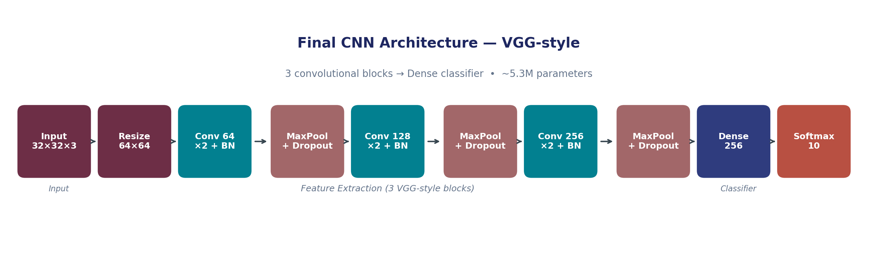
The architecture — and how we got there
How we got here
M1
Basic CNN
M2-3
Go deeper
M4-6
Better training
M7-8
Regularize
1 Conv + Dense.
Baseline: 54.7%
Stack convs, VGG-style.
50–61% — unstable.
Adam, BatchNorm,
SGD momentum. 66→75%.
Dropout + Augment + L2.
Final: 88.9% test.
Group 2 • CIFAR-10 CNNs
5 / 10

Slide 6
What actually made it better
BN
Batch Normalization
D
Dropout
L2
L2 Regularization
Stabilises layer activations. Lets us train deeper and faster.
Randomly drops 30–50% of neurons each step. Fights overfitting.
Penalises large weights. Keeps the model simpler and generalising.
AUG
Data Augmentation
LR
LR Scheduling
ES
Early Stopping
Flip / rotate / shift — the model sees more variety, memorises less.
ReduceLROnPlateau halves learning rate when val loss stalls.
Stops training when val loss stops improving — saves time and weights.
Rule of thumb: Dropout + Augmentation + Early Stopping is the reliable baseline.
Group 2 • CIFAR-10 CNNs
6 / 10

Slide 7
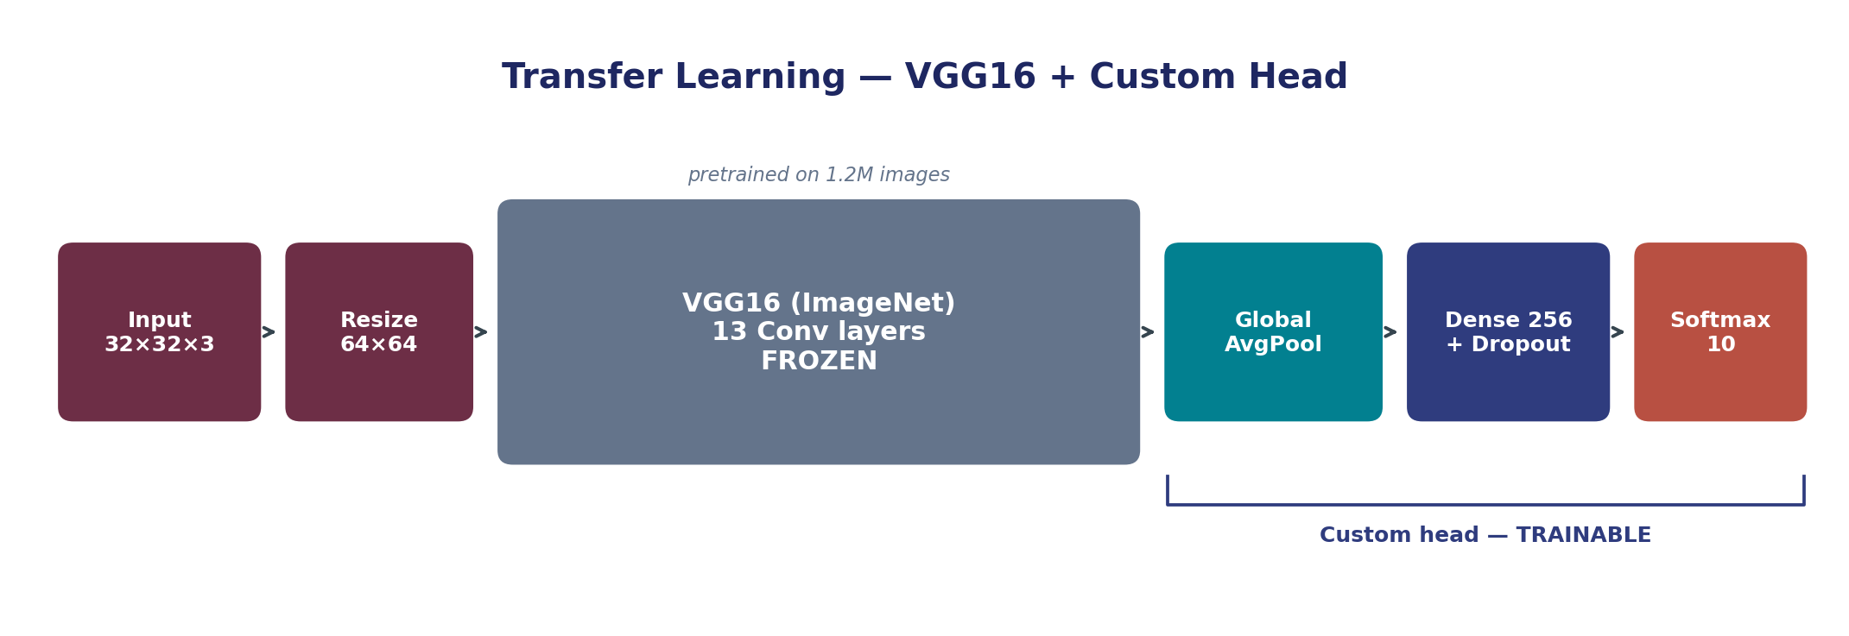
Transfer learning — standing on VGG16's shoulders
Why VGG16?
What we changed
Pretrained on 1.2M ImageNet photos
Proven VGG architecture — same family we built
Ready to use in Keras
Removed top classifier (1000 ImageNet classes)
Added GlobalAvgPool → Dense(256) → Dropout → Softmax(10)
Two-stage: freeze body, then fine-tune top layers
Group 2 • CIFAR-10 CNNs
7 / 10

Slide 8
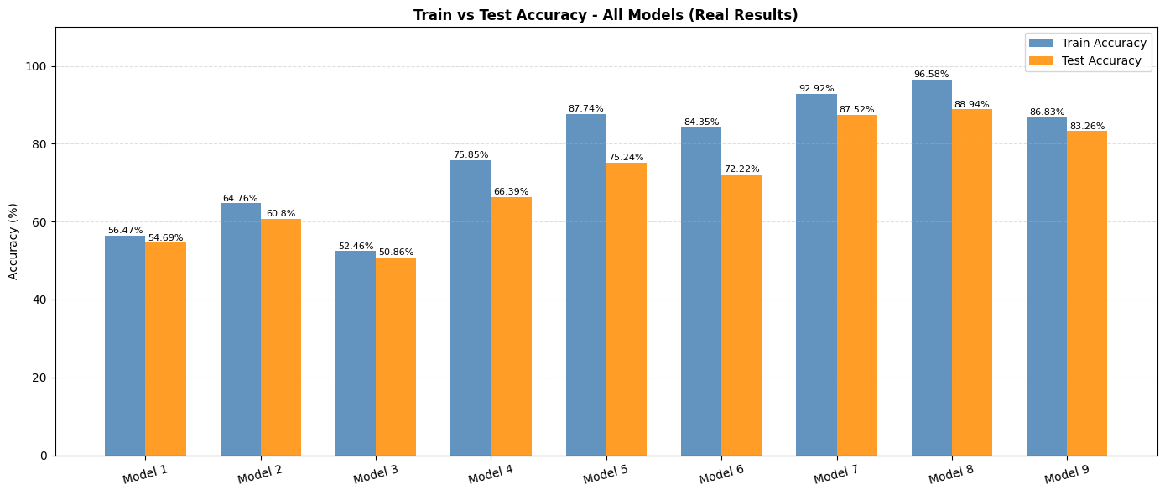
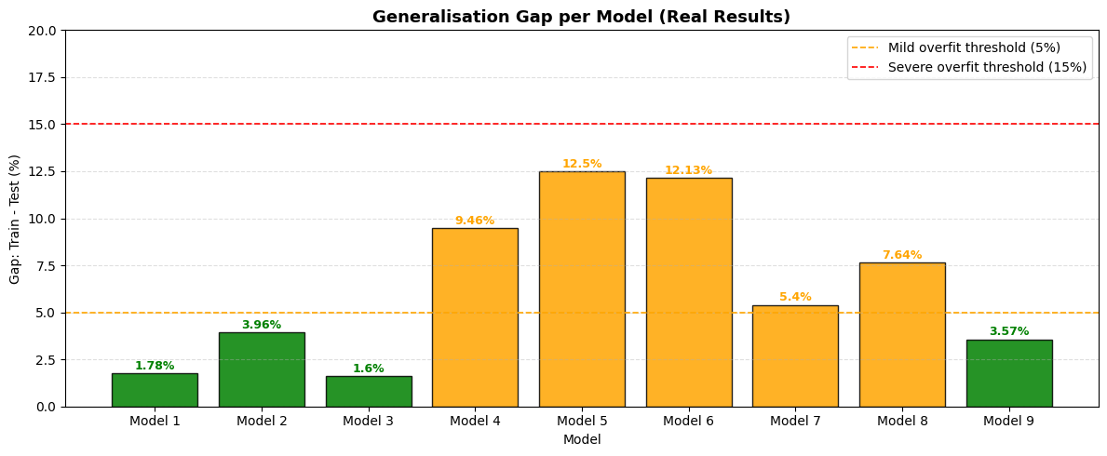
How the models compare
Best performers
MODEL 8
Best custom CNN
88.94% test accuracy
F1: 88.8% Precision: 89.0%
Gap: 7.6% (mild overfit)
MODEL 9
Transfer learning (VGG16)
87.05% test accuracy
F1: 86.9% Precision: 87.1%
Gap: 2.75% — best generalisation
Group 2 • CIFAR-10 CNNs
8 / 10

Slide 9
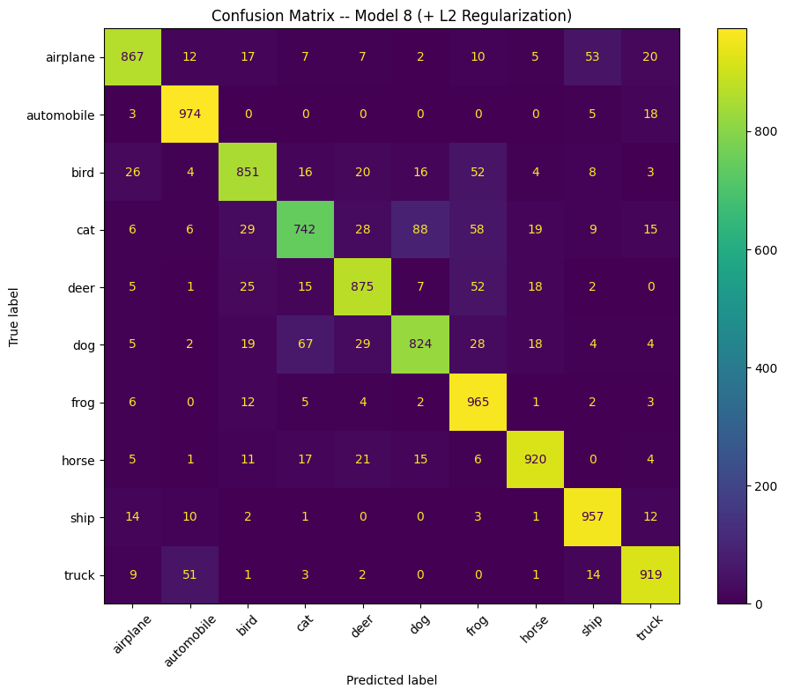
Where the model struggles
Common confusions
cat ↔ dog
similar body shape, fur and poses at 32×32
auto ↔ truck
shared wheels, boxy shape
deer ↔ horse
similar proportions, grass backgrounds
bird ↔ airplane
wings spread against sky
Hardest class: cat (74% recall)
Group 2 • CIFAR-10 CNNs
9 / 10
Confusion matrix — Model 8

Slide 10
RECAP
What we learned
01
02
03
Depth needs regularization
Small changes, big effects
Transfer learning wins on generalization
Stacking conv layers boosted accuracy but also the train-test gap. Dropout, L2 and augmentation were necessary to make it stick.
Swapping SGD → Adam added 15%. Adding BatchNorm added 9%. Most gains came from training recipe, not architecture.
VGG16 features trained on 1.2M images gave us the smallest gap (2.75%) — even though raw accuracy was slightly lower than Model 8.
BONUS — LIVE DEPLOYMENT
Gradio web app serving Model 8 — upload any image or try a random one per class.
Group 2 • CIFAR-10 CNNs
10 / 10

