Slide 1
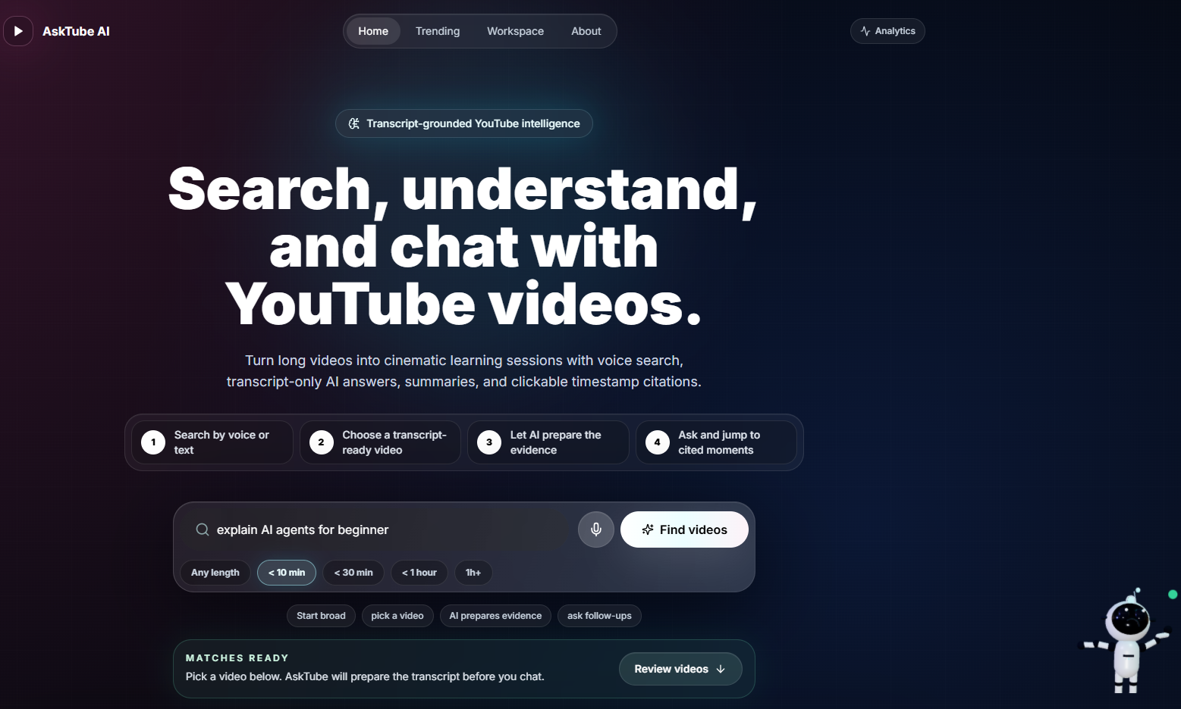
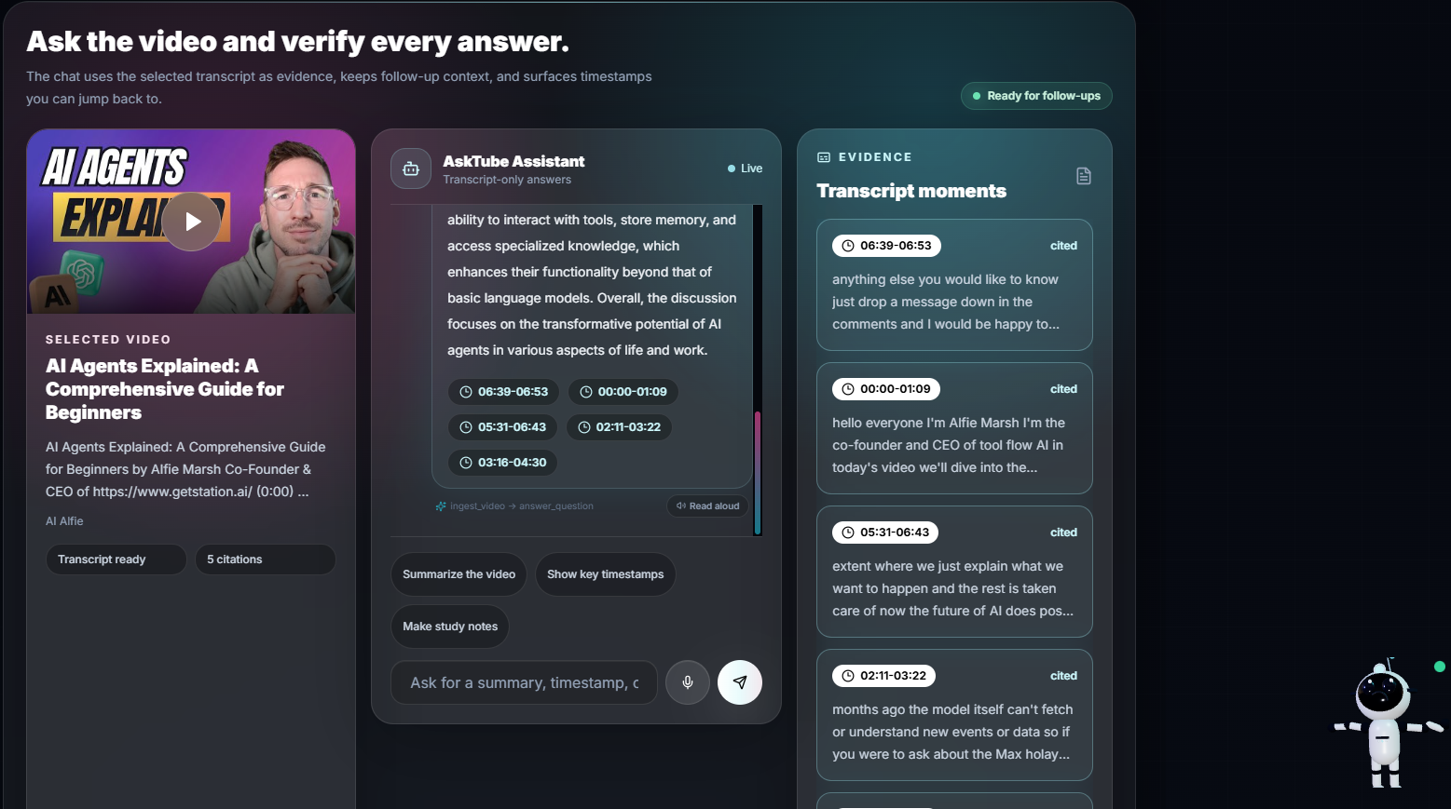
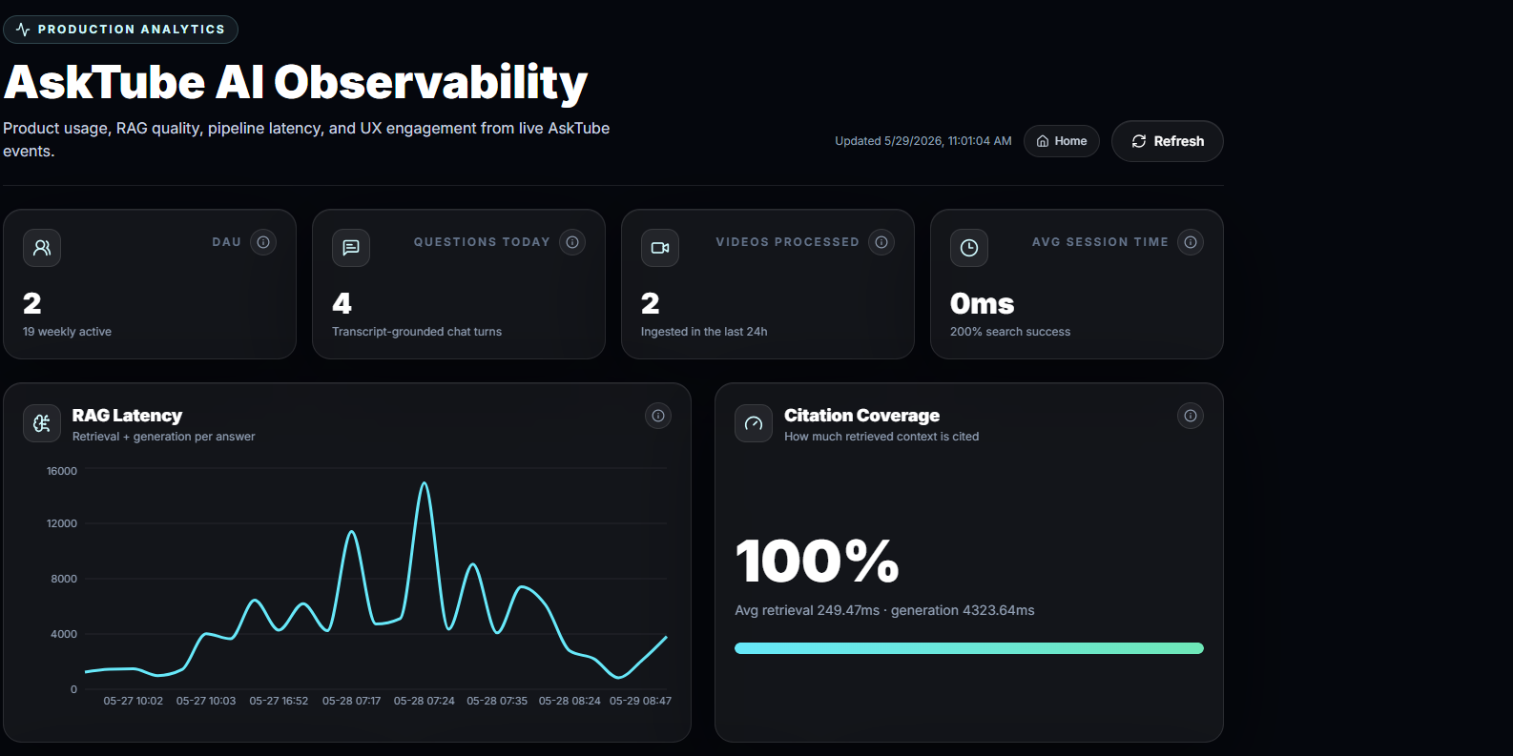
AskTube AI
SEARCH
Chat with YouTube videos through transcript-grounded AI.
https://asktube-ai.duckdns.org/
TRANSCRIPT
RAG
CITATIONS
Netflix-inspired UI + FastAPI + LangChain + ChromaDB + analytics + EC2
Final Project | Sabeur Zarai | IronHack

Slide 2
01 / PRODUCT IDEA
YouTube is huge. Learning from long videos is slow.
AskTube AI turns a video into a searchable, conversational knowledge base.
USER FLOW
TRUST RULE
WHY IT MATTERS
Search a topic, choose a video, let the app process the transcript, then ask questions with source timestamps.
The assistant answers from transcript evidence only. If the transcript cannot answer, it refuses instead of inventing.
Learners can skip guessing where information lives and jump straight to the exact moment in the video.

Slide 3
02 / USER JOURNEY
From search to cited answer
1
Search
2
Choose
3
Process
4
Chat
Text or voice search through YouTube Data API.
Netflix-style carousel with selected video state.
Transcript, chunks, embeddings, vector storage.
RAG answer with citations and memory.
Cinematic UI: dark mode, glass surfaces, duration filters, smooth transitions, 3D guidance, and graceful loading/error states.

Slide 4
03 / ARCHITECTURE
Three layers, one learning loop
FRONTEND
BACKEND API
AI + DATA
Next.js 14, TypeScript, TailwindCSS, shadcn/ui, Framer Motion, Embla, Three.js, React Three Fiber.
FastAPI async routes for search, transcripts, chunks, vectorstore, chat, agent, speech, evaluations, and analytics.
LangChain tools and agent, OpenAI models, ChromaDB vector storage, analytics DB, LangSmith tracing, Whisper fallback.
Docker Compose runs frontend, backend, ChromaDB, and analytics storage together for local development and deployment testing.

Slide 5
04 / INGESTION PIPELINE
A YouTube video becomes retrieval-ready text.
- YouTube Data API retrieves metadata, thumbnails, duration, and channel information, then applies the selected length filter.
- youtube-transcript-api is the primary source for public captions and timestamps.
- Whisper is used only as a fallback when captions are unavailable and the deployment can safely fetch audio.
- LangChain chunking keeps timestamp metadata attached to every chunk.
- OpenAI embeddings are stored in ChromaDB for similarity search.
STATUS STREAM
metadata transcript chunking embeddings vector_storage ready / error
The processing screen reflects backend progress, not only decoration.

Slide 6
05 / LANGCHAIN AGENT
The chatbot uses tools, not just a single prompt.
AgentService binds StructuredTool objects to the LLM and returns answer, citations, tool steps, and session_id.
search_youtube_videos
extract_transcript
GUARDRAILS
The final answer must use answer_question, stay transcript-only, and include timestamp citations. Off-topic questions should be refused.
chunk_transcript
store_video_vectors
ingest_video
retrieve_context
answer_question
MEMORY
Session-based memory keeps follow-up questions coherent.

Slide 7
06 / RAG ANSWERING
Answers are grounded in transcript evidence.
1
Retrieve
2
Inject
3
Generate
4
Cite
ChromaDB returns top transcript chunks.
Prompt receives context, memory, and rules.
GPT-4o-mini writes from retrieved context.
Timestamp chips point to source moments.
Anti-hallucination rule: if the transcript does not contain the answer, AskTube says it cannot answer from the video.

Slide 8
07 / VOICE + CINEMATIC UX
The interface feels like a learning product, not a backend demo.
VOICE SEARCH
ASSISTANT
ACCESSIBILITY
Browser Web Speech API captures live dictation with waveform feedback. If it fails, MediaRecorder sends audio to /api/speech/transcribe.
A floating 3D robot moves through the journey, speaks short guidance, and opens a compact transcript-grounded chat.
Semantic labels, visible focus states, reduced-motion handling, screen-reader status messages, and touch-friendly layouts.
Extra polish: loading skeletons, retry states, TTS answer playback, responsive stacking, and collapsible evidence panels.

Slide 9
08 / ANALYTICS + OBSERVABILITY
The platform is measurable, not just usable.
AskTube tracks product usage, RAG quality, pipeline performance, UX behaviour, and operational health.
PRODUCT + UX
AI / RAG
PIPELINE
search_submitted, video_selected, voice_search_completed, suggested_prompt_clicked, timestamp_clicked, 3d_chatbot_interacted.
retrieval latency, generation latency, chunks retrieved, token estimates, citation coverage, hallucination warnings.
transcript time, embedding duration, vector insert/query timing, chunk count, processing duration, Whisper fallback usage.
/analytics
Next.js dashboard with overview, AI, pipeline, UX, business metrics, and recent events.
/metrics
Prometheus metrics for HTTP latency, RAG, embeddings, vector search, processing, and WebSockets.

Slide 10
09 / TESTING + EVALUATION
The project is testable, explainable, and demo-ready.
100+
17
0
3
AUTOMATED TESTS
RAG EVAL CASES
BEHAVIORAL FAILS
DOCKER SERVICES
- Coverage includes routes, services, tools, WebSocket ingest, speech transcription, and RAG behavior.
- Evaluation cases test answerable questions, refusals, citation accuracy, summaries, memory, and hallucination prevention.
- LangSmith tracing can inspect latency, context, answer quality, and chain behavior.

Slide 11
10 / CHALLENGES + SOLUTIONS
Challenges faced during the project
The hard parts were not only building the chatbot, but making it reliable on real YouTube data and EC2.
1
YouTube access
2
Trustworthy answers
3
Production UX
CHALLENGE
CHALLENGE
CHALLENGE
Cloud IPs can be blocked and some videos have no usable captions.
A normal LLM can answer from memory and hallucinate outside the video.
Processing takes time, voice needs HTTPS, and users need clear feedback.
SOLUTION
SOLUTION
SOLUTION
Use transcript API first, add residential proxy support, and keep Whisper only as fallback.
Use RAG guardrails, transcript-only context, refusal behavior, and timestamp citations.
Add WebSocket progress, Nginx + HTTPS domain, retry states, analytics, and visible errors.
Main lesson: every failure mode became a visible state, fallback, or metric.

Slide 12
11 / LIVE DEMO
Demo path: search, prepare, ask, verify.
- Open the hosted app: https://asktube-ai.duckdns.org/
- Search with text or voice and apply a duration filter.
- Prepare one video and show the live ingestion progress.
- Ask one question, then verify the timestamp citations.
WHAT TO EMPHASIZE
Transcript-grounded workflow with tools, memory, vector search, citations, analytics, and polished UX.
Keep the demo focused on trust: every answer links back to the video. EC2 proves deployment with HTTPS; proxy support helps with YouTube cloud-IP limitations.

