Slide 1


21AIE211 Introduction to Computer Networks
END SEMESTER PROJECT
Raspberry Pi Alexa: Build your own Amazon Echo

Slide 2
Team 16
CB.EN.U4.AIE20021 | HARIPRANAV JM
CB.EN.U4.AIE20054 | PRAVIN RAJ AK
CB.EN.U4.AIE20061 | SABHARISH A L
CB.EN.U4.AIE20063 | SAI SANGAVI C
CB.EN.U4.AIE20064 | SAIVARSHA R

Slide 3
Contribution
Haripranav JM - code for date, day and time
Pravin Raj AK - code for weather and webserver
Sabharish AL - code for music
Sai Sangavi C - code for server and wiki search
Saivarsha R - code for command recognition and server connection (tara.py)

Slide 4
Concepts used
Socket programming
Threading
TCP / UDP

Slide 5

Socket Programming

Slide 6


Socket is an interface between application process and end to end transport protocol
Socket programming is the communication between the client and server applications using sockets.

Slide 7

Socket interfaces can be divided into two categories:
Stream sockets: The two communicating parties I.e., the client and the server, first establish a socket connection, after which any data passed through that connection arrives in the same order in which it was sent.
Datagram sockets: Offer connection-less semantics. Either party sends datagrams as needed and waits for the other to respond. Messages can be lost in transmission or received out of order.

Slide 8
TCP
Connection oriented
Checks for errors
Guarantees the delivery of data in the order it was sent
More reliable
Used by HTTPS, HTTP, SMTP, POP, FTP, etc.

Slide 9
UDP
Connectionless Internet protocol
Cannot guarantee delivery of data to the destination
Faster than TCP
Video conferencing, streaming, DNS, VoIP, etc.

Slide 10
Threading
Threading is the process of implementing parallelism of processes or functions. By the concept of threading, we achieve it, by creating a separate thread for a specific function and run it parallelly.

Slide 11
Packages used for speech recognition
Speech_recognition
Pyaudio and portaudio
Pyttsx3

Slide 12
Packages used for socket
socket
json

Slide 13
Packages for playing music
Youtube-dl
Pafy
Python-vlc

Slide 14
Miscellaneous packages
Wikipedia
Random
Datetime
Urllib
Threading
requests

Slide 15
Implementation

Slide 16
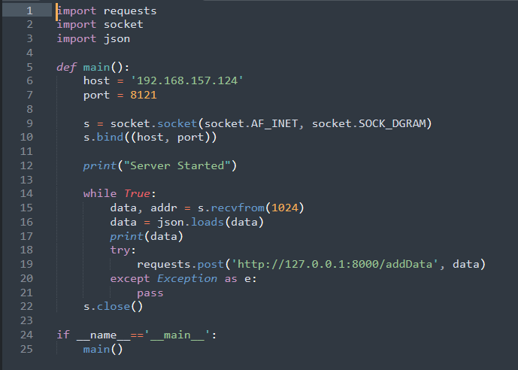
Server.py

Slide 17
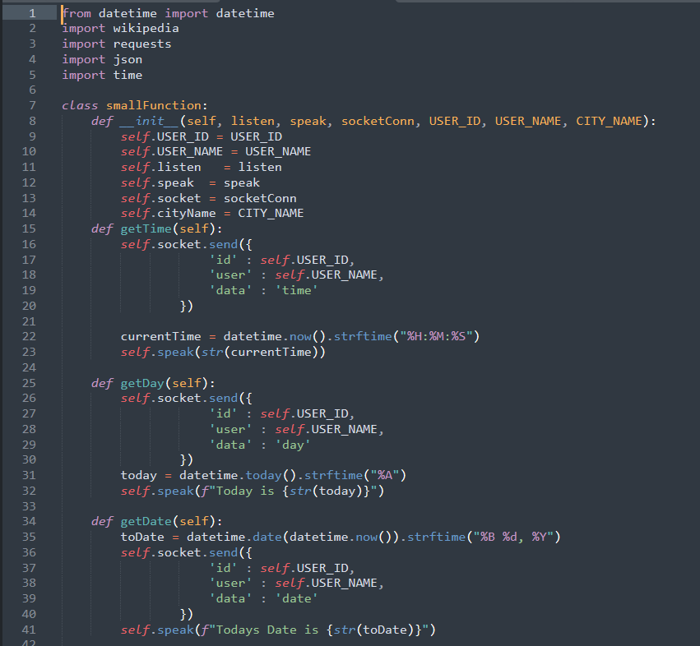
Date, time and day
Functions

Slide 18
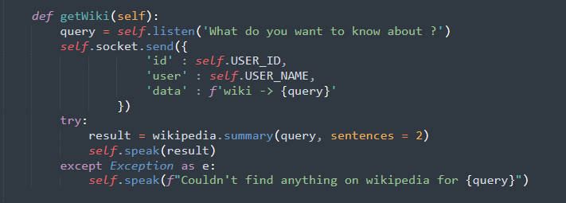
Wiki search
Function

Slide 19
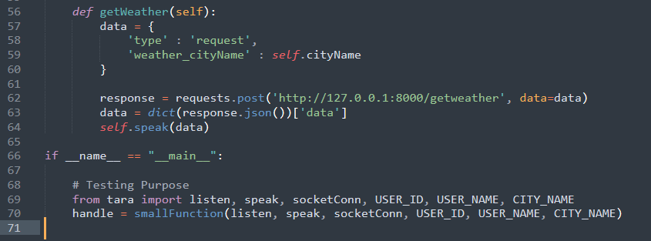
Weather and temperature
function

Slide 20
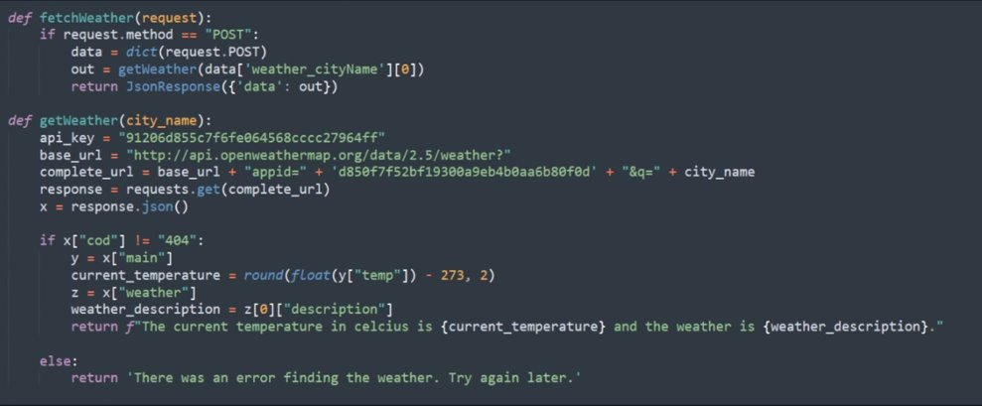
In server:

Slide 21
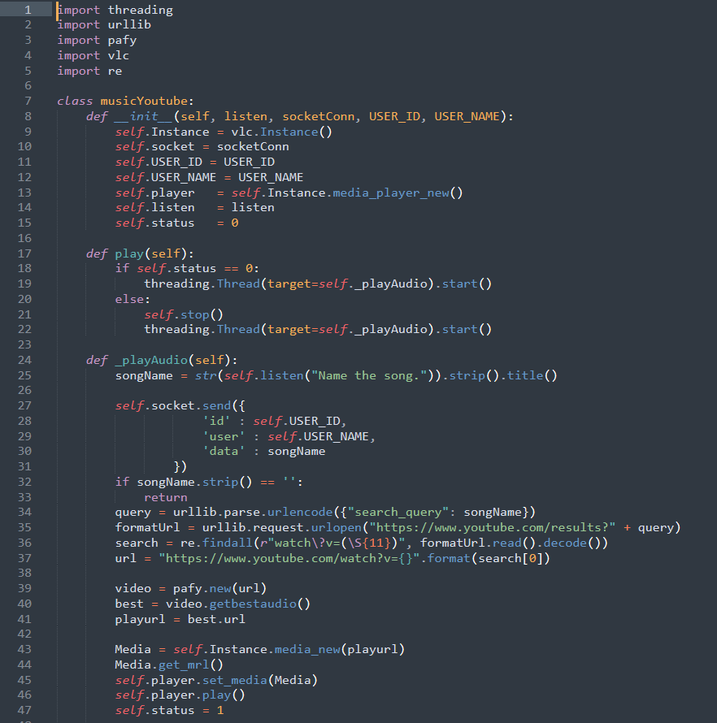
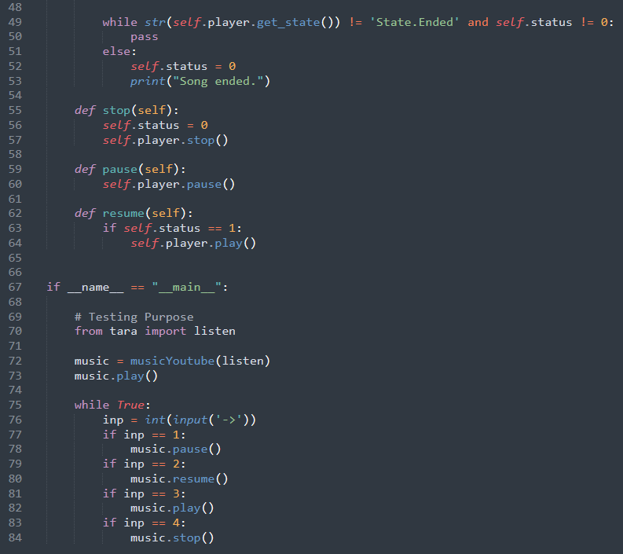
Music

Slide 22
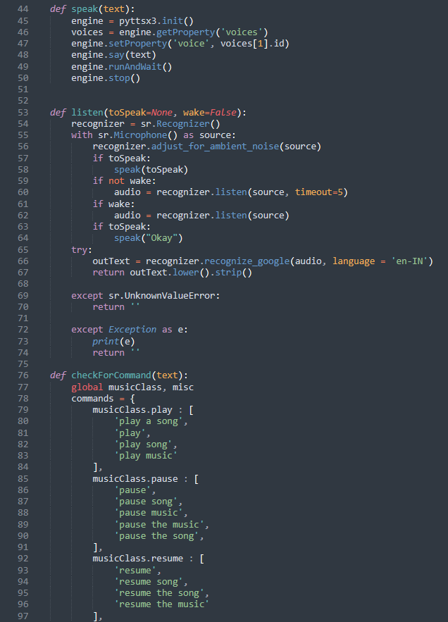
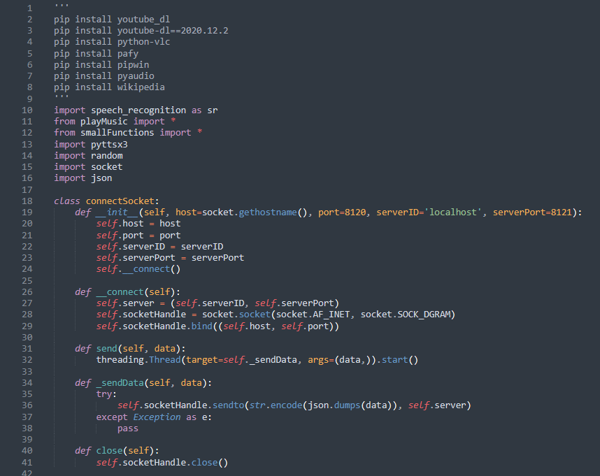
Tara.py

Slide 23
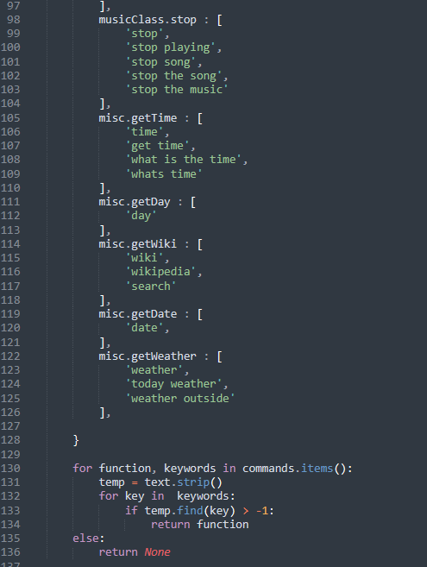
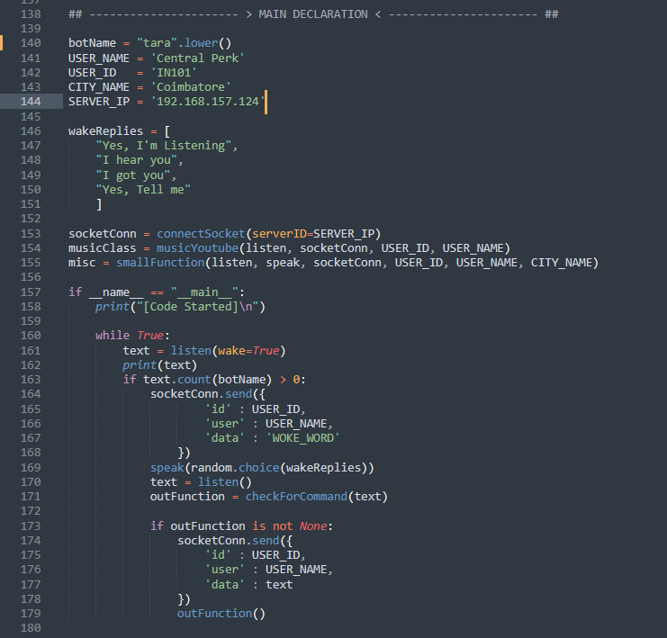

Slide 24
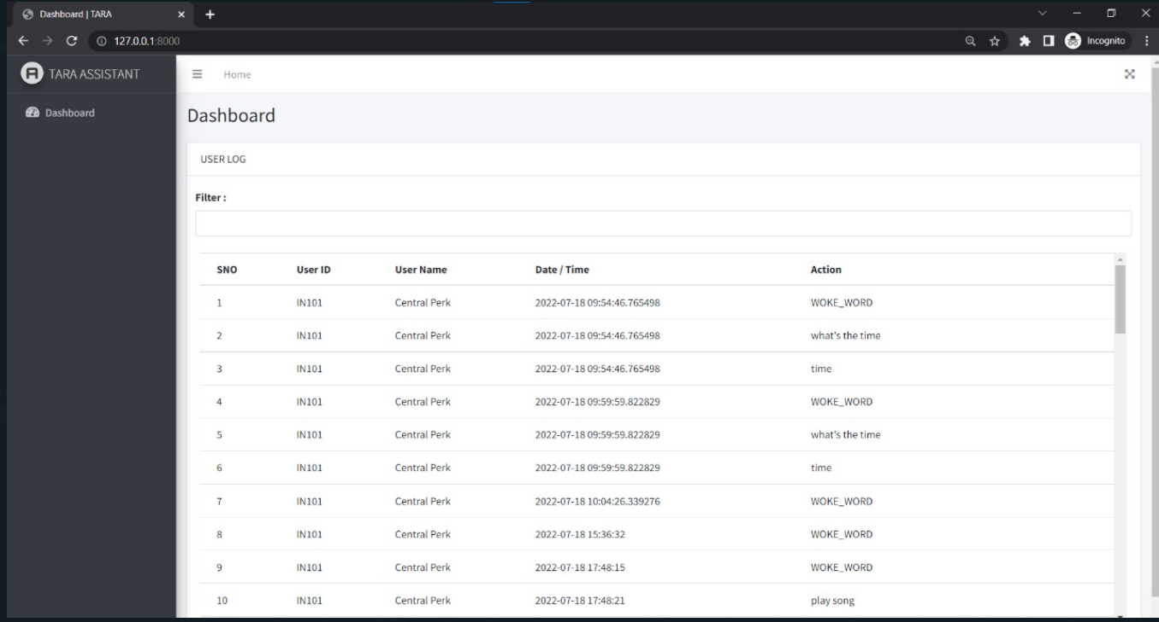
Tara assistant dashboard

Slide 25
Advantages
It is very effective as an end product
It can perform multiple functions
It is very time efficient

Slide 26
Disadvantages
We are not in the control of the data that is being collected by it
It is not secure and safe
There are possibilities of data breach

Slide 27

THANK YOU

