Slide 1

19AIE213 Robot Operating System and Robot Simulation
Topic –
Voice Controlled robot

Slide 2
Team 16
Sabharish A L - CB.EN.U4AIE20061
Saivarsha R - CB.EN.U4AIE20064

Slide 3


Launch file

Slide 4
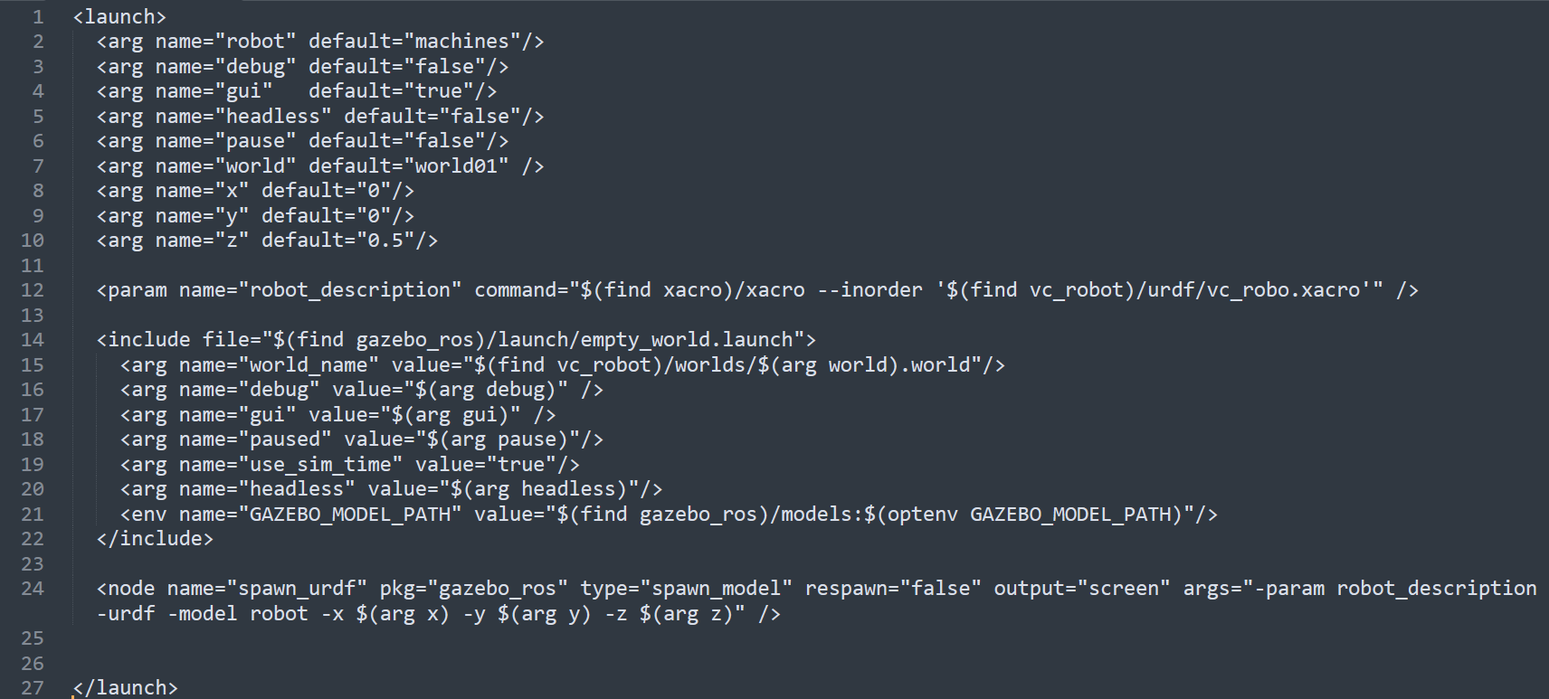
launchOne.launch

Slide 5
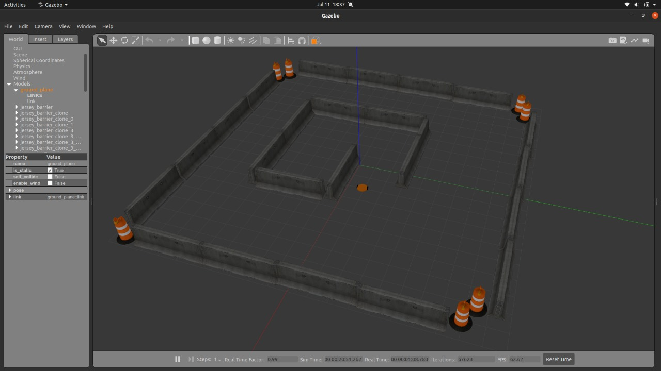
simulation

Slide 6
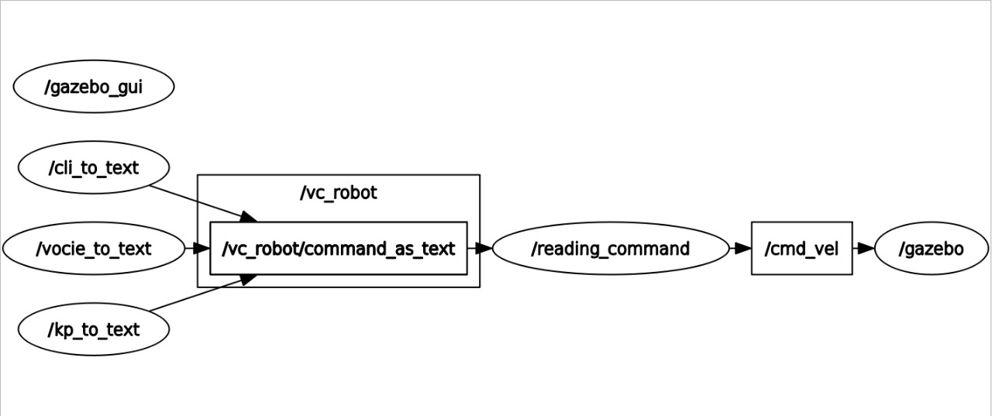
rqt_graph

Slide 7

Command.msg

Slide 8
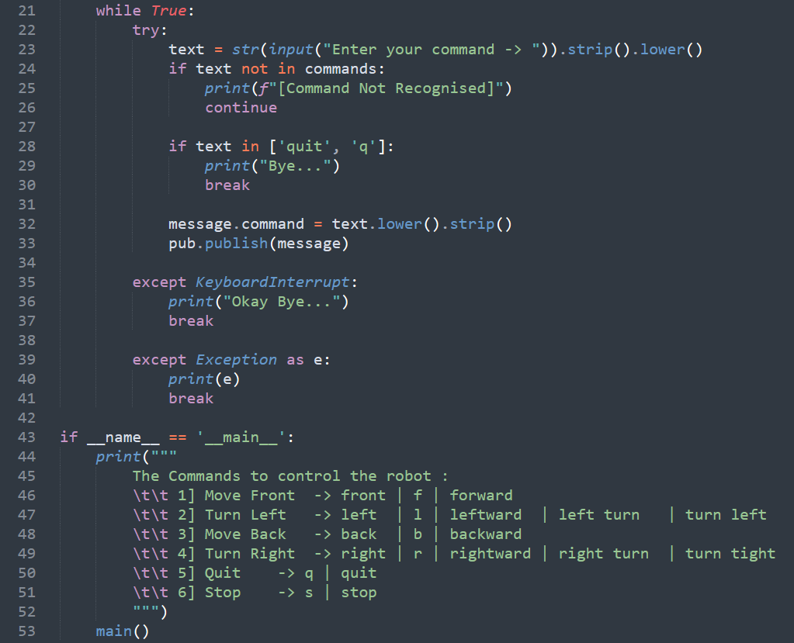
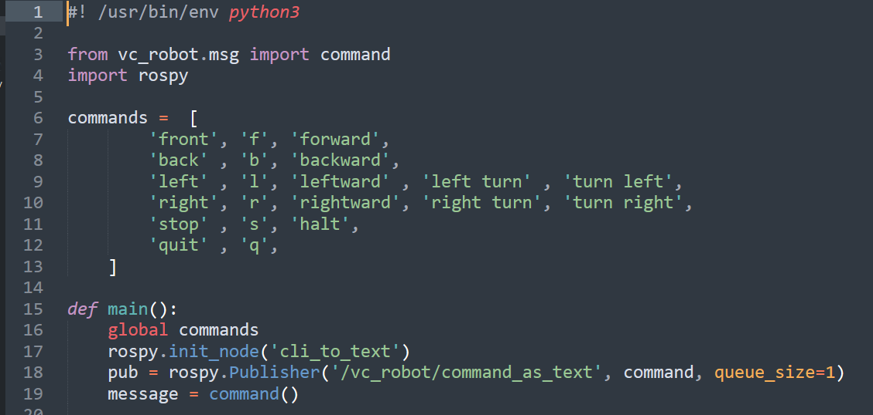
Cli_to_text.py

Slide 9
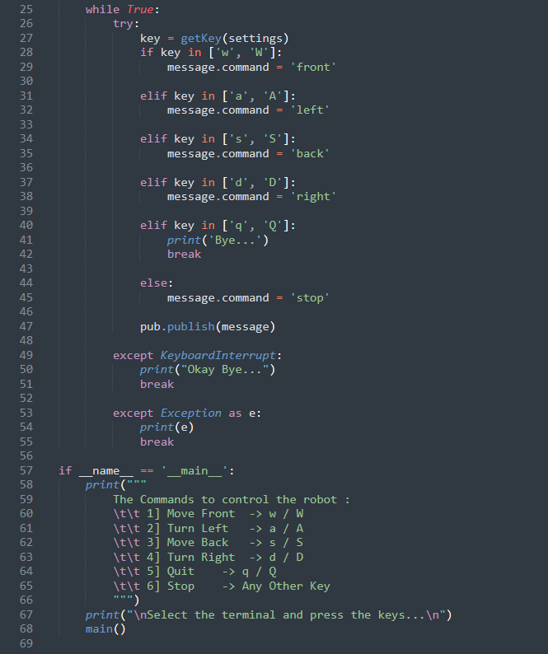
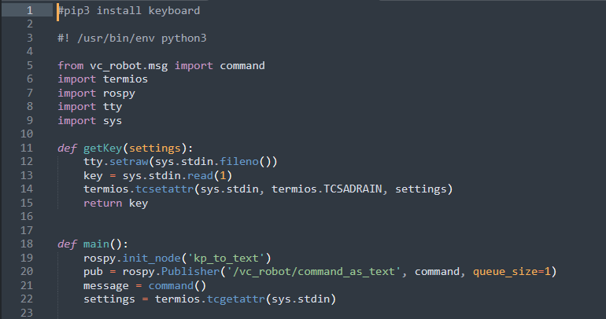
Kp_to_text.py

Slide 10
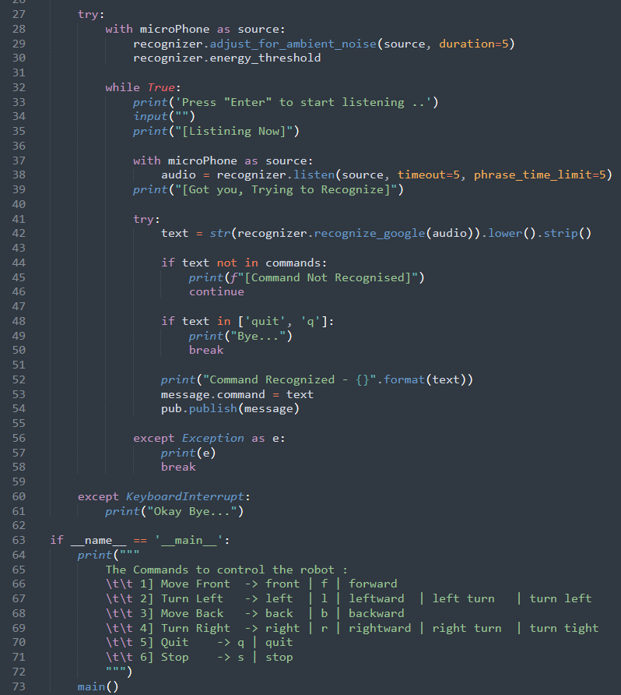
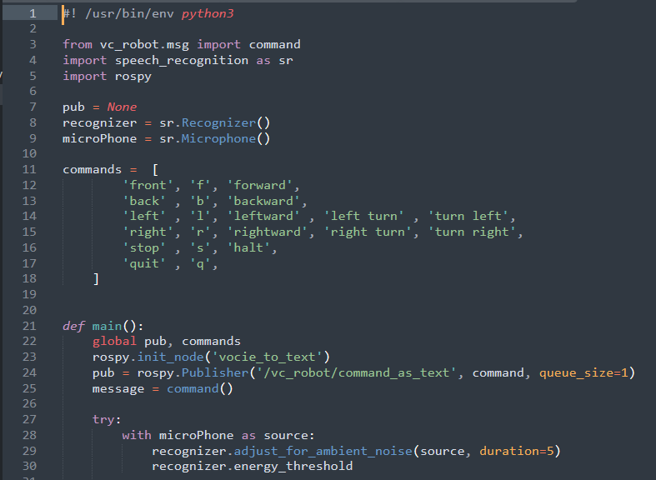
Voice_to_text.py

Slide 11
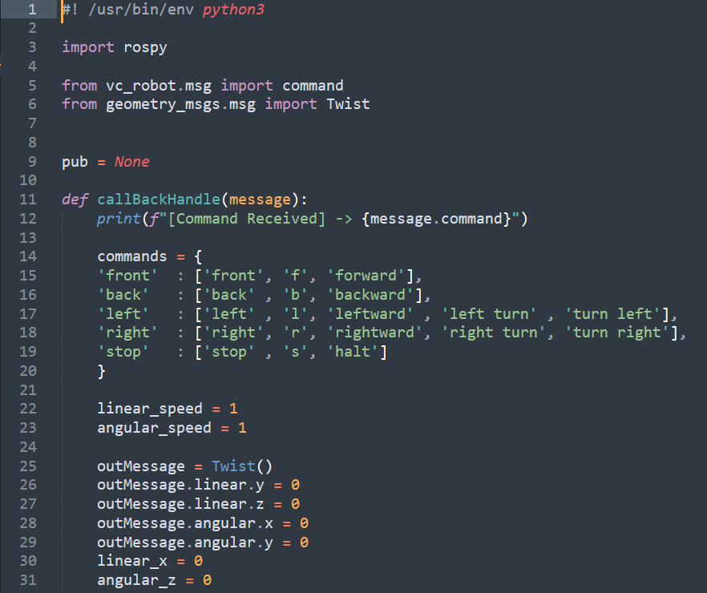
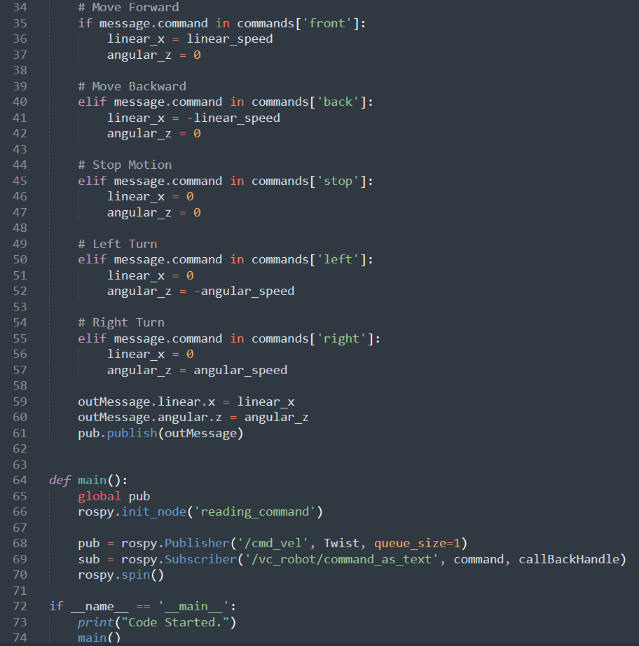
Robot_control.py

Slide 12

simulation

