Slide 1



Genesis Ideathon: Final Presentation
Team ID: [GEN26-A0H-I178]
Team Name: [4 LOST TOURISTS]
Domain: [INTELLIGENT SYSTEMS AND DIGITAL FUTURES]
Amrita Vishwa Vidyapeetham, Coimbatore Campus
Date: 11th October 2026

Slide 2
Presentation Outline
Problem Statement
Problem Understanding
Existing Gaps & Challenges
Our Proposed Solution
Technical Approach
Innovation & Uniqueness
Feasibility & Scalability
Cost for Product
Use Cases
Impacts and Benefits
Sustainable Development Goals
Individual Member Contribution

Slide 3
Problem Statement
OFFLINE-FIRST AI ASSISTANCE FOR LOW CONNECTIVITY REGION

Slide 4
Problem Understanding
Farmers, Rural Families, Low Literacy users
Internet availability and AI’s dependency on data centers which can only be served using internet
Without internet, farmers, rural families and elders can't get timely help on schemes, farming and health. They lose time, money and benefits they are entitled to, and have to travel or rely on middlemen. Health workers, panchayats and NGOs end up answering the same questions one by one, so the digital divide keeps widening.

Slide 5
Existing Gaps & Challenges
Existing tools depend on the internet or a person. Cloud chatbots and WhatsApp bots need a signal, and helplines have waiting times and fixed hours, so people in low-connectivity areas can’t get help when they need it.
No single tool is offline, voice-based, regional-language and verified. Offline translators only translate and can’t answer questions, and most apps are English-first and need typing, which excludes elders and low-literacy users.
The main unsolved challenge is giving people reliable, spoken answers in their own language when they have no internet. Existing tools solve parts of it: some work offline, some understand voice, some cover regional languages. None of them does all of it together on a low-cost phone with verified information.

Slide 6
Our Proposed Solution
An application which works without internet in mobile phones of even old models with just 4 to 6 GB of ram which can answer within a certain field.
The user speaks a question in their own language, and the phone’s offline speech tool turns it into text. The app then looks up verified facts in a local knowledge base stored on the phone, and a small compressed AI model uses those facts to write a simple answer. The phone reads the answer aloud, and all of this happens on the device with no internet.
The user gets to work on their field without even a connection of internet, they can research, ask questions, and can do multitasks through this application . They also get the benefit of using this without even the fear of their data being stolen.

Slide 7
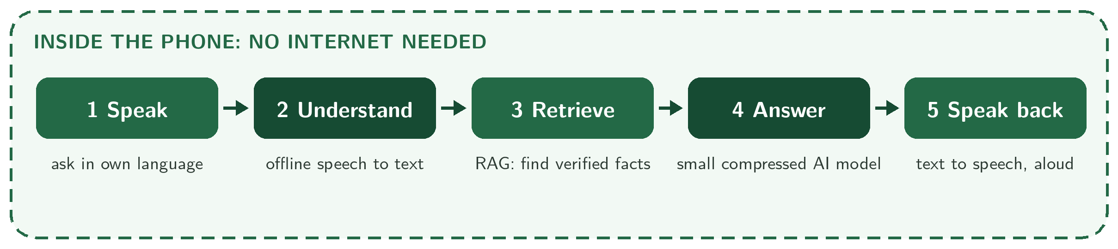
Technical Approach
The user speaks in their own language, and the offline speech-to-text system converts their voice into text that the AI can understand. The Retrieval-Augmented Generation (RAG) component searches locally stored, verified information to find relevant facts.
A small, compressed artificial intelligence model uses the question and retrieved information to generate an appropriate answer. Finally, the text-to-speech component converts the answer into spoken audio, allowing the user to receive assistance without an internet connection.
Tech Stack
Frontend: Kotlin
Database: SQLite
Backend: Python
AI/ML, APIs, or Hardware: Small Language Model (SLM), offline Speech-to-Text, Text-to-Speech

Slide 8
Innovation & Uniqueness
Provides AI assistance offline using on-device AI and locally stored information, reducing dependence on internet connectivity.
It supports users in rural and remote areas where internet access is weak, unreliable, or unavailable.
Combines offline AI, local knowledge retrieval, and voice-based interaction to make information more accessible.

Slide 9
Feasibility & Scalability
Feasibility:Can be developed using a smartphone, a small AI model, offline speech tools, and a locally stored knowledge database.
Scalability:Can be expanded by adding more languages, new knowledge resources, and support for more low-connectivity regions.
Risks: Limited device memory, battery usage, and outdated information can be addressed using lightweight models, optimized storage, and regular offline updates.

Slide 10
Cost for Product (Optional)
Development or hardware cost: 6500 rupees
Hosting or maintenance cost: 1000 per year
Estimated total: 7500 rupees

Slide 11
Use Cases :
Use case 1: Early Disease detection: Small holder farmers spot crop infections instantly using on –device edge AI camera scans.
Use case 2: Precision Irrigation: agricultural co-ops optimize water usage locally based on real time soil sensor metrics
Use case 3: Offline Field Advisory: Remote farm managers execute diagnostics without relying on continuous cloud connectivity

Slide 12
Impacts and Benefits
Accurate answers in seconds, by voice, on a mid-range phone with no internet, private and with zero data cost.
Social Impact: Protects farmer livelihoods and bridges the digital divide by delivering offline, multi-language crop diagnostics to remote communities.
Environmental Impact: Reduces chemical runoff and conserves water through precise, edge sensor-driven irrigation and disease treatment.
Instant crop disease and soil diagnosis deployed locally on low-cost hardware without requiring internet connectivity.

Slide 13
Sustainable Development Goals (SDGs)
SDG Number | Target Number | Goal Name | Connection
SDG 2 | Target 2.4 | Zero hunger | Early detection of crop diseases, pests, and nutrient deficits, directly promoting resilient agricultural practices.
SDG 12 | Target 12.4 | Responsible consumption and production | Minimizes chemical fertilizer and pesticide over-use through precision sensor data.

Slide 14
Individual Member Contribution
Member | Contribution or responsibility
Sabharish S | Solution & Technical Design Lead
Sanjith K R | Existing Solutions & Gap Analyst
Saswin J | Impact, Storytelling & Presentation Lead
Anushri Narkhede | Problem & User Research Lead

Slide 15
Yukti ID
Yukti ID
IR2026-1051088

