Slide 1
CONFIDENTIAL · NEURALCRAFT · 2025
Orqestra
AI Estate Coherence Infrastructure
"Catch the failures that live BETWEEN your AI systems."
Notes:
Set the stage: Orqestra is infrastructure, not a tool. Emphasize 'between' — that's the core insight no one has acted on.

Slide 2
PROBLEM
Enterprise AI systems develop conflicting beliefs.
Each AI system independently forms beliefs about organizational facts — prices, headcount, budgets — with no reconciliation mechanism.
No existing tool detects failures that live between systems rather than within them.
Existing observability sees one system at a time.
Datadog
LangSmith
Helicone
— each sees one agent, never the conflict between them.
Notes:
Enterprise AI systems develop conflicting beliefs with no reconciliation layer. Existing observability is single-system — it can't see the gap between agents.

Slide 3
THESIS
Cross-system coherence is a separate problem requiring separate infrastructure.
The asset isn't a model — it's a versioned, queryable record of what your organization actually believes.
The Canonical Claim Store
Notes:
We're not building better observability — we're building the missing layer. The asset is the canonical claim store, not the model.

Slide 4
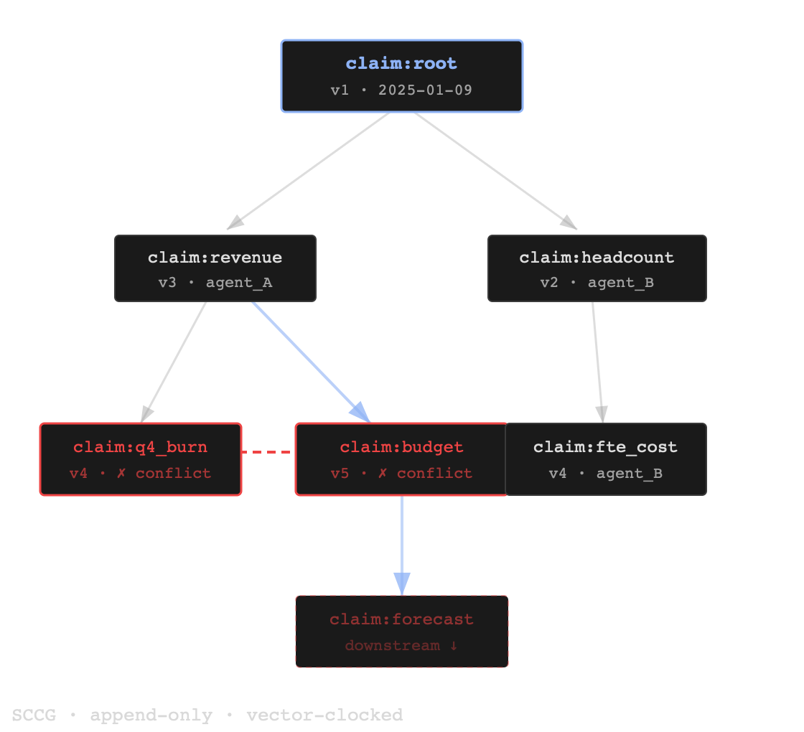
ARCHITECTURE
Two structures. Five-level funnel.
SCCG
Sparse Causal Claim Graph
Append-only DAG with vector clocks. Every claim, every derivation, immutable.
OBG
Organizational Belief Graph
Materialized semantic state — what your org currently believes, queryable in real time.
5-level detection funnel
→ ~90% LLM cost reduction
Notes:
SCCG is the immutable record; OBG is what you can query. The 5-level detection funnel is what makes it affordable — cheap heuristics first, LLM apex judge only for the hard cases.

Slide 5
INTEGRATION
Three modes. One SCCG.
01
02
03
SDK Wrapper
Write Hook
Log Ingestion
Instrument once, get full telemetry. Wrap your existing agent calls — lowest friction path.
HMAC-signed pushes from your system on every claim write. Event-driven, real-time.
Read-only. Ingest existing logs — no write access required, zero code changes.
orqestra.wrap(agent)
POST /hooks/claim
ingest(log_stream)
All three feed the same SCCG → identical coherence monitoring regardless of integration depth
Notes:
Three modes ordered by friction. Key point: all three produce the same SCCG telemetry — depth of integration doesn't change what you get, only how you get there.

Slide 6
CANON
One endpoint anchors every agent to organizational ground truth.
RETURNS
entity: "q4_burn" canonical: "$1,200,000" confidence: 0.97 conflicts: 2
REQUEST
GET /canon/resolve
Agents query Canon before responding — anchored to consensus, not fabrication.
Sub-50ms — synchronous in request path, no UX penalty.
This is the inflection point — load-bearing infrastructure , not optional tooling.
Notes:
This is the inflection point. Canon makes Orqestra load-bearing: agents can't fabricate if they query ground truth first. Sub-50ms means it's safe on the synchronous request path.

Slide 7
BLAST RADIUS
Every contradiction propagates dollar exposure downstream.
ROOT CONTRADICTION
6.5×
TOTAL EXPOSURE
$1,200
$7,800
amplification
13
From real demo data. Orqestra quantifies propagation — dollar exposure is a number, not a hypothesis.
downstream claims affected
Notes:
Contradictions don't stay local — they propagate through the claim graph. The dollar amplification makes the problem concrete. $1,200 root becomes $7,800 across 13 downstream claims.

Slide 8
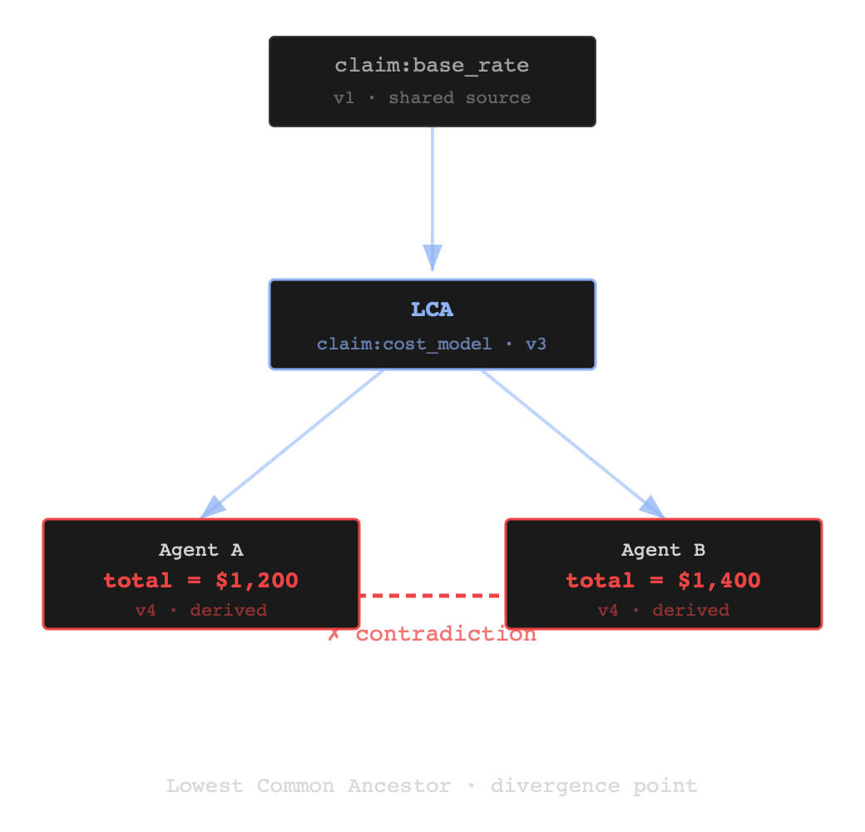
CAUSAL LINEAGE
Where the divergence happened — not just that it did.
Full SCCG walk for any contradiction — every derivation step traced back to its source.
LCA detection — two agents derive conflicting claims from the same upstream source. We find the Lowest Common Ancestor.
Existing tools flag the contradiction. Orqestra explains its origin.
Notes:
Full SCCG walk traces every derivation back to its source. LCA detection finds the exact upstream claim where two agents began to diverge. Existing tools flag the contradiction; Orqestra explains its origin.

Slide 9
PERFORMANCE
Sprint 7.1 · production instrumentation
Measured. Not projected.
P95 WRITE LATENCY
P95 READ LATENCY
COST PER 1K SAMPLES
8.66
≤10
$0.19
ms
ms
Authenticated write endpoint. 95th percentile.
Blast-radius and lineage queries. Synchronous-safe.
At gpt-5.4-mini rates. 5-level funnel cuts LLM spend ~90%.
Sub-50ms request-path latency → agents call Canon synchronously without UX penalty
Notes:
Sprint 7.1 production instrumentation — these are real numbers, not projections. Fast enough for synchronous request paths; cheap enough at scale.

Slide 10
MULTI-TENANT
Tenant isolation verified end-to-end.
ISOLATION
VERTICAL PRESETS
tenant_id — on every log line and trace
Consumer
tier-1
org_slug — scoped per request context
Clinical
tier-critical
Celery — separate contexts per request
Finance
tier-regulated
Cross-org leakage structurally impossible by query construction
Policy
tier-regulated
General
tier-standard
Notes:
Not just an architecture claim — tenant_id on every log line, separate Celery contexts, cross-org leakage is structurally impossible by query construction. Verified end-to-end.

Slide 11
STRATEGIC ARC
Optional tooling today. Operating environment tomorrow.
TODAY
Monitor
Gate
Canon
OS
Observability tooling. Detect cross-system contradictions passively.
CI/CD integration. Pre-deployment coherence checks before release.
Request-path ground truth. Load-bearing. Agents depend on it to function.
Full organizational knowledge operating environment. The canonical claim store as platform.
Notes:
The progression from optional to essential. Monitor is today. Canon is when we become load-bearing. The OS stage is the long game — an org's full knowledge operating environment.

Slide 12
DEFENSIBILITY
Individual components are replicable in months.
A versioned organizational knowledge asset built from real production traffic is not.
The longer Orqestra runs, the more valuable it gets — every claim ingested deepens the org's knowledge graph.
The longer it runs, the harder it gets to switch off — Canon becomes load-bearing infrastructure by design.
Notes:
The defensibility argument. Components can be cloned in months. A versioned knowledge asset grown from real production traffic cannot. Network effects compound — the longer it runs, the stickier it gets.

Slide 13
THE ASK
A 4-week design-partner engagement.
WE DO
YOU DO
TOGETHER
Instrument one NeuralCraft engagement with Orqestra. Full monitoring + Canon access.
Tell us what's missing for your clients to actually deploy this in production.
Mutual learning. Joint case study if it works. No payment required.
4 weeks.
1 engagement.
$0.
NeuralCraft × Orqestra · 2025
Notes:
Low commitment, high signal for both sides. Four weeks, one engagement, no payment. We instrument; NeuralCraft evaluates; both sides learn. Joint case study if it works.

