Slide 1



Project(Amazon)
View in Power BI
Sabharishraja T A

Slide 2
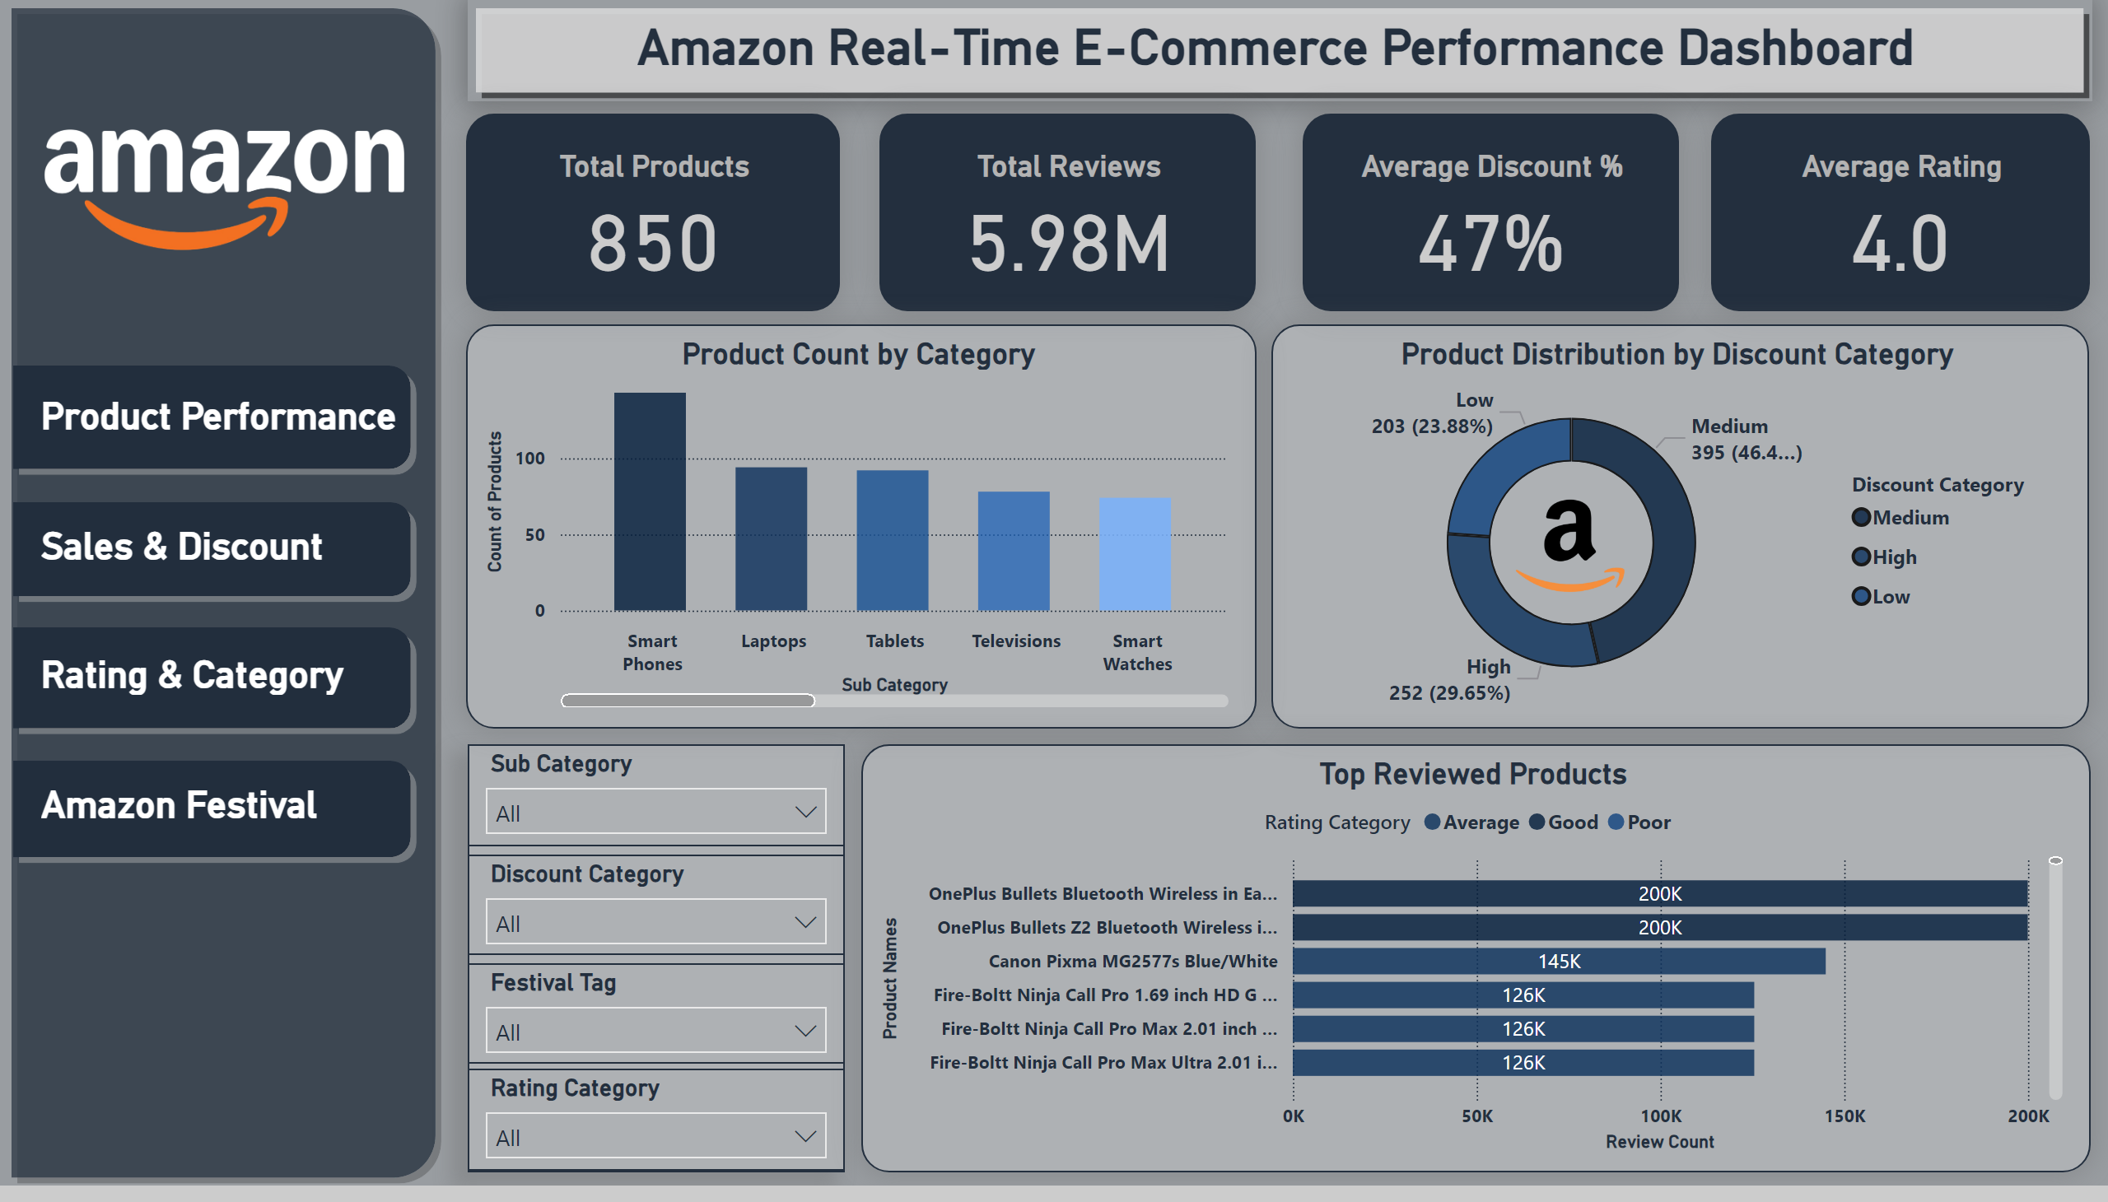
Amazon Product Performance Overview
Notes:
Total Products
No alt text provided
Average Rating
No alt text provided
Total Reviews
No alt text provided
Average Discount %
No alt text provided
Product Count by Category
No alt text provided
Product Distribution by Discount Category
No alt text provided
Top Reviewed Products
No alt text provided
image
No alt text provided
shape
No alt text provided
shape
No alt text provided
shape
No alt text provided
shape
No alt text provided
shape
No alt text provided
Amazon Real-Time E-Commerce Performance Dashboard
No alt text provided
shape
No alt text provided
slicer
No alt text provided
slicer
No alt text provided
slicer
No alt text provided
slicer
No alt text provided
image
No alt text provided
shape
No alt text provided
Sales & Discount
No alt text provided
Rating & Category
No alt text provided
Amazon Festival
No alt text provided
Product Performance
No alt text provided

Slide 3
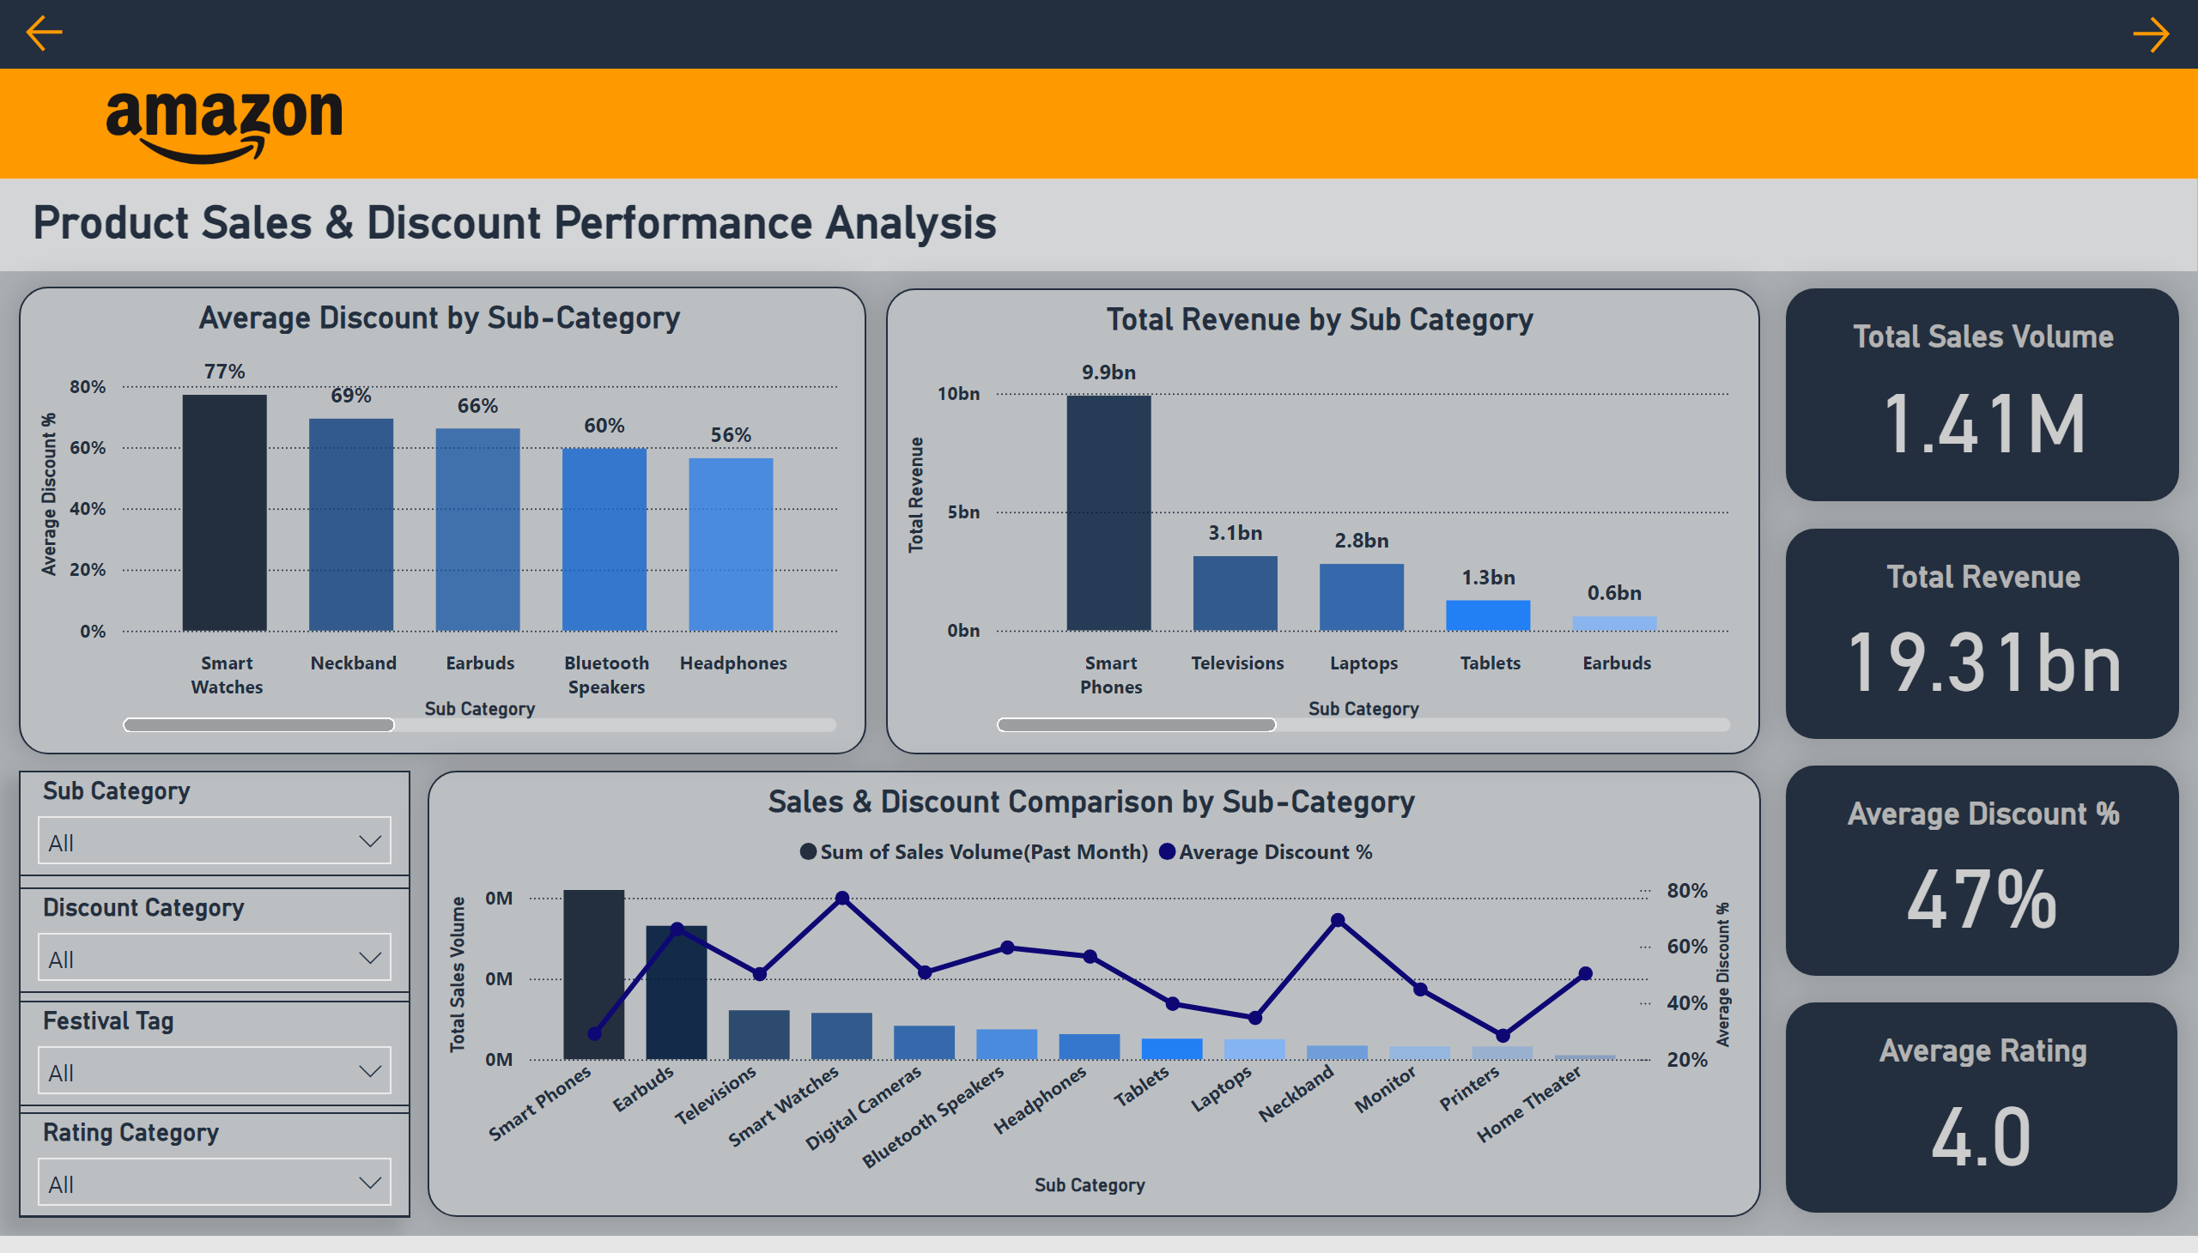
Product Sales & Discount Performance Analysis
Notes:
shape
No alt text provided
shape
No alt text provided
shape
No alt text provided
image
No alt text provided
Total Sales Volume
No alt text provided
Average Rating
No alt text provided
Average Discount %
No alt text provided
Total Revenue
No alt text provided
Average Discount by Sub-Category
No alt text provided
Sales & Discount Comparison by Sub-Category
No alt text provided
Product Sales & Discount Performance Analysis
No alt text provided
Total Revenue by Sub Category
No alt text provided
actionButton
No alt text provided
actionButton
No alt text provided
shape
No alt text provided
slicer
No alt text provided
slicer
No alt text provided
slicer
No alt text provided
slicer
No alt text provided

Slide 4
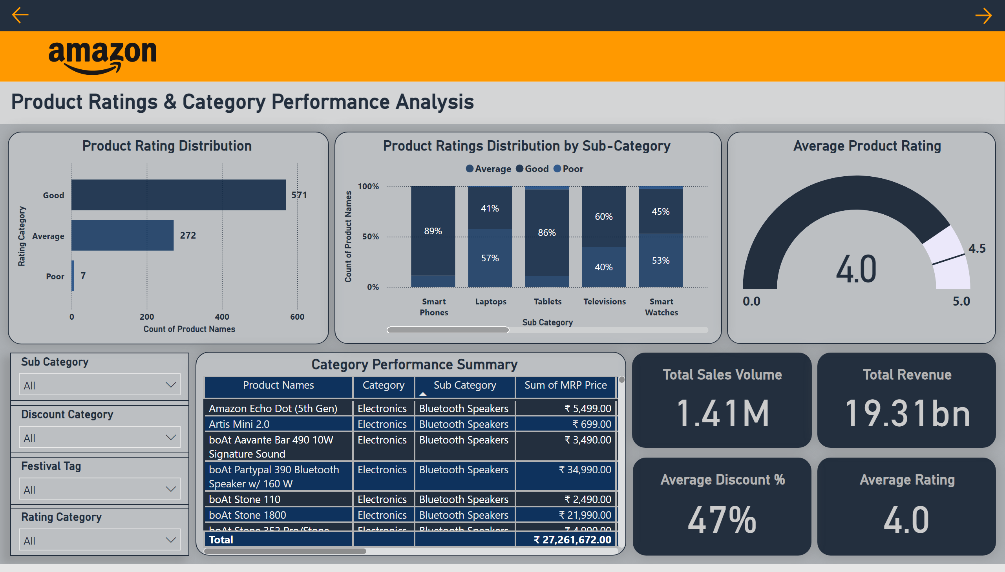
Product Ratings & Category Performance Analysis
Notes:
shape
No alt text provided
shape
No alt text provided
shape
No alt text provided
image
No alt text provided
Total Sales Volume
No alt text provided
Average Rating
No alt text provided
Average Discount %
No alt text provided
Total Revenue
No alt text provided
Product Rating Distribution
No alt text provided
Average Product Rating
No alt text provided
Product Ratings & Category Performance Analysis
No alt text provided
Category Performance Summary
No alt text provided
actionButton
No alt text provided
actionButton
No alt text provided
Product Ratings Distribution by Sub-Category
No alt text provided
shape
No alt text provided
slicer
No alt text provided
slicer
No alt text provided
slicer
No alt text provided
slicer
No alt text provided

Slide 5
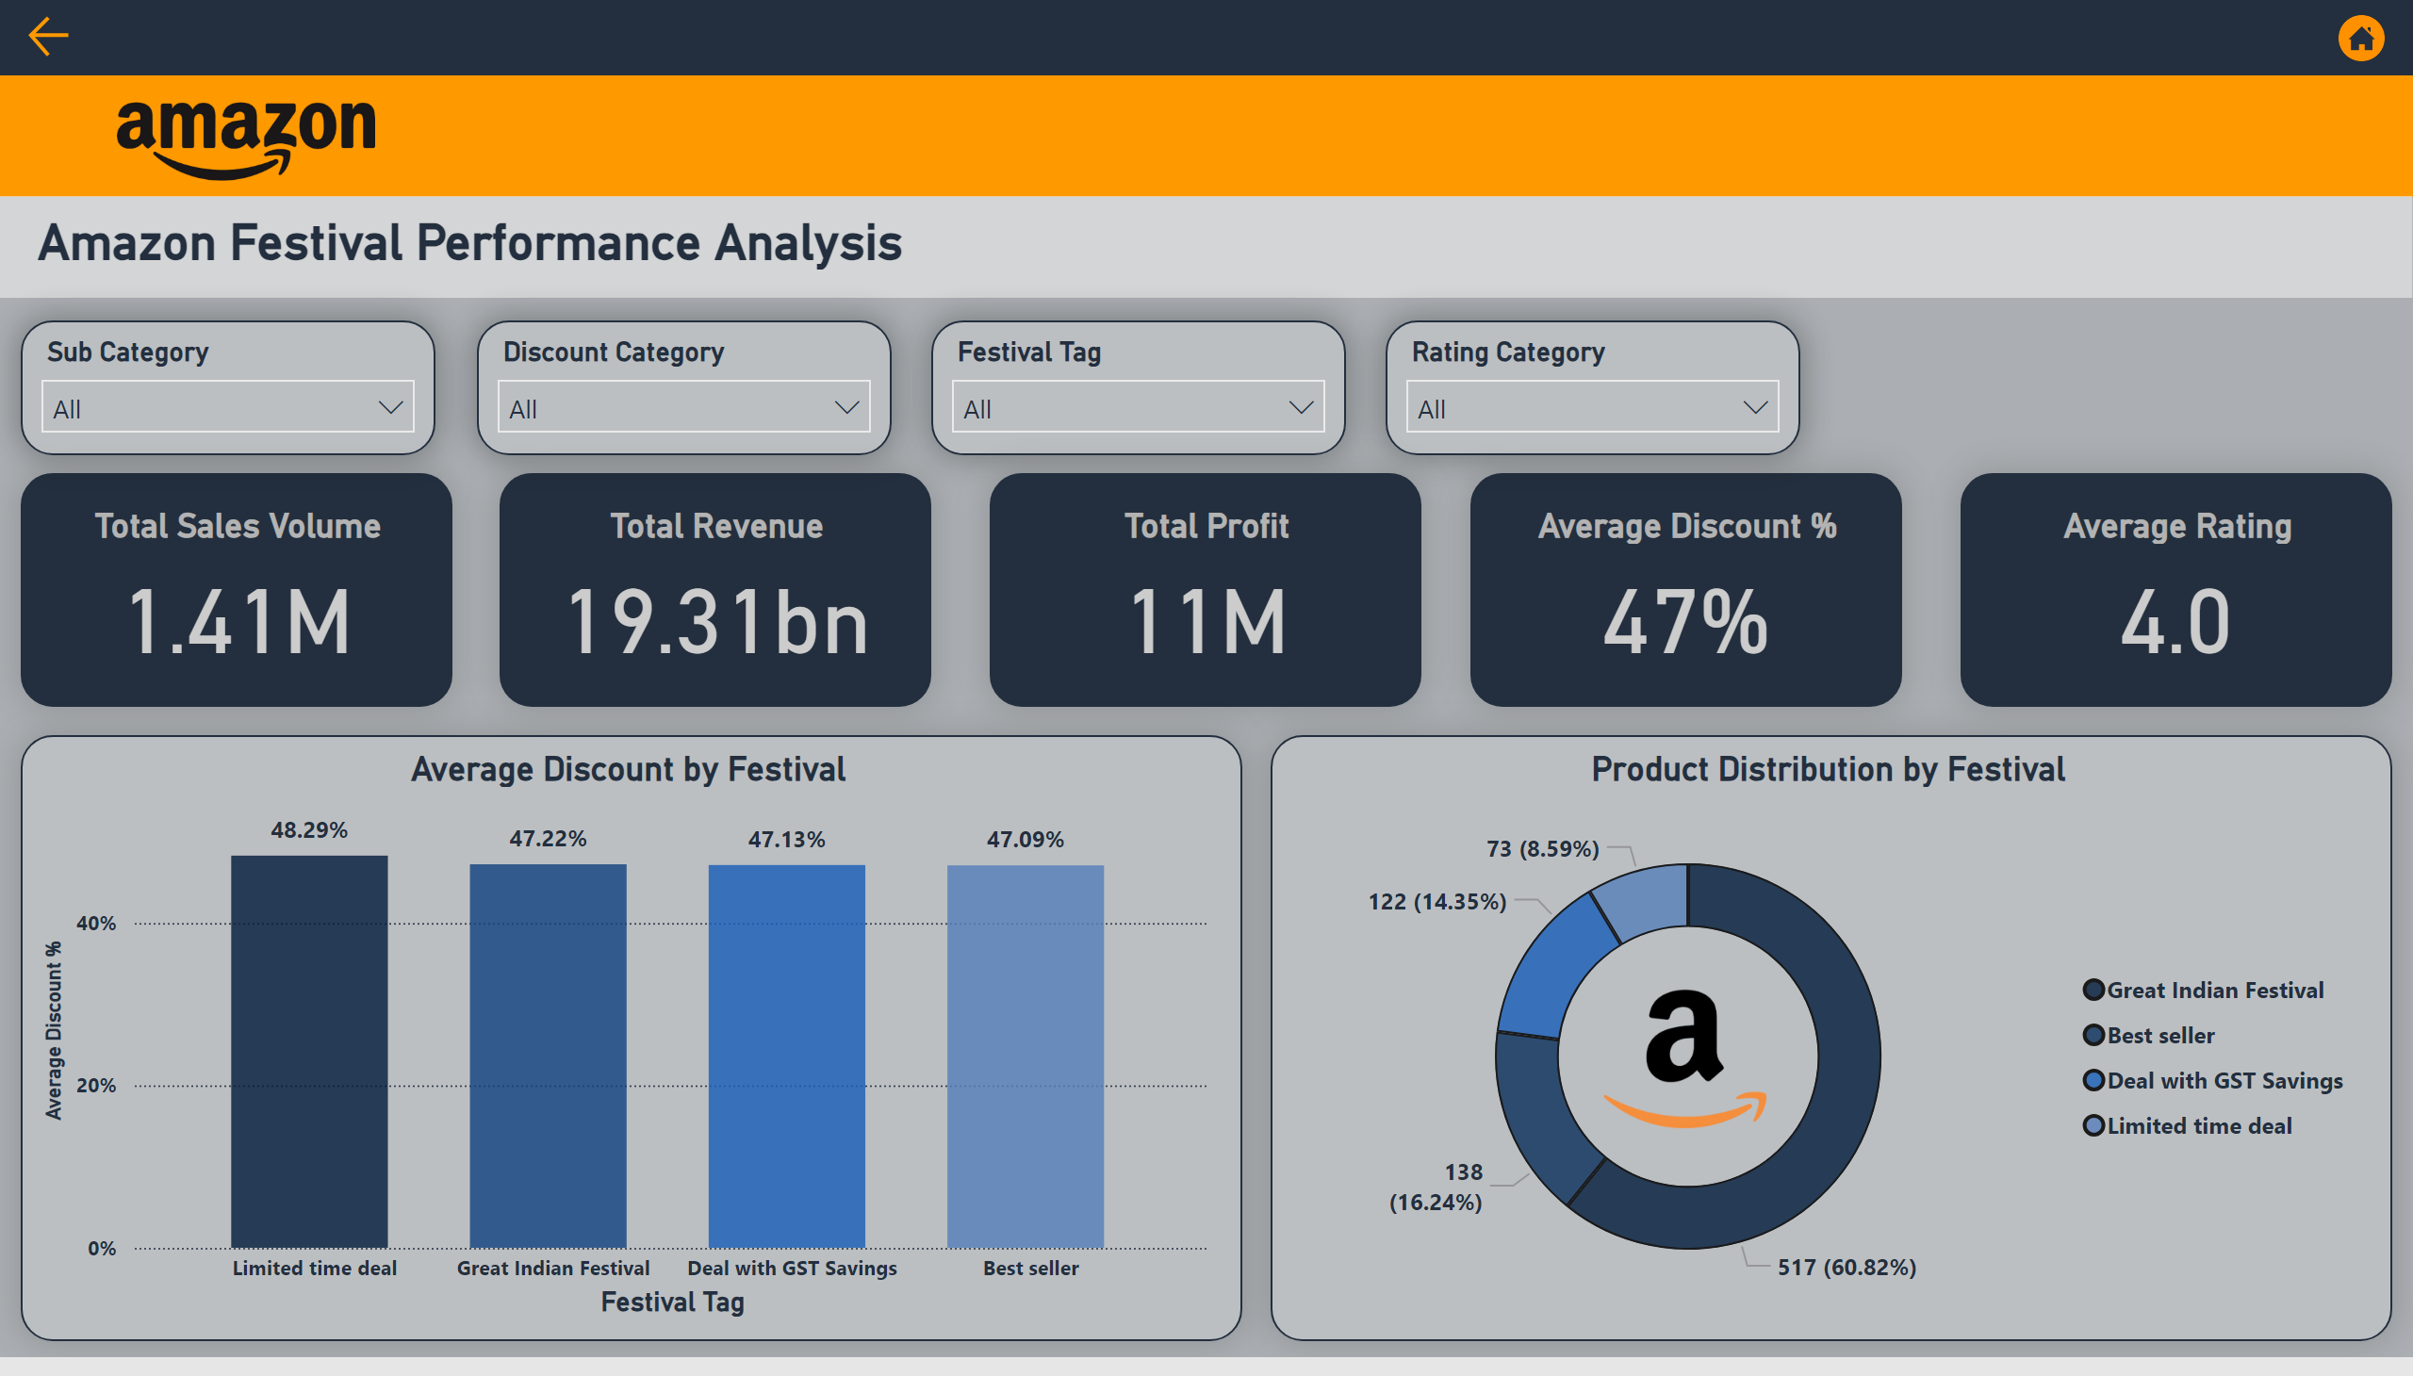
Amazon Festival & Prime Performance Analysis
Notes:
shape
No alt text provided
shape
No alt text provided
shape
No alt text provided
image
No alt text provided
Total Sales Volume
No alt text provided
Average Rating
No alt text provided
Average Discount %
No alt text provided
Total Revenue
No alt text provided
slicer
No alt text provided
slicer
No alt text provided
slicer
No alt text provided
slicer
No alt text provided
Amazon Festival Performance Analysis
No alt text provided
Total Profit
No alt text provided
Product Distribution by Festival
No alt text provided
Average Discount by Festival
No alt text provided
image
No alt text provided
actionButton
No alt text provided
image
No alt text provided

