Slide 1
Analyzing Gender Perceptions in Dating App
and Movie Preferences
Abhishek Sharma
Bhargav Sai Bhuvanagiri

Slide 2

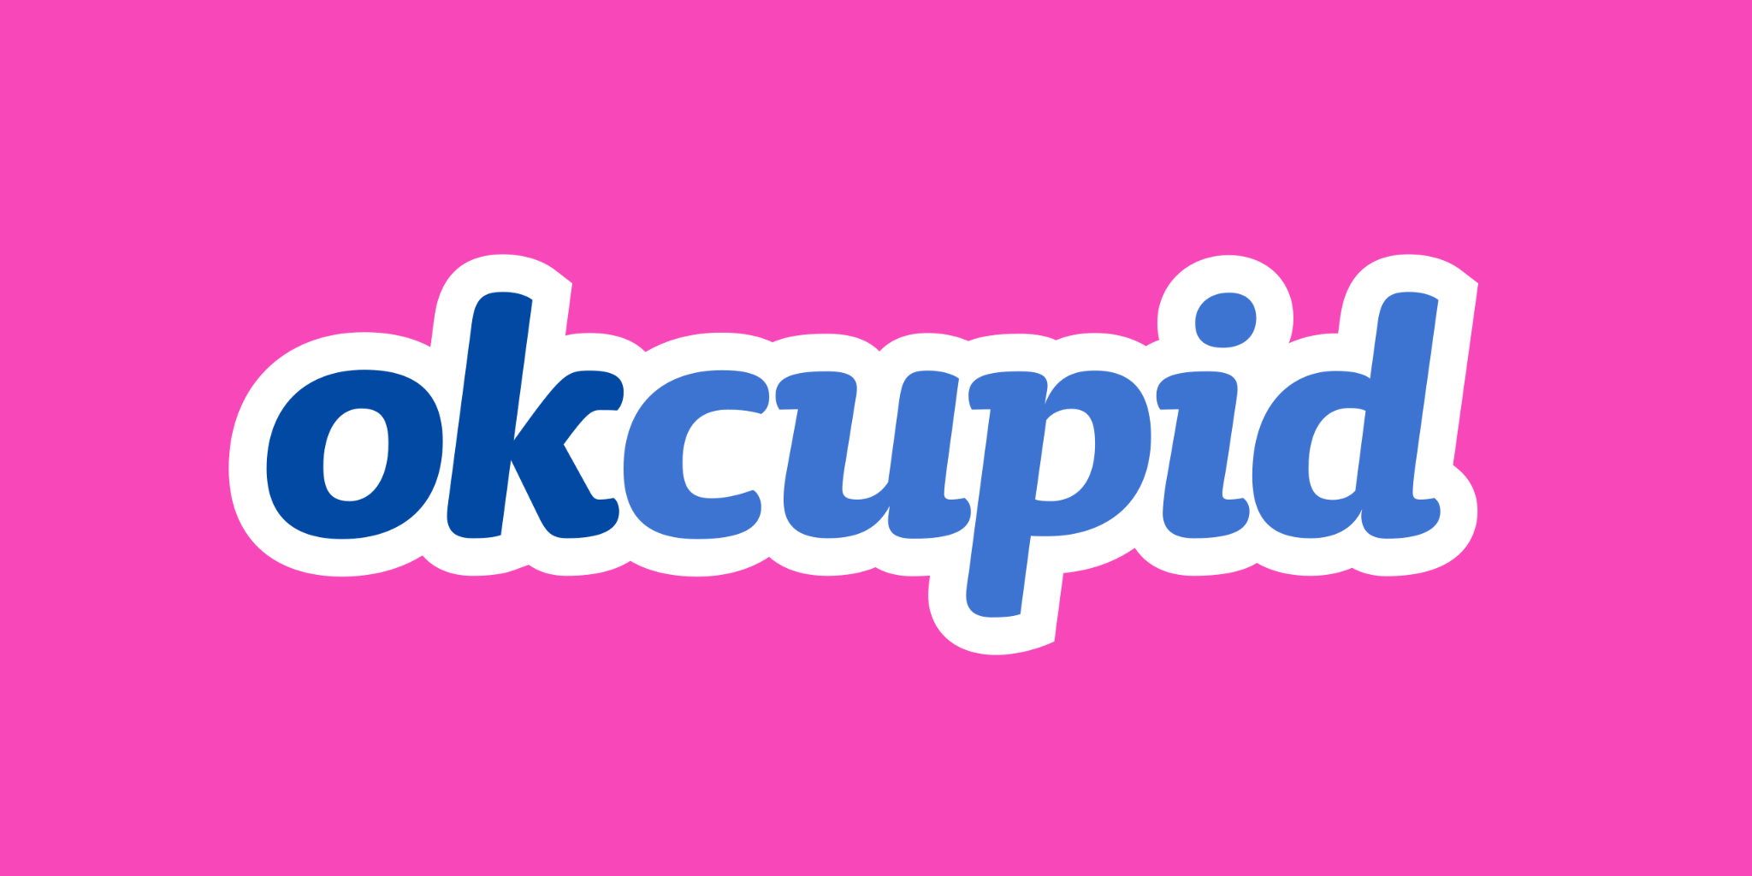
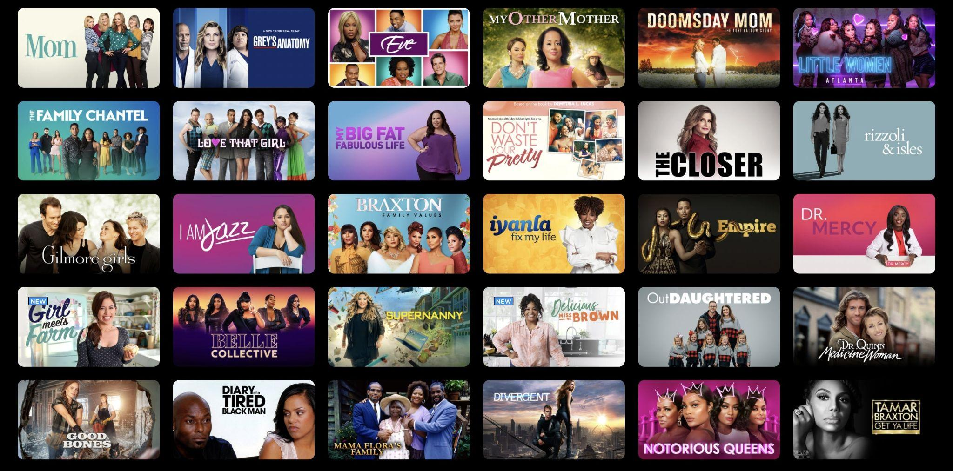
Problem Statement
Investigate inter-gender perceptions on dating apps (OkCupid^{[4]})
Emphasize qualities deemed appealing by each gender
Explore the impact of media (movies and TV shows^{[1]}) on shaping individual dating preferences.
Investigate correlations between personality traits and dating preferences
Notes:
Our project revolves around a multifaceted exploration of gender perceptions within the realm of dating apps, with a specific focus on OkCupid.
We aim to delve into the qualities that are commonly considered appealing by each gender on the platform, shedding light on the nuances of inter-gender preferences.
Additionally, our investigation extends beyond the digital sphere, probing into the influence of media, specifically movies and TV shows, in shaping individual dating preferences.
A key aspect of our study involves unraveling correlations between personality traits and dating preferences, providing a comprehensive understanding of the intricate dynamics at play in the online dating landscape

Slide 3
Objective
What matters to people: Drawing insights from user responses to diverse questionnaires on OkCupid, employing association rule mining and Natural Language Processing (NLP), we seek to discern the preferences individuals harbor for their potential partners.
What people like: Leveraging the MovieLens dataset and the Myers-Briggs Type Indicator (MBTI) personality dataset derived from Yisi Sang's publication^{[2]}, our investigation centers on examining the portrayal of the opposite gender in movies preferred by individuals.
Notes:
To determine whether peoples’ choices are dictated by what they like in context of dating choices. Our underlying hypothesis posits that the subtleties are shaped by individuals' media consumption choices. It is important to note that while media consumption is a significant factor, it is acknowledged as one among several contributors influencing these desire

Slide 4
Our Approach
Used FP Growth to get frequent patterns and association rule mining followed by extracting important words from the all texts from the respective class and further forming multiple level association rule mining.
Used FP Growth to get frequent patterns and forming multiple level association rule mining followed by using MBTI (Myers-Briggs Type Indicator) personality prediction to get the personality^{[2]}.
Class-1
(<18, M, Student)
Quick, ingenious, stimulating, alert and outspoken.
OKCupid
Class - n
(56+, F, Doctor)
Quiet, Friendly, responsible and Conscientious
Action
Marvel Avengers
Black Widow
Class-1
(<18, M, Student)
Sci/Fi
Captain Marvel
MovieLens
Class-i
(35-44, M, Engineer)
Thriller
Pepper Potts
Sci/Fi
Jane Nelson
Class-n
(56+, F, Doctor)
Romance
Titanic
Notes:
The methodology employs a two-part parallel approach, with the first part focusing on OkCupid dataset analysis, and the second part on Movielens and MBTI dataset analysis. To validate our findings, tests were conducted to assess the consistency of observations between the OkCupid and Movielens/MBTI segments.

Slide 5
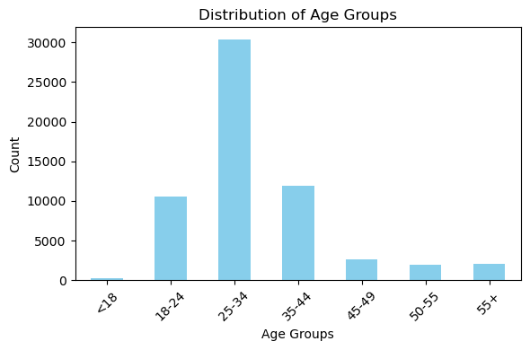
OkCupid Data visualized
In this dataset, there are 60k records containing structured information such as age, sex, orientation as well as text data from open ended descriptions.

Slide 6
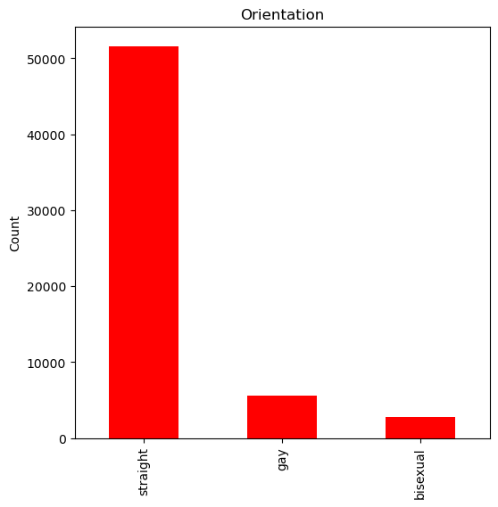
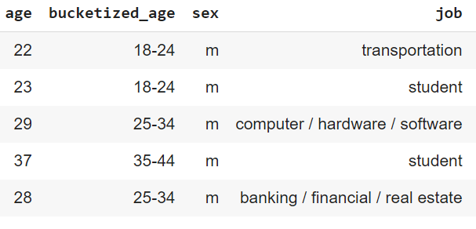
OkCupid Data visualized
Prominent Age Groups: 18-24, 25-34, 35-44, 45-49*, 50-55*
*< 5% data

Slide 7
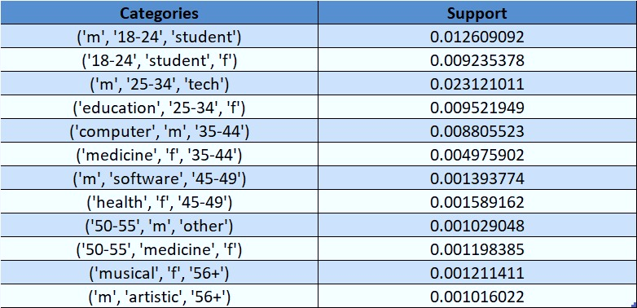
OkCupid Data visualized
Frequent patterns observed for users (Age group-gender-Occupation)

Slide 8
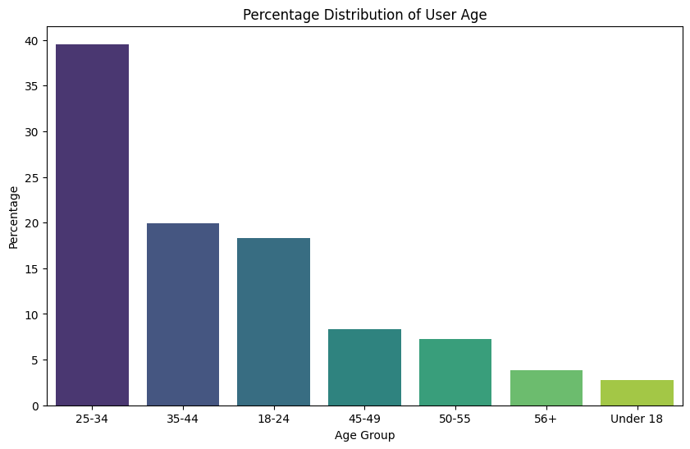
MovieLens Data visualized
The files contain 1,000,209 anonymous ratings of approximately 3,900 movies made by 6,040 MovieLens users who joined MovieLens in 2000.

Slide 9
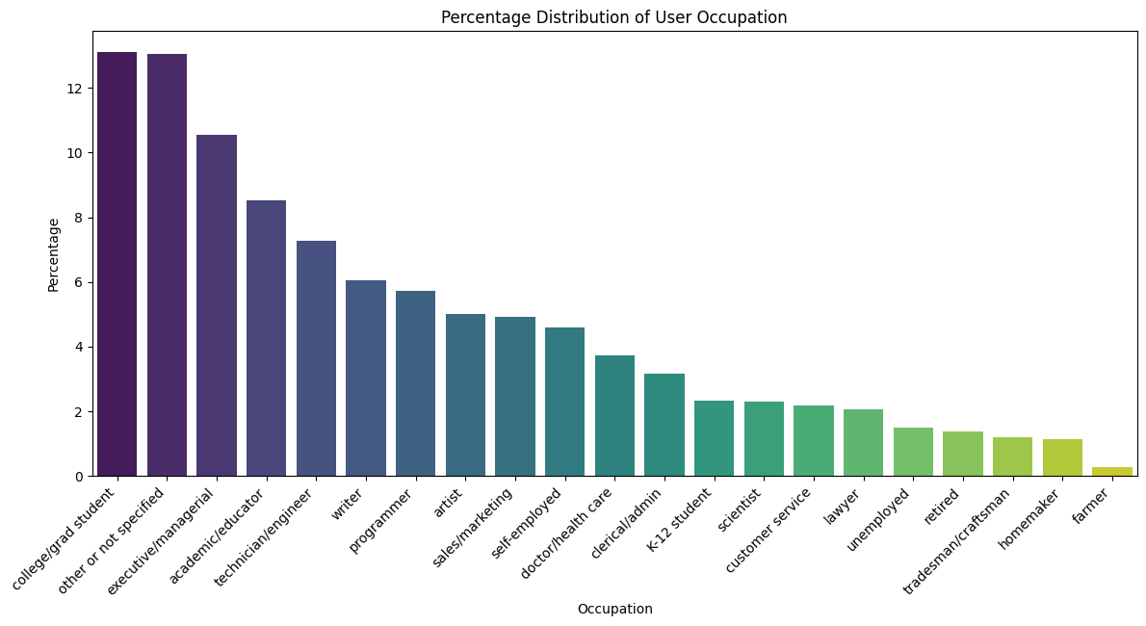
MovieLens Data visualized
Prominent Age Groups: 18-24, 25-34, 35-44, 45-49, 50-55
Prominent Occupations: College student, Management, Educator, Engineer, Writer, Programmer

Slide 10
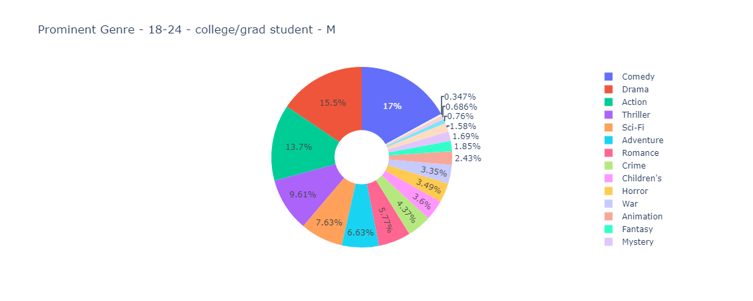
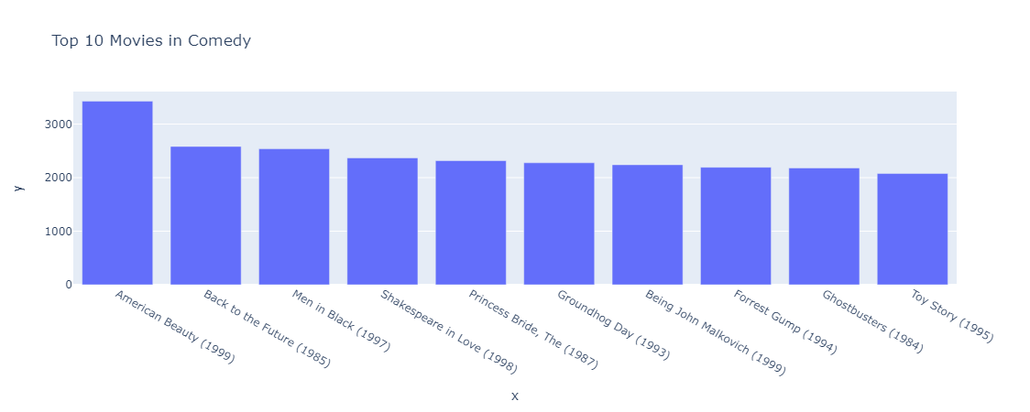
MovieLens Data visualized
Prominent Age Groups: 18-24, 25-34, 35-44, 45-49, 50-55
Prominent Occupations: College student, Management, Educator, Engineer, Writer, Programmer
Example visualization of popular genre and movies by classes - (18-24, Male, College student)
*using dash app script

Slide 11
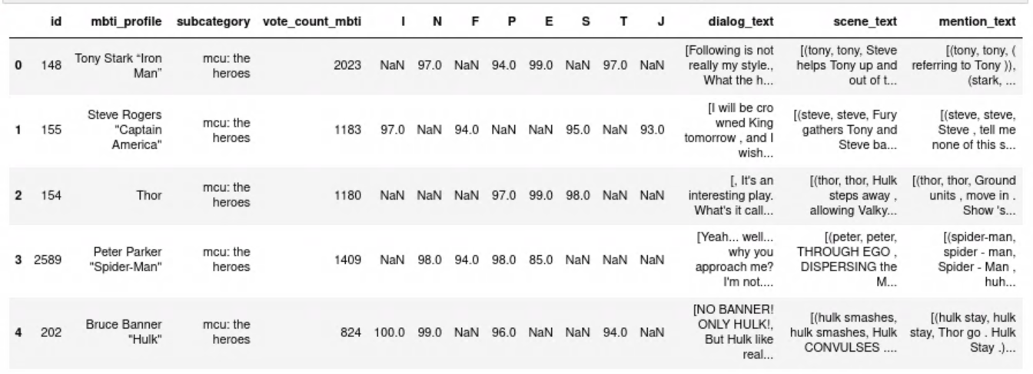
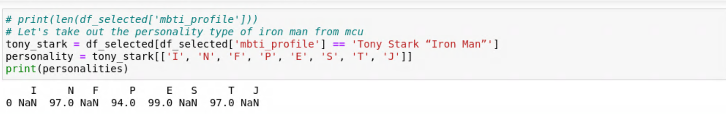
MTBI Personality inference^{[2]}
Program to analyze the movie script and extract characters in the movie script, based on it what are their personality types.
Script → characters identified → Personality predicted
The output dataframe and usage instance
*using dash app script

Slide 12
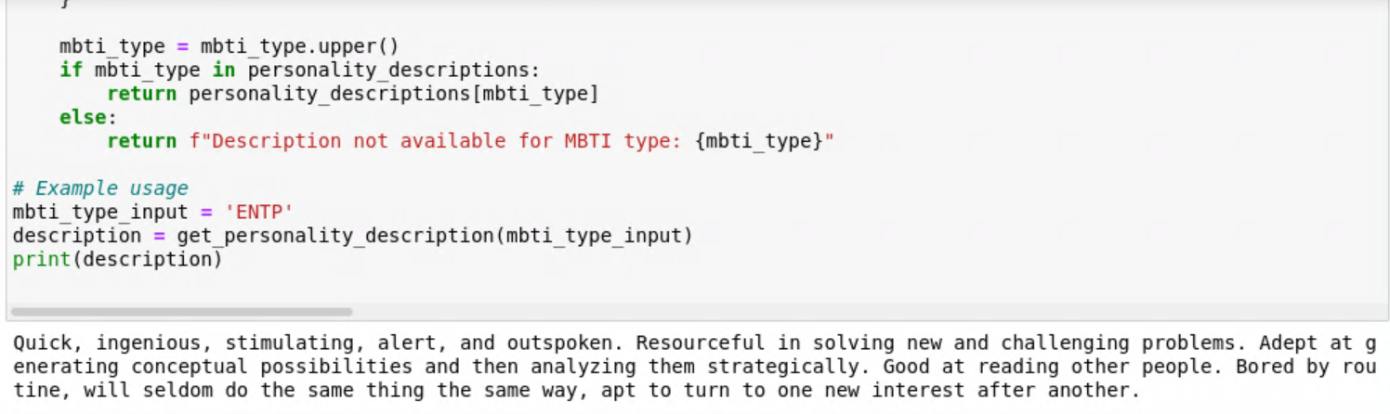
MTBI Personality inference^{[2]}
*using dash app script

Slide 13
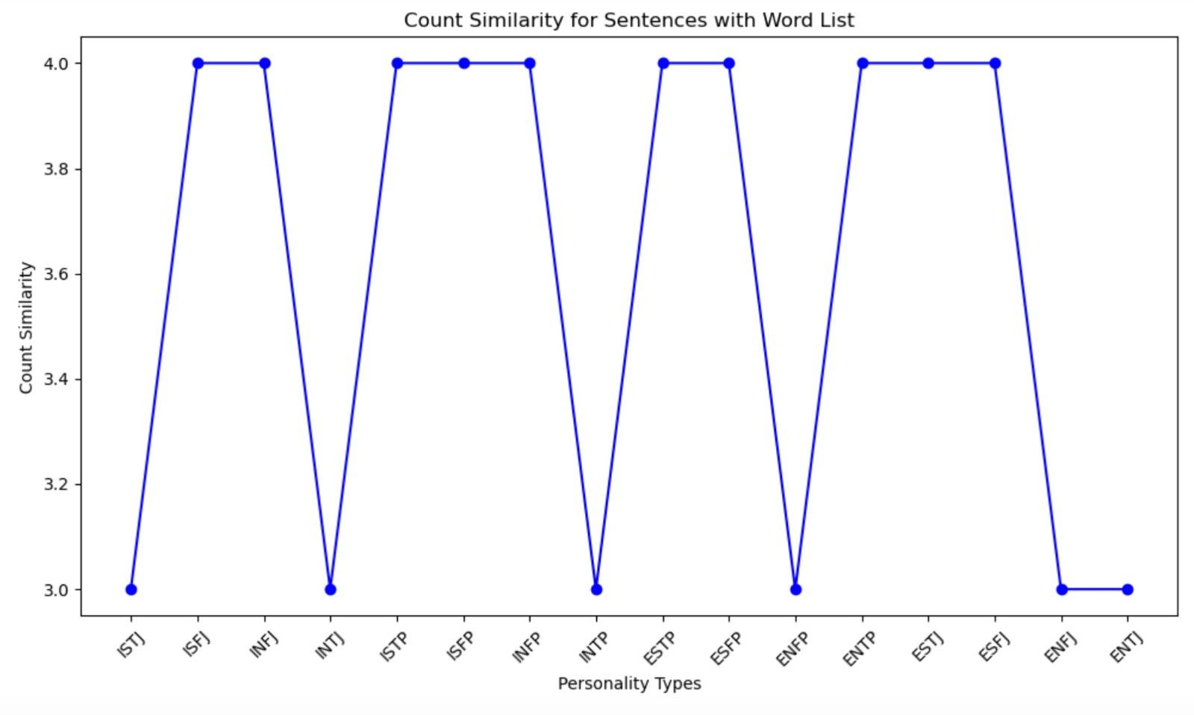
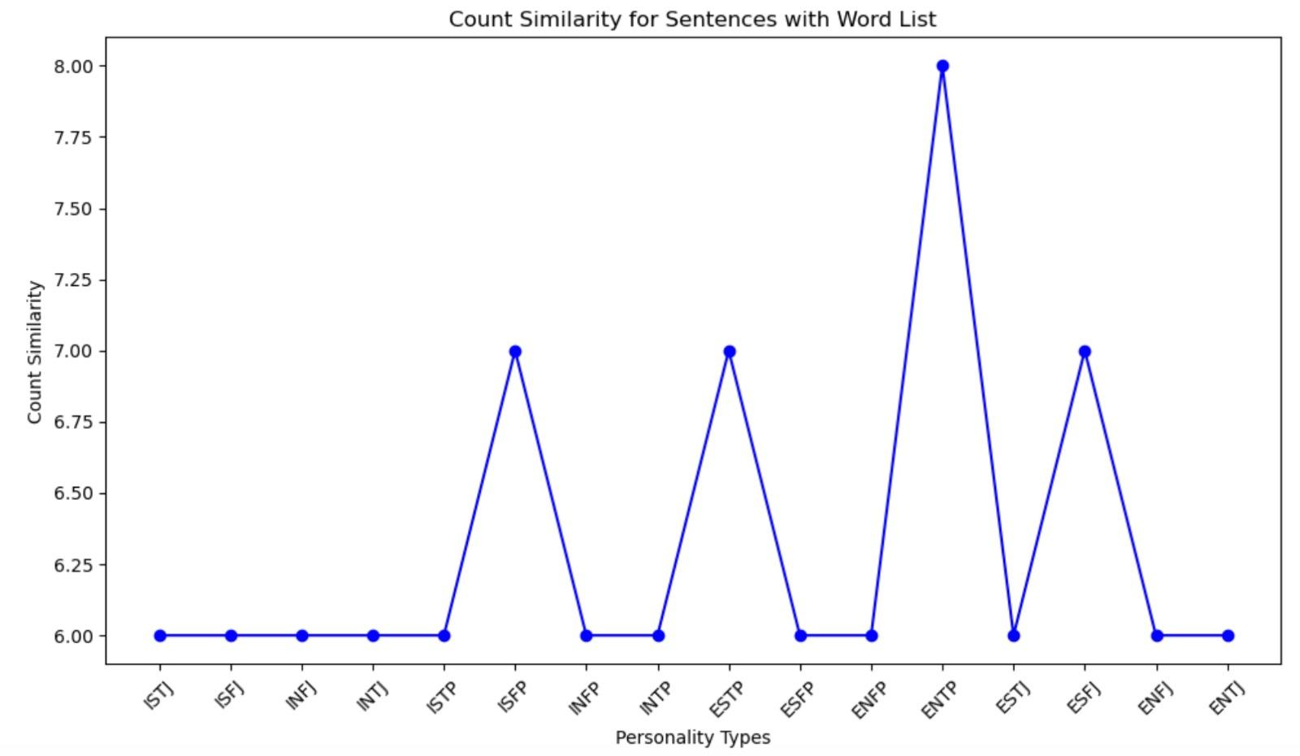
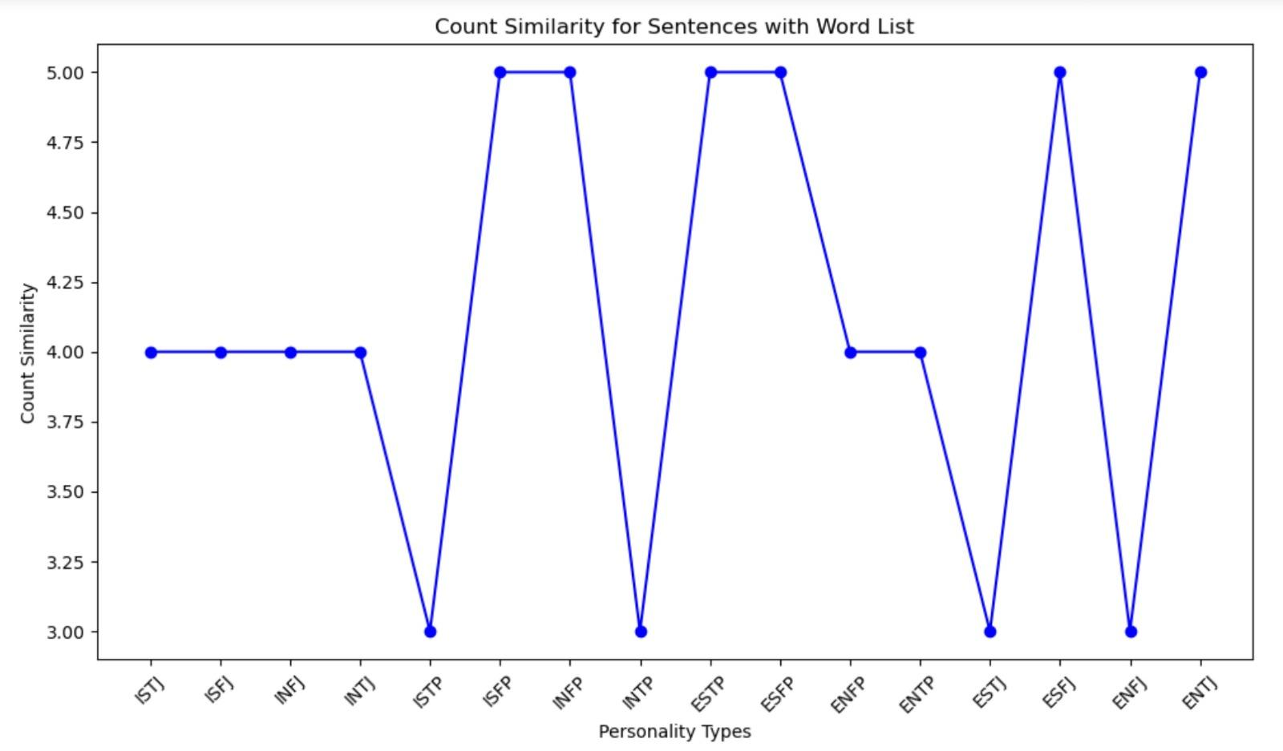
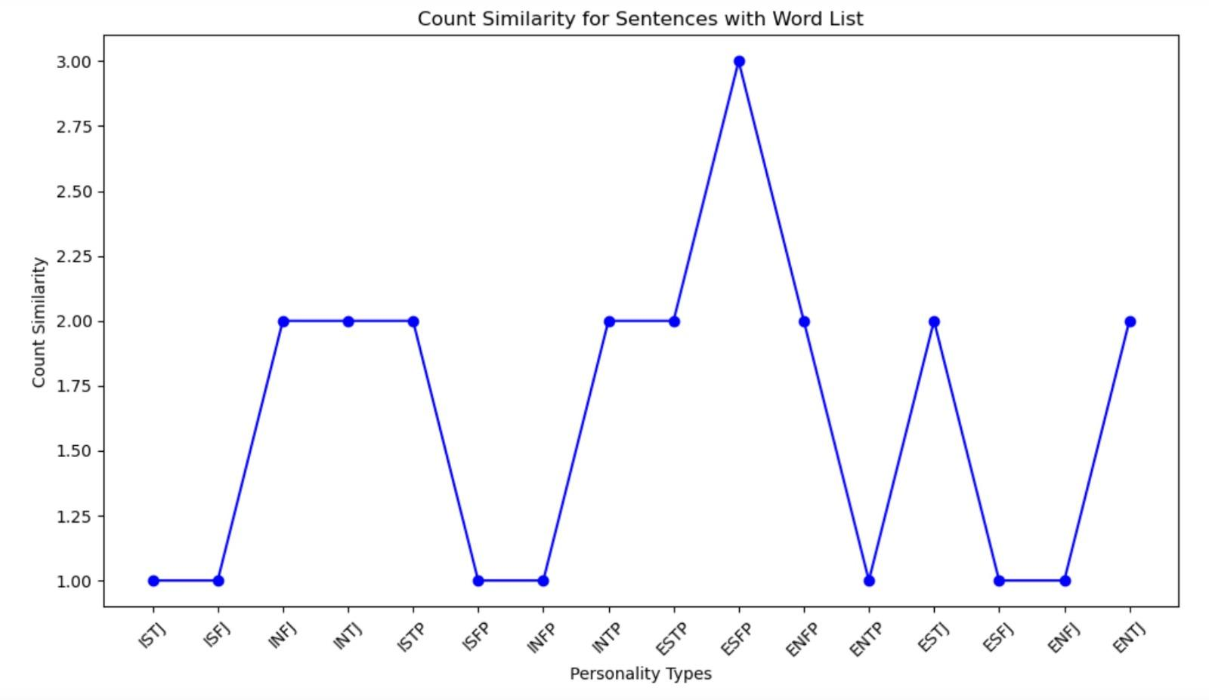
Results
Class - (18-24, Female)
Class - (25-34, Female)
Class - (35-44, Female)
Class - (25-34, Male)
Notes:
These are some of the result we obtained. We are observing whether the count of the words in users response that convey similar meaning as the description of the prominent personality type of that particular class. Although we did not expect the pattern expected, meaning the peaks were expected only for the prominent personality but we see that it is not the case. Essentially, the plots depict the correlation between personality types and the count of words they share with the important terms extracted for each class. By examining the similarity of words, we aimed to identify which personality types exhibit greater commonality with the extracted important words. This comparison is drawn in relation to the results obtained from all the code words for each class through the MBTI personality prediction. We have identified some possible reasons for that which we will mention ahead.

Slide 14
Inference
For Class ‘18-24’,Female the the personality codes ISFP,ESTJ,INTP,e.t.c personalities matched with the results we got from the MTBI Personality predictor.
For Class ‘25-34,Female’ the personality codes ESTP,ISFP,e.t.c personalities matched with the results we got from the MTBI Personality predictor.
For Class ’35-44,Female’ the personality codes INFP,ISTJ,ESTP,ESFJ,e.t.c personalities matched with the results we got from MTBI Personality predictor.
For Class ‘ 25-34,Male’ the personality codes INFJ,ESFP,ESTJ,e.t.c personalities matched with the results we got from MTBI Personality predictor.
*using dash app script

Slide 15
Conclusion
From the line charts, it's evident that certain personality types exhibit a higher count of words that match with the important terms extracted for each class.
The comparison of these results with the code outputs from the MBTI personality prediction unveils notable overlaps and discrepancies, offering insights into how well the prediction code aligns with the extracted important terms for each personality class.
*using dash app script

Slide 16
Future Work and limitations
Given good dataset with more attributes to work we can improve the accuracy of our predictor model.
More diverse dataset can lead to further interesting results we don’t have orientation in our movielens data set.
Most of the essays given in the okcupid dataset where not useful.
*using dash app script

Slide 17
Progress and Further Steps
Progress
Integrated Dataset standardization
Genre and Movie Insights
Character Extraction Model
MBTI Personality Prediction
Applied Apriori frequent pattern mining to extract user occupations from OkCupid data.
Ensured a consistent framework for comparative analysis between OkCupid profiles and
movielens dataset.
Explored movielens dataset to identify prominent genres for each user class.
Uncovered popular movies within each genre, providing detailed insights into cinematic preferences.
Created a model capable of extracting character information from movies.
Developed a model predicting MBTI personalities based on movie features like dialogues and character development.

Slide 18
Progress and Further Steps
Further Steps
User Preferences Extraction
Target Character Personality Extraction
Comparison Metric Development
MBTI Personality Prediction
Extracting partner preference traits from the OkCupid dataset.
Extracting personalities of target characters from prominent movielens dataset.
Creating a metric to compare user partner preferences with character personalities.
Drawing insights on potential correlations, concluding the impact of media on inter-gender perceptions.

Slide 19
Acknowledgment
MovieLens dataset - F. Maxwell Harper and Joseph A. Konstan. 2015. The MovieLens Datasets: History
and Context. ACM Transactions on Interactive Intelligent Systems (TiiS) 5, 4, Article 19 (December 2015), 19 pages. DOI=http://dx.doi.org/10.1145/2827872
Yisi Sang, Xiangyang Mou, Mo Yu, Dakuo Wang, Jing Li, Jeffrey Stanton, MBTI Personality Prediction for Fictional Characters Using Movie Scripts, Association for Computational Linguistics, 2022.findings-emnlp.500,6715--6724.
Emerging Trends:Word2Vec,Church, Kenneth Ward,Natural language engineering, 2017, Vol.23 (1), p.155-162
OkCupid Profiles : https://www.kaggle.com/datasets/andrewmvd/okcupid-profiles

