Slide 1
LP-2 Submission
Group No : 37
Members:
Abhijit Shendage (B150234374)
Samyak Vaidya (B150234365)
Saurabh Gore (B150234262)
Yash Patil (B150234343)
Guided By:
Prof. Kirti Satpute

Slide 2
DMW Assignments
DMW Assignment list:
1.Write Java/C++/python code for simple implementation of Kmeans/ K-medoids clustering algorithm
2. Implement Apriori approach for data mining to organize data items on shelf using given table using java/python.
3. Implement Naïve Bayes for concurrent /distributed application. Approach should handle categorical and continuous data using java/python.
4. Consider a suitable text dataset. Remove stop words, apply stemming and feature selection techniques to represent documents as vectors. Classify documents and evaluate precision, recall.
Assignment\DMW

Slide 3
STQA Assignments

Slide 4
Classification of Orthopedic patients using ML

Slide 5
Problem Statement
Design a fully tested and proven system which can assist doctors in classifying orthopedic patients based on their biomechanical features data using modern technology of ML.

Slide 6
Motivation
Machine learning has been implemented in various medical fields and proven to be very accurate in classifying and predicting diseases.
Use of machine learning is spreading widely with the growth of medical data in medical field to improve medical service and diagnosis of diseases.
Since there has not been enough application of machine learning in orthopedic field, we had a thought the biomechanical features can also be used in machine learning and thus can p0rovide a good assist to specialist and reduce their task of remembering all the values.

Slide 7
Objectives
To provide medical professionals more efficient analysis on the given biomechanical data.
To create bug-free web application for the best possible human computer interaction.
To find a suitable and accurate algorithm to enhance medical diagnosis by predicting diseases in an automated way.

Slide 8
Input
Dataset is of various biomechanical features of patients
The data has been organized in two different but related classification tasks.
The first task consists in classifying patients as belonging to one out of two categories: - Normal
- Abnormal
The second task consists in classifying patients as belonging to one out of three categories:
-Normal
-Disk Hernia
-Spondylolisthesis

Slide 9
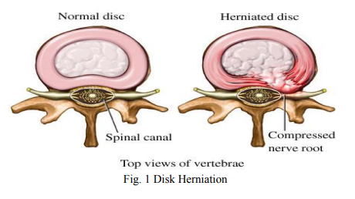
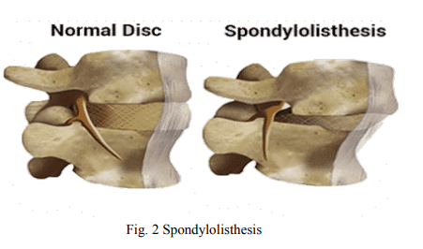

Slide 10
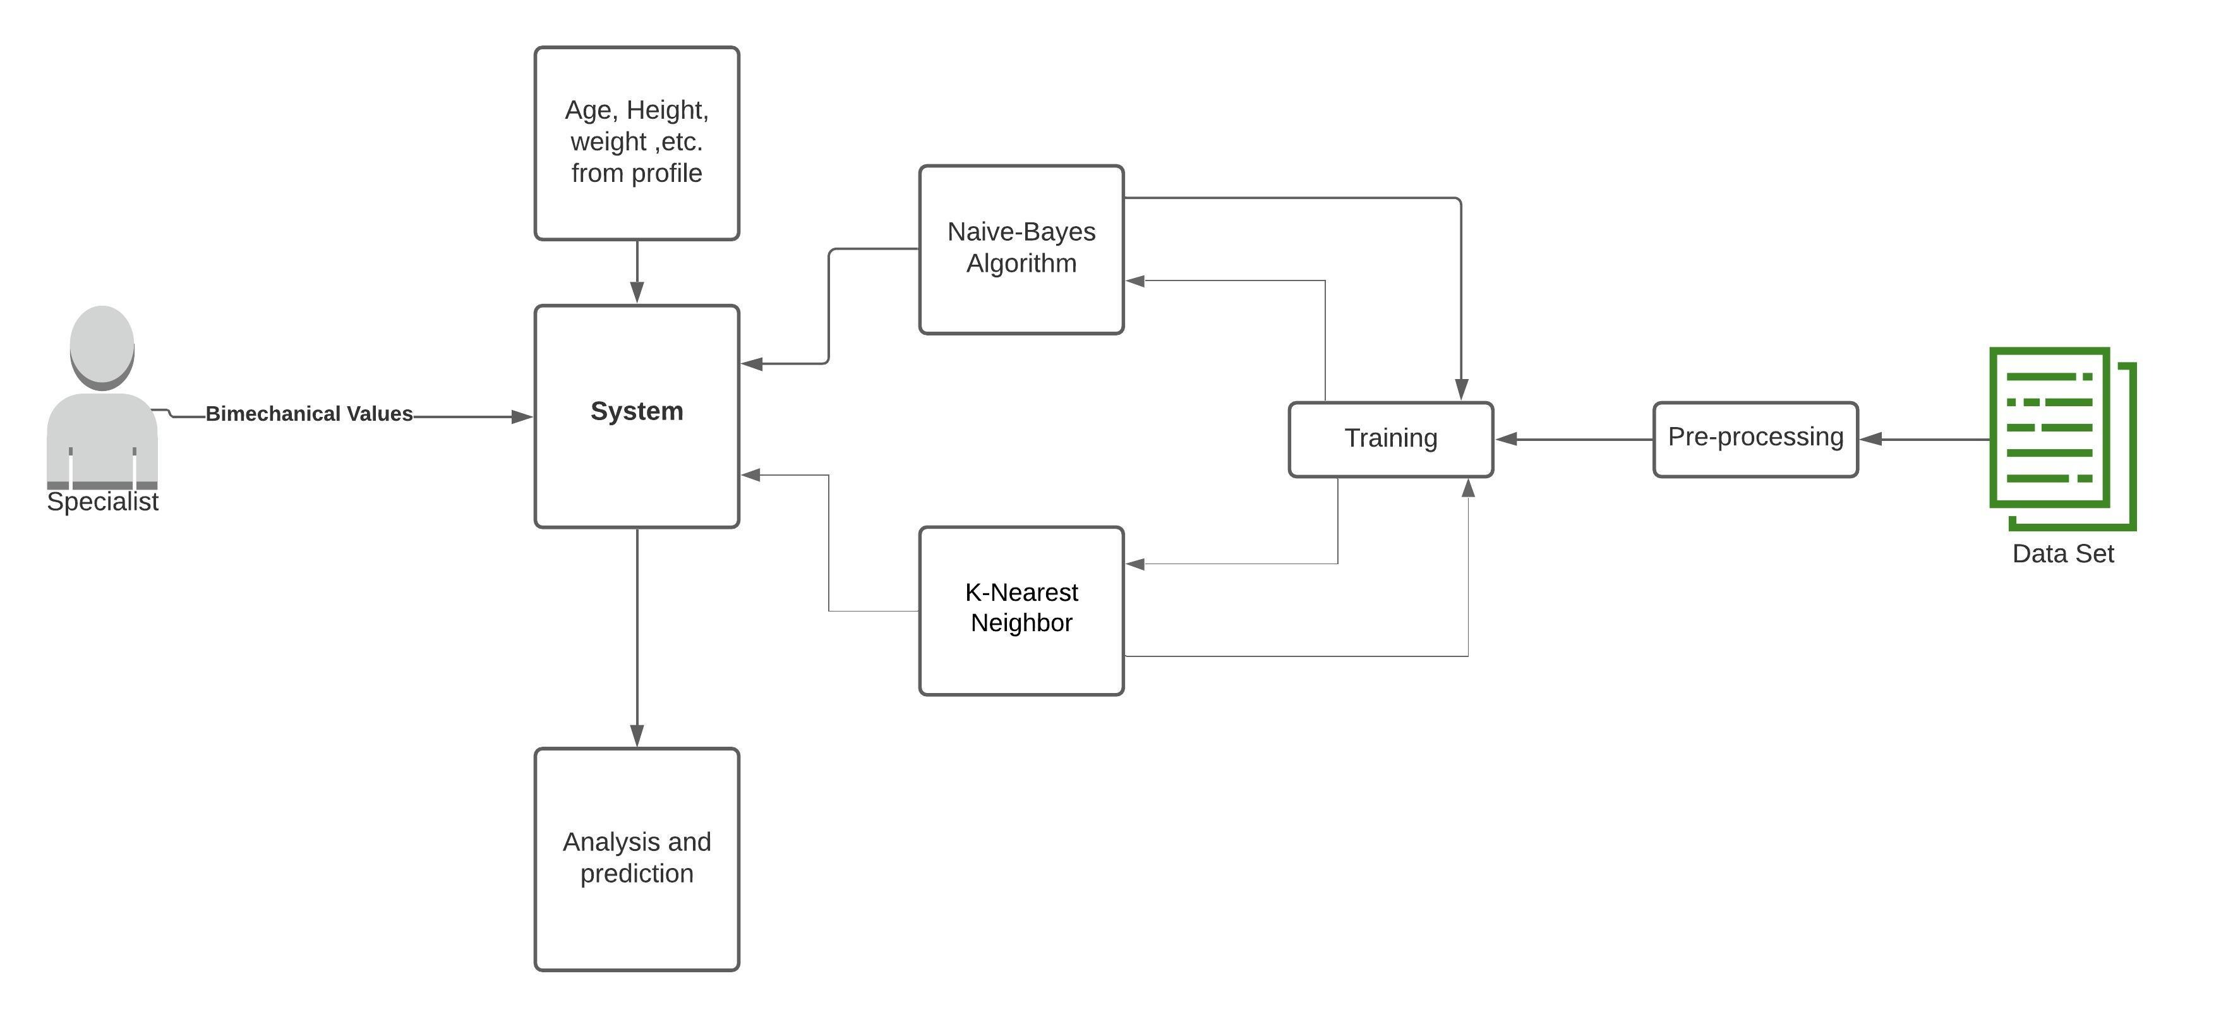
Flow Diagram

Slide 11
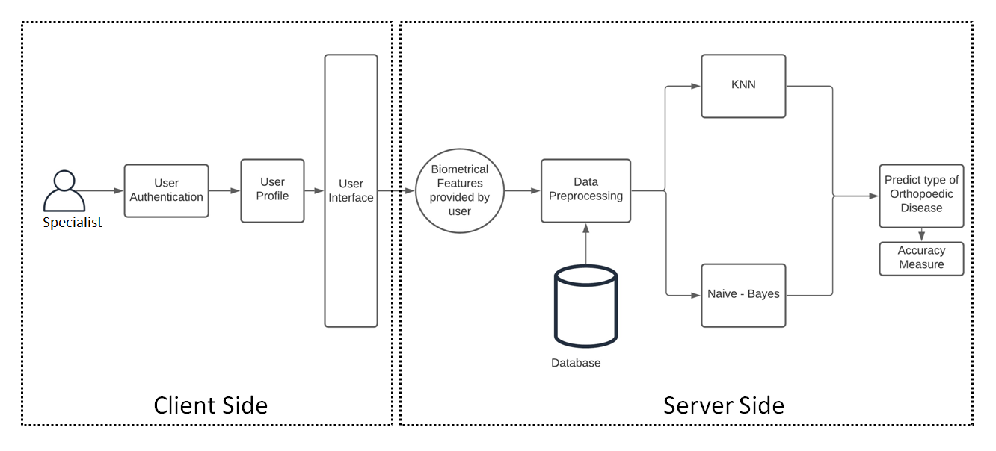
System Architecture

Slide 12
Features
Provides faster and easier way to identify diseases
Use Of modern Machine Learning Algorithms to increase accuracy of the results.
Fully tested system which avoids failures
Web application thus can be used from anywhere anytime.

Slide 13
Technology
K-Nearest Neighbors (KNN)
Naïve-Bayes
Input Biomechanical Values
KNN
Naïve Bayes
Output Results

Slide 14
KNN Algorithm
The KNN algorithm assumes that similar things exist in close proximity. In other words, similar things are near to each other.
K-Nearest Neighbor is non-parametric. It classifies object based on majority of vote it gets from its closest neighbors.
It is a supervised machine learning algorithm that can be used to solve both classification and regression problems.
The value of ‘K’ influences result. Smaller value of k means noise will have higher influence on result. On the other hand large value of ‘K’ increases the computation cost.

Slide 15
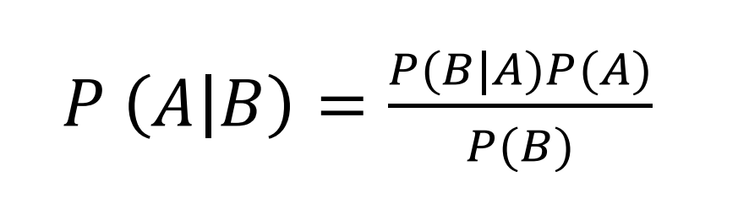
Naïve Bayes Algorithm
It is a probabilistic classification technique based on Bayes’ Theorem with an assumption of independence among predictors.
Naïve Bayes classifier assumes that the presence of a particular feature in a class is unrelated to the presence of any other feature.
Bayes’ Theorem

Slide 16
Requirements
Software Requirements:
Python-Django Web Development Framework(version 2.2+).
Web Development Kit - (HTML, CSS, JavaScript)
Database : SQLite
Operating System : Windows / Linux
Hardware Requirements:
RAM - Minimum 4 GB
Processor – at least Quad-Core
Space Requirement – Minimum 30 GB Free

Slide 17
Software Requirements
Libraries used:
• Scikit-learn
• Pandas
• NumPy
Softwares Used :
• Sublime Text
• Vscode
• Chrome Debugger

Slide 18
Unit Testing
Unit testing is a method by which individual units of source code are tested to determine if they are fit for use.
Library used for unit testing in python- unittest .

Slide 19
Selenium
Selenium is a portable framework for testing web applications.
Selenium provides a playback tool for authoring functional tests without the need to learn a test scripting language.

Slide 20
Conclusion
Hence, the orthopedic diagnosis can be improved and speeded up for biomechanical data by using algorithms such as KNN and Naïve Bayes, also the accuracy of the system is about 86 percent in categorizing the diagnosis from the measurements.

Slide 21
References
S. Pouriyeh, S. Vahid, G. Sannino, G. D. Pietro, H. Arabnia, J.Gutierrez, ―A Comprehensive Investigation and Comparison of Machine Learning Techniques in the Domain of Heart Disease‖, IEEE Symposium on Computers and Communications (ISCC), Heraklion, Greece, 2017.
Proceedings of the Second International Conference on Intelligent Computing and Control Systems (ICICCS 2018) "Analysis of Symptoms Wise Disease Inference System Using Data Mining Technique" by Tejal P. Burange and Dr. P. N. Chatur
2020 International Conference for Emerging Technology (INCET) Belgaum, India. Jun 5-7, 2020 "Disease Prediction using Machine Learning Algorithms" by Sneha Grampurohit and Chetan Sagarnal.

Slide 22
THANK YOU

