Slide 1

IntelliCross
Smart Traffic System
Group 8
Complex System Development

Slide 2
Team Members
Aakriti Tiwari
Abhijit Shendage
Atharva Gokhale
Mrunal Adhav
Nikita Jakhete

Slide 3
Contents

Slide 4

Introduction
The IntelliCross Smart Traffic Signal System endeavors to tackle the issue of traffic congestion and enhance the overall traffic efficiency at intersections. Conventional traffic light systems adhere to fixed timers, frequently resulting in unwarranted delays and traffic bottlenecks. Through the utilization of real-time data pertaining to vehicle counts at each segment of the intersection, this system will dynamically regulate traffic lights with the goal of optimizing traffic flow.
The exponential growth of urban centers and the concurrent surge in vehicular traffic pose formidable challenges for our cities. At the heart of today's traffic predicaments lies the antiquated approach to traffic management at intersections. Existing traffic control systems, characterized by fixed time schedules, often fail to adapt to dynamic real-time traffic conditions. It's akin to a traffic system that remains oblivious to the ever-evolving dynamics of our streets.

Slide 5

Key Features
Real-time data processing and analysis
Intelligent algorithm for traffic light optimization
Dynamic traffic light control

Slide 6
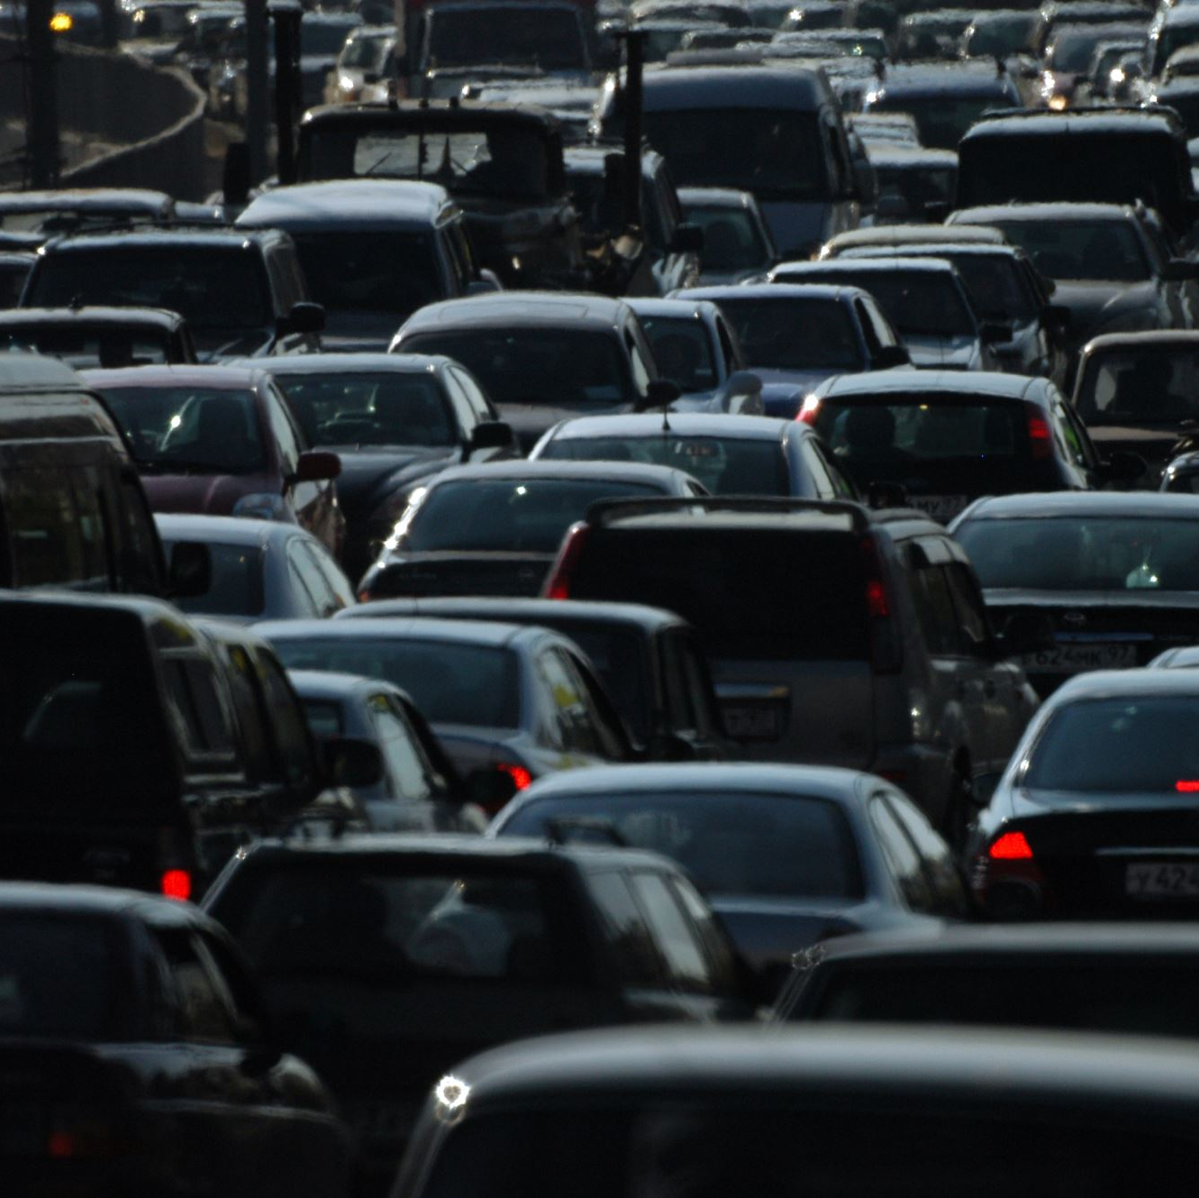
Benefits
Reduced traffic congestion
Shorter waiting times
Reduced fuel consumption and emissions
Improved traffic flow and efficiency

Slide 7

Tools/ Platform Used
Language: Python (Pygame)
IDE: Visual Studio
Documentation: Ms Word

Slide 8
Program Structure

Slide 9
Outputs Screenshots

Slide 10
Unit Testing

Slide 11
Future Scope

Slide 12

Scenarios
Normal Traffic Condition: each lane won’t have more than 5/6 vehicles. Example, at 2/3 pm there is no high volume of cars on the roads.
Peak Hours Traffic Condition: After Office hours that is 6 pm or school timings that is 10am and 6 pm.
Dynamic Traffic Input: user can give input as per their choice to check the system.

