Slide 1


IntelliCross
Smart Traffic Control
Group 8
CS6422 Complex System Development

Slide 2

Team Members
Aakriti Tiwari
Abhijeet Shendage
Atharva Gokhale
Mrunal Adhav
Nikita Jakhete

Slide 3


Introduction
The IntelliCross Smart Traffic Signal System endeavors to tackle the issue of traffic congestion and enhance the overall traffic efficiency at intersections. Conventional traffic light systems adhere to fixed timers, frequently resulting in unwarranted delays and traffic bottlenecks. Through the utilization of real-time data pertaining to vehicle counts at each segment of the intersection, this system will dynamically regulate traffic lights with the goal of optimizing traffic flow.

Slide 4

Key Features
Real-time data processing and analysis
Intelligent algorithm for traffic light optimization
Dynamic traffic light control

Slide 5
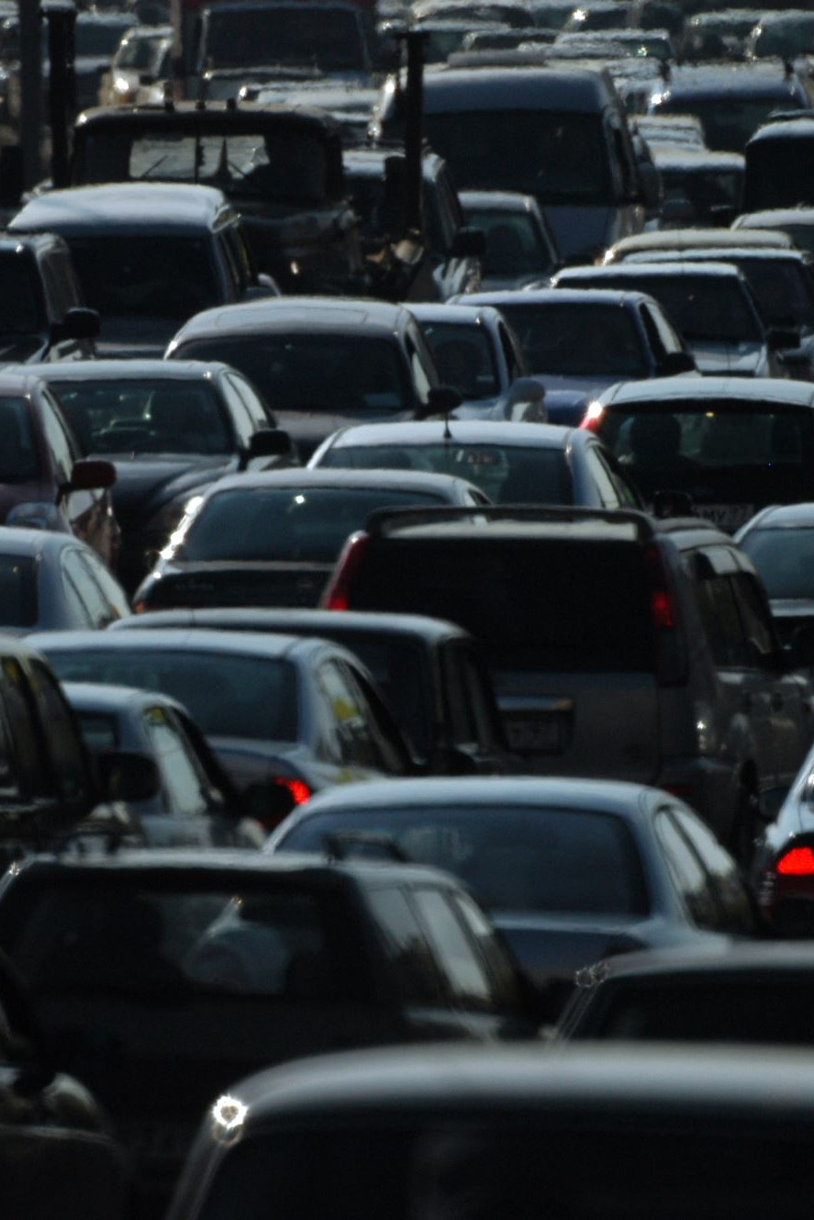
Benefits
Reduced traffic congestion
Shorter waiting times
Reduced fuel consumption and emissions
Improved traffic flow and efficiency

Slide 6

Tools/ Platform Used
Language: Python (Pygame)
IDE: Visual Studio
Documentation: Ms Word

Slide 7
Scenario 1
Scenario 2
Scenario 3
Normal Traffic Condition
Each lane won’t have more than 5/6 vehicles. Example, at 2/3 pm there is no high volume of cars on the roads.
Peak Hours Traffic Condition
After Office hours that is 6 pm or school timings that is 10am and 6 pm.
Dynamic Traffic Condition
user can give input as per their choice to check the system.

Slide 8
Thank You

