Slide 1
Welcome & Course Overview

Slide 2

“AI and Applications of AI”
Course Highlights
Comprehensive Python Foundation
Foundational Math and Stats for AI
Practical Machine Learning Implementation
Introduction to Deep Learning
Presenters
Prince Karna
Pujan Pant
Piyush Phuyal
25th May,2025

Slide 3

Python Basics
Today’s Agenda
Why Python for AI?
Variables & Data Types Deep Dive
Control Structures for AI Logic
Functions - Building Blocks of AI
Python Environment and Setup
Hands-On Practice
Kahoot(Quiz)

Slide 4

Why Python for AI?
Simple Syntax
Easy to read and write
Rich Libraries
Strong AI and ML tools
Community Support
Active global developers
Industry Standard
Widely adopted in AI

Slide 5
Variables & Data Types Deep Dive -1
🧠 What is a Variable?
A variable is like a label attached to a value in memory.
It allows you to store, modify, and reuse data in your program.
Think of it as a named box where you can put different kinds of information.
📌 Variable Naming Rules
Must begin with a letter (A-Z or a-z) or underscore _ .
Can contain letters, digits, and underscores.
Case-sensitive: Name and name are different.
Avoid using Python keywords (like if, class, for).
⚙️ How Do Variables Work in Python?
Python is dynamically typed:
You don’t need to declare the type of a variable.
The interpreter automatically figures it out based on the assigned value.
✅ Good Names:
name, user_age, temp
❌ Bad Names:
2score (starts with a number)
class (reserved words/keywords)
✅ Example:
Message = “Hello” # This is a string
Count = 15 # This is an integer
🧪 Why Are Variables Important?
They make your code reusable and maintainable.
You can store user input, track values, and pass data between functions or parts of your program.

Slide 6
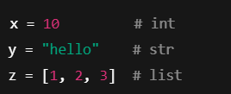

Variables & Data Types Deep Dive -2
🧠 What is a Data Type?
A data type defines the kind of value a variable can hold.
Python automatically assigns a data type when you assign a value.
Different data types are used for storing numbers, text, lists, true/false, etc.
📦 Collection Data Types
Data Type Description Example
list Ordered(changable) marks = [90, 85, 78]
tuple Ordered(unchangable) x_axis = (1,0)
dict Key-value pair student = {"name": "Bob", "age": 20}
🔢 Basic Built-in Data Types
Data Type Description Example
int Integer age = 25
float Decimal price = 99.99
str String name = “Piyush”
bool Boolean is_cool = True
🧪 How Python Identifies Data Type?
Python uses the type of value to understand what the variable is.
You can check the type using the type() function:
Question: Why Data Types Matter?

Slide 7
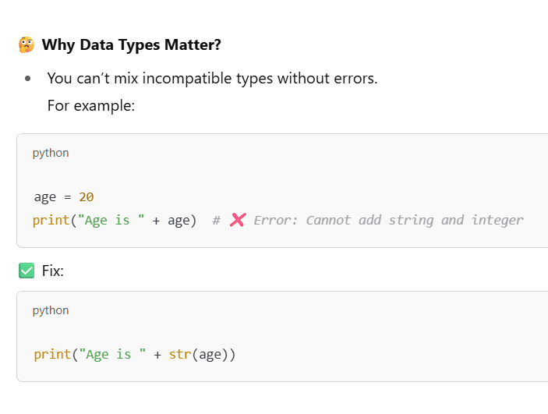

Slide 8
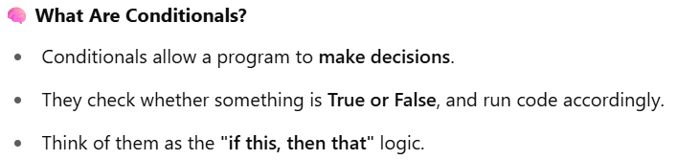
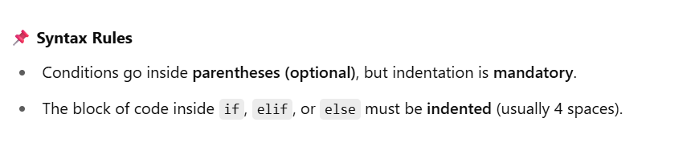
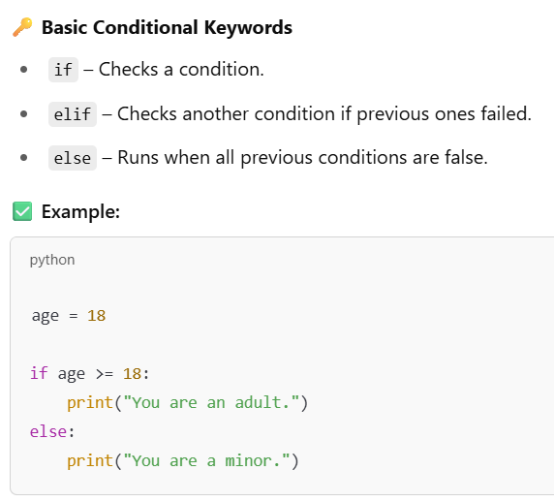
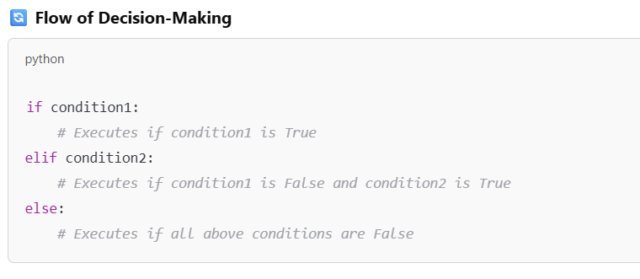
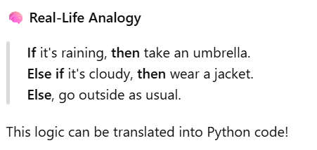
Control Structures for AI Logic-1

Slide 9
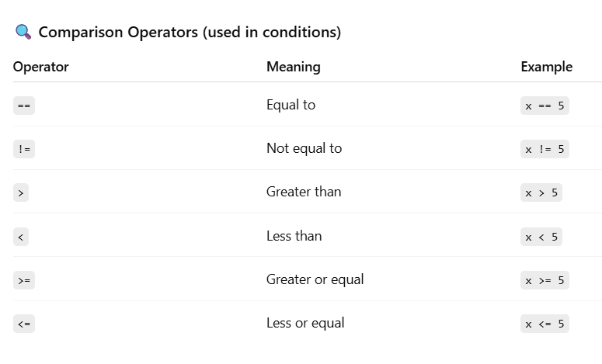
Control Structures for AI Logic-2

Slide 10
Short Break(10 min)

Slide 11
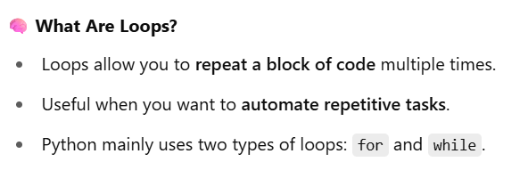
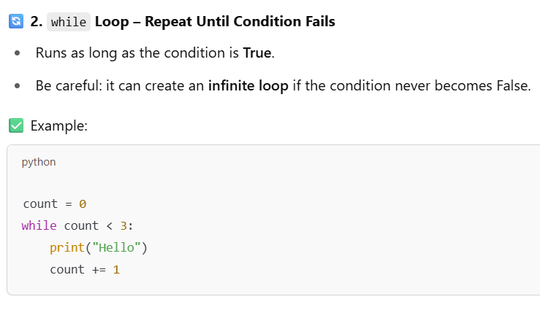
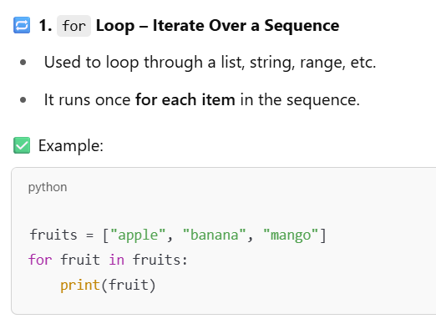
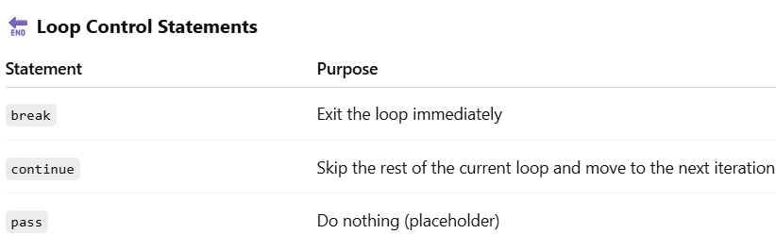
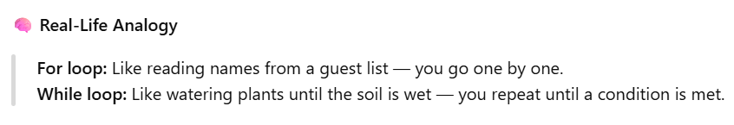
Loops for Data Processing

Slide 12
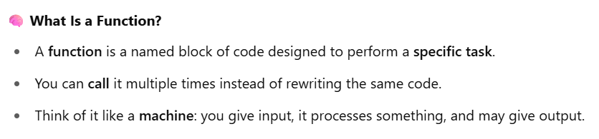
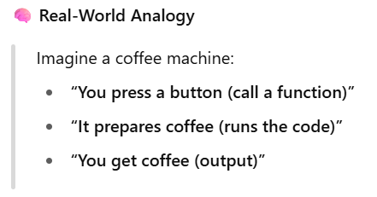
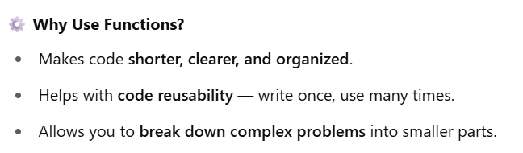
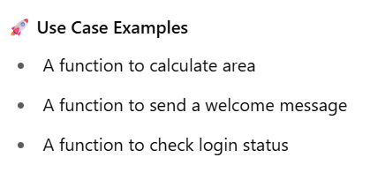
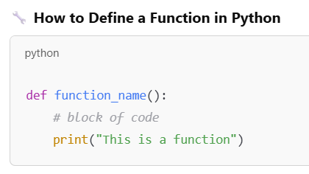
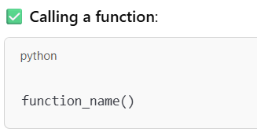
Functions - Building Blocks of AI-1

Slide 13
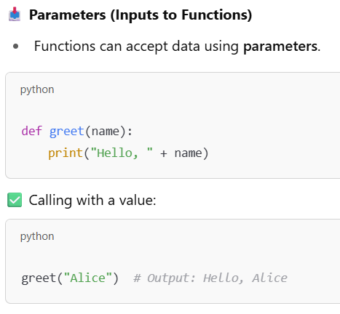
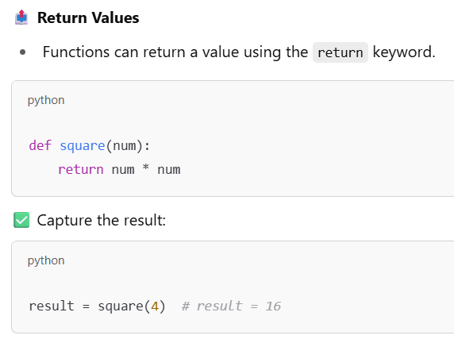
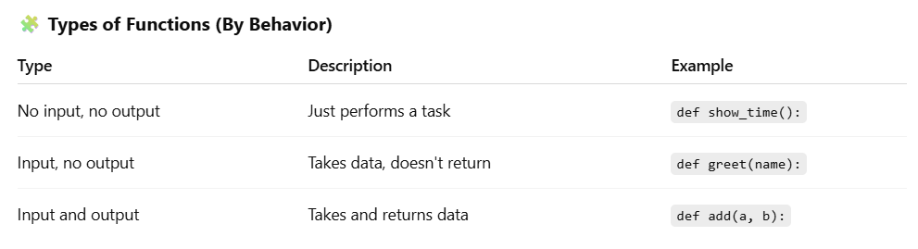
Functions - Building Blocks of AI-2

Slide 14
Main Break(30 min)

Slide 15
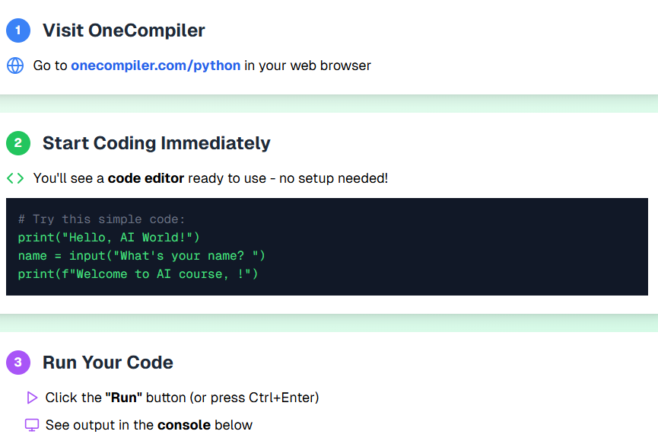
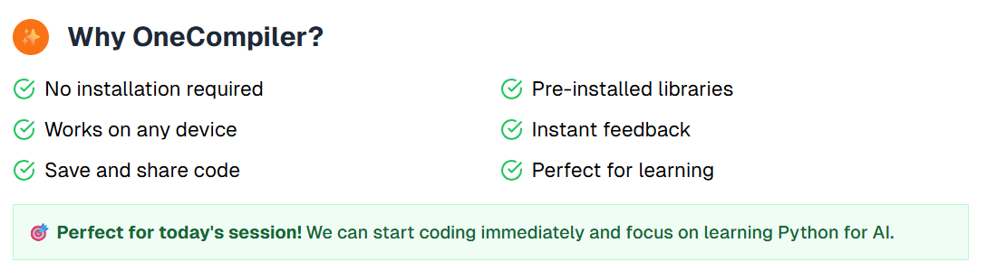
Python Environment & Setup
For the next few sessions, we will be using OneCompiler for our coding exercises. Google Colab will be used in the coming days. You can directly access OneCompiler by typing 'OneCompiler' into your web browser and selecting 'Python‘.

Slide 16
QnA
And
Feedback
Next: Data Structures Deep Dive

