Slide 1
Software Testing (Equivalence class partitioning)
Engr. Sajid Saleem

Slide 2
Outline
Equivalence Classes
Testing By Contract
Defensive testing
Types of Equivalence Classes
Continuous Equivalence Class
Discrete Equivalence Class
Single Selection Equivalence Class
Multiple Selection Equivalence Class
Testing Valid vs Invalid Data
Applicability and Limitations
Examples
Grocery Store
Banking Problem
Next Date Problem

Slide 3
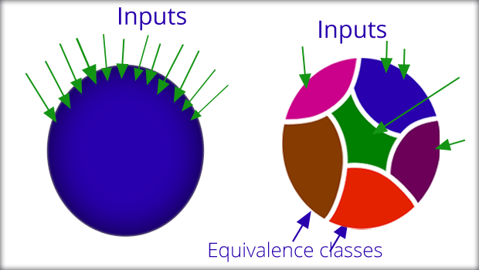
Equivalence Classes
Notes:
1 sample from a class represents all other samples of the same class.

Slide 4
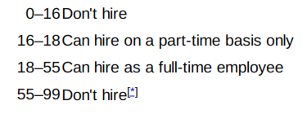
Scenario
How would you program?
Notes:
Like absolute grading system

Slide 5
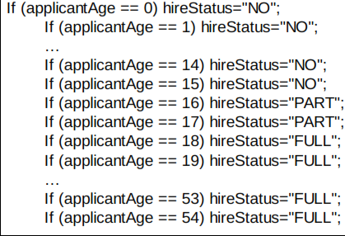
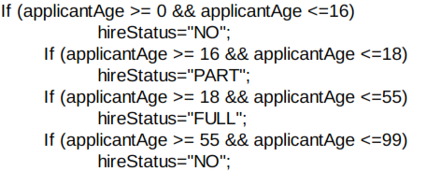
Approach 1 approach 2

Slide 6
Equivalence Class
An equivalence class consists of a set of data that is treated the same by the module or that should produce the same result.

Slide 7
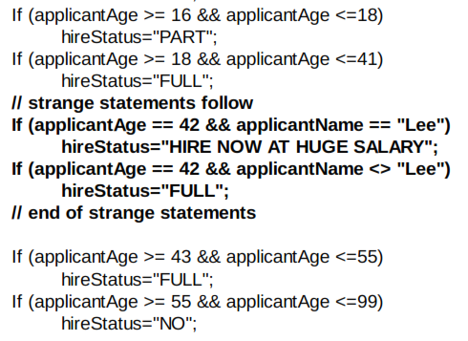
We expect the programmer will do this

Slide 8
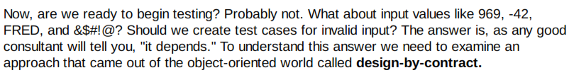
Equivalence Class

Slide 9
Design by contract : OOP approach
In the design-by-contract approach, modules (called "methods" in the object-oriented paradigm, but "module" is a more generic term) are defined in terms of pre-conditions and post-conditions.
Post-conditions define what a module promises to do (compute a value, open a file, print a report, update a database record, change the state of the system, etc.).
Pre-conditions define what that module requires so that it can meet its post-conditions.
For example, if we had a module called openFile, what does it promise to do? Open a file. What would legitimate preconditions of openFile be? First, the file must exist; second, we must provide the name (or other identifying information) of the file; third, the file must be "openable," that is, it cannot already be exclusively opened by another process; fourth, we must have access rights to the file; and so on.
Pre-conditions and postconditions establish a contract between a module and others that invoke it.

Slide 10
Testing by contract
Testing-by-contract is based on the design-by-contract philosophy.
Its approach is to create test cases only for the situations in which the pre-conditions are met.
For example, we would not test the openFile module when the file did not exist.
The reason is simple. If the file does not exist, openFile does not promise to work.
If there is no claim that it will work under a specific condition, there is no need to test under that condition.
At this point testers usually protest.
Yes, they agree, the module does not claim to work in that case, but what if the preconditions are violated during production? What does the system do?
Do we get a misspelled word on the screen or a smoking crater where our company used to be?

Slide 11
Defensive Design
A different approach to design is defensive design.
In this case the module is designed to accept any input.
If the normal preconditions are met, the module will achieve its normal postconditions.
If the normal pre-conditions are not met, the module will notify the caller by returning an error code or throwing an exception (depending on the programming language used). This notification is actually another one of the module's postconditions.
Based on this approach we could define defensive testing: an approach that tests under both normal and abnormal pre-conditions.

Slide 12
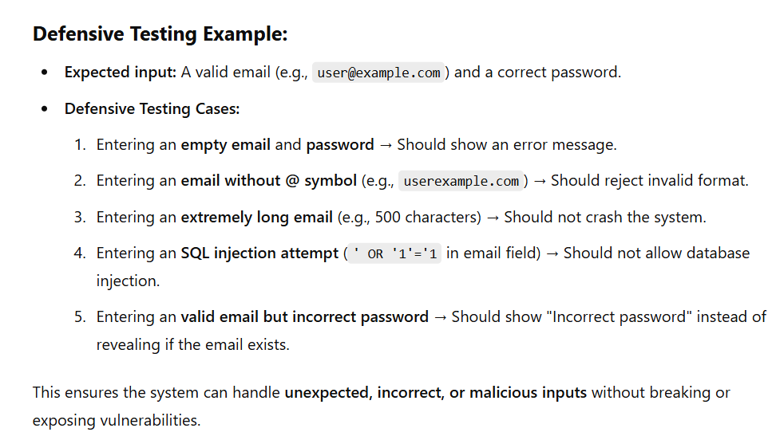

Slide 13
Types of Equivalence Classes
Different types of input require different types of equivalence classes.
Let's consider four possibilities.
Continuous Equivalence Class
Discrete Equivalence Class
Single Selection Equivalence Class
Multiple Selection Equivalence Class
Let's assume a defensive testing philosophy of testing both valid and invalid input.
Testing invalid inputs is often a great source of defects.

Slide 14
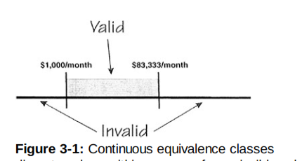
Continuous Equivalence Class
If an input is a continuous range of values, then there is typically one class of valid values and two classes of invalid values, one below the valid class and one above it.
Consider the Goofy Mortgage Company (GMC):
They will write mortgages for people with incomes between $1,000/month and $83,333/month.
Anything below $1,000/month you don't qualify.
Anything over $83,333/month you don't need GMC, just pay cash.
For a valid input we might choose $1,342/month. For invalids we might choose $123/month and $90,000/month.

Slide 15
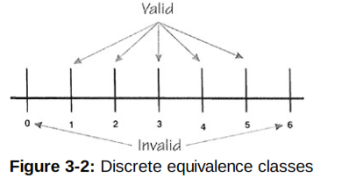
Discrete Equivalence Class
If an input condition takes on discrete values within a range of permissible values, there are typically one valid and two invalid classes.
GMC will write a single mortgage for one through five houses.
Zero or fewer houses is not a legitimate input,
Nor is six or greater.
Neither are fractional or decimal values such as 2 1/2 or 3.14159.
For a valid input we might choose two houses.
Invalids could be -2 and 8.

Slide 16
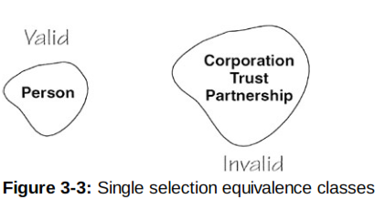
Single Selection Equivalence Class
GMC will make mortgages only for a person.
They will not make mortgages for corporations, trusts, partnerships, or any other type of legal entity.
For a valid input we must use "person."
For an invalid we could choose "corporation" or "trust" or any other random text string.
How many invalid cases should we create? We must have at least one; we may choose additional tests for additional warm and fuzzy feelings.

Slide 17
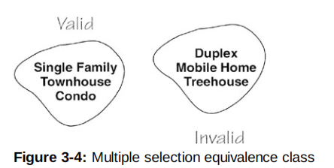
Multiple Selection Equivalence Class
GMC will make mortgages on Condominiums, Townhouses, and Single Family dwellings.
They will not make mortgages on Duplexes, Mobile Homes, Treehouses, or any other type of dwelling.
For valid input we must choose from "Condominium," "Townhouse," or "Single Family."
While the rule says choose one test case from the valid equivalence class, a more comprehensive approach would be to create test cases for each entry in the valid class.
That makes sense when the list of valid values is small.

Slide 18
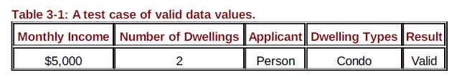
Testing Valid Data
Now, rarely will we have the time to create individual tests for every separate equivalence class of every input value that enters our system.
More often, we will create test cases that test a number of input fields simultaneously. For example, we might create a single test case with the following combination of inputs:
Each of these data values is in the valid range, so we would expect the system to perform correctly and for the test case to report Pass.

Slide 19
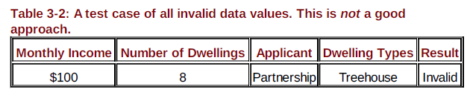
Testing Invalid Data
It is tempting to use the same approach for invalid values.
If the system accepts this input as valid, clearly the system is not validating the four input fields properly.
If the system rejects this input as invalid, it may do so in such a way that the tester cannot determine which field it rejected.

Slide 20
Testing Valid vs Invalid Data
In many cases, errors in one input field may cancel out or mask errors in another field so the system accepts the data as valid.
A better approach is to test one invalid value at a time to verify the system detects it correctly.

Slide 21
Testing Valid vs Invalid Data (contd.)
Another approach to using equivalence classes is to examine the outputs rather than the inputs.
Divide the outputs into equivalence classes, then determine what input values would cause those outputs.
This has the advantage of guiding the tester to examine, and thus test, every different kind of output.
But this approach can be deceiving. ??????

Slide 22
To define equivalence classes follow the guideline
If an input condition specifies a range, one valid and two invalid equivalence classes are defined.
If an input condition requires a specific value, one valid and two invalid equivalence classes are defined.
If an input condition is Boolean, one valid and one invalid class are defined.

Slide 23
Test cases for input box accepting numbers between 1 and 1000 using Equivalence Partitioning
One input data class with all valid inputs. Pick a single value from range 1 to 1000
Input data class with all values below lower limit. I.e. any value below 1, as a invalid input data test case
Input data with any value greater than 1000 to represent third invalid input class.

Slide 24
Applicability and Limitations
Equivalence class testing can significantly reduce the number of test cases that must be created and executed.
It is most suited to systems in which much of the input data takes on values within ranges or within sets.
It makes the assumption that data in the same equivalence class is, in fact, processed in the same way by the system.
The simplest way to validate this assumption is to ask the programmer about their implementation.
Equivalence class testing is equally applicable at the unit, integration, system, and acceptance test levels.
All it requires are inputs or outputs that can be partitioned based on the system’s requirements.

Slide 25
Test Case of Grocery Store Application
Consider a software module that is intended to accept the name of a grocery item and a list of the different sizes the item comes in, specified in ounces. The specifications state that the item name is to be alphabetic characters 2 to 15 characters in length. Each size may be a value in the range of 1 to 48, whole numbers only. The sizes are to be entered in ascending order (smaller sizes first). A maximum of five sizes may be entered for each item. The item name is to be entered first, followed by a comma, then followed by a list of sizes. A comma will be used to separate each size. Spaces (blanks) are to be ignored anywhere in the input.

Slide 26
Derived Equivalence Classes
Item name is alphabetic (valid)
Item name is not alphabetic (invalid)
Item name is less than 2 characters in length (invalid)
Item name is 2 to 15 characters in length (valid)
Item name is greater than 15 characters in length (invalid)
Size value is less than 1 (invalid)
Size value is in the range 1 to 48 (valid)
Size value is greater than 48 (invalid)
Size value is a whole number (valid)
Size value is a decimal (invalid)
Size value is numeric (valid)
Size value includes nonnumeric characters (invalid)
Size values entered in ascending order (valid)
Size values entered in nonascending order (invalid)
No size values entered (invalid)
One to five size values entered (valid)
More than five sizes entered (invalid)
Item name is first (valid)
Item name is not first (invalid)
A single comma separates each entry in list (valid)
A comma does not separate two or more entries in the list (invalid)
The entry contains no blanks (???)
The entry contains blanks (????)

Slide 27
Test Data | Expected Outcome | Classes Covered
xy,1 | T | 1,4,7,9,11,13,16,18,20,22
AbcDefghijklmno,1,2,3 ,4,48 | T | 1,4,7,9,11,13,16,18,20,23
a2x,1 | F | 2
A,1 | F | 3
Abcdefghijklmnop | F | 5
Xy,0 | F | 6
XY,49 | F | 8
Xy,2.5 | F | 10
xy,2,1,3,4,5 | F | 14
Xy | F | 15
XY,1,2,3,4,5,6 | F | 17
1,Xy,2,3,4,5 | F | 19
XY2,3,4,5,6 | F | 21
AB,2#7 | F | 12

Slide 28
BaNKING Problem by using ECP techniques
A savings account in a bank has a different rate of interest depending on the balance in the account. In order to test the software that calculates the interest due, identify the ranges of balance values that earn the different rates of interest. For example, 3% rate of interest is given if the balance in the account is in the range of $0 to $100, 5% rate of interest is given if the balance in the account is in the range of $100 to $1000, and 7% rate of interest is given if the balance in the account is $1000 and above
Equivalence Class Portioning (ECP) technique

Slide 29
Id | Input | Expected output | Actual output
1 | -5 | NA
2 | 50 | 3%
3 | 150 | 5%
4 | 1050 | 7%
5 | -1 | NA
6 | 0 | 3%
7 | 1 | 3%
8 | 99 | 3%
9 | 100 | --
10 | 101 | 5%
11 | 999 | 5%
12 | 1000 | --
13 | 1001 | 7%

Slide 30
Test Cases for Banking Problem
Id | Input | Expected output | Actual output | status
1 | -1 | Invalid
2 | 50 | 3%
3 | 150 | 5%
4 | 1100 | 7%
SO THE CONCLUSION IS : IN CASE OF REPETITION, YOU HAVE TO DELETE THE DUPLICATIONS OF TEST CASES.

Slide 31
Next Date Problem using ECP techniques
Input Classes
Day:
D1: day between 1 to 28
D2: 29
D3: 30
D4: 31
Month:
M1: Month has 30 days
M2: Month has 31 days
M3: Month is February
Year:
Y1: Year is a leap year
Y2: Year is a normal year
Output Classes
Increment Day
Reset Day and Increment Month
Increment year
Invalid Month

Slide 32
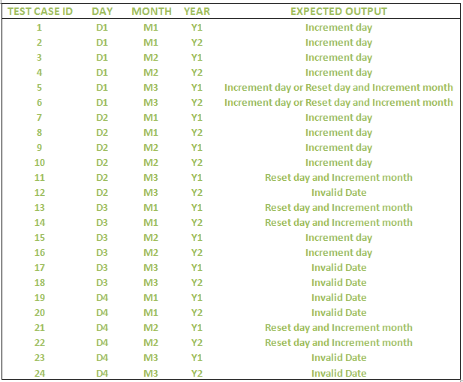
Next Date Problem using ECP techniques
How many tests are required to check full spectrum ???

Slide 33
Next Date Problem using ECP techniques
Test Case ID | Day | Month | Year | Expected Output
E1 | 15 | 4 | 2004 | 16-4-2004
E2 | 15 | 4 | 2003 | 16-4-2003
E3 | 15 | 1 | 2004 | 16-1-2004
E4 | 15 | 1 | 2003 | 16-1-2003
E5 | 15 | 2 | 2004 | 16-2-2004
E6 | 15 | 2 | 2003 | 16-2-2003
E7 | 29 | 4 | 2004 | 30-4-2004
E8 | 29 | 4 | 2003 | 30-4-2003
E9 | 29 | 1 | 2004 | 30-1-2004
E10 | 29 | 1 | 2003 | 30-1-2003
E11 | 29 | 2 | 2004 | 1-3-2004
E12 | 29 | 2 | 2003 | Invalid Date
Test Case ID | Day | Month | Year | Expected Output
E13 | 30 | 4 | 2004 | 1-5-2004
E14 | 30 | 4 | 2003 | 1-5-2003
E15 | 30 | 1 | 2004 | 31-1-2004
E16 | 30 | 1 | 2003 | 31-1-2003
E17 | 30 | 2 | 2004 | Invalid Date
E18 | 30 | 2 | 2003 | Invalid Date
E19 | 31 | 4 | 2004 | Invalid Date
E20 | 31 | 4 | 2003 | Invalid Date
E21 | 31 | 1 | 2004 | 1-2-2004
E22 | 31 | 1 | 2003 | 1-5-2003
E23 | 31 | 2 | 2004 | Invalid Date
E24 | 31 | 2 | 2003 | Invalid Date

Slide 34
THANK YOU

