Slide 1
Software Testing (Software Quality ASSURANCE – Part 1)

Slide 2
Outline
Quality
Software Quality Assurance
External Quality Characteristics (Blackbox Characteristics)
Internal Quality Characteristics (Whitebox Characteristics)

Slide 3
Quality
What is Quality???
Synonym: Excellence, Superiority, Class, Grade
Antonym: Inferior

Slide 4
More on Quality...
Quality is not absolute - it means different things in different situations
Quality is multidimensional - it has many contributing factors and cannot be easily summarized
Quality is subject to constraints - assessment is constrained by cost (of many types)
Quality is about acceptable compromises - when quality is constrained, compromises are required.
Quality criteria are not independent - they interact with each other and cause conflicts.

Slide 5
Software Quality
Software Quality is
The degree to which a system, component, or process meets specified requirements, and
The degree to which a system, component, or process meets customer or user needs or expectations (IEEE)
The totality of features and characteristics of a product or service that bear on its ability to satisfy specified or implied needs (ISO)

Slide 6
Software Quality Assurance
Software Quality Assurance (SQA) is
A planned and systematic pattern of all actions necessary to provide adequate confidence that an item or product conforms to established technical requirements.
A set of activities designed to evaluate the process by which products are developed or manufactured. (IEEE 610)

Slide 7
Software Quality Assurance
Software Quality Assurance (SQA) is
A systematic, planned set of actions necessary to provide adequate confidence that the software development process or the maintenance process of a software system product conforms to established functional technical requirements as well as with the managerial requirements of keeping the schedule and operating within the budgetary confines.

Slide 8
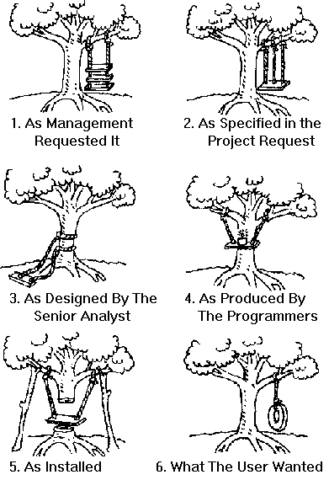
Why Quality Assurance?
Requirement gathering and Analysis
Design
Implementation or Coding
Testing
Deployment
Maintenance
SDLC

Slide 9

This is how a driver or user looks at me. I am opaque or black box for him.

Slide 10
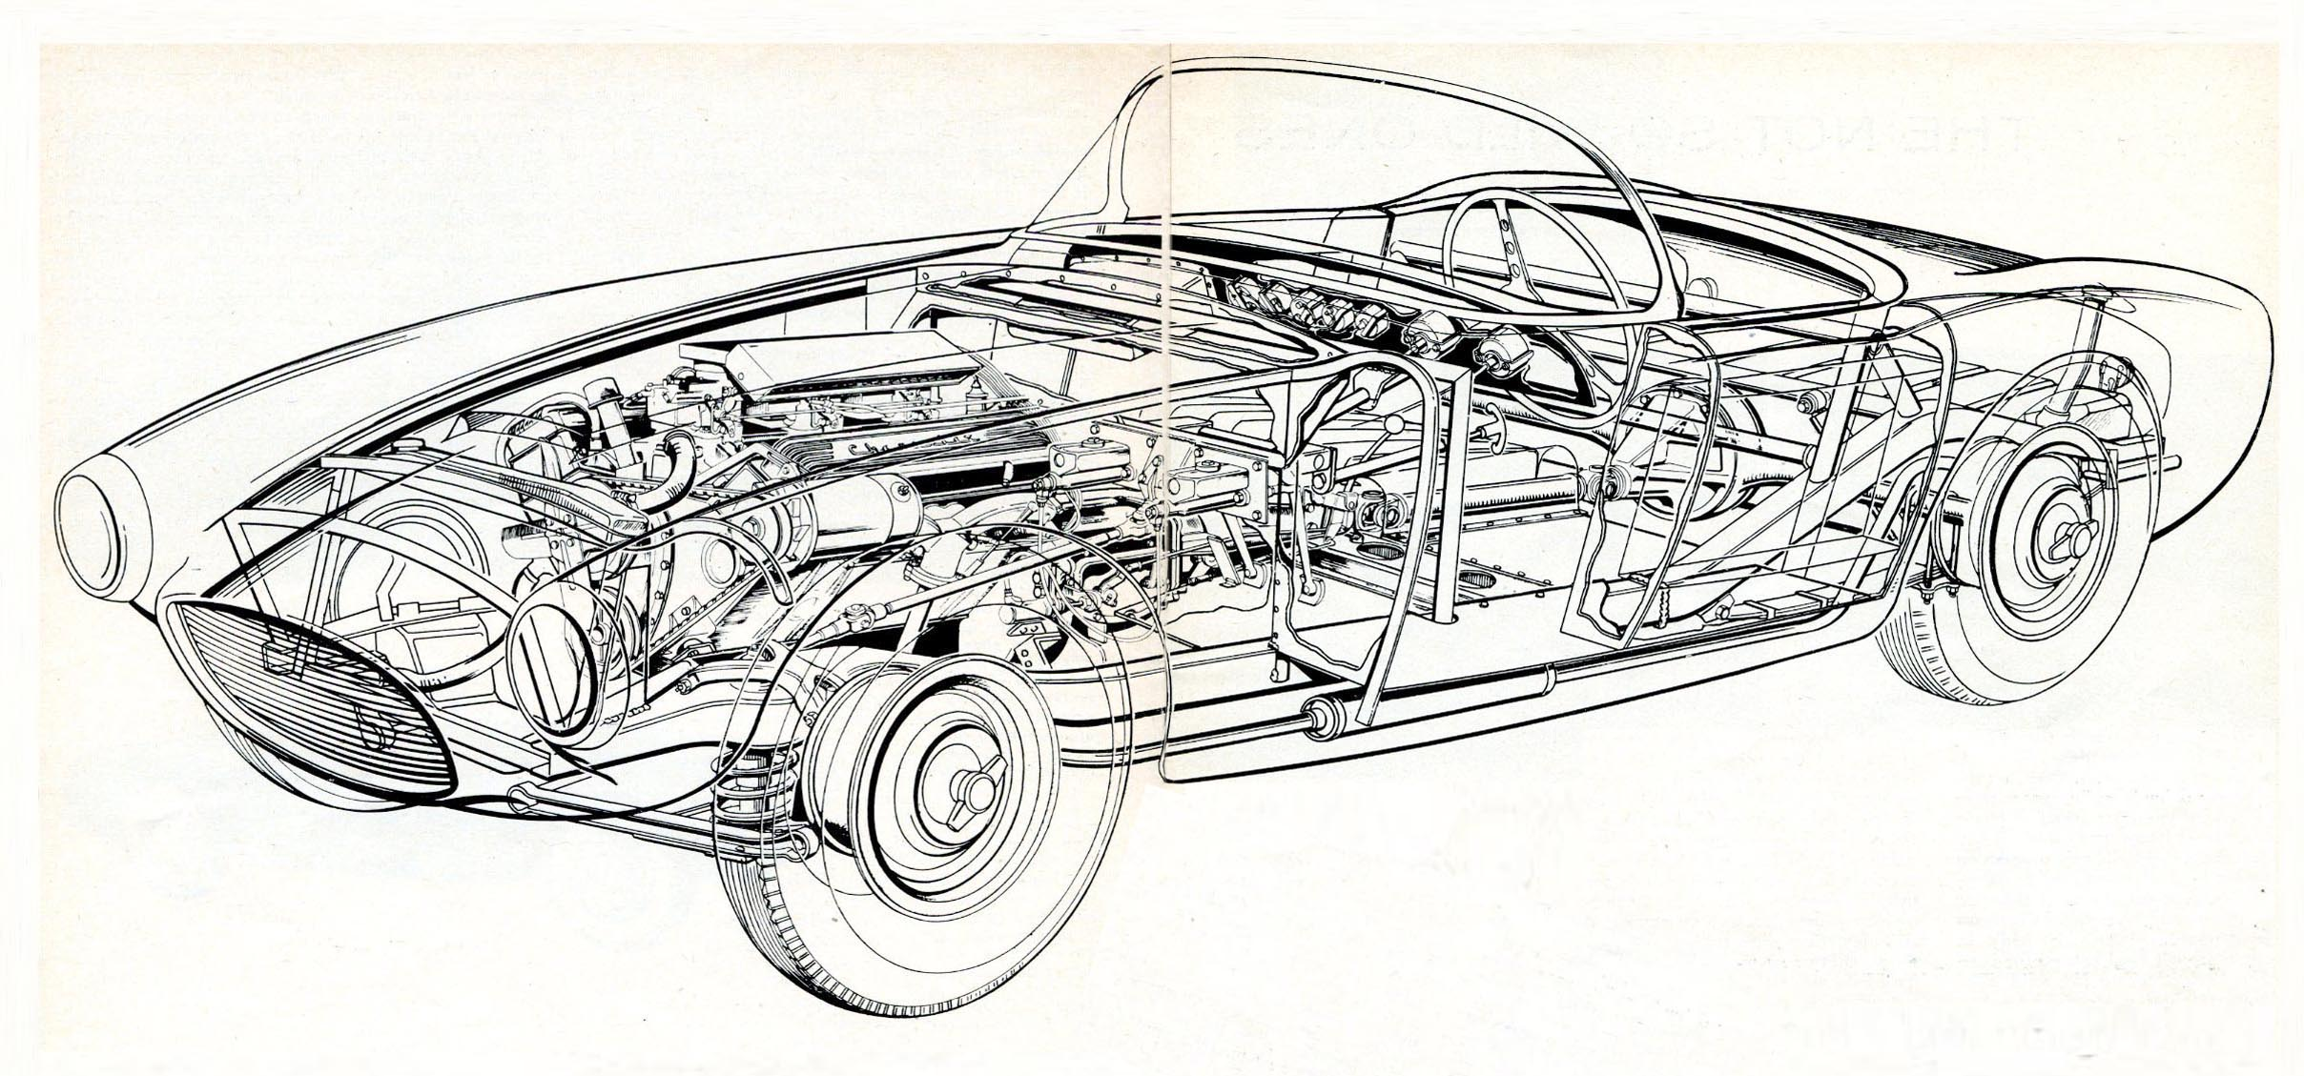
This is how an engineer looks at me. I am transparent or white box for him.

Slide 11

External quality characteristics, or the black box point of view.
Usability
Efficiency
Reliability
Integrity
Adaptability
Accuracy and Precision
Robustness

Slide 12
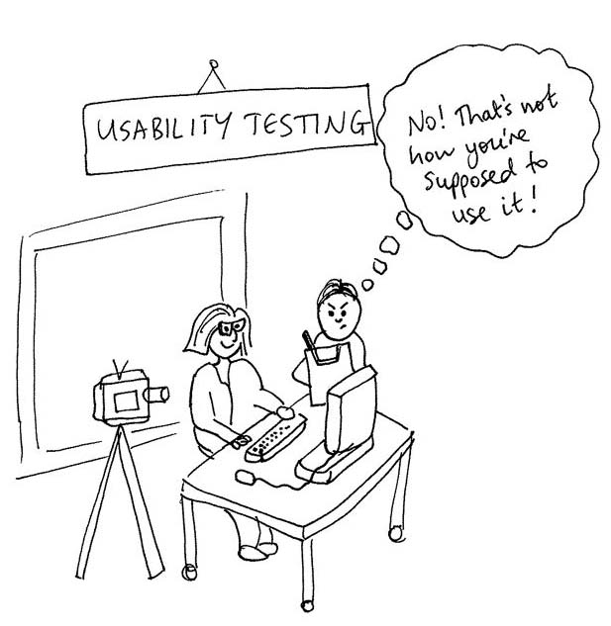
External quality characteristics, or the black box point of view.
Usability
Usability requirements deal with the scope of staff resources needed to train a new employee and to operate the software system.

Slide 13

External quality characteristics, or the black box point of view.
Efficiency
Efficiency requirements deal with the hardware resources needed to perform all the functions of the software system in conformance to all other requirements. The main
Hardware resources to be considered are the computer’s processing capabilities (measured in MIPS – million instructions per second ,etc.)

Slide 14

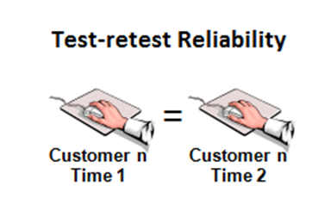
External quality characteristics, or the black box point of view.
■ Reliability

Slide 15

External quality characteristics, or the black box point of view.
Integrity
Integrity requirements deal with the software system security, that is, requirements to prevent access to unauthorized persons, to distinguish between the majority of personnel allowed to see the information (“read permit”) and a limited group who will be allowed to add and change data (“write permit”), and so forth.
Refers to the accuracy, reliability, and security of a software system.

Slide 16

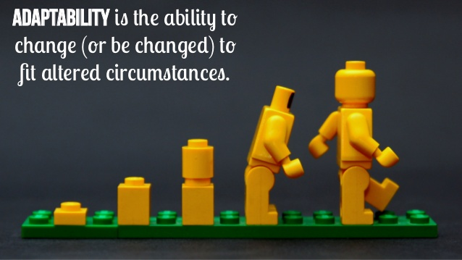
External quality characteristics, or the black box point of view.
Adaptability
Ability of a software application to function correctly across different environments, devices, or conditions with minimal modifications.

Slide 17
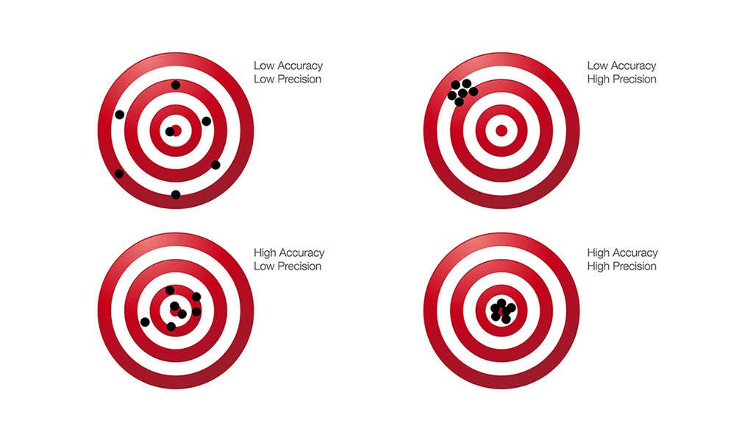
External quality characteristics, or the black box point of view.
Accuracy and precision
Both accuracy and precision are important in software testing, especially when dealing with calculations, data validation, and system performance.

Slide 18

External quality characteristics, or the black box point of view.
Robustness
Robustness reduces the impact of operational mistakes, erroneous input data, and hardware errors.
Handle unexpected conditions, errors, or unusual inputs without crashing or producing incorrect results.

Slide 19
Internal quality characteristics, or the white box point of view. (Internal Point of view)
Maintainability
Flexibility
Portability
Reusability
Readability
Testability
Understandability

Slide 20
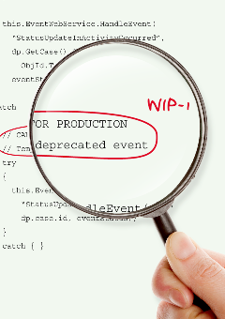
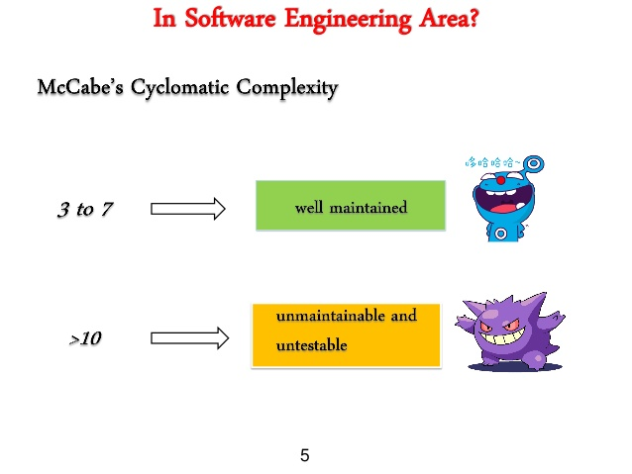
Internal quality characteristics, or the white box point of view.
Maintainability
checks how complex your code is.

Slide 21

Internal quality characteristics, or the white box point of view.
Flexibility
Ability of a software system to adapt to changes in requirements, features, or integrations without major modifications.
The extent to which you can modify a system for uses or environments other than those for which it was specifically designed.

Slide 22
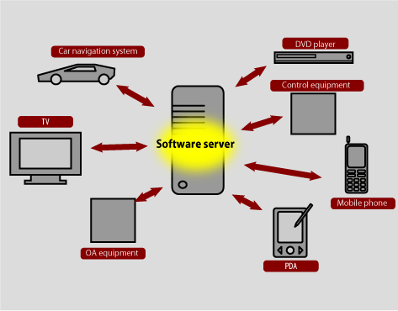
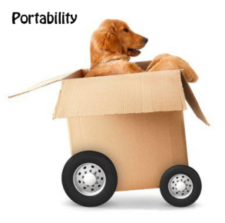
Internal quality characteristics, or the white box point of view.
Portability
Portability requirements tend to the adaptation of a software system to other environments consisting of different hardware, different operating systems.
Ability of a software system to
run on different environments,
platforms, or operating systems
with minimal effort.

Slide 23

Internal quality characteristics, or the white box point of view.
Reusability
Reusability requirements deal with the use of software modules originally designed for one project in a new software project currently being developed
Reintegrating chunks of code to create a new software.

Slide 24
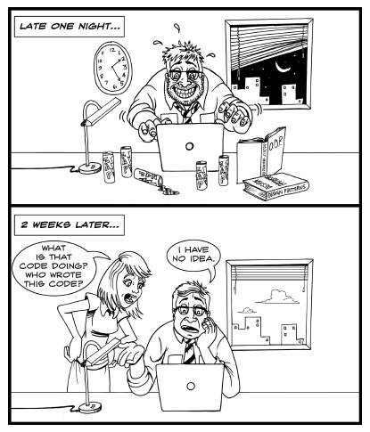
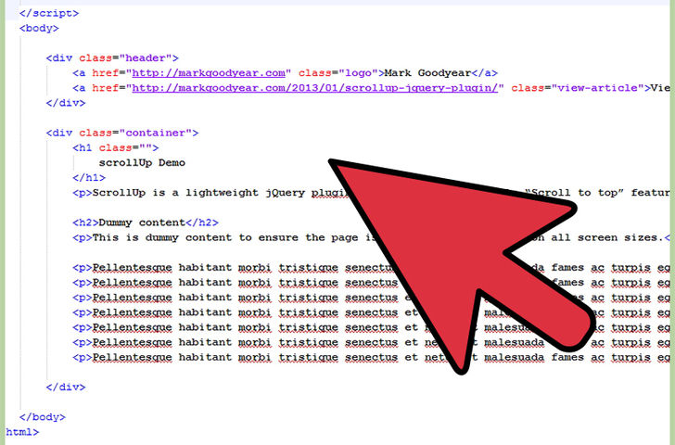
Internal quality characteristics, or the white box point of view.
Readability

Slide 25
Internal quality characteristics, or the white box point of view.
Testability
Testability requirements deal with the testing of an information system as well as with its operation.
Testability requirements for the ease of testing are related to special features in the programs that help the tester, for instance by providing predefined intermediate results and log files
Complete Code Testing
Partially Testing

Slide 26

Internal quality characteristics, or the white box point of view.
Understandability

Slide 27
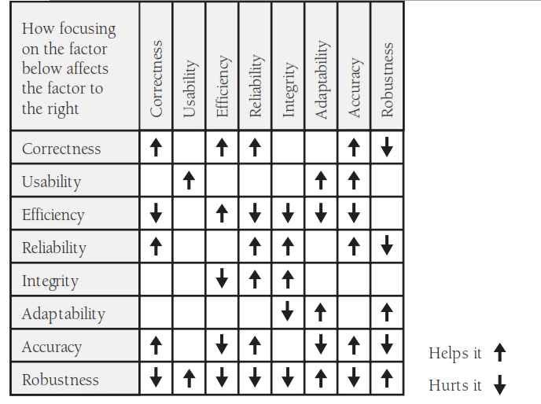
Directly proportional
In-Directly Proportional

Slide 28
THANK YOU

