Slide 1



DAE 6-MONTH
CYBERSECURITY PROGRAM
Monthly Project Showcase
SEMESTER 3 · WEEK 4
Sabitha S Karanavar
Python Developer | IAM Analyst

Slide 2


LEARNING PATH OVERVIEW
Three Semesters, One Growth Curve
From core programming fundamentals to a live enterprise-style Identity & Access Management capstone.
SEMESTER 1
SEMESTER 2
SEMESTER 3
Python & Software
Foundations
IAM Foundations &
Workforce Readiness
Healthcare IAM
Capstone (Live Project)
Programming logic, Git/GitHub,
Unix, prompt engineering
IAM Security Analyst role-play,
12-week capstone design
Hands-on identity, network &
threat-response operations
2 / 14

Slide 3

SEMESTER 1 PROJECT
Smart Deal Alert — Python Application
WHAT I BUILT
REAL-WORLD VALUE
A Python command-line app that tracks product prices and sends a deal alert when a price drops to a user's target
Secure multi-user accounts with password hashing and login-attempt limits
Persistent JSON-based data storage for products, users, and watchlists
Built iteratively across 4 versions — simple tracker → CSV watchlist → JSON storage → polished multi-user final release
Same core logic behind real e-commerce price-tracking tools consumers use every day
Introduces automation, rule-based alerting, and account security — patterns used across retail, finance, and fraud-monitoring software
First hands-on experience with the software lifecycle: design → build → test → iterate
4
working iterations
shipped
3 / 14

Slide 4




Smart Deal Alert — Stack & Learnings
TECH STACK
Python
JSON Storage
Menu-Driven CLI
Auth & Lockout Logic
WHAT I LEARNED
Core Python: dictionaries, loops, list comprehensions
Input-validation retry loops (e.g. get_positive_number)
Structuring runnable scripts with if __name__ == "__main__"
Working with JSON as lightweight persistent storage
Designing basic authentication & account-safety logic
Iterating a project across multiple presentation cycles
Sabitha S Karanavar | DAE 6-Month Program
4

Slide 5
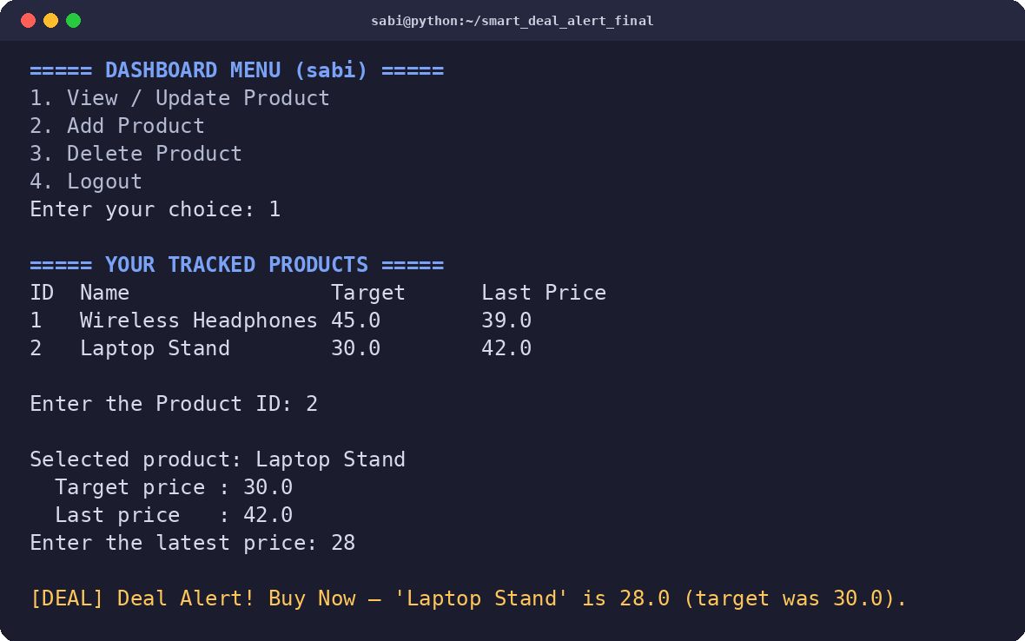
Smart Deal Alert — Program Flow
From launch to logout — how the pieces connect
Start
›
Load
Users
›
Login /
Register
›
Dashboard
›
Add / View /
Update / Delete
›
Compare
Price
›
Deal
Alert
›
Logout
›
End
Data persists between runs in users_data.json — no database needed. Each logged-in user only sees and edits their own product list.
Real program output — adding a product and getting a live Deal Alert
Sabitha S Karanavar | DAE 6-Month Program
5

Slide 6
SEMESTER 3 CAPSTONE
Healthcare IAM Operations
Simulated environment: Horizon Valley Medical Center (HVMC) — a 30-employee healthcare organization across 10 departments
WHAT THE PROJECT INVOLVES
WHY IT MATTERS
Built a full Identity & Access Management lab: Samba4 Active Directory domain, RBAC + ACL-based access control, on-prem → cloud identity via Microsoft Entra ID
Designed the network security architecture: topology, subnetting, firewall/IDS-IPS rules, secure wireless
Ran real threat exercises: phishing simulation (Kali/SET), malware analysis via VirusTotal, a real APT group mapped to MITRE ATT&CK, and a tabletop incident-response drill
IAM is the #1 control healthcare organizations rely on to protect patient data and meet compliance standards
Mirrors the daily work of real IAM Analysts, Security Operations, and GRC/Compliance teams
Builds a portfolio-ready case study directly relevant to hiring managers in healthcare IT and cybersecurity
6 / 14

Slide 7




HVMC Lab — Network Architecture
LAN, star topology — single-site home lab with segmented VLANs
Internet
Microsoft Entra ID (Cloud)
Perimeter Firewall (UFW)
Core Switch (Star Topology)
Domain Controller — dc01
(Ubuntu + Samba4)
File / App Server
(Samba Shares)
VLAN 10
Clinical
VLAN 20
Administrative
VLAN 30
IT & Security
Kali / Parrot VM (Security Testing)
Sabitha S Karanavar | DAE 6-Month Program
7

Slide 8


What I've Learned — Security Operations
Network Security
Threat & Vulnerability Mgmt
Designed a single-site LAN in a star topology, segmented into 3 VLANs — Clinical, Administrative, and IT & Security
Implemented layered defenses: UFW firewall (default-deny), Suricata IDS, and fail2ban IPS on the domain controller
Configured WPA3-Personal wireless security with Protected Management Frames, plus WIPS monitoring for BYOD devices
Enforced access control via Samba share permissions + POSIX ACLs mapped to AD-style security groups
Ran Nmap-based asset discovery and vulnerability scans against the lab and an authorized external host — 149 unique CVEs identified
Diagnosed malware samples using VirusTotal and open-source threat-intelligence correlation (MalwareBazaar samples)
Applied risk management: identified, treated, and monitored risks derived directly from the vulnerability scan results
Ran a tabletop incident-response exercise, documenting a detection use case end-to-end
Started threat intelligence work: IoC analysis complete, OpenCTI platform implementation in progress
Sabitha S Karanavar | DAE 6-Month Program
8

Slide 9
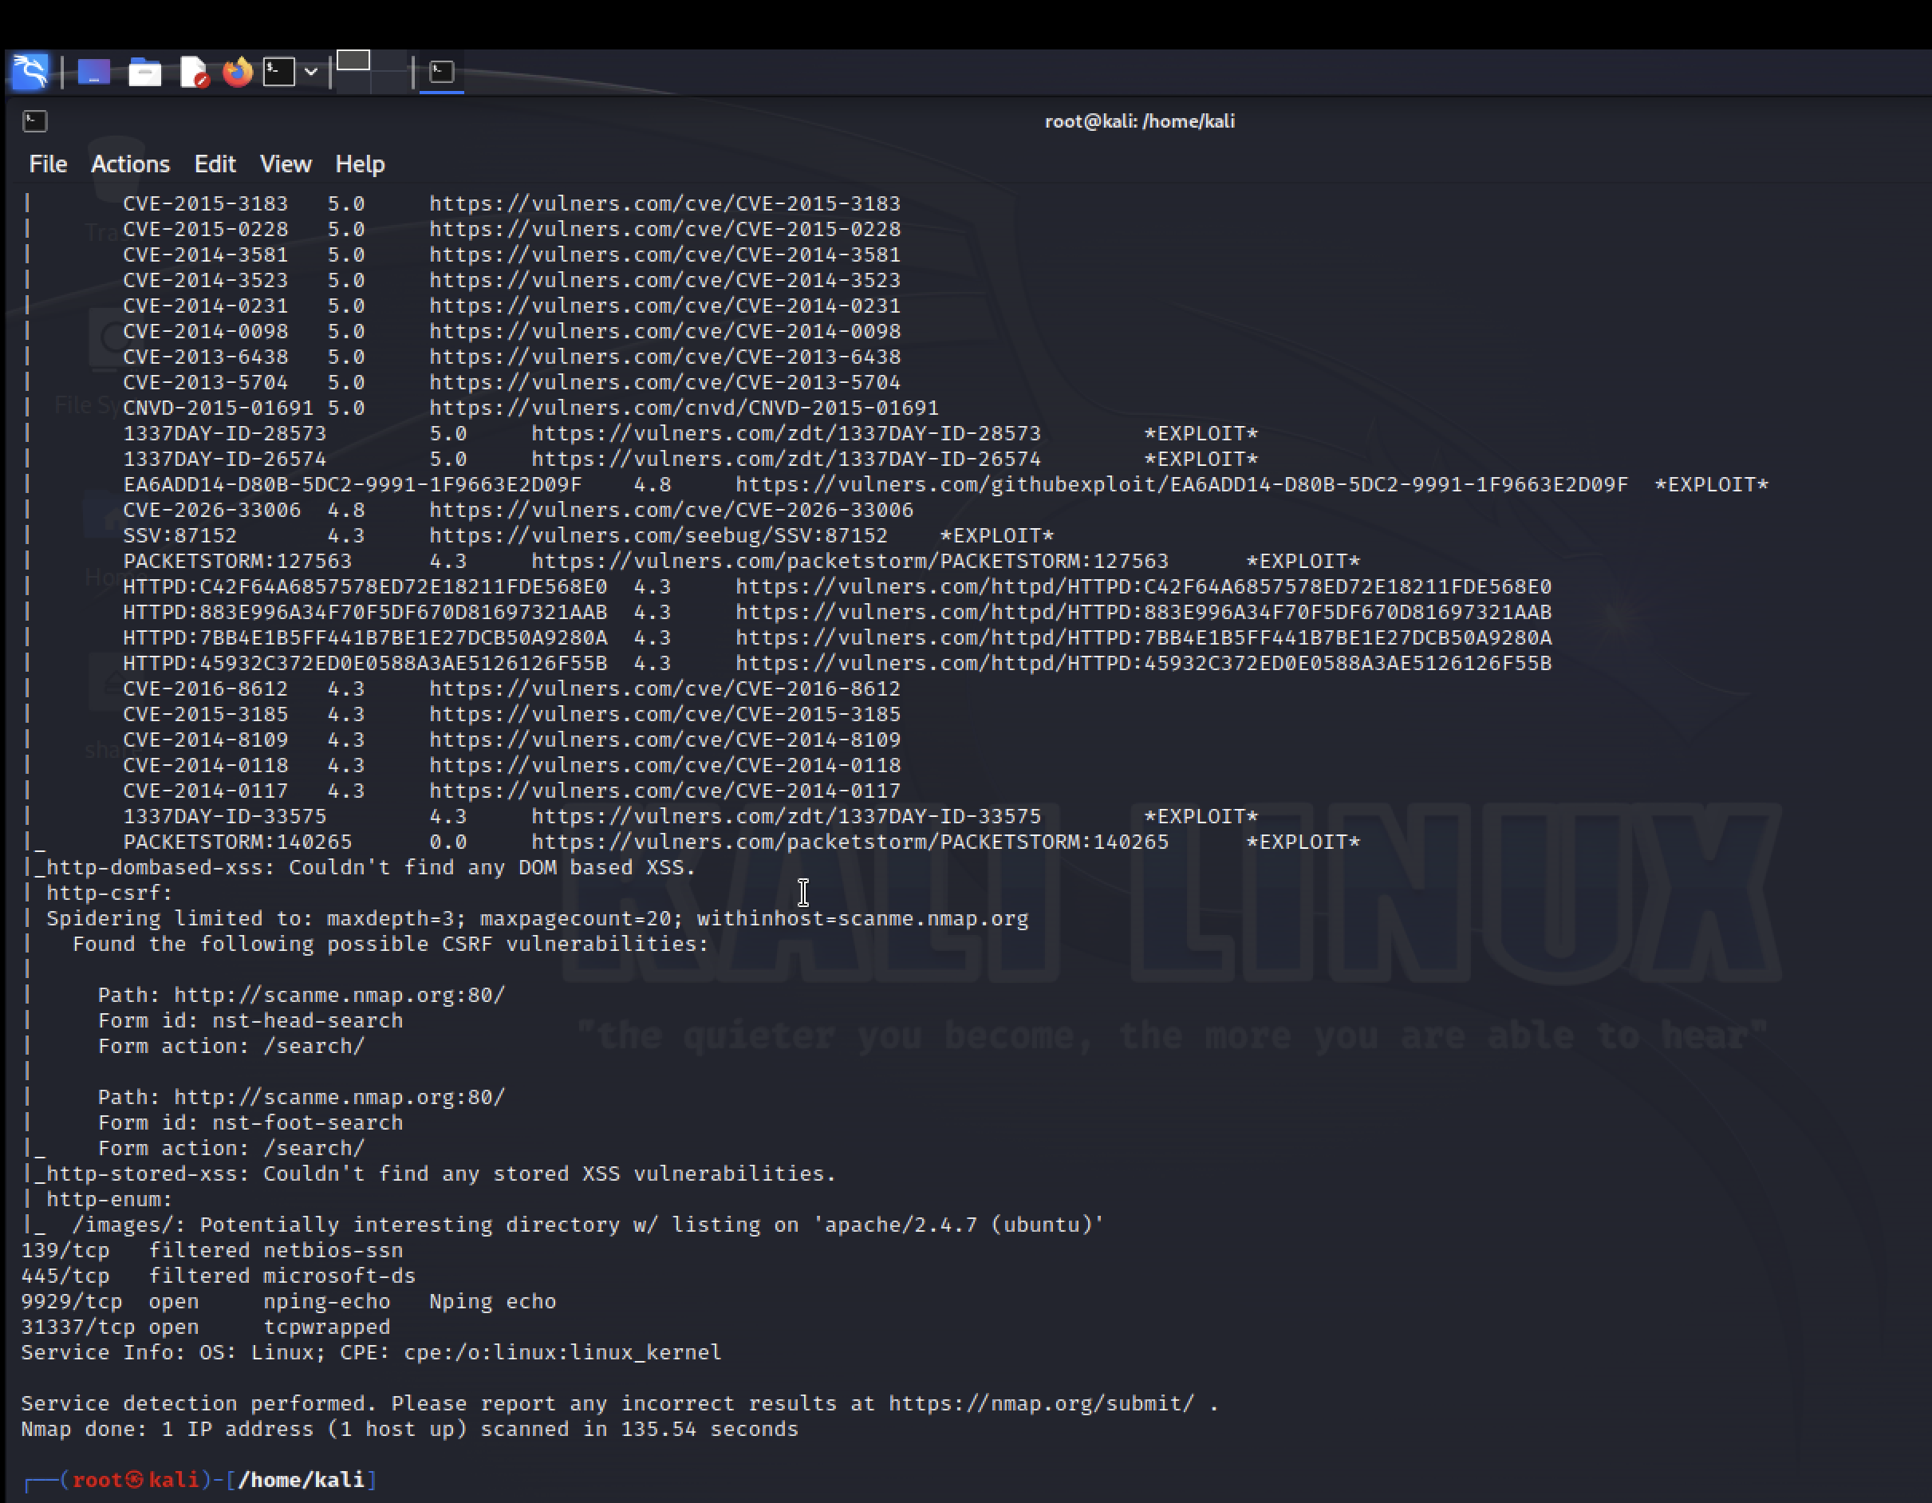
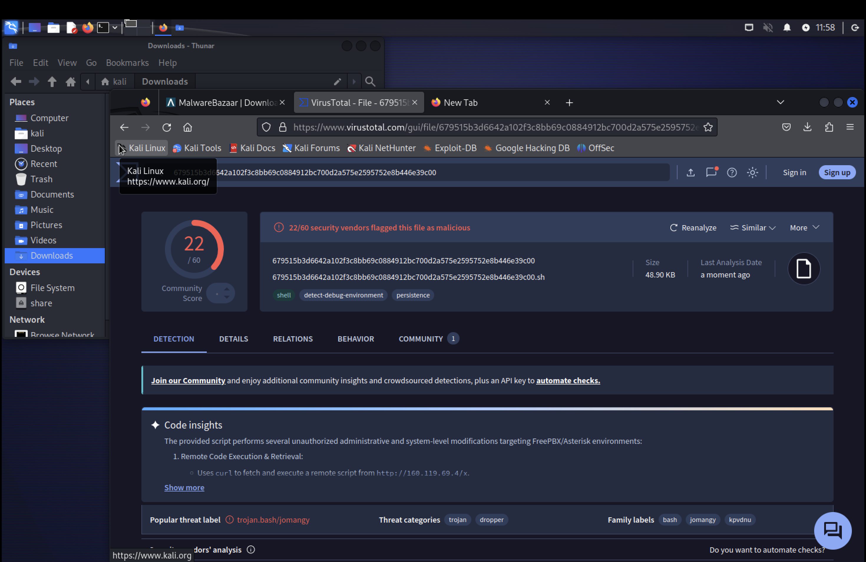
HVMC IAM Lab — Project Workflow
From org definition to a documented, portfolio-ready security lab
Define Org
(HVMC)
›
RBAC & OU
Design
›
Build Lab
(Ubuntu + Samba4, UTM)
›
Secure Network
(Firewall/IDS/IPS/WPA3)
›
Assess Threats
& Vulnerabilities
›
Document &
Portfolio
Nmap vulnerability scan — 149 CVEs identified against the lab
VirusTotal malware diagnosis (22/60 engines flagged)
Sabitha S Karanavar | DAE 6-Month Program
9

Slide 10


CAPSTONE STATUS
Progress: Week 4 of 12
WEEK 1
WEEK 12
~30% complete — Weeks 1–3 done, Week 4 (Entra ID Foundation) in progress
COMPLETED SO FAR
STILL TO COMPLETE
Week 1 — Scope Definition & First Build Steps
Week 2 — Security Operations: Network Security
Week 3 — Domain Controller & Client; Security Operations: Threats & Vulnerability
Week 4 — Policy & User Accounts; Entra ID Foundation (in progress)
Wk 5–7 — Joiner-Mover-Leaver lifecycle activities & periodic access reviews
Wk 8–9 — Scripted account provisioning/deprovisioning + Conditional Access policies
Wk 10 — Standard Operating Procedures documentation
Wk 11–12 — Design-document reconciliation, rubric cross-check & final portfolio publishing
10 / 14

Slide 11







SKILLS GAINED
Skills Built Across All 3 Semesters
Python Programming
Git, GitHub & Unix
Identity & Access Mgmt
Logic, functions, JSON, file I/O
Version control, CLI fluency
RBAC, ACLs, JML lifecycle
Network Security
Cloud Identity
Threat & Vuln. Analysis
Topology, subnetting, IDS/IPS
Microsoft Entra ID, MFA, SSO
Malware analysis, MITRE ATT&CK
Security Tooling
Incident Response
Reporting & Communication
Wireshark, Nmap, OpenVAS, Kali
Detect → contain → recover drills
Status updates, documentation
11 / 14

Slide 12


AI-Assisted Research — Both Projects
I used three AI tools throughout Semester 1 and Semester 3 to research faster and think more clearly
Gemini NotebookLM
ChatGPT
Claude
Organized research notes and source material, and generated grounded summaries of IAM & security concepts.
Brainstormed approaches, explained unfamiliar concepts, and helped debug Python logic.
Supported technical planning, documentation, and structuring project write-ups and code.
Takeaway: AI tools sped up research and learning — every technical decision and every line of code was still mine.
Sabitha S Karanavar | DAE 6-Month Program
12

Slide 13




HOW I LEARN
Learning Toolkit & What's Next
YouTube
Supplemental tutorials & concept walkthroughs
CERTIFICATIONS & WHAT'S NEXT
Currently pursuing the Google Cybersecurity Professional Certificate
Next certification goal: CompTIA Security+
Leaning more heavily on Monday.com next semester — planning tasks ahead to stay on schedule and finish on time
Schoology
Coursework, assignments & instructor materials
Monday.com
Tracking weekly tasks against the 12-week capstone plan
Google Cybersecurity Cert
In progress, alongside coursework
13 / 14

Slide 14


THANK YOU
Let's Connect
Thank you to my instructors and peers at DAE — which has become a second home to me — for their support throughout this journey, from my first Python program to hands-on healthcare IAM operations.
SCAN TO CONNECT
SCAN FOR GITHUB
linkedin.com/in/sabitha-s-
49ba9b428
github.com/sabi-s/dae-
6-month-Sabi
Sabitha S Karanavar
DAE Cybersecurity & Networking Program

