Slide 1
Securing a Hospital in Microsoft Azure
FIELD DAY 2026 · PROJECT WALKTHROUGH
Horizon Valley Medical Center — identity, network, data protection and security operations
Sabitha S Karanavar
Notes:
Hello, I'm Sabitha. This is a walkthrough of how I built and secured a cloud environment for a fictional hospital, Horizon Valley Medical Center, in Microsoft Azure — from storage and network to identities, monitoring and incident response.

Slide 2
One hospital, secured layer by layer
THE PROJECT AT A GLANCE
A fictional 30-person hospital whose patient records (ePHI) must stay private under HIPAA.
30
3
10
$0
staff identities in 10 department groups
network tiers behind firewalls and Bastion
locked business applications
for all identity and security tooling
9
8 / 8
94
13
automated security alert rules
security incidents triaged and closed
access-review lines checked
Zero Trust sign-in policies designed
Built step by step: data → network → identities → monitoring → incident response → identity governance.
Notes:
The project ran from September to October 2026 in my own Azure subscription and Entra ID tenant. Total cloud spend was about 54 dollars of free-trial credit; all identity work cost nothing.

Slide 3
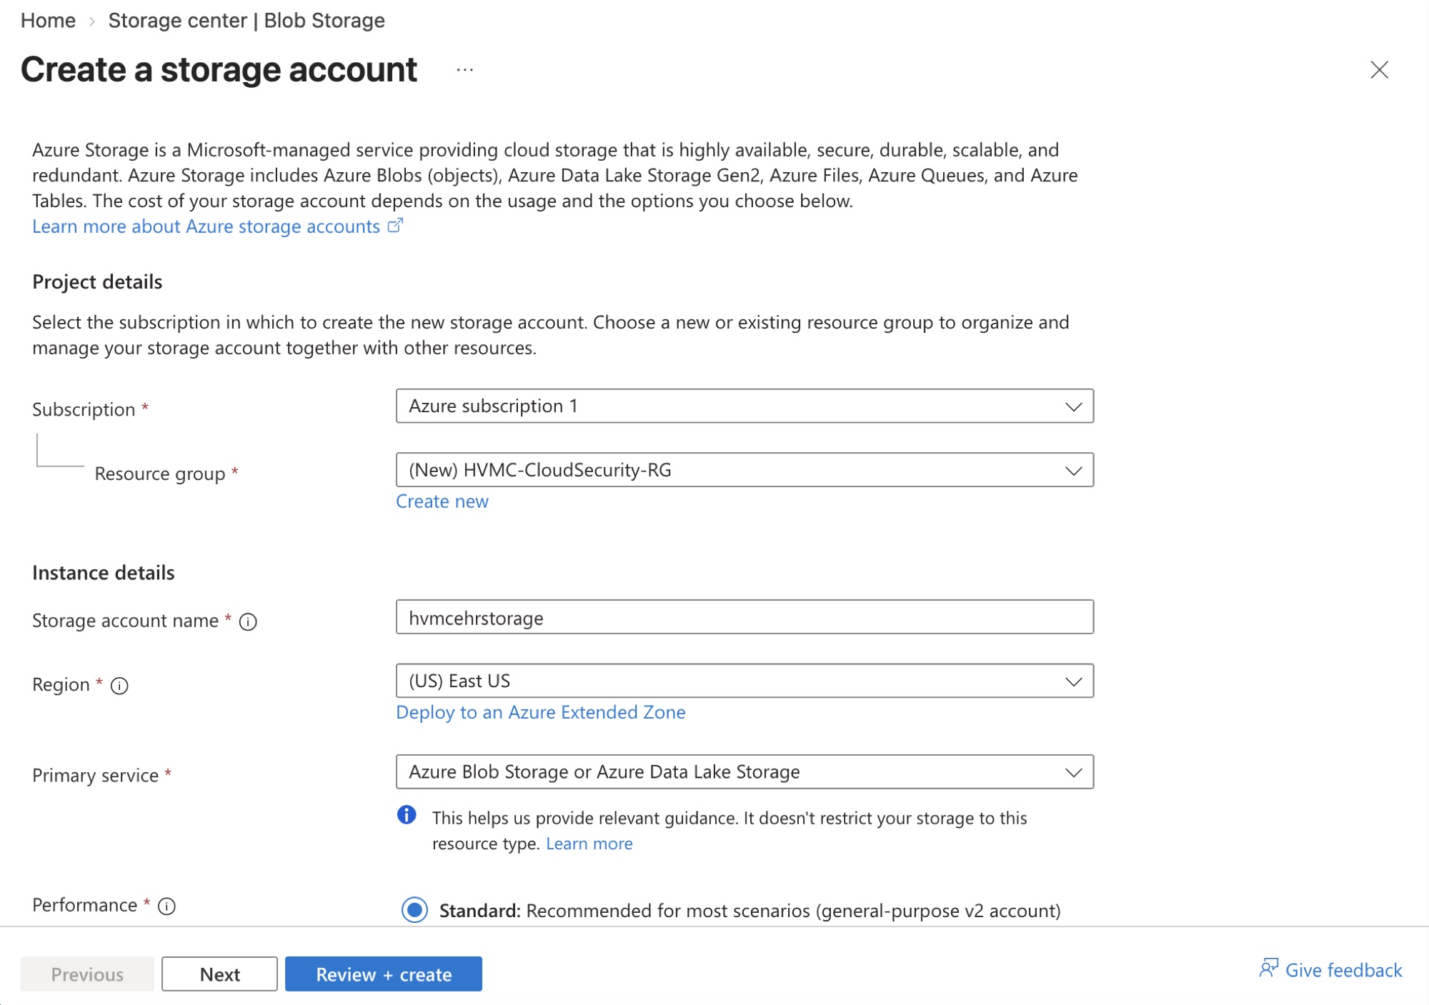
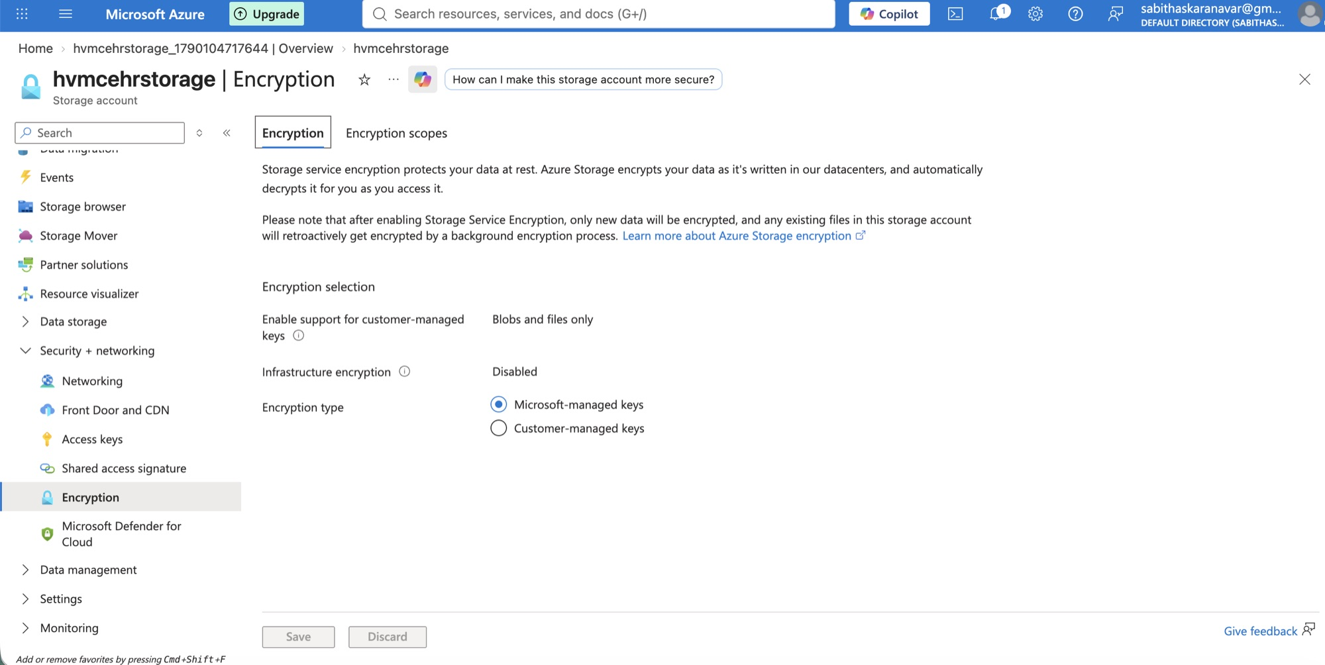
A private home for patient records
STEP 1 · DATA
I created the EHR storage account and confirmed every file is encrypted at rest automatically.
Encryption at rest with Microsoft-managed keys
Creating the storage account hvmcehrstorage (East US)
Notes:
Patient records live in a storage account I created for the EHR. Azure encrypts everything at rest; I verified the encryption settings and kept secure transfer and TLS 1.2 on.

Slide 4
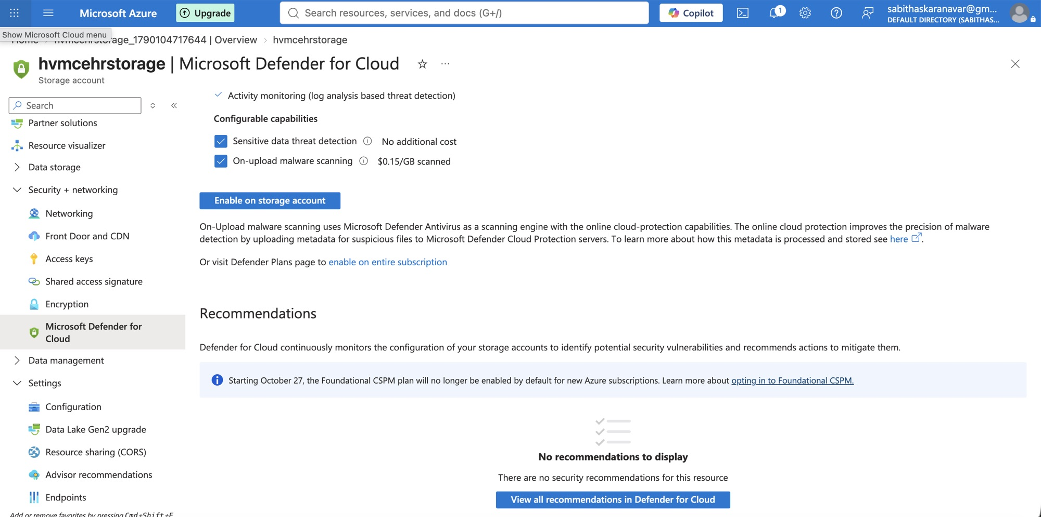
Malware and threat scanning on the records
STEP 1 · DATA
Microsoft Defender for Storage watches the account and scans every uploaded file for malware.
Notes:
I enabled Defender for Storage with on-upload malware scanning, so a poisoned file uploaded to the patient-record store is detected.

Slide 5
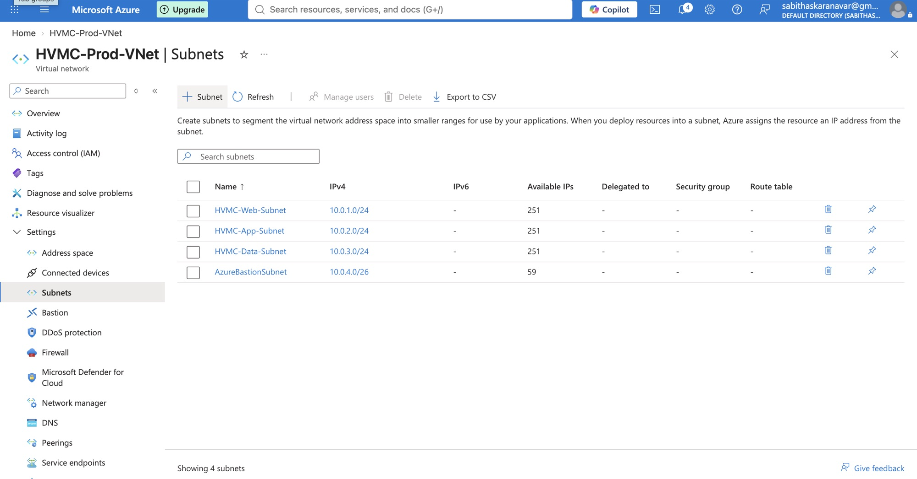
A three-tier hospital network
STEP 2 · NETWORK
Web, application and database tiers live in separate subnets, so one break-in can't reach everything.
Notes:
The virtual network HVMC-Prod-VNet has four subnets: Web, App, Data and a dedicated Bastion subnet — the classic three-tier pattern.

Slide 6
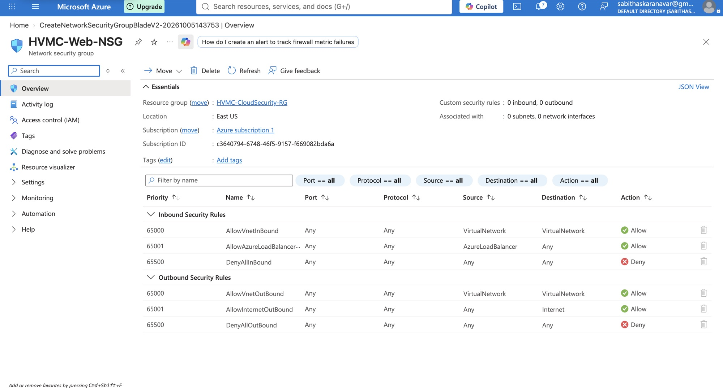
Firewall rules between the tiers
STEP 2 · NETWORK
Network security groups allow only the traffic each tier needs — everything else is denied.
Notes:
Each tier has its own network security group: the web tier accepts HTTPS, the app tier only from the web tier, the database only from the app tier.

Slide 7
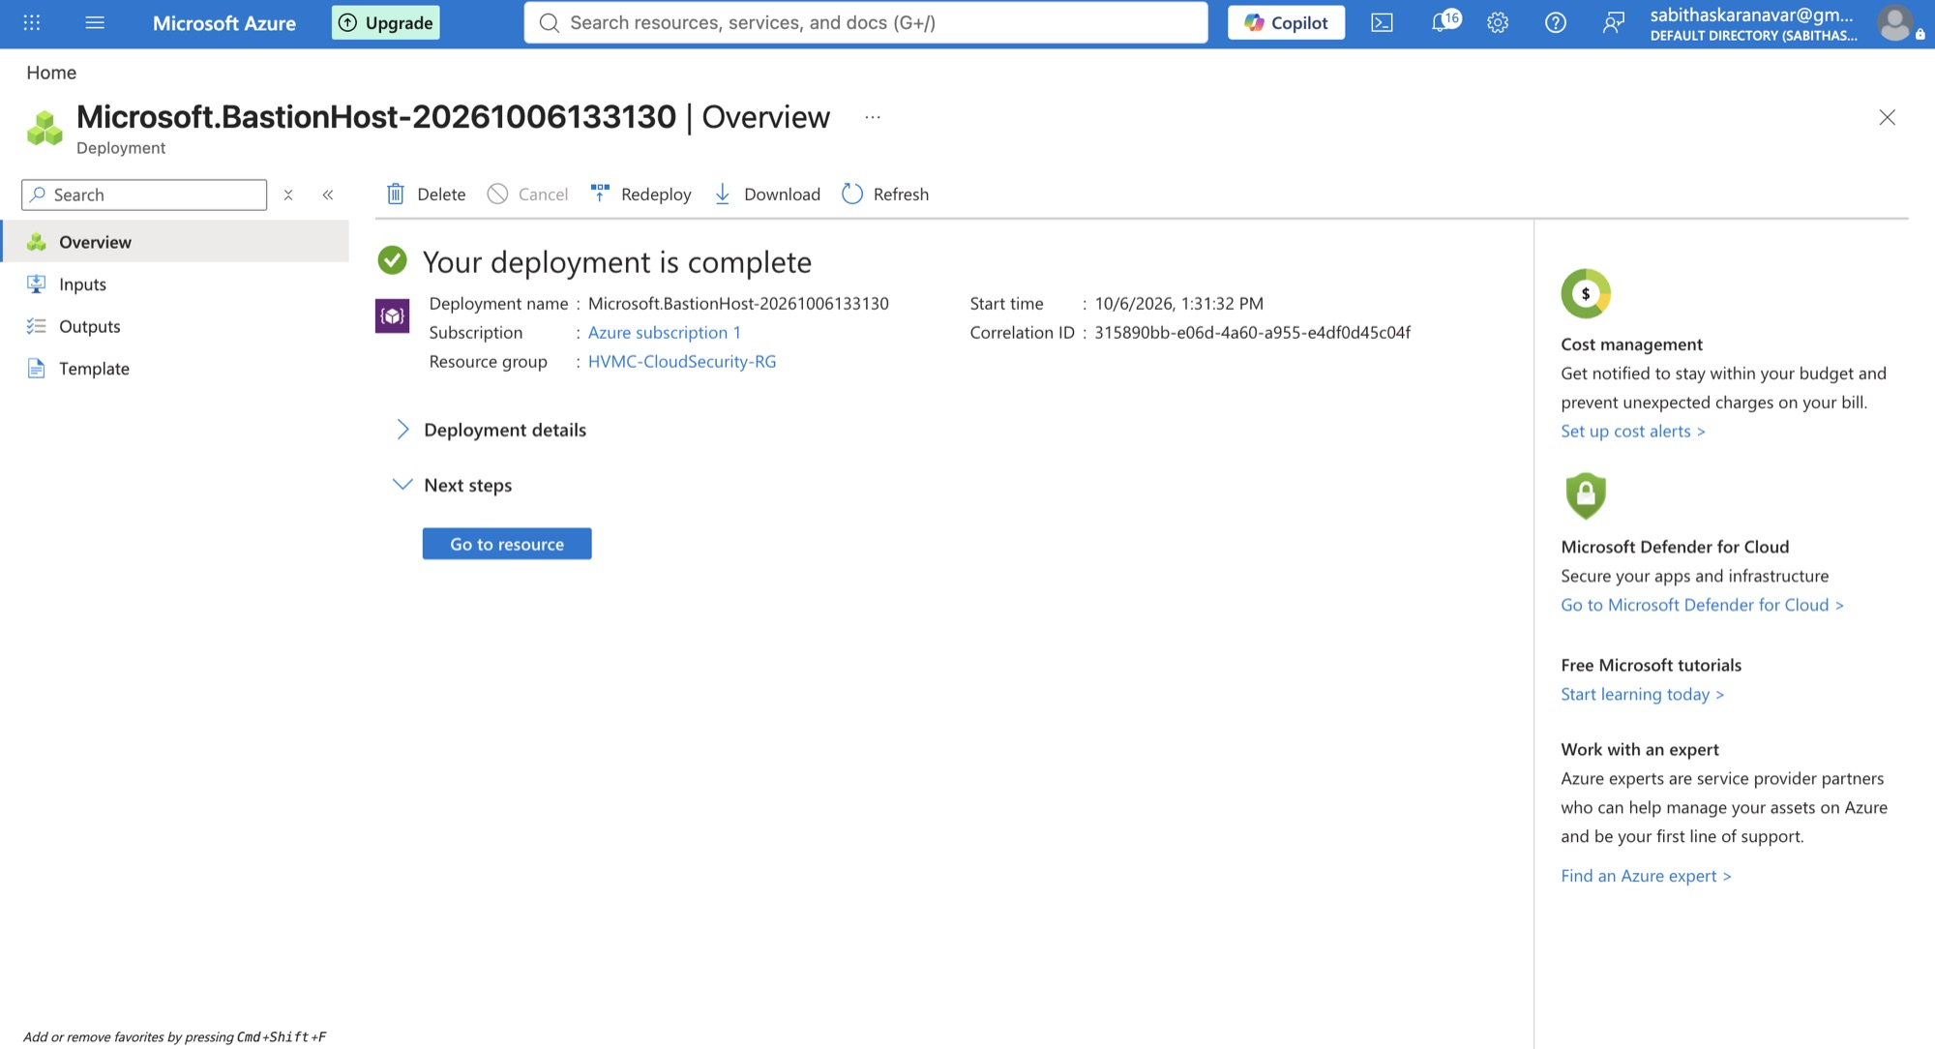
Admin access without exposing servers
STEP 2 · NETWORK
Azure Bastion lets administrators reach servers through the browser — no public IP addresses on any server.
Notes:
Instead of opening remote-desktop or SSH ports to the internet, administrators connect through Azure Bastion inside the network.

Slide 8
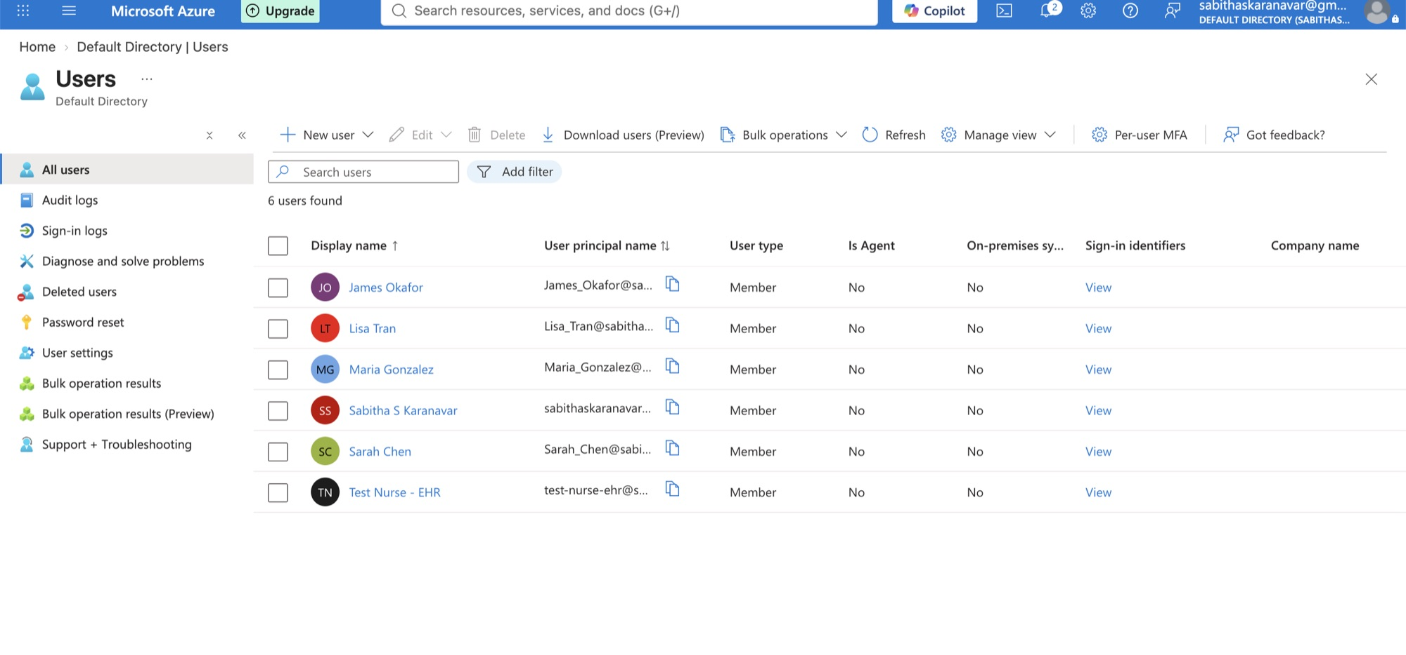
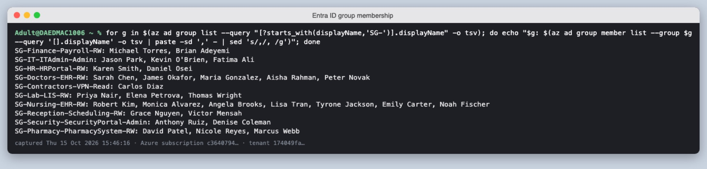
Every staff member has one identity
STEP 3 · IDENTITY
I created the hospital's staff in Microsoft Entra ID and organised them into department groups.
September: first accounts, including a test nurse for safe testing
October: 10 department groups with their members
Notes:
I started with a few accounts by hand, then imported the whole staff list. Groups like SG-Nursing-EHR-RW let me give access to a whole role at once.

Slide 9
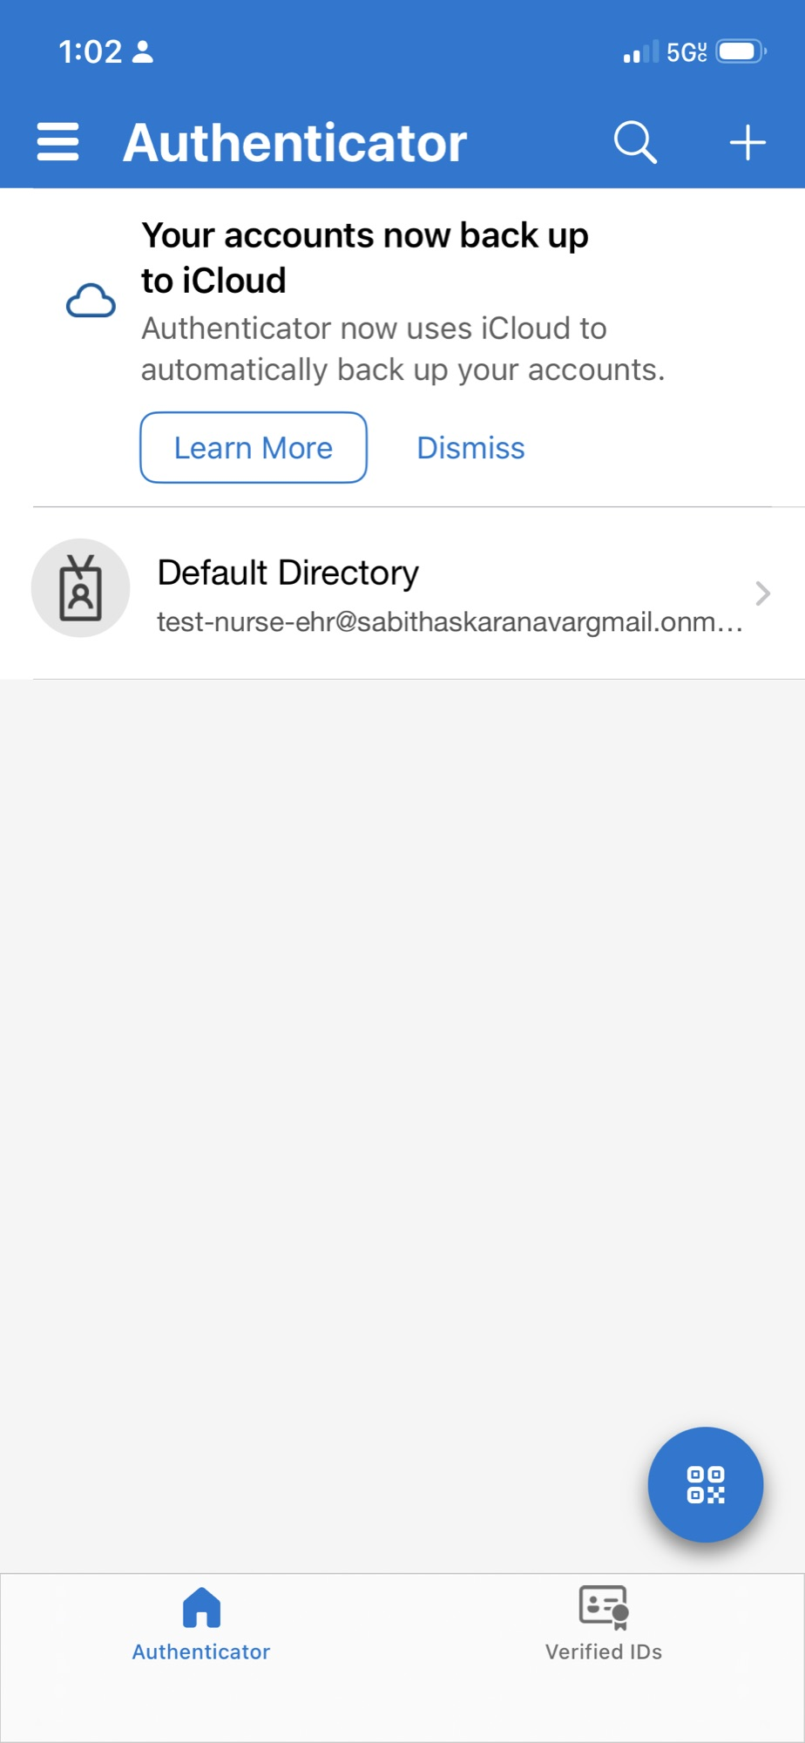
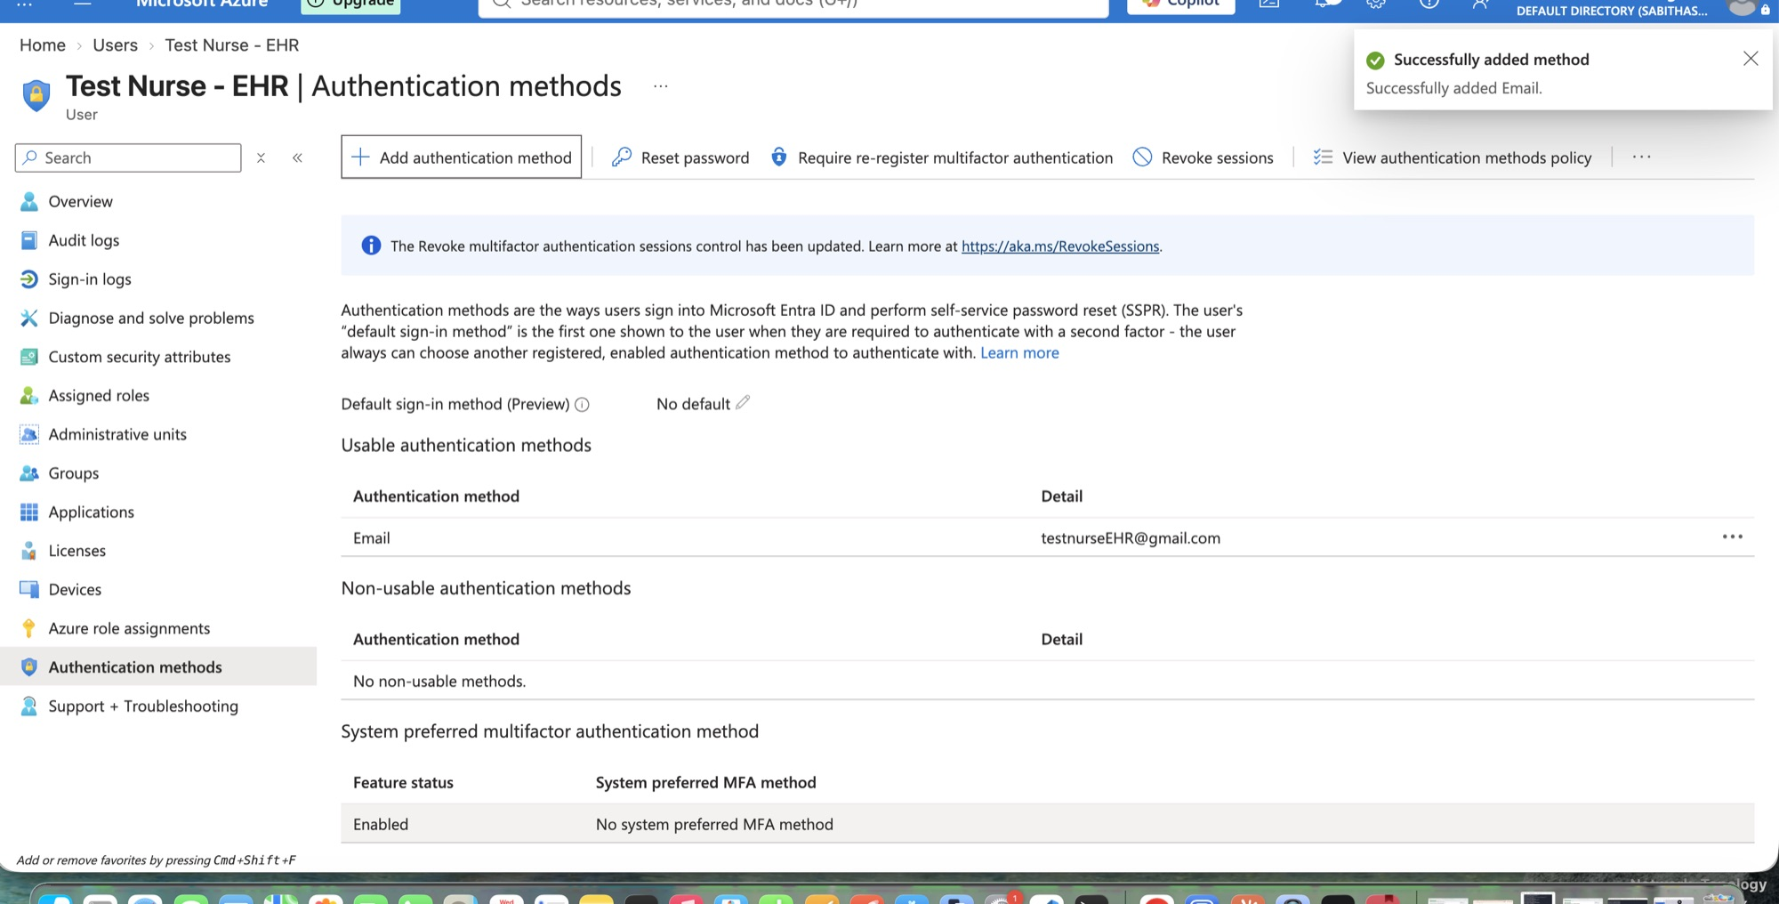
Two-step sign-in (MFA)
STEP 3 · IDENTITY
The test nurse signs in with a password plus the Microsoft Authenticator app on a phone.
Microsoft Authenticator registered for the test nurse
Authentication methods on the test nurse's account
Notes:
I registered multifactor authentication for the test nurse exactly as a real employee would, so a stolen password alone is not enough.

Slide 10
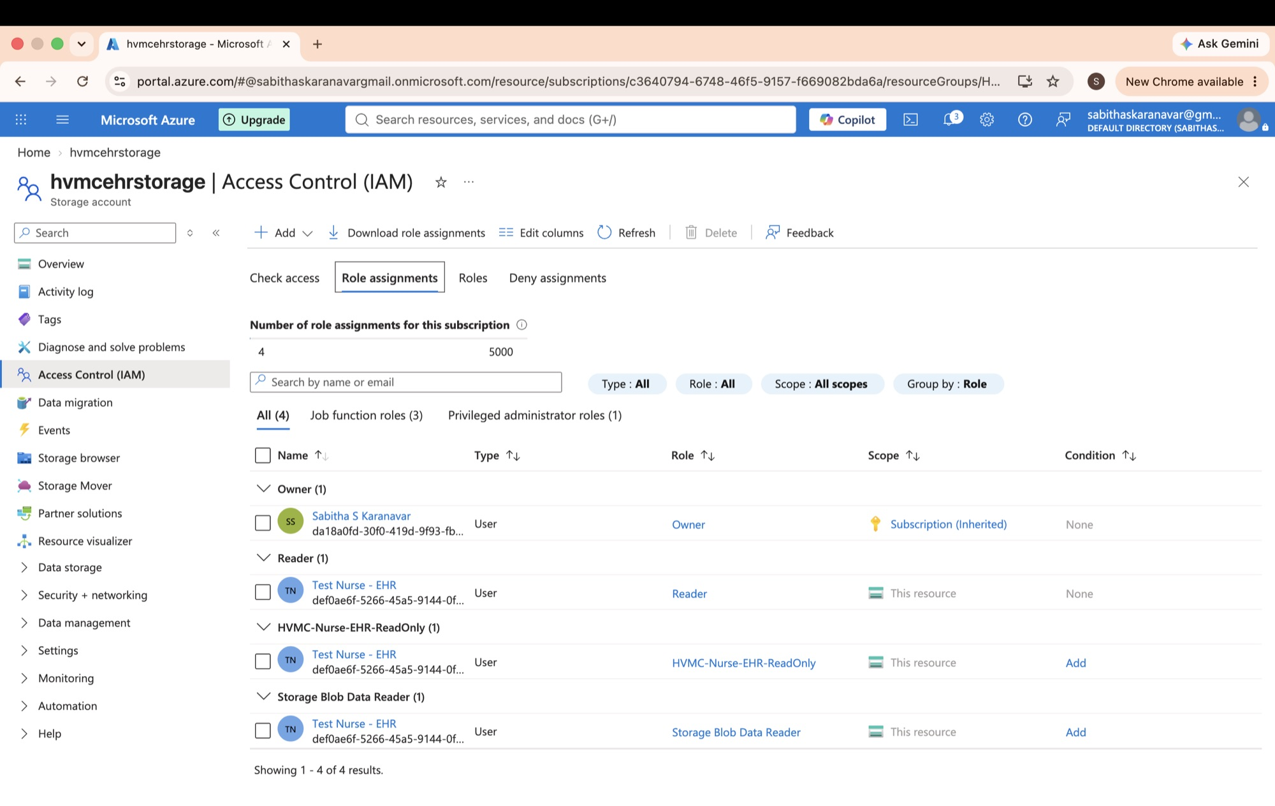
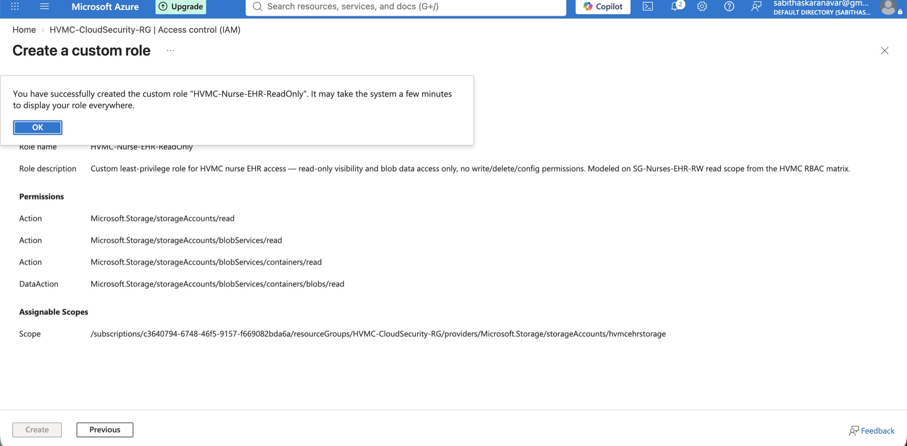
A custom least-privilege role
STEP 3 · IDENTITY
I designed a read-only role for nurses — they can view patient records but never change or delete them.
Custom role HVMC-Nurse-EHR-ReadOnly: read actions only
The role assigned on the EHR storage account
Notes:
Built-in roles gave too much, so I wrote a custom role with only read permissions and assigned it to the test nurse on the storage account.

Slide 11
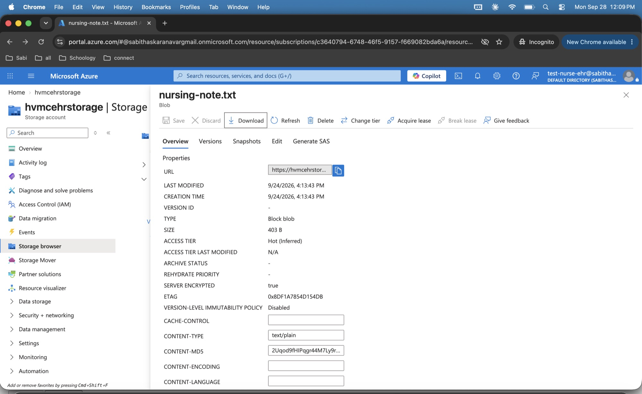
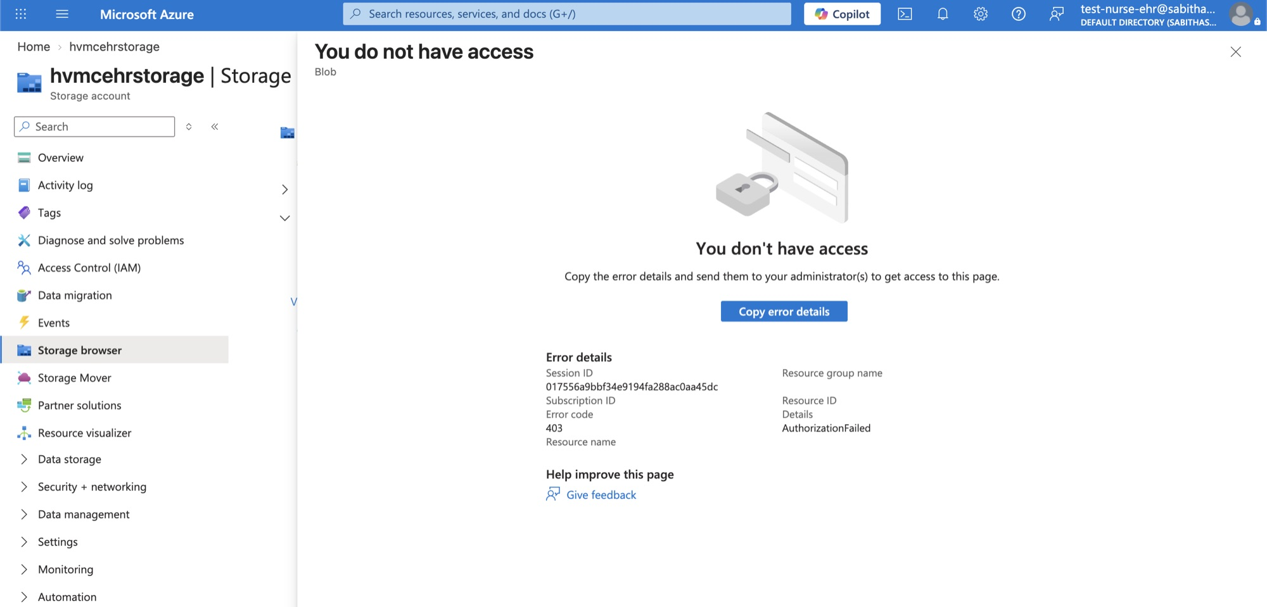
Least privilege, proven
STEP 3 · IDENTITY
Signed in as the nurse: she can read a nursing note, but anything beyond her role is refused.
Refused: 'You do not have access' (403)
Allowed: reading nursing-note.txt
Notes:
I tested as the nurse in a private browser window. Reading the note works; browsing what she isn't allowed to see is blocked. That is least privilege working.

Slide 12
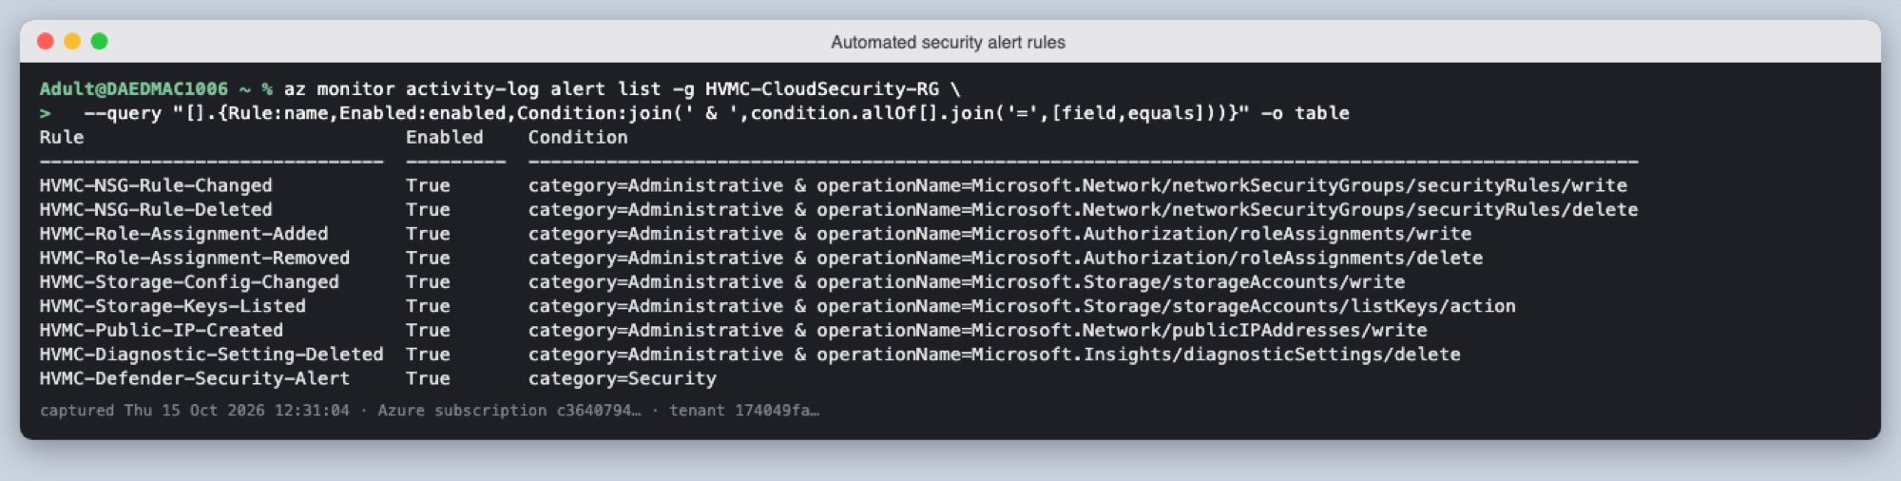
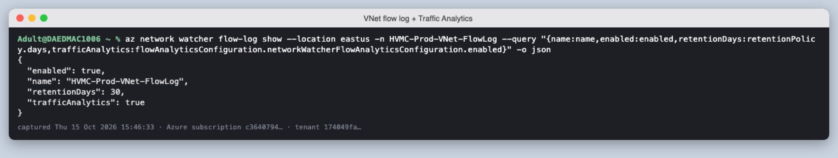
Every change is logged and alerted
STEP 4 · MONITORING
All Azure activity flows into one log workspace, and nine alert rules e-mail me about risky changes.
Nine automated alert rules (firewall, roles, storage keys, logging disabled …)
VNet flow logs with Traffic Analytics record network traffic
Notes:
This is the Azure version of AWS CloudTrail and VPC flow logs. Any firewall change, new role, storage-key read or logging change triggers an e-mail.

Slide 13
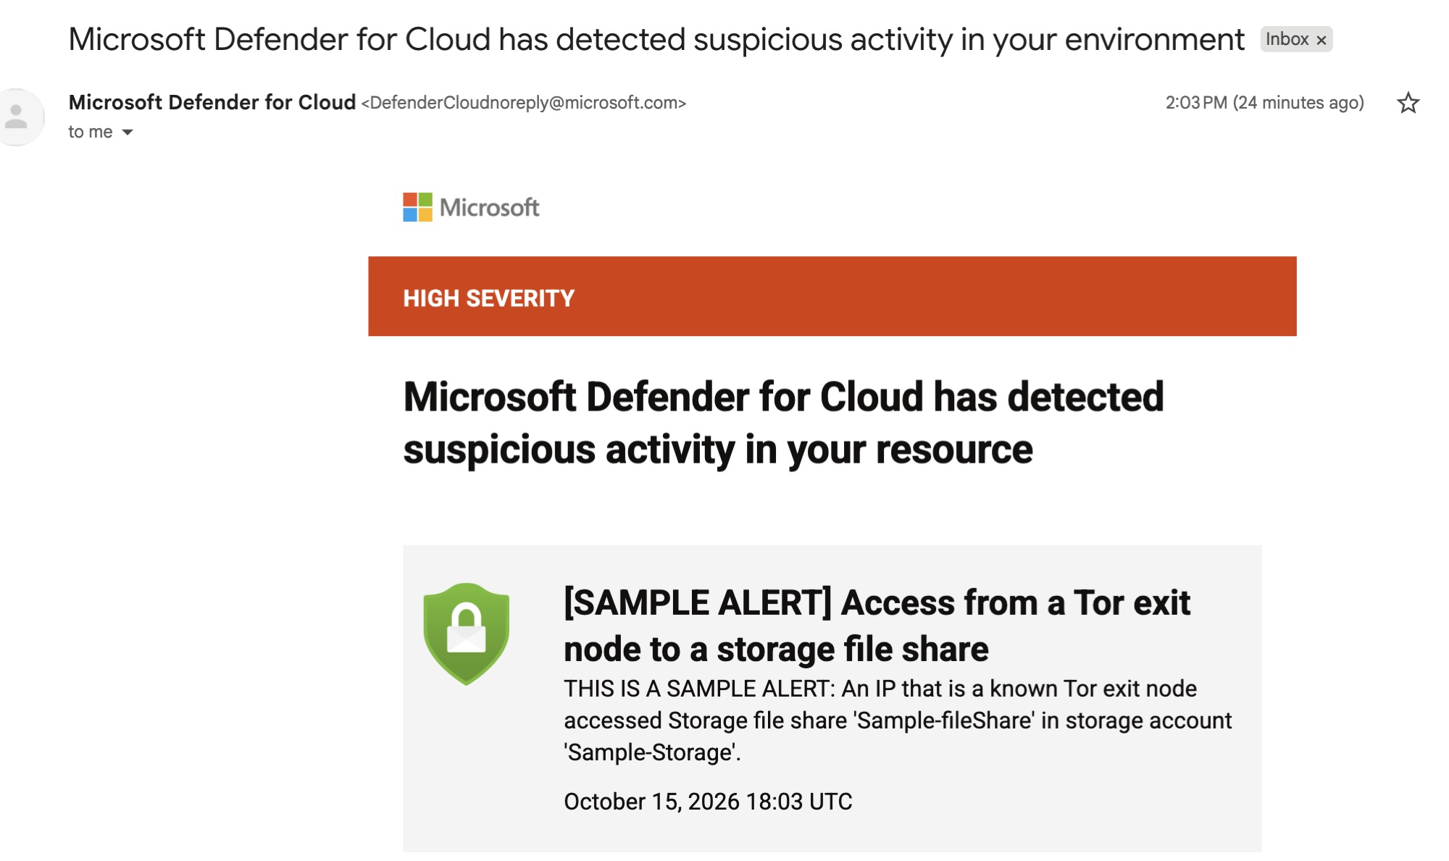
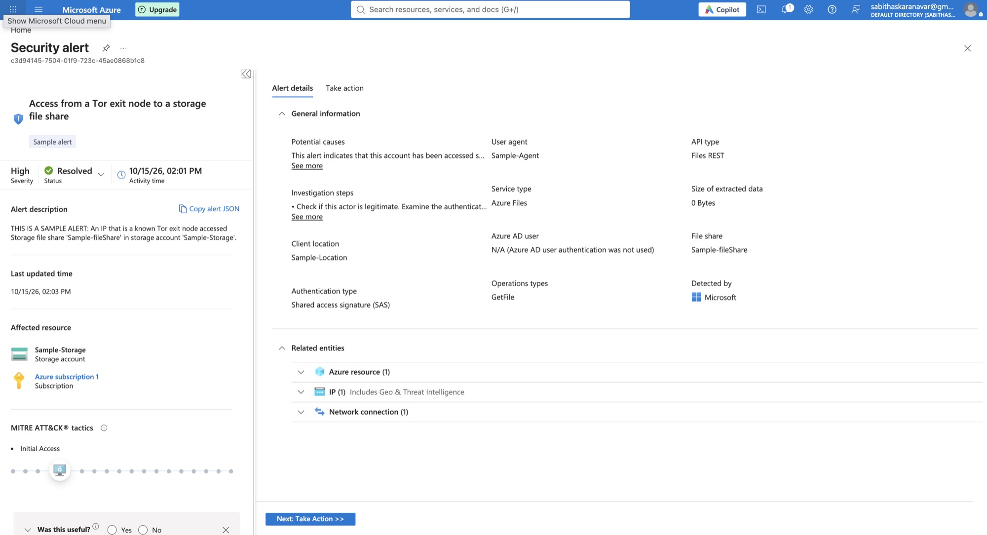
Threats detected within seconds
STEP 4 · THREAT DETECTION
Microsoft Defender raised the alert, e-mailed me, and I resolved it in Azure following my playbook.
The same alert in Azure — resolved, with MITRE tactic
The real alert e-mail I received
Notes:
Using Defender's built-in test alerts, detection reached Microsoft Sentinel in about six seconds and my inbox moments later.

Slide 14
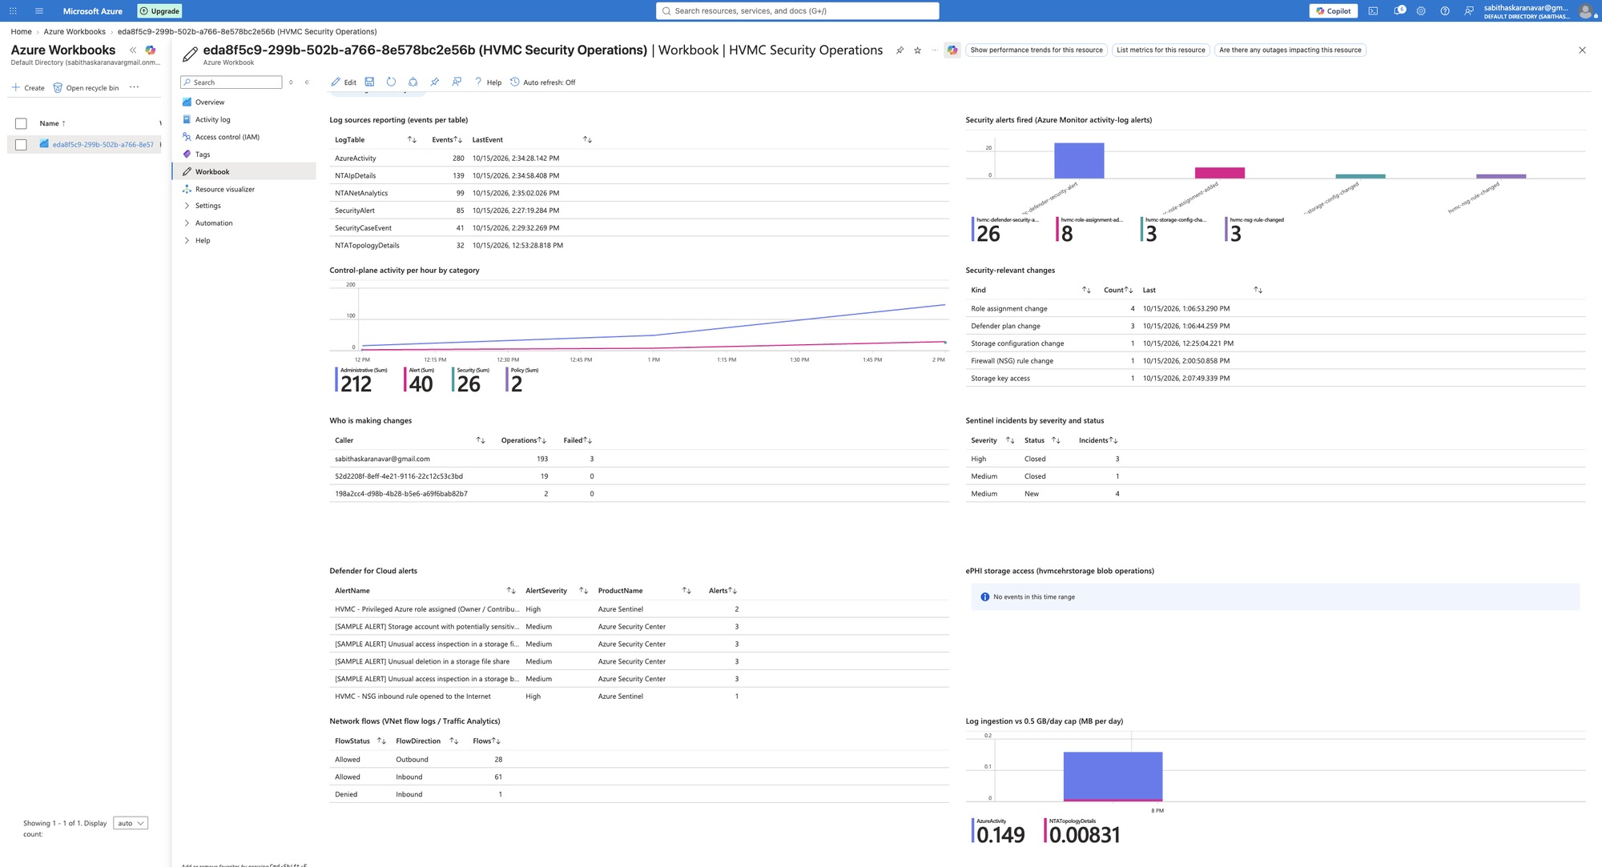
A live security dashboard
STEP 4 · DASHBOARD
An Azure Workbook shows log sources, alerts, activity, incidents and network flows on one screen.
Notes:
I built this Workbook myself with ten queries. It is free and reads the logs live.

Slide 15
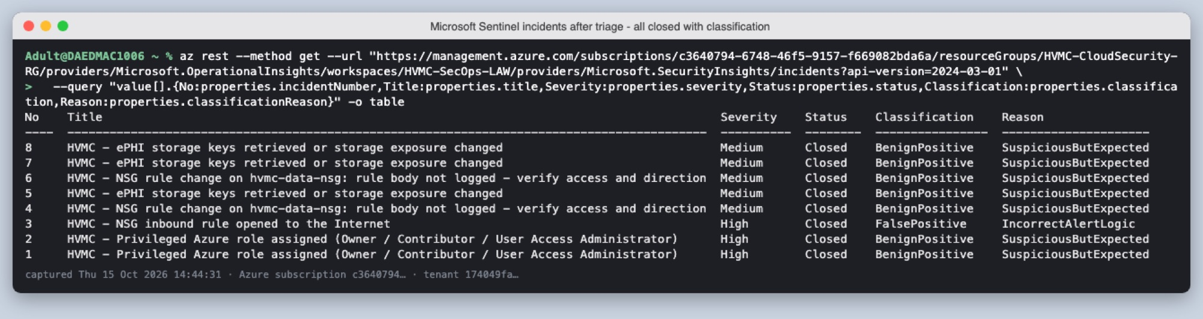
My incident response playbook, tested live
STEP 4 · INCIDENT RESPONSE
I wrote a five-phase playbook and tested it safely — every incident was triaged, explained and closed.
6.6 min
6 s
8 / 8
2
firewall change → alert e-mail
Defender alert → Sentinel
incidents closed with a reason
detection flaws found and fixed
Microsoft Sentinel incidents — all closed with a classification
Notes:
The playbook covers identification, containment, investigation, eradication and recovery. I tested it with safe triggers that never weakened security. Testing even exposed two flaws in my own detections, which I fixed.

Slide 16
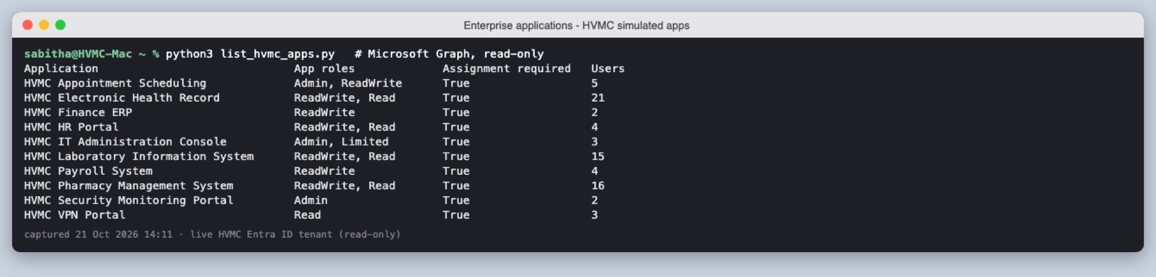
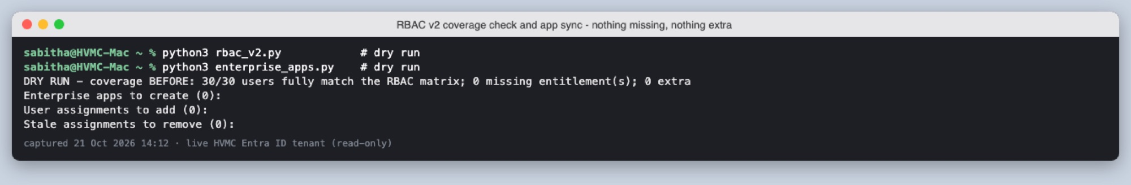
The right keys for every role
STEP 5 · GOVERNANCE
Ten locked applications, and every person's access now matches the approved design exactly — 30 of 30.
Ten HVMC applications, each requiring assignment
Coverage check: nothing missing, nothing extra
Notes:
I redesigned role-based access: 13 more precise groups, ten simulated hospital apps, and a helper script that hands out app access from the groups.

Slide 17
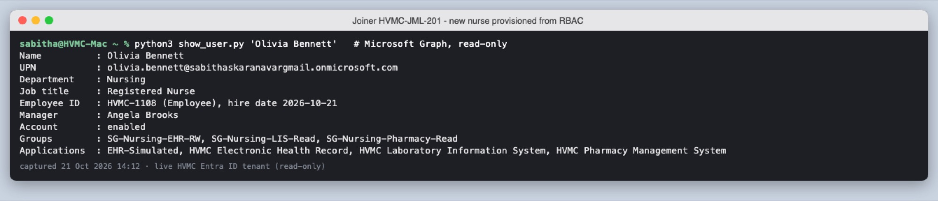
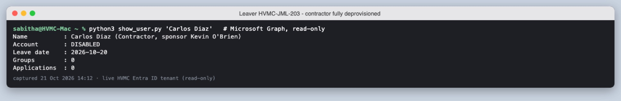
Joiners and leavers, handled safely
STEP 5 · GOVERNANCE
A new nurse got exactly her role's access on day one; a departing contractor lost everything.
Joiner: Olivia Bennett, ready on day one
Leaver: contractor disabled, 0 groups, 0 apps
Notes:
Each change ran as a ticket with a dry run and before-and-after evidence. A nurse who moved to pharmacy also lost her old access — I even found and fixed a leftover key from an old test app.

Slide 18
The access review: does everyone still need this?
STEP 5 · GOVERNANCE
Every manager confirmed their team's access; the review found and removed a hidden leftover key.
94
93
1
1
access lines reviewed by managers
confirmed with a justification
leftover key removed
legacy app brought under control
Key finding A switched-off test account still held a role on the patient-record storage. Disabling an account does not remove its access — only the review caught it.
Notes:
HIPAA expects regular access reviews. Managers confirmed 93 lines. One finding: a disabled test account still held a key to the patient-record storage — disabling an account does not remove its access. The review removed it.

Slide 19
Smart locks for the future
STEP 6 · ZERO TRUST DESIGN
I designed 13 Conditional Access rules that check how someone signs in, ready to switch on with a licence.
Everyone
Administrators
MFA always · block old sign-in methods · block outside the US · stop device-code phishing
Phishing-resistant MFA (passkeys) · re-check every 4 hours
Patient-record apps
Contractors
Only on hospital-managed devices with MFA · 8-hour shift sessions
Only their contracted apps · MFA at every sign-in
Notes:
These rules need a paid licence, so they are saved as deployable files in report-only mode. Two sealed emergency accounts are part of the design.

Slide 20
Security features I added (1 of 2)
SUMMARY
Identity, network and data protection — what is built and working, and what is designed and ready.
Layer | Security feature I added | Status
Identity | Multifactor authentication (Microsoft Authenticator); security defaults on for the whole tenant | Live
Identity | Least-privilege custom role HVMC-Nurse-EHR-ReadOnly; RBAC v2 with 23 role groups (30/30 users exact) | Live
Identity | 10 applications with 'assignment required'; group-driven access sync; no stored secrets | Live
Identity | Managers and employee IDs; contractor sponsor and end date; shared test account disabled | Live
Network | Three-tier VNet (Web / App / Data) with a network security group per tier | Live
Network | Azure Bastion for admin access — no public IPs on servers; NAT gateway for outbound | Live
Network | Explicit deny of inbound Internet traffic to the database tier | Live
Data | Encryption at rest, HTTPS only, TLS 1.2; soft delete; geo-redundant copies | Live
Data | Defender for Storage with on-upload malware scanning; storage key rotation | Live
Notes:
This table summarises every control in the project. Green items were built and tested; orange items are designed and ready to deploy.

Slide 21
Security features I added (2 of 2)
SUMMARY
Monitoring, response and governance — the controls that watch, react and keep access correct over time.
Layer | Security feature I added | Status
Monitoring | Central Log Analytics workspace; Activity Log, NSG, Bastion and patient-record access logs | Live
Monitoring | VNet flow logs with Traffic Analytics; 9 e-mail alert rules; $10 cost budget alert | Live
Detection | Defender for Cloud (Storage, Resource Manager); Microsoft Sentinel with 4 custom rules + Fusion | Live
Response | Five-phase incident response playbook, tested live; detections tuned and incidents grouped | Live
Visibility | Azure Workbook and HTML security dashboard with key metrics | Live
Governance | Joiner / mover / leaver process with tickets; quarterly access review (HIPAA) | Live
Zero Trust | 13 Conditional Access policies and two break-glass accounts (needs a licence) | Designed
Hardening | Restrict app consent, app registration and guest invites; second Global Administrator | Designed
Notes:
Monitoring and governance are what keep the earlier controls honest over time.

Slide 22
What I learned and what comes next
LESSONS AND NEXT STEPS
Security is a loop: build it, test it, review it — and next, an on-site directory on my Mac.
Test what you build
Disabling is not removing
Licences shape design
My own tests found a false alarm and duplicate incidents I would never have seen on paper.
A switched-off account kept its access until the review caught it.
On the free tier I automated what the paid features would do, and designed the rest.
Next: Ubuntu server in UTM → name and fixed address → Samba domain controller → department structure → mirror the 31 staff identities from Entra ID.
Notes:
Next I'm building the hospital's on-site directory. Windows Server doesn't run on my Apple M4 Mac, so I'm using Ubuntu Linux in UTM with Samba, which works like Active Directory.

Slide 23
Questions?
THANK YOU
All work, scripts and evidence: github.com/sabi-s/dae-6-month-Sabi
Sabitha S Karanavar
Notes:
Thank you. I'm happy to show any part live or answer questions.

