Slide 1
Candidate set
Initial random selection
of training set
Candidate set
Training set
QbC iteration: 1
Candidate set
QbC iteration: n
Candidate set
Training set

Slide 2
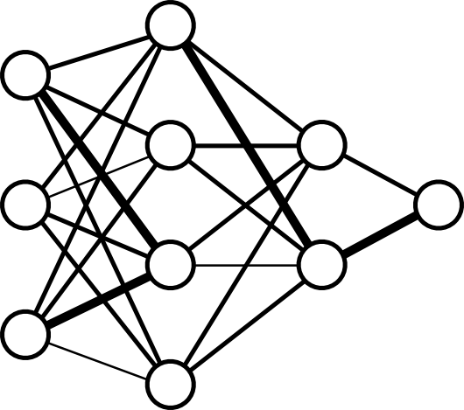
Candidates pool
random selection
QbC loop
Candidates pool
Training
Test
(re)train
evaluate
Candidates pool
Training
σ(qi)
Selected
Test

