Slide 1
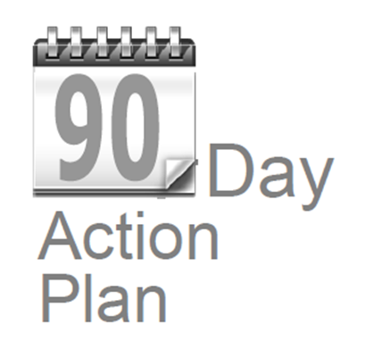

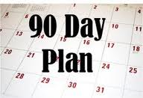

3. Logo
X
90 Day
Action Plan
Action Plan
90 Day
1

