Slide 1
NPL Identity
Creative brief – 25.04.13

Slide 2

Current league logos
Above: Logo used in all external comms
Opposite : NPL legal entity logo

Slide 3

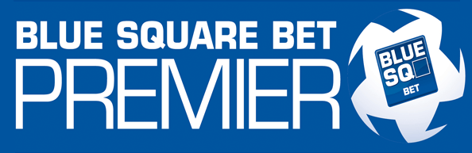


Equivalents – Football Conference
Above: Logo used in all external comms
Opposite : FC legal entity logo

Slide 4
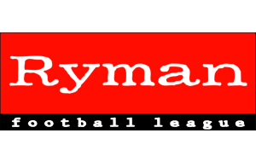


Equivalents – Isthmian League
Above: Logo used in all external comms
Opposite : IL legal entity logo

Slide 5
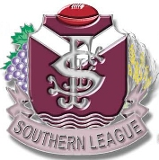


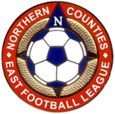
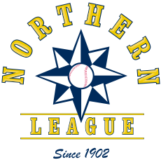
Other league logos

Slide 6








Example club logos

Slide 7
NPL – Brief
Incorporate Northern Premier League
More classical design yet retaining elements of modernity – emphasise Premier??
Colour scheme – none set but need to be rich
Has to work against white and dark b/grounds
Identity should convey
Established
Size (not just a regional league in the North)
Spirit of community

Slide 8
NPL logo - applications
Anything that comes from the legal entity, so:-
Sales brochure
Display banners
Ties & scarves
Blazer badge
Official league merchandise
Lapel badges
Polo shirts
Sweat shirts
Mugs etc
Letterhead/invoice etc

Slide 9
Timeline
Logo designs & draft brochure - May week 1
Additional copy for brochure - May week 1
Presentation-standard visuals (& mock up) required by – 17th May
Approval by league board - 20th May
Commence production – w/c 21st May
Delivery of printed brochures – 14th June
Launch at AGM/Awards – 15th June

